Slide 1
Inside-Out Security: Building Castles not Warehouses Death Stars

Slide 2
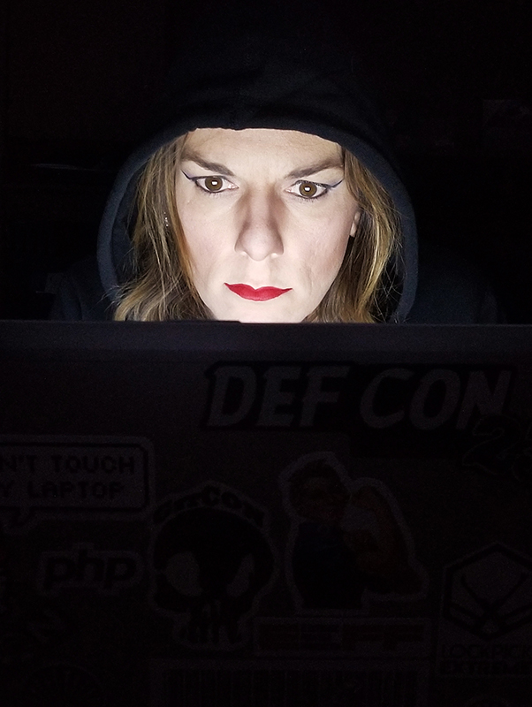
Hacker/Researcher
Security Evangelist
InfoSec Professional

Slide 3
Story Time

Slide 5
US CEOs Top Concerns 2019
1. | Cyber Security
2. | New Competitors
3. | Recession Risk
4. | Threats to Global Trade Systems
5. | Declining Trust in Political and Policy Institutions
Source: The Conference Board (2019)
Notes:
The Conference Board
Top External Concern for 2019

Slide 6
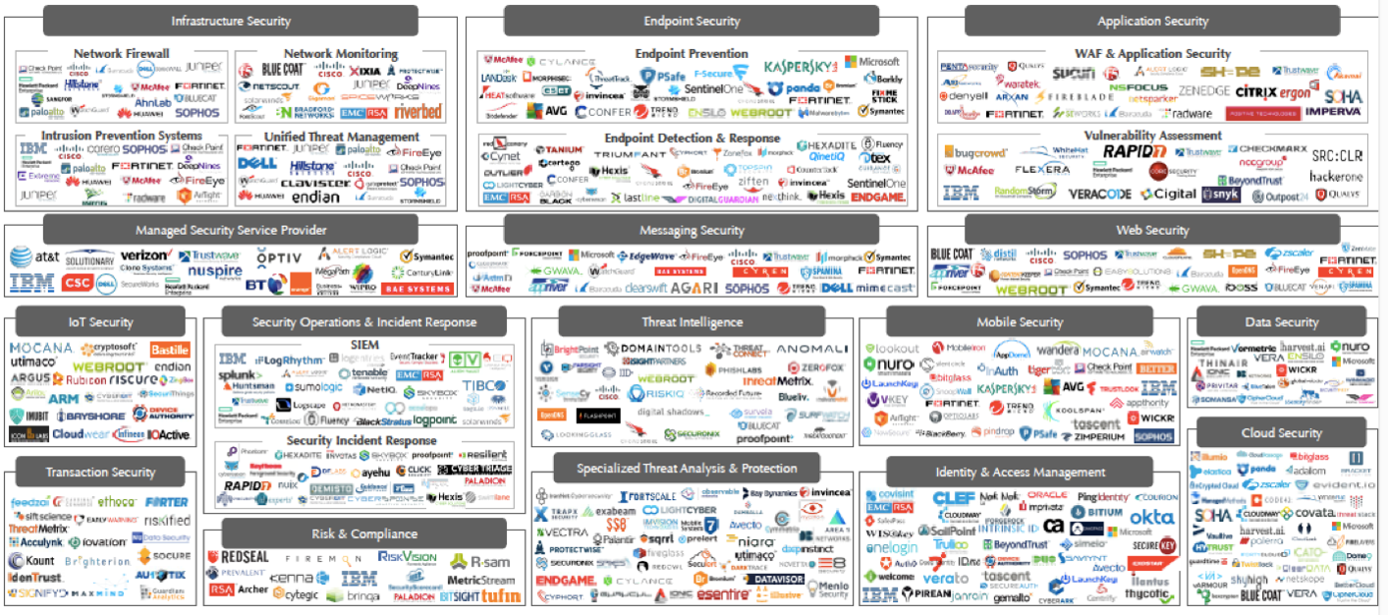
$177 Billion

Slide 7
Security Budgets 2017-2019
Source: CDW/IDG Mitigating Risk Survey (2019)
Notes:
Increased 22%
Same 53%
Decreased 25%

Slide 8
Top 5 Vulnerability Themes
Configuration Management | 40%
Account Management | 27%
Patch Management | 13%
Authentication Weaknesses | 7%
Software Lifecycle | 5%
Top 5 Findings
Source: CDW Information Security Assessments Practice (2017-2019)

Slide 9
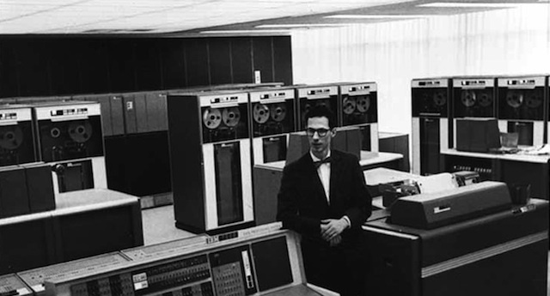
MIT Museum - museum.mit.edu
Notes:
Compatible Time Sharing Network
MIT, November, 1961
Fernando Corbató
IBM 7090, using interrupts
Allan Scherr
1962 – Wanted to bump up his usage time (allotted 4 hours)
Printed password file, distributed to other users

Slide 10
Notes:
Fast-forward 30 years, and the internet is now a thing
Corporate networks start connecting, first defense is a firewall
The lazy and hurried option

Slide 11
How did this
turn out?
slashfilm.com

Slide 12
framepool.com

Slide 13
Service Delivery
Financial Assets
People Assets
Trade Secrets
Private Data

Slide 14
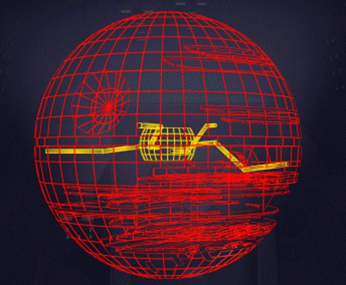
Theft
FRAUD
Exposed
Data
Interrupted
Business

Slide 16
Detection
Defenses
Critical Assets
Mitigation
Defenses
Prevention
Defenses

Slide 17
Identify business assets/threats
Establish micro-perimeters
Defend Micro-perimeters
Assess Defenses
Wash, Rinse, Repeat
Translate to IT Assets

Slide 19
Identify business assets/threats
Define micro-perimeters
Defend Micro-perimeters
Assess Defenses
Wash, Rinse, Repeat
Translate to Application Assets

Slide 20
“We cannot change where we’re headed by doing the same things that got us here”
– Unknown

Slide 21
References:
“2019 Global CEO Survey”, The Conference Board, retrieved from https://www.conference-board.org/press/pressdetail.cfm?pressid=7650
“The Cybersecurity Insight Report”, CDW Corporation https://www.cdw.com/content/cdw/en/orchestration/cyber-security-report.html
“Zero Trust Networks”, Doug Barth & Evan Gillam, O’Reilly Media, Inc. https://www.oreilly.com/library/view/zero-trust-networks/9781491962183/
“Enterprise Security: A Data-Centric Approach to Securing the Enterprise”, Aaron Woody, O’Reilly Media, Inc. https://www.oreilly.com/library/view/enterprise-security-a/9781849685962/
Special Thanks To:
IDG Communications, Inc., https://www.idg.com/
CDW, https://www.cdw.com/content/cdw/en/solutions/cybersecurity.html

Slide 22
@AlyssaM_Infosec
alyssam-infosec
https://alyssasec.com

Slide 23
Thank You

