Slide 1
Steganography The art of hiding stuff in stuff so others don’t find your stuff & A little about my Botnet Stego C&C project
Some information drawn from following articles:
Exploring Steganography:Seeing the Unseen http://www.jjtc.com/pub/r2026.pdf
With a little from Lossy Compression Tolerant Steganography http://nas.takming.edu.tw/chkao/LNCS2001.pdf Hide and Seek: An Introduction to Steganography http://www.citi.umich.edu/u/provos/papers/practical.pdf

Slide 2
Definition
Steganography is the practice of hiding data in other data in an effort to keep 3rd parties from knowing that the intended message is even there
Encryption’s ugly step brother
It has art aspects since human judgment is involved

Slide 3
Isn’t this security though obscurity?
Sort of…
With Encryption alone, 3rd parties may not be able to read the message, but they know one was sent
In some cases, just being caught sending a message can bring suspicion, or give information to the 3rd party
Why is this person hiding something?
Crypto laws http://rechten.uvt.nl/koops/cryptolaw/
Why all the communication right now?
Resistant to “Rubber-hose Cryptanalysis” Thanks to Marcus J. Ranum for that lovely term

Slide 4
About the 1st article
“Exploring Steganography: Seeing the Unseen” was published in 1998
Over the last 12 years, bandwidth and storage have skyrocketed
24bit images are common now, as are PNGs that use lossless compression
Still, the article gives a good intro to the subject which is why I chose it over some newer articles
The article mostly talks about images, but Steganography can be used in many other places

Slide 5
Historical examples
Greeks and wax covered tablets
Histiaeus and the shaved head
Invisible inks in WWII
Open coded messages (Pershing example)
Microdots

Slide 6
Images
Information about pixels
R | G | B
0-255 | 0-255 | 0-255
00-FF | 00-FF | 00-FF
00000000-11111111 | 00000000-11111111 | 00000000-11111111

Slide 7
LSB (Least Significant Bit) Encoding
Can you tell the difference?
Before Encoding:
255,0,0
FF,00,00
11111111,00000000,00000000
After Encoding “101”:
255,0,1
FF,00,01
11111111,00000001,00000001

Slide 8
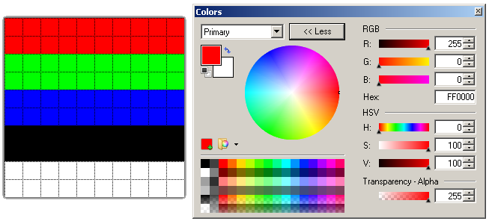
Can you tell the difference?
Original
Same file with “I should be able to hold 37 bytes!!!” encoded

Slide 9
Why lossy formats/re-encoding are problems
Wow, that got mangled!!!
JPEGs use a different color space (YCbCr),
stego can be done, but in a different way because of color space
and the use of Discrete Cosine Transform lossy compression

Slide 10
Image resizing/recompressing
Causes changes in palette and bit order
May be solvable with redundancy
Hamming Code http://en.wikipedia.org/wiki/Hamming_code http://candle.ctit.utwente.nl/Docs/wp5/tel-sys/exercises/datalinkp2p/hamming74demo.html
James Shewmaker https://media.defcon.org/dc-16/video/Defcon16-James_Shewmaker-StegoFS.m4v

Slide 11
Digital Watermarks
Copyright enforcement
Redundant pattern encoding to resist data loss during resize/re-encoding
Change the media enough to kill the watermark, the media degrades beyond the point of usefulness (Think leaked movies)

Slide 12
Detection
Access to the original image
Statistical analysis (source material category makes a big difference)
Odd artifacts

Slide 13
Stego Tools
Since the article is 12 years old, lets look for newer tools:
Search Sourceforge http://sourceforge.net/search/?type_of_search=soft&words=Steganography
Steghide (JPEG, BMP, WAV and AU) http://steghide.sourceforge.net/
Outguess http://www.outguess.org/
My example code http://www.irongeek.com/i.php?page=security/unicode-and-lsb-stego-code

Slide 14
Other steganography examples
Truecrypt hidden volumes http://www.irongeek.com/i.php?page=videos/truecrypt1
Office 2007 documents as ZIP archives Putting a file inside of a DOCX, it�s just a ZIP file with some XML, just add you inserted file name into [Content_Types].xml so the DOCX does not report as corrupted. Tacked on to image (copy /B image.jpg+putty.zip test.jpg) Slack space Alternative Data Streams More on these: http://www.irongeek.com/i.php?page=videos/anti-forensics-occult-computing
EXIF or other Metadata
IP over ICMP or DNS

Slide 15
Text Based Stego
Pros:
Most “Web 2.0” apps accept text, not necessarily images
Text takes up little space
Cons:
Harder to encode and be stealthy
Less bits to hide in
In some ways harder to code from a logic standpoint

Slide 16
Pershing Example: Which Character?
The key is knowing what character to pay attention to:
Apparently neutral's protest is thoroughly discounted and ignored. Isman hard hit. Blockade issue affects pretext for embargo on by products, ejecting suets and vegetable oils.
pershingsailsfromnyjunei
Pershing sails from NY June 1

Slide 17
Unicode Stego
65536 positions in UTF16
Characters that look similar (homoglyphs) are encoded at multiple positions
Using these, values can be encoded !"$%&'()*+,-./0123456789:;<=>?@ABCDEFGHIJKLMNOPQRSTUVWXYZ[\]^_`abcdefghijklmnopqrstuvwxyz{|}~
Example: Code Point 65 = A Code Point 65315 =Ａ

Slide 18
Antonio Alcorn’s Work
CGI can be found at: http://www.cs.trincoll.edu/~aalcorn/steganography/encrypt
“Ηеllo, Ι need sоmе ϲovег tеxt tо use.”
The word “test” is encoded above

Slide 19
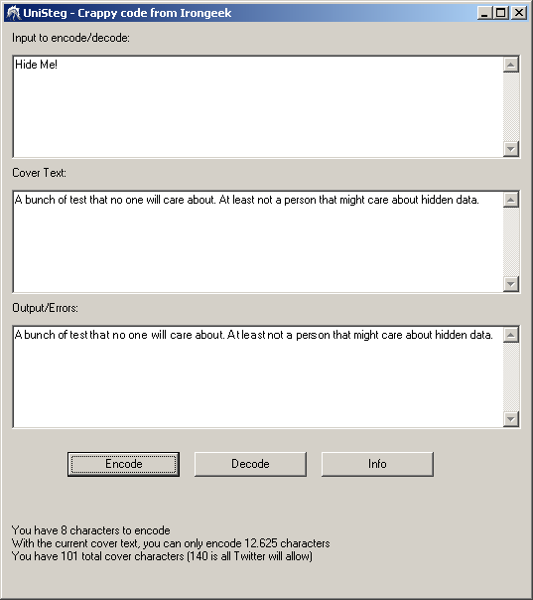
My work on Unicode Stego
http://www.irongeek.com/i.php?page=security/unicode-and-lsb-stego-code
The Latin alphabet is encoded more than once in Unicode, high values used to represent 1s, lows represent 0s (most characters I could just recode as full width Latin by adding 65248)
Firefox and Twitter:
IE and Twitter:

Slide 20
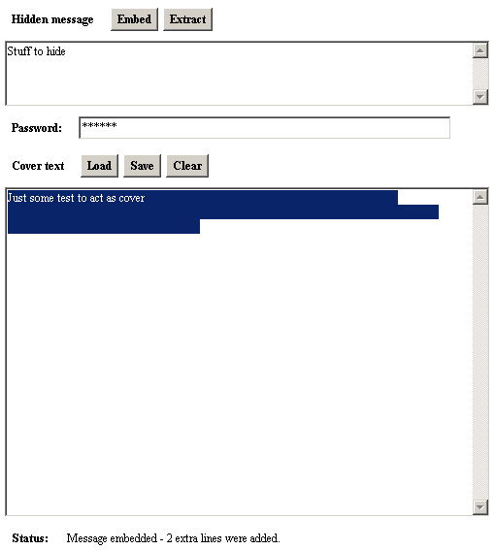
Snow:White Space Stego
http://www.darkside.com.au/snow/
http://fog.misty.com/perry/ccs/snow/jsnowapp/jsnowapp.html

Slide 21
Other Ideas I’m working on
How about a code book for leet/texting/misspellings speak?
I can has cheese burger? How are you?
i can haz chee$e burg3r? How are you? = 01000001 = A
i can has ch3ese burger? H0w r you? = 01011010 = Z
Red are encoded
Blue characters are ones that could have been encoded, but were not needed
Issues:
Encoder and decoder will be tougher program, but I could do it all in low ASCII.
I would likely have less room to add data.
Bits | Replace | Transforms
00 | s_ | s | z_ | $
01 | I | you | e | _i_ | _u_ | 3
10 | o | are | 0_ | _r_
11 | a| why | 4 | _y_

Slide 22
More ideas/concepts I’ve been playing with
Punctuation Encoding Lookup Table
0000 = ;
0001 = ?
0010 = .
0011 = '
0100 = &
0101 = !
0110 = :
0111 = ,
1000 = $
1001 = -
1010 = #
1011 = =
1100 = %
1101 = *
1110 = +
1111 = @
Simplify the language to conserve space
Give the user a set of control characters they have to integrate into their writing (Punctuation)
“test” becomes “,&:!,',&”
User adds word to the Punctuation to make it make sense: Hi, Robin & I have been working on botnets:stegofun! Progress is slow, it‘s taking a long time, it is time consuming & frustrating
Could encode most common letters as one symbol, but that would break if crypto were used
Trade off between frequency of character (more data can be hidden) and ease of writing cover text (Vanna White Problem)

Slide 23
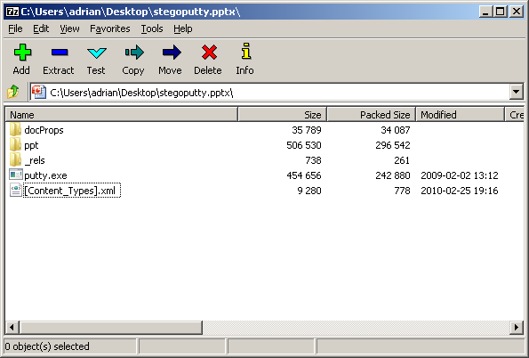
Send a Zip file as an Office doc?
Upload to Google Docs
Email to an account that the other end checks

Slide 24
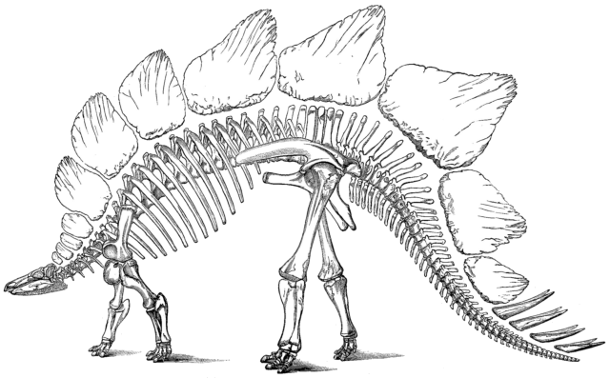
SnarlBot Project
I chose the name because I’m a dork who was a kid in 1984. Figure it out. ☺

Slide 25
SnarlBot
A simple botnet that uses Social Media/Web 2.0 web apps for “blind drops” as part of the command and control channel
Content at the blind drops use Steganography so it’s not obviously a botnet doing the communicating

Slide 26
Topology
Web server with user generated content
Bot
Proxy if desired
Bot
Channels can use SSL from the
web app provider, and stego to
prevent further investigation
SSL may draw attention if the site normally defaults to plain text
Bot
Bot Master

Slide 27
This schemes advantages
The blind drop obfuscates who is controlling the botnet
Proxies can be used for web traffic to further obfuscate the identity of the bot herder
Steganography plus encryption makes the channel hard to detect
Social web sites like Twitter or Facebook are not as likely to be blocked as IRC or P2P
SSL support for the C&C provided by the web host of the blind drop

Slide 28
Disadvantages
More data has to be sent to get a message though
The more complicated something becomes, the more bugs it will have
May have to simplify the C&C commands
Use single byte command: “a” for attack
IPv4 addresses can be expressed in 4 bytes
This make the Steganography less adaptable, but more meaning can be encoded in less bytes

Slide 29
Isn’t this a little black hat? Other uses?
Yep, it’s a little black hat, but who’s to say someone is not already doing it?
This could start research on how it can be detected.
May have applications for privacy providing darknets like I2P or Tor http://www.irongeek.com/i.php?page=videos/darknets-i2p-tor-phreaknic

Slide 30
Similar Project
Robin Wood’s KreiosC2 http://www.digininja.org/kreiosc2/index.php Does not use stego yet, but should be easy to add for someone that knows Ruby

Slide 31
Conclusions/Questions
Other Steganography techniques?
Usefulness?
Detection?
Other uses for research?

