Slide 1
Sniffers Class:
Let’s get Decongested!
Adrian Crenshaw

Slide 2

About Adrian
I run Irongeek.com
I have an interest in InfoSec education
I don’t know everything - I’m just a geek with time on my hands
(ir)Regular on the ISDPodcast
http://www.isd-podcast.com/

Slide 3
IANAL
Federal Wiretap Act
Wiretapping Law
http://en.wikipedia.org/wiki/Telephone_tapping
http://www.cathygellis.com/writing/CopySense_and_Sensibility_CGellis.pdf
Botnet Research, Mitigation and the Law http://hopetracker.donthax.me/

Slide 4
What is a sniffer?
A networking tool that lets you see what is on the wire or other networking medium
Lets you find network problems by looking at the raw packets/frames
AKA: Packet analyzers
Trademark of Network Associates Sniffer Network Analyzer

Slide 5
Types
General network diagnostics
  Wireshark
  Microsoft Network Monitor 3.4
  TCPDump
  Commview
Special purpose
  Sniff passwords: Cain, Ettercap, Dsniff
  IDS: Snort
  Network forensics: NetworkMiner, Ettercap, P0f, Satori
Many use libpcap/WinPcap libraries

Slide 6
Why sniff your own network?
Find out where problems lie
Analyze protocols
Find plaintext protocols in use at your organization so you can discontinue their use
  Telnet, HTTP, SMTP, SNMP, POP3, FTP, etc
Find rogue devices
Find traffic that should not exist
(Why is there leet speak leaving my box?)

Slide 7
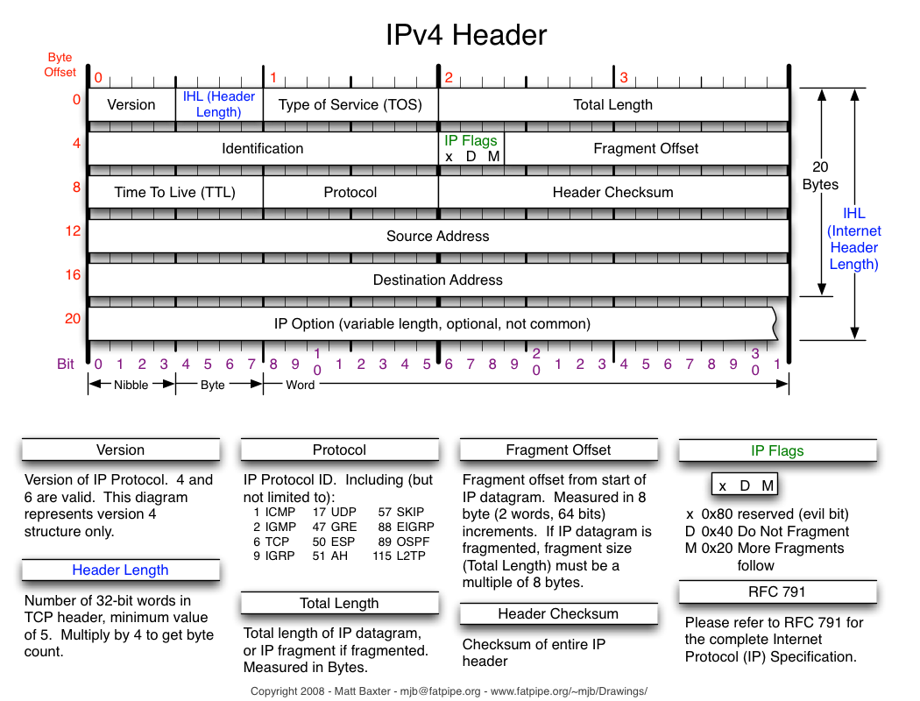

Slide 8
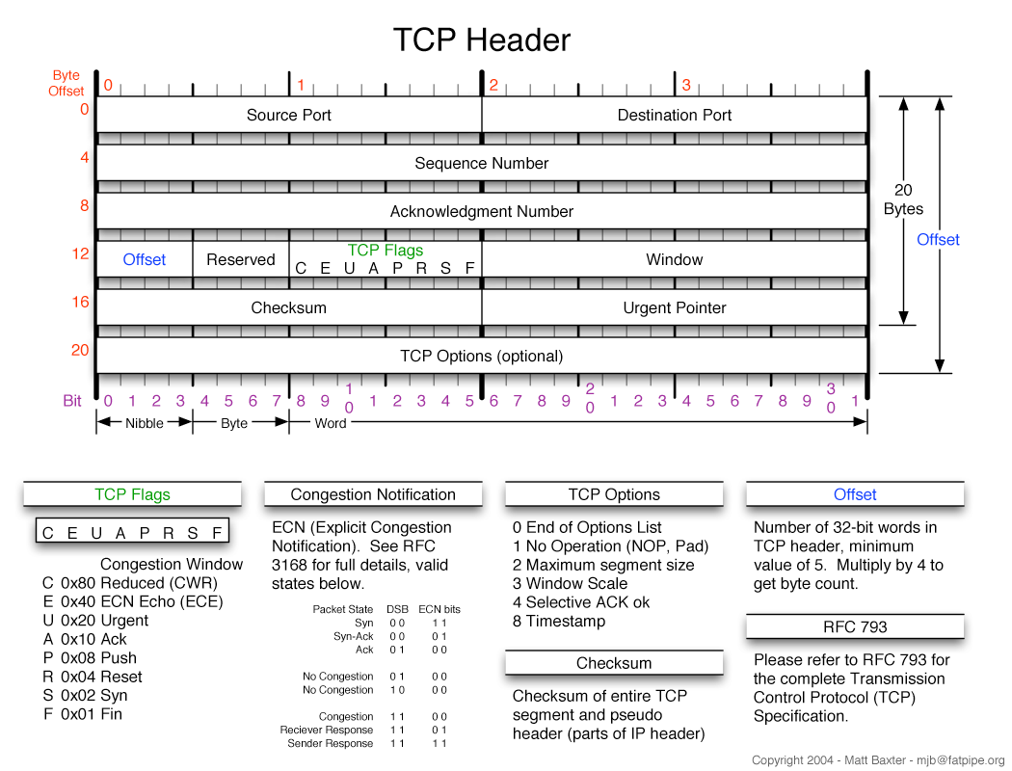

Slide 9
Network card modes
Normal
  Only frames destined for the NIC’s MAC address, and broadcasts, are passed up the network stack
Promiscuous mode
  Lets you see traffic in your collision domain, even if it’s not destined for your MAC address
  Some wireless card don’t support it
Monitor mode (RFMON)
  Allows raw viewing of 802.11 frames
  Generally you have to use *nix (some exceptions)
  ifconfig wlan0 down
  iwconfig wlan0 mode monitor
  ifconfig wlan0 up
  Kismet!!!

Slide 10
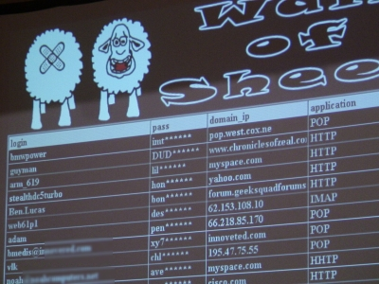

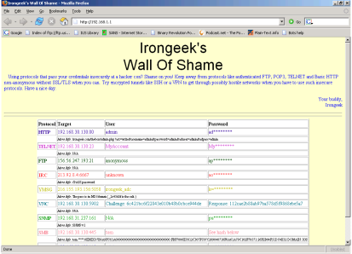
Wall of shame/sheep/social science majors
Plaintext protocols? At a hacker con?
http://www.wallofsheep.com/

Slide 11
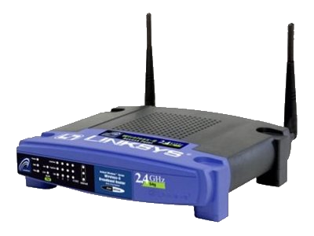


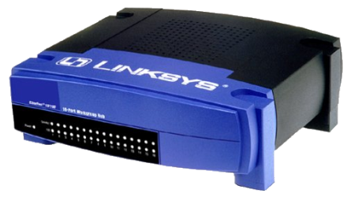
Collision domains and who can sniff what where when and how
Broadcast/Self
Routed through me
ARP poisoned
Promiscuous
Monitor mode

Slide 12
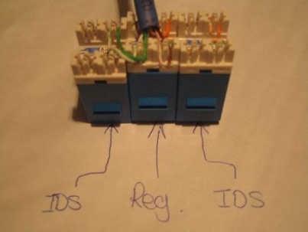
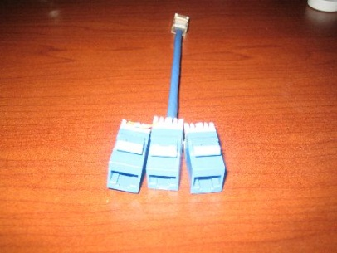
Other ways of getting to a place you can sniff from
Mirror port
TAP (Pics from Tony)
Own a box (Metasploit and others)
Pivotbox/Blackthrow/Dropbox/Kamikaze box/Svartkast
ARP Poison
Get in the route

Slide 13

Wireshark Demo
We’re going to need a bigger packet…

Slide 14
Working with pcaps
tcpdump/dumpcap
tcpreplay
packeth
wlan2eth
http://www.willhackforsushi.com/?page_id=79
nm2lp(NetMon to LibPcap)
http://www.inguardians.com/tools/
Metasploit?
http://www.offensive-security.com/metasploit-unleashed/Packet_Sniffing_With_Meterpreter

Slide 15
ARP Poisoning
On the local subnet, IPs are translated to MAC addresses using ARP (Address resolution Protocol)
ARP queries are sent and listened for, and a table of IPs to MACs is built (arp -a)
Pulling off a MITM (Man In The Middle) attack
If you MITM a connection, you can proxy it and sometime get around encryption
  SSL
  RDP
  WPA

Slide 16

Man in the Middle
Switch
Fritz
Cindy
Hey Cindy, I’m Fritz.
Hey Fritz, I’m Cindy.
Cracker

Slide 17

Ettercap Demo
Insert obscure D&D reference here
ettercap -T –q –i eth0 -M ARP // //

Slide 18

Cain Demo
Brotherly Love?

Slide 19
Other ways to MITM
Be a router (Yersinia)
Rogue DHCP
Rogue access points (Karma)
DNS Poison
WPAD?

Slide 20
Passive OS Fingerprinting
RFCs are implemented differently by different vendors
  Different window sizes
  Different TTL
  Different responses to probes
  Different DHCP requests
Tools like P0f, Ettercap and Satori do passive OS finger printing
NetworkMiner combines them all!! ☺

Slide 21
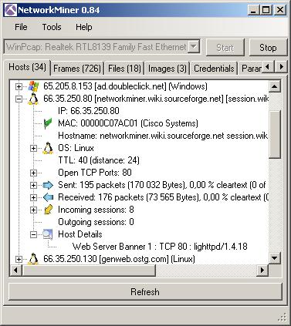
NetworkMiner Demo
No, not an underage Internet user.

Slide 22
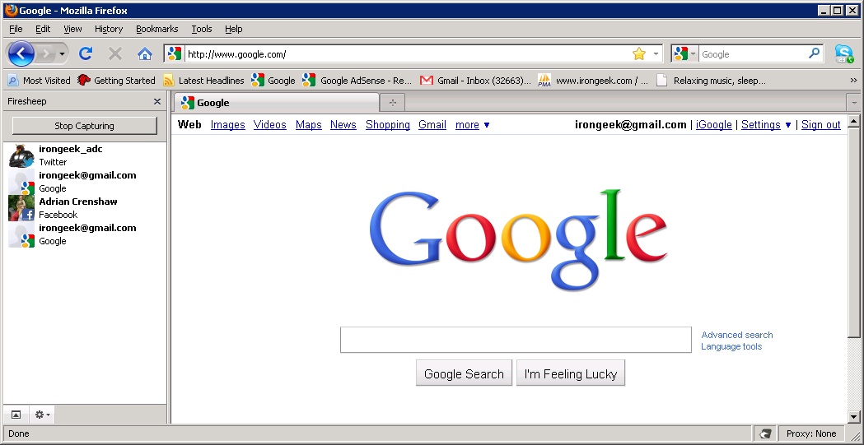
FireSheep
Baaaahh!!!
http://codebutler.github.com/firesheep/

Slide 23
Links
Articles:
Intro to Sniffers
http://www.irongeek.com/i.php?page=security/AQuickIntrotoSniffers
Cain RDP (Remote Desktop Protocol) Sniffer Parser
http://www.irongeek.com/i.php?page=security/cain-rdp-mitm-parser
Caffeinated Computer Crackers: Coffee and Confidential Computer Communications
http://www.irongeek.com/i.php?page=security/coffeecrack
The Basics of Arpspoofing/Arppoisoning
http://www.irongeek.com/i.php?page=security/arpspoof
Fun with Ettercap filters
http://www.irongeek.com/i.php?page=security/ettercapfilter

Slide 24
Links
Videos:
Hacker Con WiFi Hijinx Video: Protecting Yourself On Potentially Hostile Networks presentation for the ISSA in Louisville Kentucky
http://www.irongeek.com/i.php?page=videos/hacker-con-hostile-networks-louisville-issa
DNS Spoofing with Ettercap
http://www.irongeek.com/i.php?page=videos/dns-spoofing-with-ettercap-pharming
More Useful Ettercap Plugins For Pen-testing
http://irongeek.com/i.php?page=videos/ettercap-plugins-find-ip-gw-discover-isolate
Intro to the AirPcap USB adapter, Wireshark, and using Cain to crack WEP
http://www.irongeek.com/i.php?page=videos/airpcap-wireshark-cain-wep-cracking
Using Cain and the AirPcap USB adapter to crack WPA/WPA2
http://www.irongeek.com/i.php?page=videos/airpcap-cain-wpa-cracking
Passive OS Fingerprinting With P0f And Ettercap
http://www.irongeek.com/i.php?page=videos/passive-os-fingerprinting
Network Printer Hacking: Irongeek's Presentation at Notacon 2006
http://www.irongeek.com/i.php?page=videos/notacon2006printerhacking
Sniffing VoIP Using Cain
http://www.irongeek.com/i.php?page=videos/cainvoip1
Cain to ARP poison and sniff passwords
http://www.irongeek.com/i.php?page=videos/cain1

Slide 25
Links
Protection:
SSH Dynamic Port Forwarding
http://www.irongeek.com/i.php?page=videos/sshdynamicportforwarding
An Introduction to Tor
http://www.irongeek.com/i.php?page=videos/tor-1
Encrypting VoIP Traffic With Zfone To Protect Against Wiretapping
http://irongeek.com/i.php?page=videos/encrypting-voip-traffic-with-zfone-to-protect-against-wiretapping
Finding Promiscuous Sniffers and ARP Poisoners on your Network with Ettercap
http://irongeek.com/i.php?page=videos/finding-promiscuous-and-arp-poisoning-sniffers-on-your-network-with-ettercap
DecaffeinatID: A Very Simple IDS / Log Watching App / ARPWatch For Windows
http://www.irongeek.com/i.php?page=security/decaffeinatid-simple-ids-arpwatch-for-windows

Slide 26
Links
Tools:
Wireshark
http://www.wireshark.org/
Ettercap
http://ettercap.sourceforge.net/
Cain
http://www.oxid.it/cain.html
NetworkMiner
http://networkminer.wiki.sourceforge.net/NetworkMiner
Firesheep
http://codebutler.github.com/firesheep/
Backtrack Linux
http://www.backtrack-linux.org/downloads/

Slide 27
Events
Louisville Infosec
http://www.louisvilleinfosec.com/
DerbyCon 2011, Louisville Ky
http://derbycon.com/
Skydogcon/Hack3rcon/Phreaknic/Notacon/Outerz0ne
http://www.skydogcon.com/
http://www.hack3rcon.org/
http://phreaknic.info
http://notacon.org/
http://www.outerz0ne.org/

Slide 28
Questions?
42

