Slide 1
Funnypots and Skiddy Baiting: Screwing with those that screw with you
Adrian Crenshaw

Slide 2
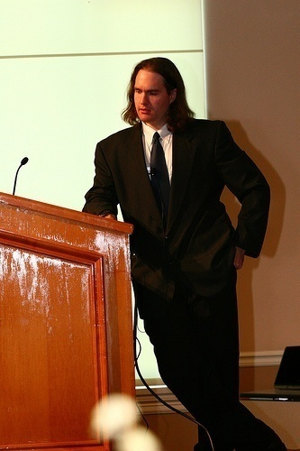
About Adrian
I run Irongeek.com
I have an interest in InfoSec education
I don’t know everything - I’m just a geek with time on my hands
(ir)Regular on the ISDPodcast
http://www.isd-podcast.com/
Researcher for Tenacity Institute
http://www.tenacitysolutions.com/
Notes:
Take a note from Johnny Long’s book, and Bruce Potter’s book.

Slide 3
Easily offended?
This may not be the talk for you.
I’m not recommending you do any of these things, and neither is Tenacity. This content is purely presented for entertainment value.
Remember, evil is an art form:
Ph'nglui mglw'nafh Cthulhu R'lyeh wgah'nagl fhtagn

Slide 4
Defining Terms
Skiddy Baiting: Sort of like Masturbating, ultimately it accomplishes nothing, but it sure is fun. It’s all about making the Skiddy hurt themselves.
Funnypots: Like a honeypot, but instead of being for research, it’s more about personal amusement.
Is this hacking back? More like booby-traps (no, not the 4Chan kind).
Legality?

Slide 5
Ideas
Some of these techniques I’ve actually pulled off, some are less fleshed out and more along the lines of concepts.
Core idea: How can we trick attackers into hurting/embarrassing themselves?
Please submit more ideas!

Slide 6

Fun With Loopback
There’s no place like 127.0.0.1

Slide 7
When I think about you, I attack myself.
(With apologies to the Divinyls)
Started off as an old IRC joke
127.0.0.1 is the local loopback address
127.*.*.* is also loopback
You can map hostnames in your domain to loopback
hackme1.irongeek.com = 127.13.43.22

Slide 8
Some choice quotes
"I'm hitting this box with everything I've got! It seems to be locked down pretty tight. But I think I've found a way in now, he's running Linux, in fact Ubuntu just as I am so that give's me an edge. Wonder if I'll just do an "rm -rf /" right away or something more sophisticated like slowly corrupting the files on the drive”
"Thanks! I've set a cronjob to start overwriting the files with /dev/urandom exactly 12.00 tomorrow. Muhhahahhaha.”
And of course the inevitable:
"Hmm. Irongeek I thought you said I could hack your box????! Mere seconds before the cronjob was to start I suddenly couldn't log in to my own box anymore?!? Did you hack me in return!! That's pretty low! All my files are gone too!!! Please if you have them restore them. I've got tons of memories in there! I'm sorry I mocked you, I'll doing anything you want if you can restor my computer. I freely admit your a much greater hacker than me... just restore the files ok, lets call it quits! I don't want to have to bring the law into this........... So how will it be"

Slide 9
Packet Swatting
A riff on a theme

Slide 10
Don’t try this at home
To repeat, neither Tenacity, Notacon nor myself recommend doing the things in the following few slides!
Still, a pen-tester might want to know about this sort of trap to avoid legal entanglements. Confirm your IPs folks!
Warning!
Bad Ideas Ahead!

Slide 11
Packet SWATing
What is SWATting?
http://en.wikipedia.org/wiki/Swatting
Why stop with loopback?
DNS entries for an organization’s domain do not have to map to IPs that the organization owns

Slide 12

Steps Bob would take
Nslookup fsb.ru/Gov .中国 .cn /SomeScaryAgency.gov
Map a host name to IP found in step 1.
Tell the skiddy.
?????
Profit!!!

Slide 13

Lemon wiping
For when you want your hard drive to feel (un)clean

Slide 14

The idea
Why wipe your drive with just 0, 1 or random?
Why not an arbitrary pattern?
Fun for the forensics examiner/snooper.
Let’s have a party!!! A lemon party!!!

Slide 15
Lemonwipe
(rude and crude)
Not recommended from a legal standpoint, but funny.
Repeat script to feed into DD:
@Echo Off
:TOP
type %1
Goto TOP
Command:
repeat.bat adrianbeer.jpg | dd of=\\.\f:
Create one big file:
@Echo Off
:TOP
type %1 >>%2\%1
if not %errorlevel%==0 goto :error
Goto TOP
:error
echo Exiting and deleting %2\%1
del %2\%1
exit /B -1
Command:
Smack.bat image.jpg f:

Slide 16

Robots.txt trolling
As heard about on many podcasts, don’t look at it if you have my resume on file
ing

Slide 17
So, what’s it all about?
Robots.txt is used to tell search engine spiders what not to index
Many attackers start their recon by looking at robots.txt, for example: http://www.irongeek.com/robots.txt
Sample robots.txt file:
User-agent: *
Disallow: /private
Disallow: /secret

Slide 18
Index.htm file for /secret
(slightly modified)
<html>
<head>
<meta http-equiv="Content-Type" content="text/html; charset=windows-1252">
<META HTTP-EQUIV=REFRESH CONTENT="1; URL=http://rule34.paheal.net/post/view/12930">.
<title>New Page 1</title>
</head>
<body>
<img src="http://irongeek.com/sigs/logo.php">
You don't seem to be a spider,
Redirecting.</body></p>
<p>:)<body></p></body>
</html>

Slide 19
I’ll butter your popcorn
Log the IP, or not, as you wish
For alternatives
http://en.wikipedia.org/wiki/Shock_sites
Jar

Slide 20
DNS fun
What is in a name?

Slide 21
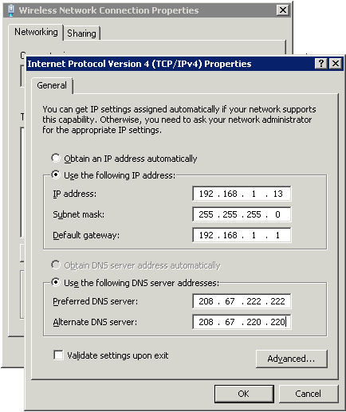
Neighbors using your WiFi?
You really should use WPA, but…
  You may have odd equipment without support (still try)
  You just want to have fun
  (great in apartment complexes)
  Hell, do it with a spare router
Have DHCP on your router hand out a pranked DNS server
Make sure you set your own computers’ DNS server entries statically (I use OpenDNS)

Slide 22
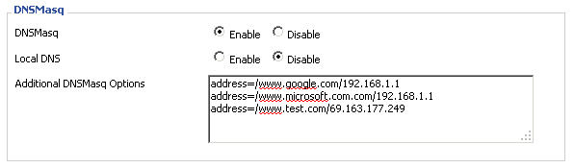
Router setup
I use DD-WRT on my router, but there are other ways.
Do some looking around for an Interesting IP
  Vhosts may be a problem
  Might point it to a host you control
Be creative

Slide 23


Let’s be patronizing
Would you like some help with that?

Slide 24
PHP IDS
Download from:
http://php-ids.org/
Instructions: http://www.irongeek.com/i.php?page=security/phpids-install-notes
Too much code to show, but this stub on my site’s template:
<?
include ("idsstub.php");
?>
What happens if someone tries an SQL or XSS injection?

Slide 25
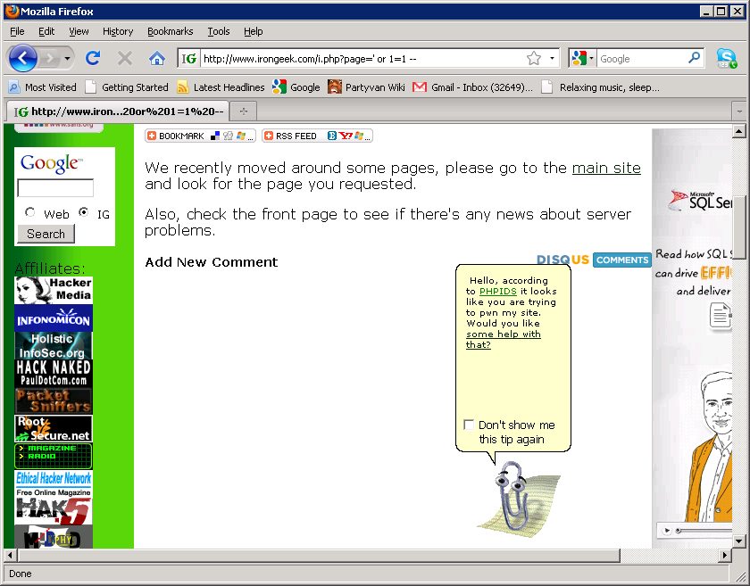
Results

Slide 26

Don’t look in places you don’t belong
File shares, thumb drives and other media

Slide 27

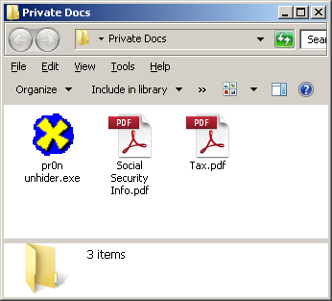
Really Rouge File
Shares
Someone scanning for open file shares?
Give them some docs to look at.
EXEs of course…

Slide 28
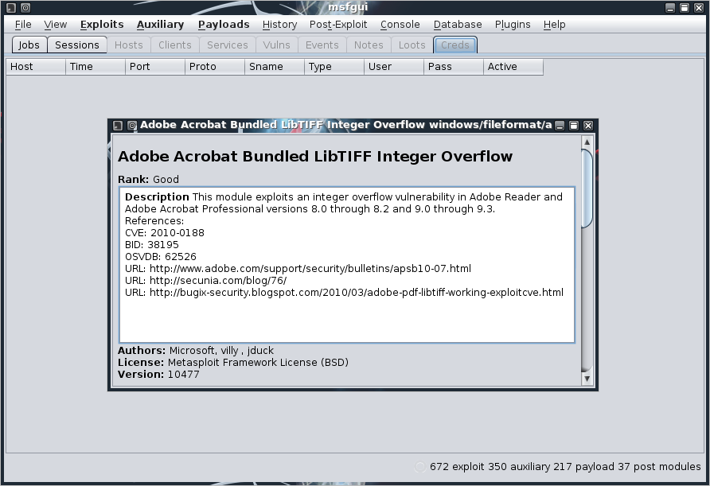
Remember when data was safe?
Checkout Metasploit “Exploits->windows->file formats” and ExploitDB.com

Slide 29
Exotic Injection Vectors and flaws in security/hacking tools
SQL Injection and XSS: Not just for forms anymore!

Slide 30
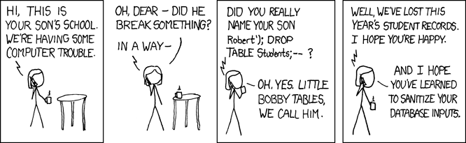
Exotic Injection Vectors
SQL and XSS have possibilities
  Many apps feed into a database
  Many apps use HTML based reports
User Agent Strings
Computer names/Descriptions
Wireless SSIDs
Event Logs
Sniffed passwords
Image from: http://xkcd.com/327/

Slide 31
Examples and Inspiration
XSS, Command and SQL Injection vectors: Beyond the Form http://www.irongeek.com/i.php?page=security/xss-sql-and-command-inject-vectors
Go to http://www.exploit-db.com/search/ and look for:
  Buffer overflows in Wireshark
  XSS in Xplico
  Buffer overflow in Retina WiFi Security Scanner
  Buffer overflows in Cain
Slightly related:
Look for people using BackTrack, hope they run services and don’t change the password ☺

Slide 32
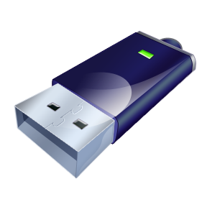

Fun with Thumbdrives and USB!
Portable evil

Slide 33

Many Options for Thumbdrives
Bad files like the previous slides
U3 Tool (Windows 7 and Linux)
http://u3-tool.sourceforge.net/
Steve Stasiukonis of Secure Network Technologies Inc pen-test story
http://technet.microsoft.com/en-us/magazine/2008.01.securitywatch.aspx
http://www.darkreading.com/security/perimeter/showArticle.jhtml?articleID=208803634
Hak5 Switchblade
http://www.hak5.org/w/index.php/USB_Switchblade

Slide 34
Other USB Options?
Ok, this will be a little price prohibitive
Programmable HID USB Keyboard Dongle Devices
  Simple microcontroller based device that acts as a USB HID (Human Interface Device)
  Can be used to script any actions a keyboard and mouse can do
  Way more information can be found here:
  http://www.irongeek.com/i.php?page=security/programmable-hid-usb-keystroke-dongle

Slide 35

A word on “deaddrops”
Ok, not really about attacking attackers
Pic from: http://deaddrops.com/
Is this really a good idea?
Digital equivalent of a “glory hole”?

Slide 36

unguarded equipment/ Inverse USB attack
Be careful what ports you put your stick in!

Slide 37
All sorts of options
No one at a hacker con has ever messed with my stuff (at home is a different matter)
But, what if they did?
Suck data off of their flash drive?
http://www.irongeek.com/i.php?page=security/thumb-sucking-udf-flash-drive
Install something bad on their flash drive?
Scar them emotionally?

Slide 38

Reaction Shots!
Got a webcam built-in?
Motion Detection: http://noeld.com/programs.asp?cat=video
Shock site/image/video on key press!
Special key needed to not see shock image
AutoIt will do the trick
What has been seen can not been unseen!

Slide 39

Dis-Honorable Mentions
Warped minds think alike

Slide 40

Pete Stevens for screwing with WiFi piggy backers
Forget encrypting it, let’s just have fun!
IPTables to redirect to a transparent proxy.
Flip all the images.
Full details at:
http://www.ex-parrot.com/~pete/upside-down-ternet.html
I seem to recall them doing something like this at Phreaknic

Slide 41

Screwing with 419 Scammers
Hate being contacted by Nigerian princes?
Play along with the scam for awhile.
Get funny pictures of the scammers.
More details and hall of shame at:
http://forum.419eater.com/forum/album.php

Slide 42
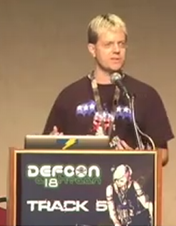
Pwned by the Owner
Zoz had some of his Mac equipment stolen
Hoped to get the information via DynDNS, but had static network settings
Time passes till some thief figured out how to get the Mac back online…then DynDNS gives him info…and box was not nuked! ☺
SSH/VNC into box so he could mess with the guy
Gets pics of the guy, unemployment docs (name), address, browsing info, keylogs, passwords, dating profiles, etc…
…and unimpressive nudes
Finally, sends the cops..luckily he had his serial number
Video from Defcon 18 (funny when thief gets profiled):
http://www.youtube.com/watch?v=U4oB28ksiIo&t=3m12s

Slide 43


th3j35t3r vs. Anonymous
DHN is a stress test/DDoS tool
DHN has some obfuscating ability (Tor for CC, spoofing of IP and MAC [yeah, I have questions about that])
DHN source is available
Th3j35t3r modified the source and uploaded it to other sites, then spread the word
New code gives away location/information about the attacker
I’ve read about this being done in the past by others to slow down skiddys

Slide 44


Jason Scott…
Known for TextFiles.org, BBS Documentary, Sockington the cat, etc.
He had a a bunch of people hotlinking to a cool image of the grim reaper on his site from their MySpace profile templates, sucking up bandwidth
What to do?

Slide 45
…for Goatse’ing MySpace
Replace the image with Goatse!
HotFreeLayouts even sent an email asking him to stop
More details at “Freedom, Justice and a Disturbingly Gaping Ass”:
http://ascii.textfiles.com/archives/1011

Slide 46
Got ideas?
Send them to me

Slide 47
Thanks
Notacon for having me
Gene Bransfield for feedback
Tenacity for helping get me here
By buddies from Derbycon and the ISDPodcast

Slide 48
Events
DerbyCon 2011, Louisville Ky
Sept 30 - Oct 2
http://derbycon.com/
Louisville Infosec
http://www.louisvilleinfosec.com/
Other Cons:
http://www.skydogcon.com/
http://www.dojocon.org/
http://www.hack3rcon.org/
http://phreaknic.info
http://notacon.org/
http://www.outerz0ne.org/
Notes:
Beg for hardware donations. ☺

Slide 49
Questions?
42

