Slide 1
Footprinting, scoping and recon with DNS, Google and Metadata
Adrian Crenshaw

Slide 2
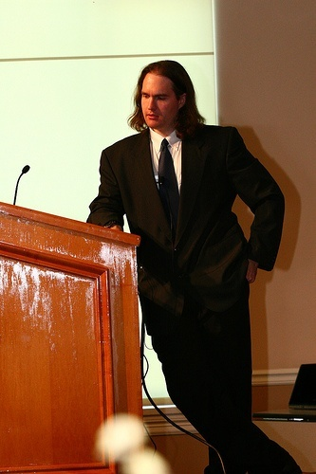

About Adrian
I run Irongeek.com
I have an interest in InfoSec education
I don’t know everything - I’m just a geek with time on my hands
Sometimes my presentations
are like this.
And sometimes my presentations
are like this.
Notes:
Take a note from Johnny Long’s book, and Bruce Potter’s book.

Slide 3
Class Structure
Mile wide, 2.5 feet deep
Feel free to ask questions at any time
There will be many long breaks to play with the tools mentioned

Slide 4
So, what info is out there?
Other names:
Scoping
Footprinting
Discovery
Recon
Cyberstalking

Slide 5
Subtopics
DNS, Whois and Domain Tools
Finding general Information about an
organization via the web
Anti-social networks
Google Hacking
Metadata
Other odds and ends
Notes:
The topics will be somewhat out of order since they are so interlinked.

Slide 6
Why?
For Pen-testers and attackers:
Precursor to attack
Social Engineering
User names and passwords
Web vulnerabilities
Internal IT structure (software, servers, IP layout)
Spearphishing
For everyone else:
You want to keep attackers from finding this info and using this against you. ☺
Notes:
It’s all about making connections, finding information that may be useful later.

Slide 7
Dropping Docs
All these techniques are legal
Sorry if I “drop someone’s docs” other than my own
Please don’t misuse this information

Slide 8
Backtrack 4 Prep
Enable the interface:
ifconfig eth0 up
Get an IP:
dhclient
Start up the GUI/WIMP:
startx
Notes:
Demo Time!!!

Slide 9
DNS, Whois and Domain Tools
Who-do the voodoo that you do so well

Slide 10
DNS
Glue of the Internet
Think of it as a phone book of sorts
Maps names to IPs, and IPs to names
(and other odds and ends)
Organization information is also kept

Slide 11
Simple DNS Lookups
Host name to IP lookup:
nslookup www.irongeek.com
Reverse lookup:
nslookup 208.97.169.250
Notes:
We get an “A” record for first, and a “PTR” for a single IP.
Mention that one IP may have multiple host names.
If you exploit one web app on a share hosting provider, you may be able to mess with the sites of other domains hosted there.
http://serversniff.net/content.php?do=hostonip

Slide 12
DNS Record Types
Just a few record types cribbed from: http://en.wikipedia.org/wiki/List_of_DNS_record_types
Code | Number | Defining RFC | Description | Function
A | 1 | RFC 1035 | address record | Returns a 32-bit IPv4 address, most commonly used to map hostnames to an IP address of the host, but also used for DNSBLs, storing subnet masks in RFC 1101, etc.
AAAA | 28 | RFC 3596 | IPv6 address record | Returns a 128-bit IPv6 address, most commonly used to map hostnames to an IP address of the host.
MX | 15 | RFC 1035 | mail exchange record | Maps a domain name to a list of mail exchange servers for that domain
CNAME | 5 | RFC 1035 | Canonical name record | Alias of one name to another: the DNS lookup will continue by retrying the lookup with the new name.
PTR | 12 | RFC 1035 | pointer record | Pointer to a canonical name. Unlike a CNAME, DNS processing does NOT proceed, just the name is returned. The most common use is for implementing reverse DNS lookups, but other uses include such things as DNS-SD.
AXFR | 252 | RFC 1035 | Full Zone Transfer | Transfer entire zone file from the master name server to secondary name servers.

Slide 13
Getting a list of host names
Zonetransfers
Nmap –sL <some-IP-range>
Serversniff
http://serversniff.net/subdomains.php

Slide 14
DIGing for data
dig irongeek.com any
dig @ns1.dreamhost.com irongeek.com any
Notes:
Demo Time!!!
Windows users must run the installer for the resolv.conf file.

Slide 15
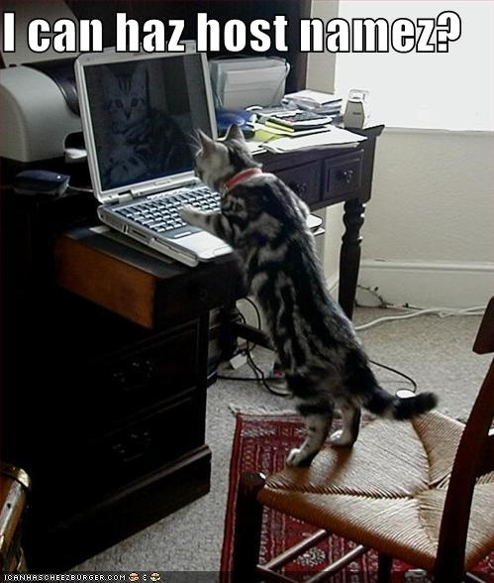
Zone Transfer:Give me all your records!

Slide 16
Zone Transfer: NSLOOKUP
(Windows version)
C:\Documents and Settings\Adrian>nslookup
Default Server: resolver1.opendns.com
Address: 208.67.222.222
> set type=ns
> irongeek.com
Server: resolver1.opendns.com
Address: 208.67.222.222
Non-authoritative answer:
irongeek.com nameserver = ns1.dreamhost.com
irongeek.com nameserver = ns2.dreamhost.com
irongeek.com nameserver = ns3.dreamhost.com
> server ns1.dreamhost.com
Default Server: ns1.dreamhost.com
Address: 66.33.206.206
> ls irongeek.com
[ns1.dreamhost.com]
*** Can't list domain irongeek.com: Query refused
> exit

Slide 17
Zone Transfer: Can you DIG it?
dig issa-kentuckiana.org ns
dig @dns3.doteasy.com issa-kentuckiana.org axfr
dig louisvilleinfosec.com ns
dig @dns3.doteasy.com louisvilleinfosec.com axfr
dig ugent.be ns
dig @ugdns1.ugent.be ugent.be axfr
Notes:
Demo Time!!!
Windows users must run the installer for the resolv.conf file.
Explain about the –t option.

Slide 18
Zone Transfer: Others
ServerSniff:
http://serversniff.net/nsreport.php
http://serversniff.net/content.php?do=subdomains
Fierce
http://ha.ckers.org/fierce/
./fierce.pl -dns irongeek.com
GUI Dig for Windows
http://nscan.org/dig.html
Notes:
Demo Time for ServerSniff!!!
Tell them about hackme1.irongeek.com

Slide 19
Nmap Demo
nmap –sL <some-IP-range>
Notes:
Demo Time!!!
Not as good as a zone transfer because it returns only continuous IPs.

Slide 20
Whois: Whooo, are you? Who-who-who-who.
Great for troubleshooting, bad for privacy
Who owns a domain name or IP
E-mail contacts
Physical addresses
Name server
IP ranges
Who is by proxy?

Slide 21
Whois Demo
whois irongeek.com
whois 208.97.169.250
Notes:
Demo Time!!!
Can’t whois a host name, but a domain name or IP works fine.

Slide 22
Whois Tools
*nix Command line
Nirsoft’s
http://www.nirsoft.net/utils/whois_this_domain.html http://www.nirsoft.net/utils/ipnetinfo.html
Pretty much any network tools collection
Windows Mobile:
  http://www.cam.com/vxutil_pers.html
Notes:
Show the different ways to “whois”. Both domains and IPs.

Slide 23
Whois and domain tools sites
http://www.domaintools.com/
http://samspade.org
http://www.serversniff.net

Slide 24
Traceroute
(ok, not really a DNS tool, but I was too lazy to make another section)
Windows (ICMP):
tracert irongeek.com
*nix (UDP by default, change with –I or -T):
traceroute irongeek.com
Just for fun:
http://www.nabber.org/projects/geotrace/
Notes:
Great for finding out who uses what ISP, or how networks are peered (Social engineering time!).
Also, if you can compromise someone in the route, traffic can be sniffed or altered.
Find out info about the network layout, and host names can be of interest.
More options can be found with “tracert -?” in Windows, “man traceroute” in Linux.
ICMP time exceeded (type 11) packet

Slide 25
Finding general Information about an organization via the web
So, you have a job posting for an Ethical Hacker huh?
Notes:
Mention “Satan is on my friends list” presentation.

Slide 26
Sites about the organization
The organization’s website (duh!)
Wayback Machine
http://www.archive.org
Monster (and other job sites)
http://www.monster.com/
Zoominfo
http://www.zoominfo.com/
Google Groups (News groups, Google Groups and forums)
http://groups.google.com/
Board reader
http://boardreader.com
LinkedIn
http://www.linkedin.com/
Notes:
Look at the organizations' current site, and old versions of their site.
Once it’s on the net, it’s there forever (more or less).
As for Job sites: So, you are looking for a MySQL admin, huh? What does that tell me about your organization’s infrastructure?
All sorts of info can be found out by looking at job postings.
Search for forum and usenet posts about the companies' tech problems. Strange what admins will ask in public.

Slide 27
Anti-social networks
It’s all about how this links to that links to some other thing…
Notes:
Mention “Satan is on my friends list” presentation.

Slide 28
Cyberstalking Sites
Useful:
http://www.pipl.com
http://www.peekyou.com
http://yoname.com
Not quite related, but cool:
http://tineye.com
Crap:
http://www.spock.com
http://wink.com
http://Rapleaf.com (not very useful anymore)
Notes:
Show top 3, and Tin Eye.

Slide 29
Tools
Maltego
http://www.paterva.com/maltego/community-edition/
Covers a large cross section of what this presentation is about.
Notes:
Show Maltego.

Slide 30
Google Hacking
More than just turning off safe search (though that’s fun too)

Slide 31
So, do you really know what’s shared online about your organization?
PII (Personally identifiable information)
Email address
User names
Vulnerable web services
Web based admin interfaces for hardware
Much more……..
YOU HAVE TO USE YOUR IMAGINATION

Slide 32
Google Advance Operators
Operators | Description
site: | Restrict results to only one domain, or server
inurl:/allinurl: | All terms must appear in URL
intitle:/allintitle: | All terms must appear in title
cache: | Display Google’s cache of a page
ext:/filetype: | Return files with a given extension/file type
info: | Convenient way to get to other information about a page
link: | Find pages that link to the given page
inanchor: | Page is linked to by someone using the term
http://www.googleguide.com/advanced_operators.html

Slide 33
More Operators
Operators | Description
- | Inverse search operator (hide results)
~ | synonyms
[#]..[#] | Number range
* | Wildcard to put something between something when searching with “quotes”
+ | Used to force stop words
OR | Boolean operator, must be uppercase
| | Same as OR

Slide 34
Examples
inurl:nph-proxy
intitle:index.of.etc
intitle:index.of site:irongeek.com
filetype:pptx site:irongeek.com
"vnc desktop" inurl:5800
adrian crenshaw -site:irongeek.com
Notes:
Demo Time!!!

Slide 35
Examples
SSN filetype:xls | filetype:xlsx
"dig @* * axfr”
inurl:admin
inurl:indexFrame.shtml Axis
inurl:hp/device/this.LCDispatcher
“192.168.*.*” (but replace with your IP range)
Notes:
Demo Time!!!

Slide 36
Google Hacking DB
http://johnny.ihackstuff.com/ghdb.php
Notes:
Demo Time!!!

Slide 37
Google Hacking Tools
Metagoofil
./metagoofil.py -d irongeek.com -l 1000 -f all -0 output.html -t temp
Online Google Hacking Tool
http://www.secapps.com/a/ghdb
Spiderfoot
http://www.binarypool.com/spiderfoot/
Goolag
http://goolag.org
Notes:
Show off Metagoofil, maybe Spiderfoot.

Slide 38
More Google Hacking Tools
Gooscan
Should be on BackTrack CD/VM
Wikto
http://www.sensepost.com/research/wikto/
SiteDigger
http://www.foundstone.com/us/resources/proddesc/sitedigger.htm
BiLE
http://www.sensepost.com/research_misc.html
MSNPawn
http://www.net-square.com/msnpawn/index.shtml
Notes:
I’ve often had the problem of automated Google hacking tools that use scraping making Google list me as a bot, causing me to have to enter a CAPTCHA to search.
Other tools require the old, now depreciated, Google SOAP APIs. More on that in a bit.

Slide 39
Google SOAP API Proxys
EvilAPI
http://evilapi.com/ (defunct?)
Aura
http://www.sensepost.com/research/aura/

Slide 40
Metadata
Data about data

Slide 41

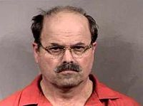

Pwned by Metadata
Cat Schwartz
Is that an unintended thumbnail in your EXIF data, or are you just happy to see me?
Dennis Rader (BTK Killer)
Metadata in a Word DOC he sent to police had the name of his church, and last modified by “Dennis” in it.
Darkanaku/Nephew chan
A user on 4chan posts a pic of his semi-nude aunt taken with an iPhone, Anonymous pulls the EXIF GPS info from the file and hilarity ensues.
More details can be on the following VNSFW site:
http://encyclopediadramatica.com/User:Darkanaku/Nephew_chan

Slide 42
Examples of file types that contain metadata
MAC addresses, user names, edits, GPS info. It all depends on the file format.
JPG
EXIF (Exchangeable image file format)
IPTC (International Press Telecommunications Council)
PDF
DOC
DOCX
EXE
XLS
XLSX
PNG
Too many to name them all.
Notes:
Show EXE metadata.
Show Word metadata.
Show EXIF data in jpg.
Show Office 2007 metadata in this presentation by unzipping it.
Show PDF metadata. http://regex.info/exif.cgi.
Show Radical kitty cat in EXIFRead. My Zombie an Beer pick as well.

Slide 43
Metadata Tools
Strings
Metagoofil
http://www.edge-security.com/metagoofil.php
EXIF Tool
http://www.sno.phy.queensu.ca/~phil/exiftool/
EXIF Viewer Plugin
https://addons.mozilla.org/en-US/firefox/addon/3905
Jeffrey's Exif Viewer
http://regex.info/exif.cgi

Slide 44
Metadata Tools
EXIF Reader
http://www.takenet.or.jp/~ryuuji/minisoft/exifread/english/
Flickramio
http://userscripts.org/scripts/show/27101
Pauldotcom http://www.google.com/search?hl=en&q=metadata+site%3Apauldotcom.com&btnG=Search

Slide 45
Other odds and ends
Stuff that does not quite fit anywhere else

Slide 46
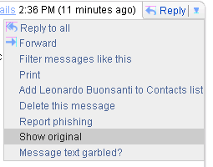
Mail Header Fun
http://www.irongeek.com/i.php?page=security/how-to-cyberstalk-potential-employers

Slide 47
Robots.txt
http://www.irongeek.com/robots.txt
User-agent: *
Disallow: /private
Disallow: /secret
This is my Robots.txt file.
for the love of Cthulhu,
don’t go there!

Slide 48
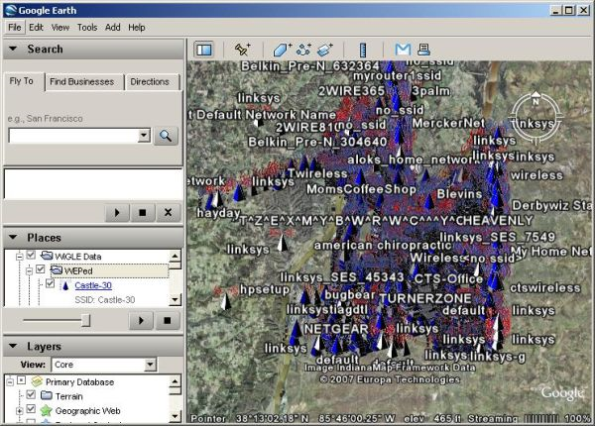
IGiGLE and WiGLE
http://www.irongeek.com/i.php?page=security/igigle-wigle-wifi-to-google-earth-client-for-wardrive-mapping
Notes:
So, what WiFi is in the area, and based on BSSID who provides the WAPs.

Slide 49
More Links
Recon Sites and Tools
http://www.binrev.com/forums/index.php?showtopic=40526
Pauldotcom
http://mail.pauldotcom.com/pipermail/pauldotcom/2009-March/000960.html
VulnerabilityAssessment.co.uk - An information portal for Vulnerability Analysts and Penetration Testers
http://www.vulnerabilityassessment.co.uk/Penetration%20Test.html

Slide 50
Events
Free ISSA classes
ISSA Meeting
http://issa-kentuckiana.org/
Louisville Infosec
http://www.louisvilleinfosec.com/
Phreaknic/Notacon/Outerz0ne
http://phreaknic.info
http://notacon.org/
http://www.outerz0ne.org/
Notes:
Beg for hardware donations. ☺

Slide 51
Thanks
Brian
http://www.pocodoy.com/blog/
Kelly for getting us the room and organizing things
Jonathan Cran
http://hexesec.wordpress.com/
http://www.0x0e.net/ghg/
Folks at Binrev and Pauldotcom
Louisville ISSA
Russ Mcree
http://holisticinfosec.org
iamnowonmai for helping me “zone out”
Larry “metadata” Pesce
http://pauldotcom.com
John for the extra camera

Slide 52
Questions?
42

