Slide 1
Pilfering Local Data: Things an Attacker Would want to Grab with Short Term Local Access
Adrian Crenshaw

Slide 2
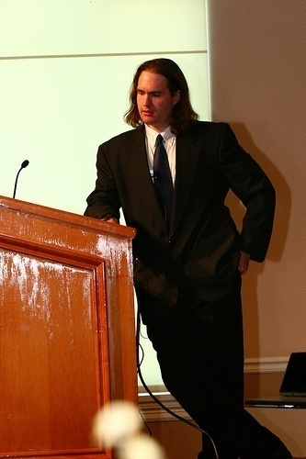
About Adrian
I run Irongeek.com
I have an interest in InfoSec education
I don’t know everything - I’m just a geek with time on my hands
(ir)Regular on: http://www.isdpodcast.com/
Notes:
Take a note from Johnny Long’s book, and Bruce Potter’s book.

Slide 3
What I plan to cover
Core items an attacker would want to locate and copy off of a Windows system with short term access
Data that could be found: Passwords, Usernames Docs, Emails, Paths
Tools they would use to bypass weak security precautions like file system permissions and OS/BIOs passwords

Slide 4
Why this talk is sort of a sham
If you have short term access, your goal as an attacker should be to extend that access
There are just so many options for useful files to grab, so it’s hard to decide the most important
Still useful from the context of stolen and decommissioned equipment, but then time is not as critical

Slide 5
How are we getting at the data?

Slide 6
Distros/Boot environments
Just a few:
BackTrack Linux http://www.backtrack-linux.org
Bart’s PE/UBCD4Win http://www.nu2.nu/pebuilder/ http://www.ubcd4win.com/
Winbuilder/Win7PE SE http://winbuilder.net/ & http://reboot.pro/12427/
Konboot http://www.piotrbania.com/all/kon-boot/

Slide 7
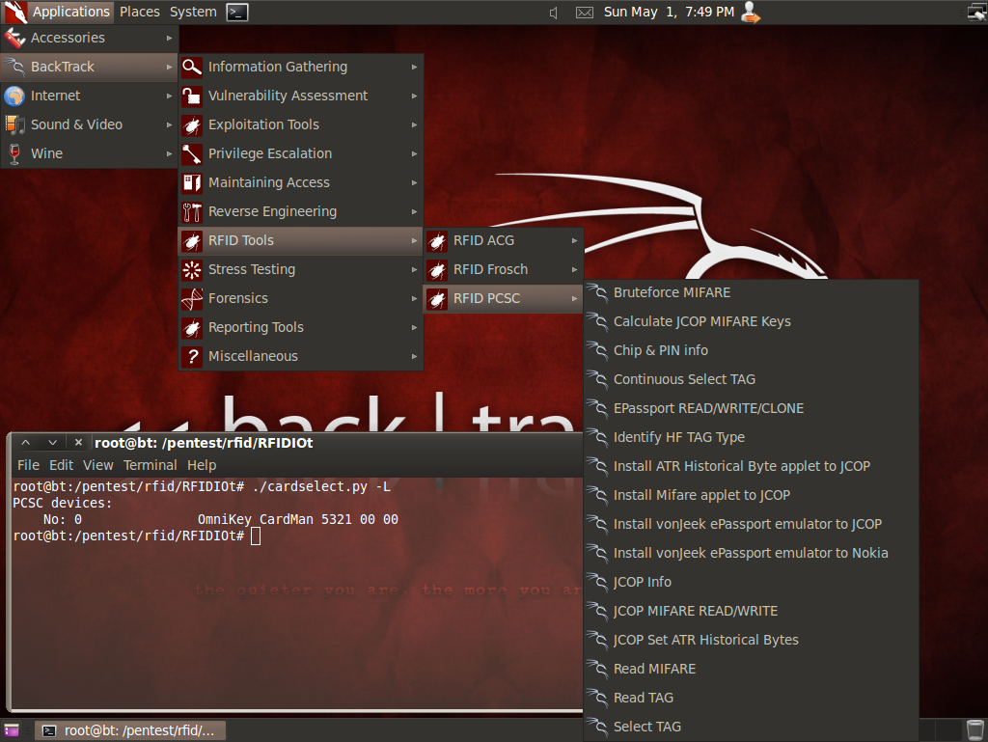
BackTrack Linux
Tons of security tools
Awesome hardware support for odd wireless needs
Well maintained
Can do a hard drive install if you wish
Image from http://www.backtrack-linux.org/screenshots/

Slide 8
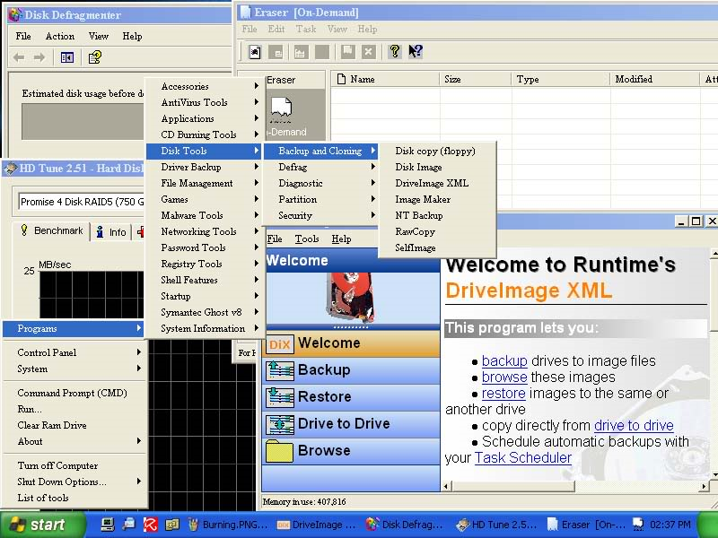
Bart’s PE/UBCD4Win
Bart’s PE can be built from the files on a Windows XP CD
UBCD4Win is Bart’s Pe with a bunch of extras + Multi-boot (DBAN)
Plugins can be made to add functionality
Image from http://www.ubcd4win.com/screen.htm

Slide 9
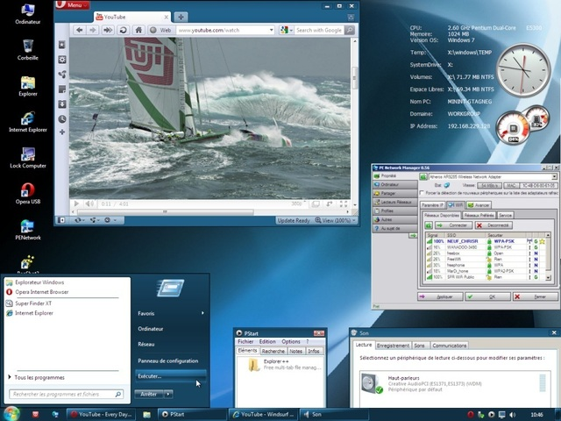
Winbuilder/Win7PE SE
Make a Windows based boot USB/CD/DVD
Starting OS needed depends on build
Plugins can be made to add functionality
Build even up to Win7 SP1 32/64bit
Hardcore roll your own
Image from http://reboot.pro/12427/

Slide 10
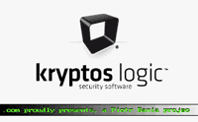
Konboot
Bypass password on some versions of Windows and Linux
Changes kernel on boot
Login to Linux with “kon-usr” as username.
Use a blank password in Windows
Meant to run from a CD/Floppy, sometimes works from a UFD using instructions found here: http://www.irongeek.com/i.php?page=security/kon-boot-from-usb
Image from http://www.piotrbania.com/all/kon-boot/

Slide 11
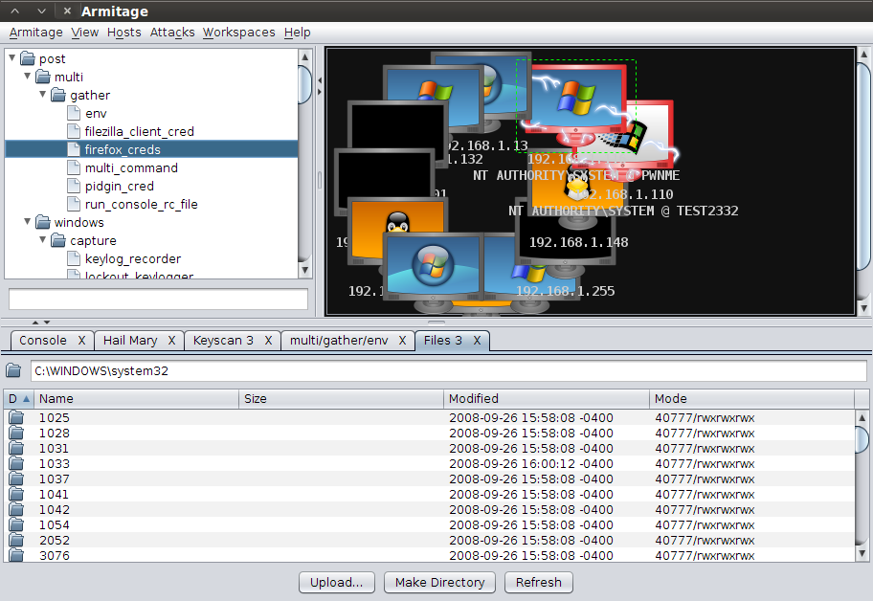
Remote exploits as well
Metasploit/Armitage http://www.fastandeasyhacking.com/

Slide 12
Some Useful Tools

Slide 13
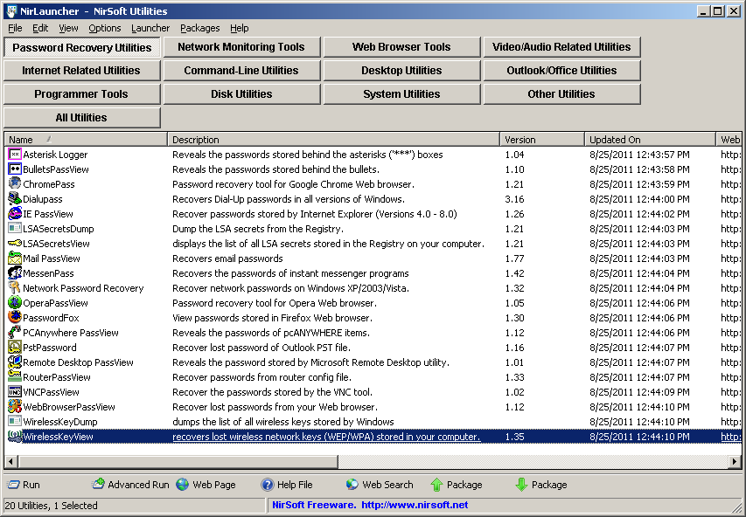
NirSoft Tools
http://launcher.nirsoft.net/

Slide 14
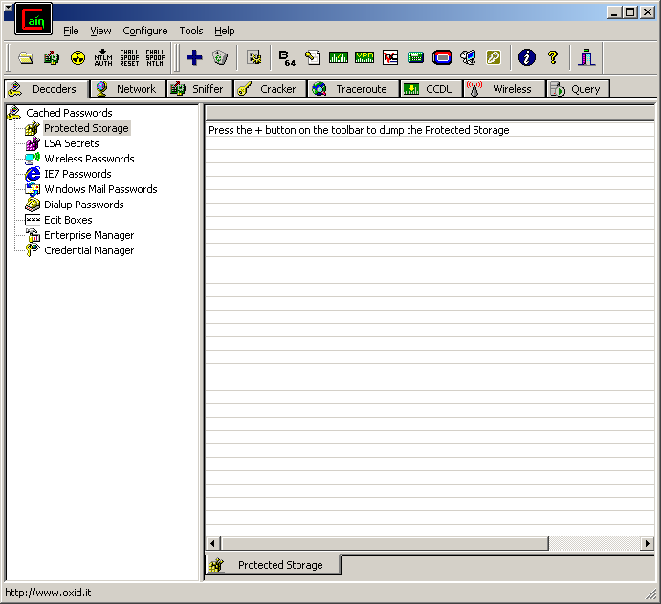
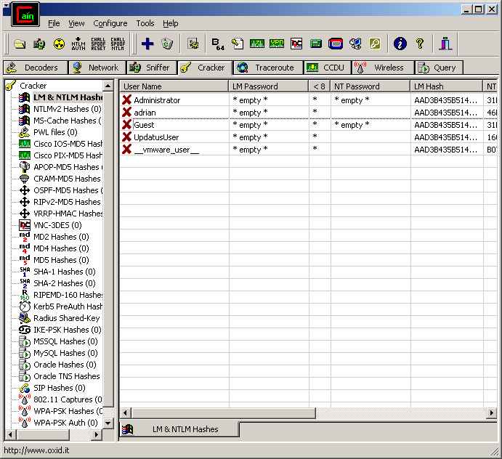
Cain
http://www.oxid.it/cain.html

Slide 15
Passwords
and hashes

Slide 16
Windows System Trifecta
C:\Windows\System32\config SAM SYSTEM SECURITY
Grab These Files!!!
NTUSER.DAT may also be useful as it maps to HKEY_CURRENT_USER
Hell, get SOFTWARE to while you are at it!

Slide 17
Why these files?
Cain
LSA Secrets:SYSTEM and SECURITY
Cached passwords:SYSTEM and SECURITY
SAM Hashes: SAM and SYSTEM
WirelessKeyView will do via Windows dir on Windows XP

Slide 18
Why exploit local passwords?
There are several reasons why an attacker may want to find local passwords:
To escalate privileges on the local host (install games, sniffers, key stroke catchers and other software or just to bypass restrictions).
Local passwords can be used to gain access to other systems on the network. Admins may reuse the same usernames and passwords on other network hosts (more than likely if they use hard drive imaging). Similar themes are also often used for password selection.
Just for the fun of doing it.

Slide 19
Scenario
Imaged Systems
Uses it on
other systems
Repeat
ad nauseum
Attacker grabs local password on one box
Grabs passwords from other systems, and installs keyloggers/sniffers to get network credentials for more systems

Slide 20
Glossary
Cracking a Password: De-obfuscating a password’s representation. Brute force attack: Using all possible character combinations till a match for the password is found. Also know as an incremental attack in John the Ripper. Dictionary attack: Using each entry in a word list until a match for the password is found. Hashing: Applying a mathematical formula to a piece of text to get a shorter number or string. One way hash: A hash where the original string the hash was derived from can not be easily found by a simple method. Plain text: The un-obfuscated or un-encrypted form of a string. Opposite of cipher text. Password Hash: The “hashed” version of a password that’s stored for later authentication. Reversible Encryption (Obfuscation): Encryption that is easily reversed if the algorithm is know. Example: ROT13. Salt: A number used to seed a hashing or encryption algorithm to add to the possible number of outcome the ciphertexts.

Slide 21
Hash Examples
Type Hash plaintext badpass MD2 9C5B091C305744F046E551DB45E7C036 MD4 640061BD33AA12D92FC40EA87EA408DE MD5 F1BFC72887902986B95F3DFDF1B81A5B SHA-1 AF73C586F66FDC99ABF1EADB2B71C5E46C80C24A SHA-2 (256) 4F630A1C0C7DD182D2737456E14C89C723C5FCE25CAE39DA4B93F00E90A365CB SHA-2 (384) 8E3B1BB56624C227996941E304B061FD864868AA3DB92A1C82AE00E336BE90809E60BB2A29FC1692189DE458B6300016 SHA-2 (512) 6109E5BDF21C7CC650DC211CF3A3706FAB8D50B132762F6D597BE1BD499E357FAF435FAB220FA40A1067707D0E0C28F39C1EC41F435C4D820E8AB225E37489E3 RIPEMD-160 595FD77AA71F1CE8D7A571CB6ABDA2A502BA00D4 LM 4CF3B1913C3FF376 NT 986CA892BEAB33D1FC2E60C22EC133B7 MySQL323 0AFDA7C85EE805C2 MySQLSHA1 229749C080B28D3AEFAB78279C4668E6E12F20FA Cisco PIX RtJk8qcKDPR.2D/E VNC Hash DAD3B1EB680AD902

Slide 22
Great Resources
Password Storage Locations For Popular Windows Applications http://www.nirsoft.net/articles/saved_password_location.html Also, using tools to reverse engineer what his apps were doing helped a bunch
Bunch of my stuff on hacking SAM/SYSTEM hashes http://www.irongeek.com/i.php?page=security/cracking-windows-vista-xp-2000-nt-passwords-via-sam-and-syskey-with-cain-ophcrack-saminside-bkhive-etc
Question Defense http://www.question-defense.com/
Ron’s Password Lists http://www.skullsecurity.org/wiki/index.php/Passwords

Slide 23
Assumptions and Workarounds
In most cases, these tools/attacks will require physical access to a box
In some cases you will…
…need to be logged into the target account on the box.
…just need access to the file system.
…you must be logged in as the target account, and not have changed the password using a boot CD. ☺

Slide 24
Windows Profile Info
I used C:\ in this presentation as the root drive, but it could be something else
Some differences in subdirectories when it comes to profiles
Win 7/Vista C:\Users
Windows XP C:\Documents and Settings\
Let’s use <profile> as shorthand

Slide 25
AppData
Enable the viewing of system and hidden files and folders
Windows 7/Vista <profile>\AppData\Local <profile>\AppData\LocalLow <profile>\AppData\Roaming
Windows XP (sort of) <profile>\Application Data , maps to Roaming <profile>\Local Settings\Application Data, maps to Local
Go read http://download.microsoft.com/download/3/b/a/3ba6d659-6e39-4cd7-b3a2-9c96482f5353/Managing%20Roaming%20User%20Data%20Deployment%20Guide.doc

Slide 26
More Details
<profile>\AppData\Roaming Synchronized with the server if roaming profiles are used.
<profile>\AppData\Local Specific to that computer, even with roaming profiles enabled. Also meant for larger files.
<profile>\AppData\LocalLow Same use as LocalLow, but with lower integrity level an can be written to in protected mode.

Slide 27
Windows local accounts: LM
LAN Manager (Used in older Windows Operating System)
Convert password to upper case.
Pad the plaintext with null characters to make it 14 bytes long.
Split into two 7 character (byte) chunks.
Use each 7 byte chunks separately as keys to DES encrypt the magic value ("KGS!@#$%" or in HEX 0x4b47532140232425).
Concatenate the two cipher texts from step four to produce the hash.
Store the hash in the SAM file.

Slide 28
Windows local accounts: NTLM
NT Manager
Take the Unicode mixed-case password and use the Message Digest 4 (MD4) algorithm to obtain the hash.
Store the hash in the SAM file.

Slide 29
Open Source/Free tools for cracking the SAM
FGDump (Pwdump) http://www.foofus.net/~fizzgig/fgdump
Cain http://www.oxid.it/cain.html
Backtrack 5R1 DVD (SAMDump2 and other tools) http://www.backtrack-linux.org/

Slide 30
A few notes on using SAMDump from Backtrack
fdisk -l mkdir /media/sda1 mount /dev/sda1 /media/sda1 -o force samdump2 /media/sda1/Windows/System32/config/SYSTEM /media/sda1/Windows/System32/config/SAM >hashes.txt

Slide 31
Cached Domain Credentials
Cracking Cached Domain/ADS Passwords By default Windows systems in a domain or Active Directory tree cache the credentials of the last ten previously logged in users. This is done so that the users can still login again if the Domain Controller or ADS tree can not be reached either because of Controller failure or network problems. These cached passwords are stored as encrypted (using NL$KM LSA) hashes in the local systems registry at the values: HKEY_LOCAL_MACHINE\SECURITY\CACHE\NL$1 through HKEY_LOCAL_MACHINE\SECURITY\CACHE\NL$10
I’ve read the algorithm for MSCacheV1 is: MD4(MD4(Unicode($pass)).Unicode(strtolower($username))) according to the folks at http://www.insidepro.com
MSCacheV2 adds even more issues

Slide 32
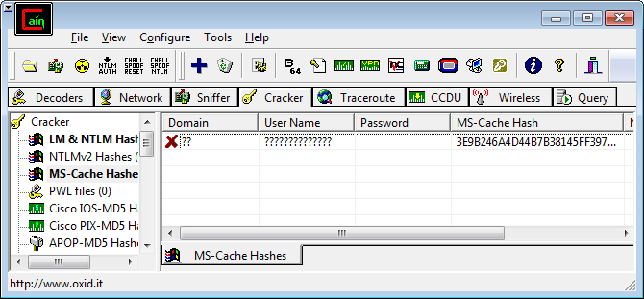
Win 7 + Cain does not seem to work
Cain
Hashcat http://hashcat.net format: 98bc149b523691e3e51a91b6596e9750:somedomainuser

Slide 33
Cracking Creds Countered
Credential Cache Cracking Countermeasures
Choose stronger domain passwords. Use more than just alpha-numeric characters and perhaps throw in some extended ASCII characters by way of the Alt+num-pad method.
For those who are still paranoid and have a VERY reliable connection to their domain controller, they can follow these steps to disable the caching of passwords and credentials: Set the registry value HKLM\SOFTWARE\Microsoft\Windows NT\CurrentVersion\Winlogon\CachedLogonsCount to 0 then reboot. This can also be done with the Local Security Policy or with a GPO.
Use same “Fascist Methods” as before for restricting physical access to the computer.

Slide 34
Unknown Apps: System Process Monitoring Apps and Demo
ProcessActivityView http://www.nirsoft.net/utils/process_activity_view.html
RegFromApp http://www.nirsoft.net/utils/reg_file_from_application.html
Procmon http://technet.microsoft.com/en-us/sysinternals/bb896645.aspx

Slide 35
Unknown Apps: Don’t know how it’s hashed?
Compare the hash to know examples of other hashes
Get a copy of the app, use the password “password” and search for the resulting hash on Google
Get the source code
How good are you at reverse engineering with a debugger?

Slide 36
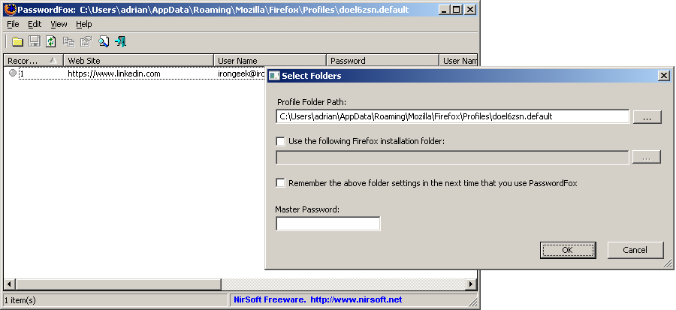
Browser Passwords: Firefox
Stored in an SQLite database, but needing some key files
<profile>\AppData\Roaming\Mozilla\Firefox\Profiles\<Firefox Profile>\secmod.db <profile>\AppData\Roaming\Mozilla\Firefox\Profiles\<Firefox Profile> \cert8.db <profile>\AppData\Roaming\Mozilla\Firefox\Profiles\ <Firefox Profile>\key3.db <profile>\AppData\Roaming\Mozilla\Firefox\Profiles \<Firefox Profile>\ signons.sqlite

Slide 37
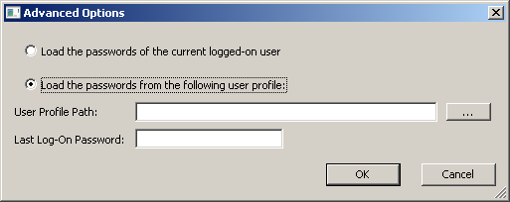
Browser Passwords: Internet Explorer
IE 4-6: Sprt in registry called Protected storage: HKEY_CURRENT_USER\Software\Microsoft\Protected Storage System Provider
IE 7+: All auto complete passwords in reg at HKEY_CURRENT_USER\Software\Microsoft\Internet Explorer\IntelliForms\Storage2 Have to know the URL to decrypt, but can guess common URLs.
HTTP passwords for IE 7 in “Credential” directory under profile <Windows Profile>\AppData\Roaming\Microsoft\Credentials

Slide 38
Great Apps
PSPV http://www.nirsoft.net/utils/pspv.html
PasswordFox http://www.nirsoft.net/utils/passwordfox.html
IE Passview http://www.nirsoft.net/utils/internet_explorer_password.html
ChromePass http://www.nirsoft.net/utils/chromepass.html

Slide 39
VNC
Depends on Version I know old ones could be found here: TightVNC: HKEY_CURRENT_USER\Software\ORL\WinVNC3 HKEY_LOCAL_MACHINE\SOFTWARE\ORL\WinVNC3 HKEY_USERS\.DEFAULT\SOftware\ORL\WinVNC3 RealVNC: HKEY_CURRENT_USER\Software\RealVNC\WinVNC4 HKEY_LOCAL_MACHINE\SOFTWARE\RealVNC\WinVNC4 HKEY_USERS\.DEFAULT\SOftware\RealVNC\WinVNC4
The password is DES encrypted, but since the fixed key (23 82 107 6 35 78 88 7) is know, it was trivial to decrypt.
UltraVNC Same basic algorithm, two bytes added on the end (not sure why) and stored in: C:\Program Files\UltraVNC\ultravnc.ini
Try Cain or Nir’s VNCPassView to decode

Slide 40
Remote Desktop Protocol (RDP)
Apparently use to be saved in the .RDP file
Now seems to be in the same place as Network Credentials
Try RDPV from Nir, Or Cain

Slide 41
Instant Messaging Varies
So many, it would suck to list them, so let’s ask Nir: http://www.nirsoft.net/articles/saved_password_location.html
I use PidginPortable from my Desktop, so for it: <Windows Profile>\Desktop\PidginPortable\Data\settings\.purple
Doing it by hand sucks
MessenPass http://www.nirsoft.net/utils/mspass.html MSN Messenger Windows Messenger (In Windows XP) Windows Live Messenger Yahoo Messenger (Versions 5.x and 6.x) Google Talk ICQ Lite 4.x/5.x/2003 AOL Instant Messenger v4.6 or below, AIM 6.x, and AIM Pro. Trillian Miranda GAIM/Pidgin MySpace IM PaltalkScene Digsby

Slide 42
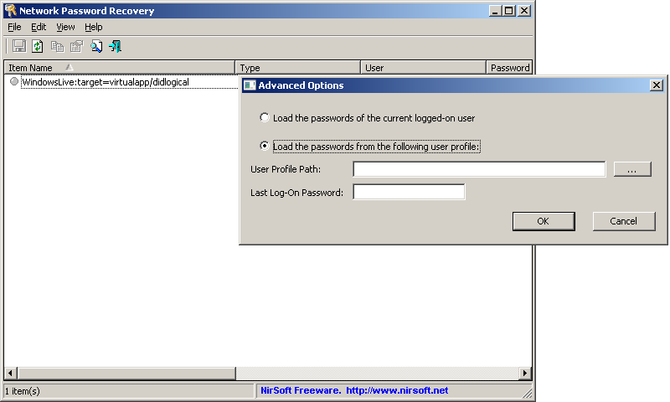
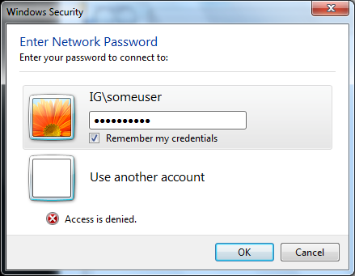
Network Shares
Windows XP/2003: <Profile>\Application Data\Microsoft\Credentials\<User SID>\Credentials and [Windows Profile]\Local Settings\Application Data\Microsoft\Credentials\[User SID]\Credentials
Windows Vista: <Profile>\AppData\Roaming\Microsoft\Credentials\<Random ID> <Profile>\AppData\Local\Microsoft\Credentials\<Random ID>

Slide 43
Wireless Forget cracking it, just look it up!
Based on interface number
Vista/Windows 7 store in: C:\ProgramData\Microsoft\Wlansvc\Profiles\Interfaces
XP in: HKEY_LOCAL_MACHINE\SOFTWARE\Microsoft\WZCSVC\Parameters\Interfaces\<Interface Guid>
They appear to be encrypted, but apparently the key is available to programs with the right privileges
Details obtained from here: http://www.nirsoft.net/utils/wireless_wep_key_faq.html

Slide 44
Other Data

Slide 45
Outlook Cache (if in Cached Exchange Mode)
Find and .OST file in C:\Users\<username>\AppData\Local\Microsoft\Outlook
Open with Kernel OST Viewer http://www.nucleustechnologies.com/download-ost-viewer.php

Slide 46
Outlook 2010 Attachments Temp
Outlook Attachments Temp <Profile>\AppData\Local\Microsoft\Windows\Temporary Internet Files\Content.Outlook
If the item was open when Outlook was closed, it may be here
May have to forcefully browse to this by typing in the path

Slide 47
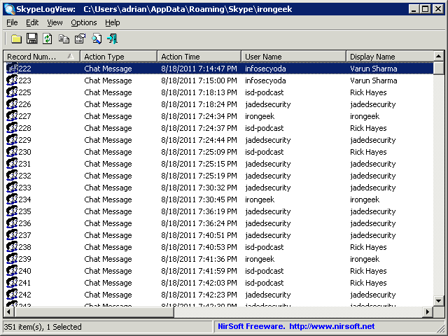
Skypelogs
Database file in: <Profile>\AppData\Roaming\Skype\<Skype ID>

Slide 48
Look in the logs
Windows XP C:\Windows\System32\config in *.evt files
Vista and newer C:\Windows\System32\winevt\Logs in *.evtx files
Did the user type the name in the wrong place? http://www.irongeek.com/i.php?page=security/pebkac-attack-passwords-in-logs

Slide 49
Printer Spool
Sometimes a print job will get stuck here, and we all know what useful information people sometimes print.
Location: C:\Windows\System32\spool\PRINTERS
Try some of the tool listed at the bottom of this page: http://www.undocprint.org/formats/winspool/spl
O&K Printer Viewer and LBV SPLViewer recommended

Slide 50
So many others…
Internet Explorer History <profile>\AppData\Local\Microsoft\Windows\History
IE Cookies <profile>\AppData\Roaming\Microsoft\Windows\Cookies
Firefox Cached Pages <profile>\AppData\Local\Mozilla\Firefox\Profiles\<some profile number>.default\Cache
Firefox Form History File <profile>\ AppData\Roaming\Mozilla\Firefox\Profiles\<some profile number>.default\formhistory.sqlite
Firefox Cookies <profile>\AppData\Roaming\Mozilla\Firefox\Profiles\<some profile number>.default\cookies.sqlite

Slide 51
A word on automation
Look at using an autorun payload off of a U3
Video on Russell Butturini’s payload: http://www.irongeek.com/i.php?page=videos/incident-response-u3-switchblade
See this wiki: http://www.hak5.org/w/index.php/USB_Hacksaw

Slide 52
Other Resources: Videos
Making Windows 7 SP1 32/64bit Boot CD/DVD/USBs with Winbuilder Video http://www.irongeek.com/i.php?page=videos/oisf-2011#Making_Windows_7_SP1_32/64bit_Boot_CD/DVD/USBs_with_Winbuilder
Password Exploitation Class Video http://www.irongeek.com/i.php?page=videos/password-exploitation-class
Portable Boot Devices (USB/CD/DVD):Or in Canadian, what is this all aboot? http://www.irongeek.com/i.php?page=videos/portable-boot-devices-usb-cd-dvd

Slide 53
Other Resources
Forensically interesting spots in the Windows 7, Vista and XP file system and registry http://www.irongeek.com/i.php?page=security/windows-forensics-registry-and-file-system-spots
Building a boot USB, DVD or CD based on Windows 7 with WinBuilder and Win7PE SE Tutorial http://www.irongeek.com/i.php?page=security/winbuilder-win7pe-se-tutorial
Mubix's Windows Post Exploitation List https://docs.google.com/document/d/1U10isynOpQtrIK6ChuReu-K1WHTJm4fgG3joiuz43rw/edit?hl=en_US
Mubix's Linux Post Exploitation https://docs.google.com/document/d/1ObQB6hmVvRPCgPTRZM5NMH034VDM-1N-EWPRz2770K4/edit?hl=en_US

Slide 54
Events
Louisville Infosec http://www.louisvilleinfosec.com/
DerbyCon 2011, Louisville Ky http://derbycon.com/
So many others http://hack3rcon.org/ http://skydogcon.com http://phreaknic.info http://notacon.org/ http://www.outerz0ne.org/
Notes:
Beg for hardware donations. ☺

Slide 55
Questions?
42

