Slide 1
More PHUKD Than Ever
Programmable Hid USB Keyboard/Mouse Dongle
Adrian Crenshaw

Slide 2

About Adrian
I run Irongeek.com
I have an interest in InfoSec education
I don’t know everything - I’m just a geek with time on my hands
I’m an (Ir)regular on the InfoSec Daily Podcast: http://isdpodcast.com
Co-Founder of Derbycon
Twitter: @Irongeek_ADC
Notes:
Take a note from Johnny Long’s book, and Bruce Potter’s book.

Slide 3
Refresher on the PHUKD
If you’ve seen the last PHUKD talk, go get yourself a beer and bring Adrian some mead

Slide 4

First, a little story
I was given a device called a Phantom Keystroker as a speaker’s gift for doing a FireSide talk at Shmoocon 2010
The Keystroker was meant to annoy someone by sending keystrokes and mouse movements to their computer
But, what if it was programmable?

Slide 5
Why would you want a programmable keystroke device?
Likely types faster than you can, without errors
Works even if U3 autorun is turned off
Draws less attention than sitting down in front of the terminal would. The person turns their head for a minute, the pen-tester plugs in their programmable USB key stroke dongle, and Bobs your uncle, instant pwnage.
Can also be set to go off on a timer when you know a target will be logged in
Just use your imagination!

Slide 6
What sort of commands would you want to issue?
Add a user
Run a program
Copy files to your thumbdrive for later retrieval
Upload local files
Download and install apps
Go to a website they have a cookie/session for, and do a sort of CSRF (sic)

Slide 7
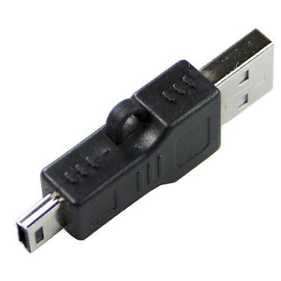

Other ideas
Embed a hub and storage in better packaging
http://www.dealextreme.com/details.dx/sku.2704~r.48687660
Leave it around in a thumb drive package for unsuspecting people to pick up and use
Trojaned Hardware: Use a timer or sensor and embed it in another device you give to the target as a “gift“
Have it “wake up”, mount onboard storage, run a program that covers what it is doing (fake BSOD for example), does its thing, then stops (leaving the target to think “it’s just one of those things”)
Default BIOs password brute forcing?

Slide 8
Ok, we have some names, now how would we build one?
Did some Googling…
Found some limited items…
Then I found…

Slide 9
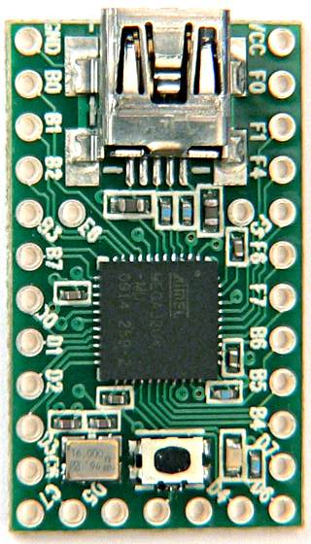
The Teensy
Teensy 2.0 is 1.2 by 0.7 inch
AVR processor, 16 MHz
Programmable over Mini USB in C or Arduino dev package
$16 to $27
USB HID Support!!!
http://www.pjrc.com/teensy/

Slide 10
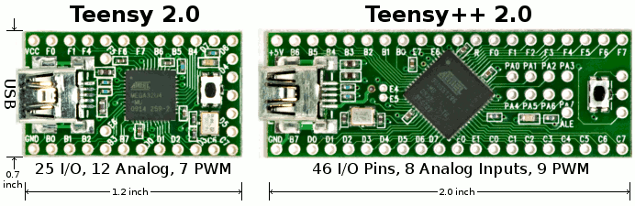
More detailed Specs
Specification | Teensy 2.0 | Teensy++ 2.0
Processor | ATMEGA32U4 | AT90USB1286
Flash Memory | 32256 | 130048
RAM Memory | 2560 | 8192
EEPROM | 1024 | 4096
I/O | 25 | 46
Analog In | 12 | 8
PWM | 7 | 9
UART,I2C,SPI | 1,1,1 | 1,1,1
Price | $16 | $24

Slide 11
Setup Development Environment
Get the following files and install in this order (I assume you already have a working Java RE)
  Arduino Dev Package
  http://arduino.cc/en/Main/Software
  Teensyduino and the serial drivers
  http://www.pjrc.com/teensy/td_download.html
  Teensy Loader
  http://www.pjrc.com/teensy/loader.html
  PHUKD Library
  http://www.irongeek.com/i.php?page=security/programmable-hid-usb-keystroke-dongle
Put the Phuked folder in the \arduino-0022\libraries directory
Set the board type

Slide 12
A few tips before we code
Beware of the Teensy writing over your code
Hold down the tiny pushbutton as you plug it in to avoid running the current program on the Teensy
Really need to check out:
http://www.pjrc.com/teensy/teensyduino.html

Slide 13
PHUKD Library
CommandAtRunBarX(char *SomeCommand) Opens a run bar/terminal and executes the given command.
ShrinkCurWinX()
Shrinks the active window to help hide it.
PressAndRelease(int KeyCode, int KeyCount)
This function simplifies the pressing and releasing of a key. You can also specify how many times to hit the key (really useful for tabbing to where you need to be on web sites).

Slide 14
PHUKD Library
ShowDiag()
Just sends diagnostic info out the keyboard interface. Things like the reading on analog pin 0, and the state of each input. Should work on both types of Teensy, but I've not done a lot of testing.
DIPOptions
Not really a function, but a string you can set in your sketch that ShowDiag will print out. I kept forgetting which DIP switch I had set to run which function, so I use this as a reminder at runtime.

Slide 15
PHUKD Library
int ledkeys(void)
ledkeys returns the setting of the "lock keys“
Num Lock = 1
CAPS Lock = 2
Scroll Lock = 4
Add them together to get combos.
boolean IsNumbOn(void)
Returns TRUE if NUM Lock LED is on and FALSE otherwise.
boolean IsCapsOn(void)
Returns TRUE if Caps Lock LED is on and FALSE otherwise.
boolean IsScrlOn(void)
Returns TRUE if Scroll Lock LED is on and FALSE otherwise.

Slide 16
Let’s show a little basic electronics

Slide 17

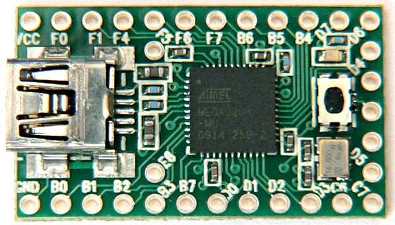



Butt Ugly Schematic
Photoresistor that is above 10K Ω in the dark, and less than 10K Ω in the light
USB
Connector
10K Ω Resistor
DIP Switches
Common Ground
Please note that the Teensy can use internal pullup resistors

Slide 18
How Analog Input Works
It’s All About Ohms Law
As the resistance of the Photoresistor drops (with brighter light), the resistor drops more of the voltage.
1023 = 5v, 0 = 0v (in a perfect world)
Photoresistor that is above 10K Ω in the dark, and less than 10K Ω in the light
10K Ω Resistor
Common Ground
+5v

Slide 19

What is a pull up resistor?
You don’t want a floating, indeterminate input
Which is a stronger connection, ground or VCC?
You can do it in code on the Teensy
Pull Down Resistor
Pull Up Resistor
Input
10K Ω Resistor
10K Ω Resistor
Input
+5v
Common Ground
+5v
Common Ground

Slide 20
More developers working on stuff like this
Powershell...omfg
David Kennedy (ReL1K)
Josh Kelley (Winfang)
Rubber Ducky
Robin Wood
Darren Kitchen
Others
Brad Bowers
Monta Elkins
Richard Rushing

Slide 21
Keylogger
(Ok, come back now)
Hey! Where is my mead?

Slide 22
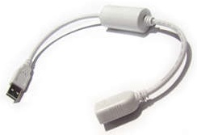

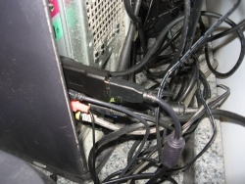
Hardware keyloggers
Hardware keyloggers are fairly simple devices conceptually
Essentially they are installed between the keyboard and the computer, and then log all of the keystrokes that they intercept to their onboard flash memory
A snooper can then come along later to pick up the key logger and extract the captured data (passwords, documents, activity, etc.)

Slide 23
Markets
Writer
(yeah, right)
Businesses monitoring employees
Parents monitoring children
(More likely spouses monitoring each other)
Pen-testers/Crackers/Spies

Slide 24
Pros/Cons
Pros
  Hardware keyloggers are not likely to be detected by anti-malware apps
  Logs keystrokes even before OS boots (Think BIOS Passwords)
  OS Independent
Cons
  Physical access
  Little information about target app receiving keystrokes
  Expensive
  If found, easy to remove

Slide 25
PHUKD + Keylogger?

Slide 26
Objective: Combining Keyloggers and Programmable HIDs
Log all the keys using a MicroSD card
Vary payloads based on keystrokes
Log username/password and use them later
Screw with the person who is typing
Flexible hobbyist platform to add new functionality
  WiFi
  Bluetooth
  Ethernet

Slide 27
Problems that will be solved
Making the hardware reliably with different keyboard makes and models.
Packaging. For this project I will mostly be bread boarding the circuits, but eventually I would need to come up with more surreptitious packaging.
Keeping the costs low.

Slide 28
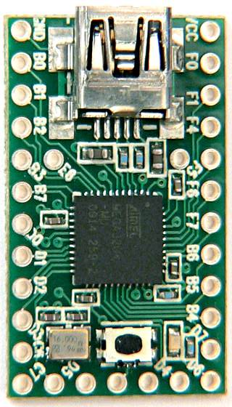
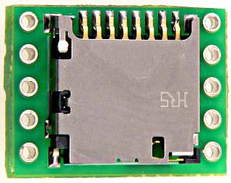
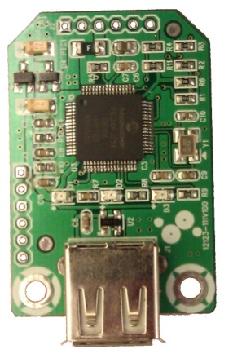
Parts
Teensy ($16)
http://pjrc.com/store/teensy.html
PS/2 Female Cable (Free?)
(Cut it off a KVM cable or something)
SD Adapter ($8)
http://pjrc.com/store/sd_adaptor.html
USB Host Adapter ($14.90)
http://www.sure-electronics.com/goods.php?id=1140

Slide 29
Libraries
PHUKD Library
http://www.irongeek.com/i.php?page=security/programmable-hid-usb-keystroke-dongle#Programming_examples_and_my_PHUKD_library
Teensy PS/2 Library (I have my own mod of this)
http://www.pjrc.com/teensy/td_libs_PS2Keyboard.html
SDFat16Lib
http://code.google.com/p/sdfatlib/

Slide 30
PS/2 Keylogger
Going old school!

Slide 31
PS/2 Scan Codes
Scan Codes read from the PS/2 Connection
Defined in the Teensy PS/2 Library with #Defines and Arrays
Have to translate to USB, which makes things tougher
Key | Code | Release
A | 1C | F0, 1C
B | 32 | F0, 32
C | 21 | F0, 21
D | 23 | F0, 23
E | 24 | F0, 24
F | 2B | F0, 2B
G | 34 | F0, 34

Slide 32
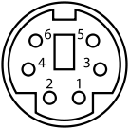
PS/2 Keylogger
+CLK/IRQ
+DATA
Pin 1 | +DATA | Data
Pin 2 | Not connected | Not connected*
Pin 3 | GND | Ground
Pin 4 | VCC | +5 V DC at 275 mA
Pin 5 | +CLK | Clock
Pin 6 | Not connected | Not connected**
Info and PS/2 pic from Wikipedia

Slide 33
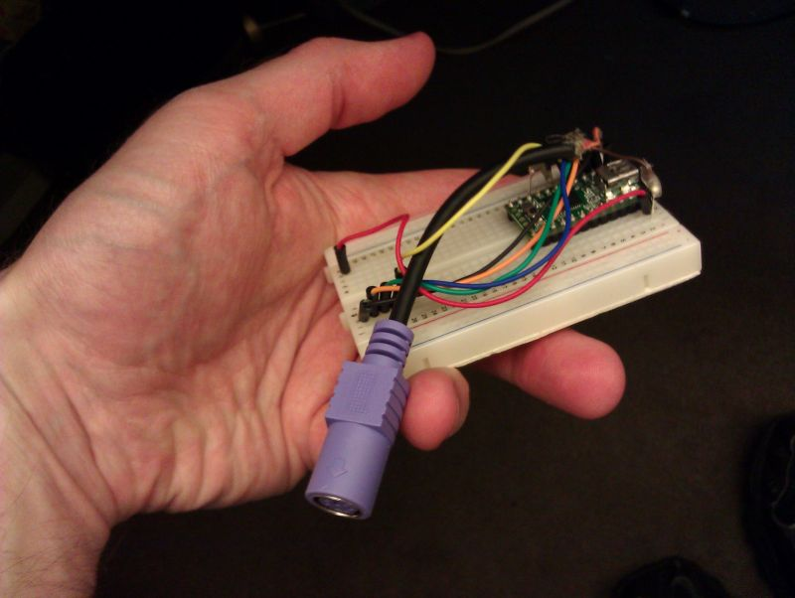
PS/2 Keylogger Code and Demo

Slide 34
USB Keylogger
User Recording Programmable HID USB Keyboard Dongle
=
UR PHUKD

Slide 35
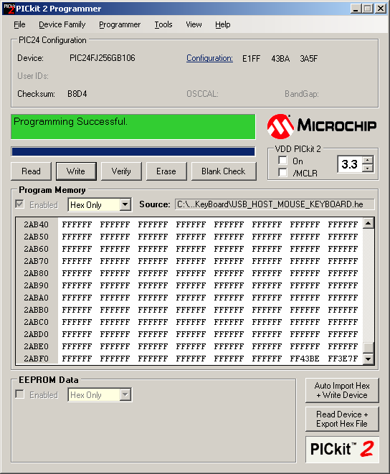
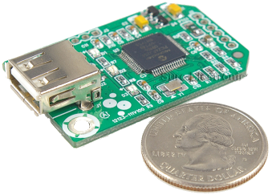
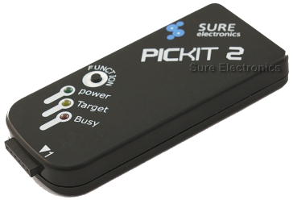
Programming: What you will need
We will need something to program it with
PICKit 2 Programmer (clone)
http://www.sureelectronics.net/goods.php?id=21
PICkit 2 Development Programmer/Debugger Official Software
http://www.microchip.com/stellent/idcplg?IdcService=SS_GET_PAGE&nodeId=1406&dDocName=en023805
MPLAB IDE X Beta 7.02MPLAB C30 Lite Compiler for dsPIC DSCs
and PIC24 MCUs (Use lite options)
http://www.microchip.com/en_us/family/mplabx/index.html

Slide 36

USB Keylogger
RX on USB Module to TX on Teensy
TX on USB Module to RX on Teensy

Slide 37
Getting the source…
Had to get Sure Electronics
to send me the source
Took some convincing
Your mostly on your own
for support
Code and HEX files
http://www.sure-electronics.net/download/index.php?name=MB-CM13111&type=0
HID: Raw Report 00-00-13-00-00-00-00-00-
p
HID: Raw Report 00-00-13-00-00-00-00-00-
p
HID: Raw Report 00-00-13-00-00-00-00-00-
p
HID: Raw Report 00-00-13-00-00-00-00-00-
p

Slide 38
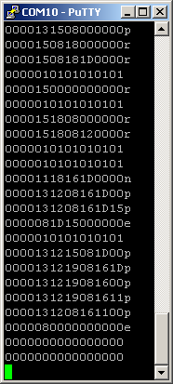
USB To Serial To USB
HID Keyboard Reports
Key(s) | Code
a | 0000040000000000
Left Ctrl+Shift+Alt | 0700000000000000
Right Ctrl+Shift+Alt | 7000000000000000
a+b+c | 0000050406000000

Slide 39
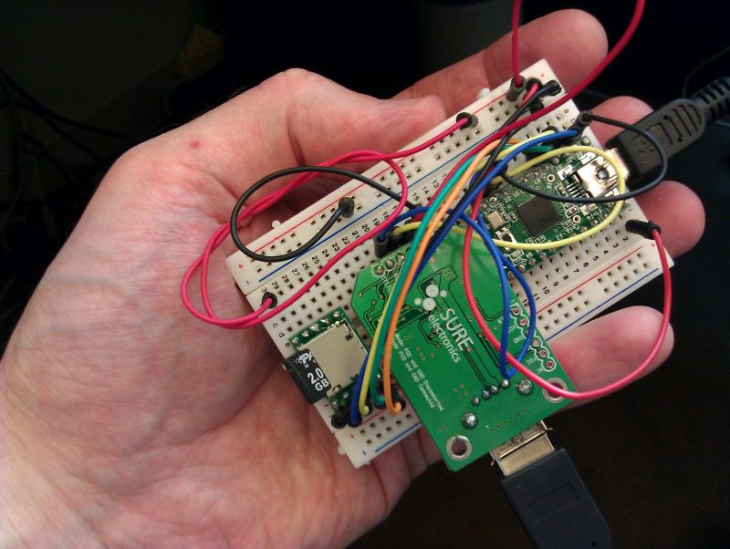
USB Keylogger Code and Demo

Slide 40
More Ideas
Arduino community supports so many peripherals, what might be possible?
Wireless keylogger?
Ethernet Keylogger?

Slide 41
Current URPHUKD Problems
Not passive
If the keyboard has a hub in it, it won’t work with the keylogger
Kind of hard to package it smaller
Got some hardware coming soon that may help this

Slide 42
Useful Tools/Links
Homemade Keylogger/PHUKD Hybrid
http://www.irongeek.com/i.php?page=security/homemade-hardware-keylogger-phukd
PHUKD Project site
http://www.irongeek.com/i.php?page=security/programmable-hid-usb-keystroke-dongle
Paul’s Teensyduino Docs
http://www.pjrc.com/teensy/teensyduino.html
USBDeview
http://www.nirsoft.net/utils/usb_devices_view.html
Reg From App
http://www.nirsoft.net/utils/reg_file_from_application.html
HAK5’s Rubber Ducky Forum
http://www.hak5.org/forums/index.php?showforum=56

Slide 43
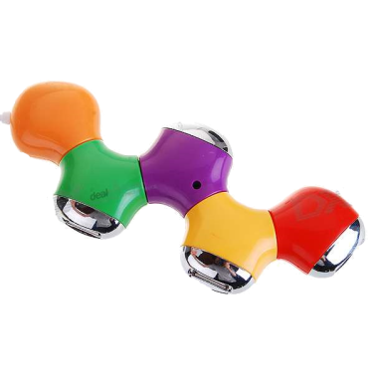
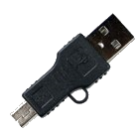
Sources for more parts
Teensy
http://www.pjrc.com/teensy/
Sure Electronics
http://www.sure-electronics.com/
Ebay
http://www.ebay.com/
Photoresistors and other small parts
http://www.bgmicro.com
http://www.mouser.com
LEDs
http://www.ledshoppe.com/
Other stuff
Small USB A to Mini USB
http://www.dealextreme.com/details.dx/sku.2704~r.48687660
Small HUB
http://www.dealextreme.com/details.dx/sku.30564~r.48687660

Slide 44
Events
Derbycon
http://www.derbycon.com
Louisville Infosec
http://www.louisvilleinfosec.com
Others
http://skydogcon.com
http://hack3rcon.org
http://phreaknic.info
http://notacon.org
http://outerz0ne.org
Notes:
Beg for hardware donations. ☺

Slide 45

theNurse
Brad "theNurse" Smith donation page: http://www.social-engineer.org/bradsmithdonation/
Medical status page:
http://www.social-engineer.org/brad-smith-updates/

Slide 46
Questions?
42
Twitter: @Irongeek_ADC

