Slide 1


Tor and I2P Workshop
Adrian Crenshaw

Slide 2


About Adrian
I run Irongeek.com
I have an interest in InfoSec education
I don’t know everything - I’m just a geek with time on my hands
Sr. Information Security Engineer at a Fortune 1000
Co-Founder of Derbycon
http://www.derbycon.com
Twitter: @Irongeek_ADC
Notes:
Take a note from Johnny Long’s book, and Bruce Potter’s book.

Slide 3
Perspective and General Warnings
I will be taking two perspectives
  People trying to stay anonymous
  People trying to de-anonymize users
I’m not really a privacy guy
IANAL
Be careful where you surf, contraband awaits

Slide 4
Part 0:
Basics of how Tor and I2P work

Slide 5
A little background…
Darknets
There are many definitions, but mine is “anonymizing private networks ”
Use of encryption and proxies (some times other peers) to obfuscate who is communicating to whom
Sometimes referred to as Cipherspace
(love that term)

Slide 6
Tor
The Onion Router

Slide 7
Overview
Who?
First the US Naval Research Laboratory, then the EFF and now the Tor Project (501c3 non-profit).
http://www.torproject.org/
Why?
“Tor is free software and an open network that helps you defend against a form of network surveillance that threatens personal freedom and privacy, confidential business activities and relationships, and state security known as traffic analysis.” ~ As defined by their site
What?
Access normal Internet sites anonymously, and Tor hidden services.
How?
Locally run SOCKS proxy that connects to the Tor network.

Slide 8
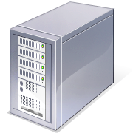


Tor: The Onion Router
Layered encryption
Bi-directional tunnels
Has directory servers
Mostly focused on out proxying to the Internet
More info at https://www.torproject.org
Internet Server
Directory Server

Slide 9



Layers like an Ogre

Slide 10
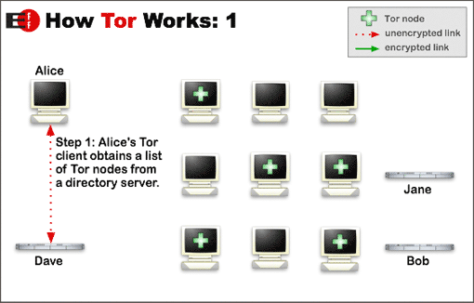
Layout to connect to Internet
Image from http://www.torproject.org/overview.html.en

Slide 11
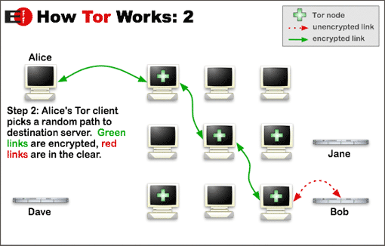
Layout to connect to Internet
Image from http://www.torproject.org/overview.html.en

Slide 12
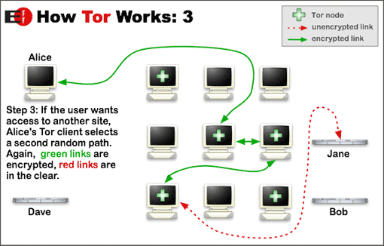
Layout to connect to Internet
Image from http://www.torproject.org/overview.html.en

Slide 13
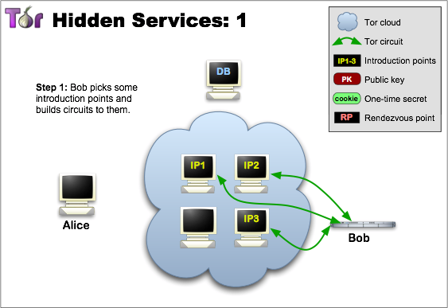
Layout to connect to Hidden Sevice
Image from http://www.torproject.org/hidden-services.html.en

Slide 14
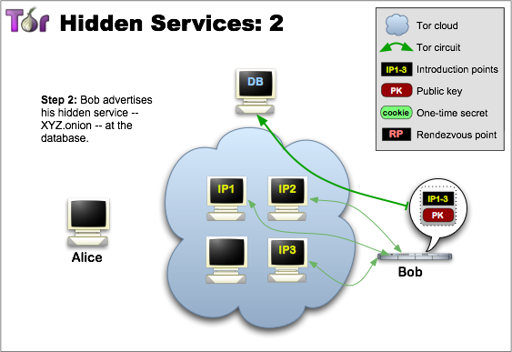
Layout to connect to Hidden Sevice
Image from http://www.torproject.org/hidden-services.html.en

Slide 15
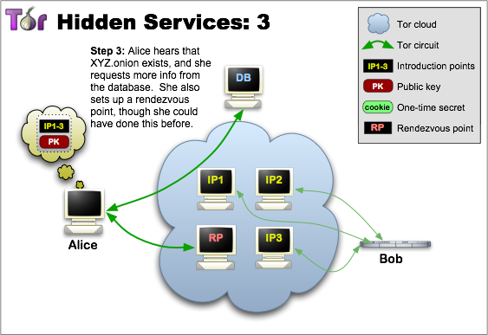
Layout to connect to Hidden Sevice
Image from http://www.torproject.org/hidden-services.html.en

Slide 16
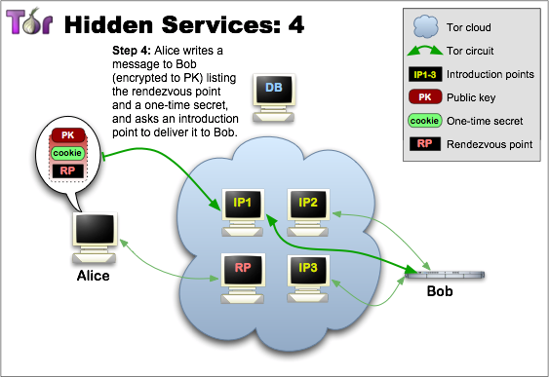
Layout to connect to Hidden Sevice
Image from http://www.torproject.org/hidden-services.html.en

Slide 17
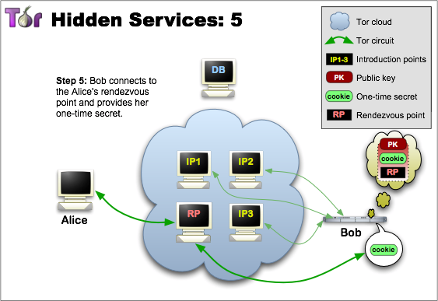
Layout to connect to Hidden Sevice
Image from http://www.torproject.org/hidden-services.html.en

Slide 18
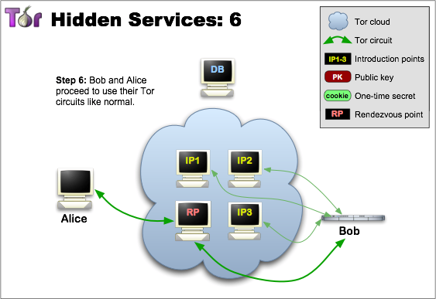
Layout to connect to Hidden Sevice
Image from http://www.torproject.org/hidden-services.html.en

Slide 19
Node types
Client
Just a user
Relays
These relay traffic, and can act as exit points
Bridges
Relays not advertised in the directory servers, so harder to block
Guard Nodes
Used to mitigate some traffic analysis attacks
Introduction Points
Helpers in making connections to hidden services
Rendezvous Point
Used for relaying/establishing connections to hidden services

Slide 20
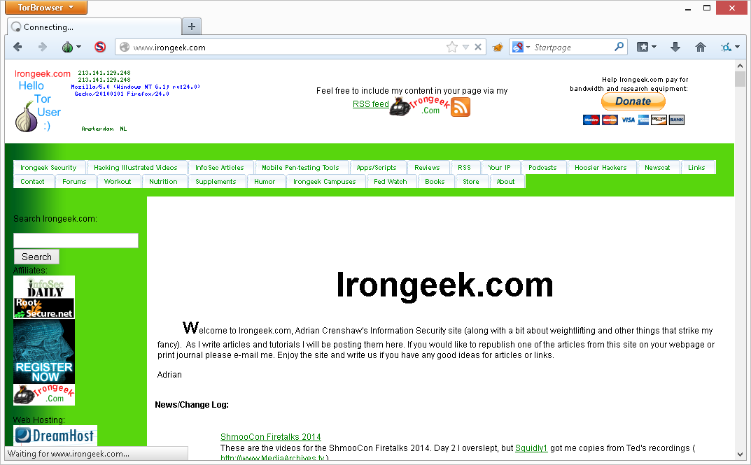
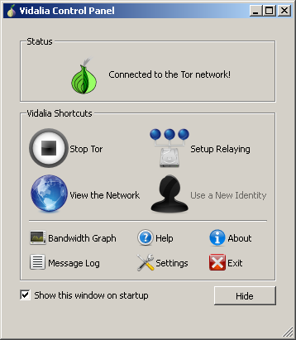
What does it look like to the user?

Slide 21
Applications/Sites
Tails: The Amnesic Incognito Live System
https://tails.boum.org/
Tor2Web Proxy
http://tor2web.org
Tor Hidden Wiki:
http://kpvz7ki2v5agwt35.onion
Scallion (make host names)
https://github.com/lachesis/scallion
Onion Cat
http://www.cypherpunk.at/onioncat/
Reddit Onions
http://www.reddit.com/r/onions

Slide 22
Tor Pros and Cons
Pros
If you can tunnel it through a SOCKS proxy, you can make just about any protocol work.
Three levels of proxying, each node not knowing the one before last, makes things very anonymous.
Cons
Slow
Do you trust your exit node?
Semi-fixed Infrastructure:
Sept 25th 2009, Great Firewall of China blocks 80% of Tor relays listed in the Directory, but all hail bridges!!!
https://blog.torproject.org/blog/tor-partially-blocked-china
http://yro.slashdot.org/story/09/10/15/1910229/China-Strangles-Tor-Ahead-of-National-Day
Fairly easy to tell someone is using it from the server side
http://www.irongeek.com/i.php?page=security/detect-tor-exit-node-in-php

Slide 23
What does the traffic look like?
(Keep in mind, this is just the defaults)
Local
9050/tcp Tor SOCKS proxy
9051/tcp Tor control port
(9150 and 9151 on Tor Browser Bundle)
Remote
443/tcp and 80/tcp mostly
Servers may also listen on port 9001/tcp, and directory information on 9030.
More details
http://www.irongeek.com/i.php?page=security/detect-tor-exit-node-in-php
http://www.room362.com/tor-the-yin-or-the-yang

Slide 24

I2P
Invisible Internet Project
(in a nutshell)
Especially as compared to Tor

Slide 25
Overview
Who?
I2P developers, started by Jrandom.
http://www.i2p2.de/
Why?
To act as an anonymizing layer on top of the Internet
What?
Mostly other web sites on I2P (eepSites), but the protocol allows for P2P (iMule, i2psnark), anonymous email and public Internet via out proxies.
How?
Locally ran proxies that you can connect to and control via a web browser. These connect other I2P routers via tunnels. Network information is distributed via a DHT know as NetDB.

Slide 26
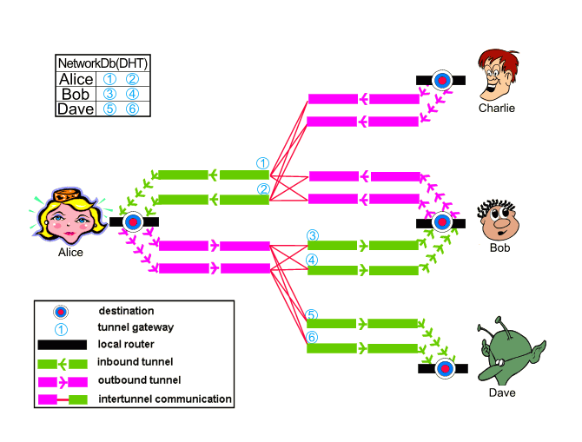
Layout
Image from http://www.i2p2.de/how_intro

Slide 27

I2P: Ins and Outs
Unidirectional connections: In tunnels and out tunnels
Information about network distributed via distributed hash table (netDB)
Layered encryption
Mostly focused on anonymous services
More info at http://www.i2p2.de/

Slide 28



Silly Garlic Routing
Animation
Make a Garlic message to multiple destinations.
Then send it.
Unpack it and send individual cloves to their destinations.
Brian
Calvin
Dave
Adrian

Slide 29
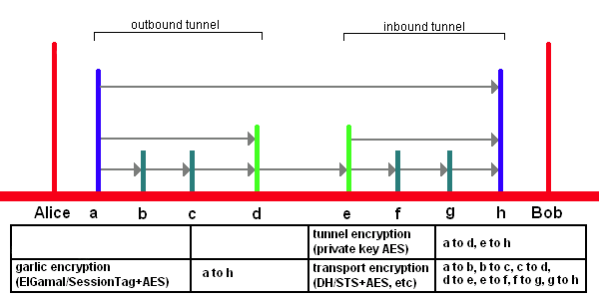
Encryption Layers
EIGamal/SessionTag+AES from A to H
Private Key AES from A to D and E to H
Diffie–Hellman/Station-To-Station protocol + AES
Image from http://www.i2p2.de/

Slide 30
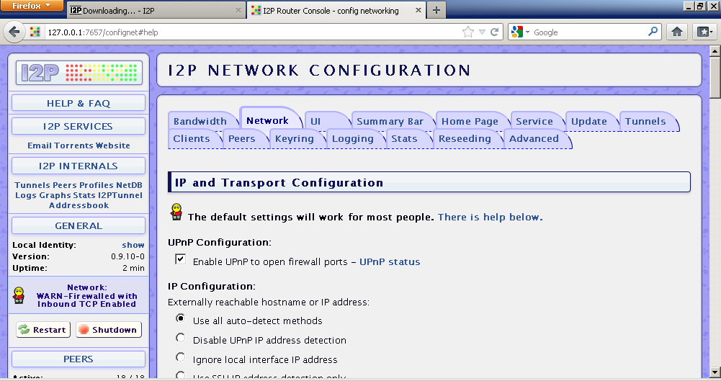
What does it look like to the user?

Slide 31
Naming and Addresses
Details
http://www.i2p2.de/naming.html
516 Character Address
-KR6qyfPWXoN~F3UzzYSMIsaRy4udcRkHu2Dx9syXSzUQXQdi2Af1TV2UMH3PpPuNu-GwrqihwmLSkPFg4fv4y
QQY3E10VeQVuI67dn5vlan3NGMsjqxoXTSHHt7C3nX3szXK90JSoO~tRMDl1xyqtKm94-RpIyNcLXofd0H6b02
683CQIjb-7JiCpDD0zharm6SU54rhdisIUVXpi1xYgg2pKVpssL~KCp7RAGzpt2rSgz~RHFsecqGBeFwJdiko-
6CYW~tcBcigM8ea57LK7JjCFVhOoYTqgk95AG04-hfehnmBtuAFHWklFyFh88x6mS9sbVPvi-am4La0G0jvUJw
9a3wQ67jMr6KWQ~w~bFe~FDqoZqVXl8t88qHPIvXelvWw2Y8EMSF5PJhWw~AZfoWOA5VQVYvcmGzZIEKtFGE7b
gQf3rFtJ2FAtig9XXBsoLisHbJgeVb29Ew5E7bkwxvEe9NYkIqvrKvUAt1i55we0Nkt6xlEdhBqg6xXOyIAAAA
SusiDNS Names
something.i2p
Hosts.txt and Jump Services
Base32 Address
{52 chars}.b32.i2p
rjxwbsw4zjhv4zsplma6jmf5nr24e4ymvvbycd3swgiinbvg7oga.b32.i2p

Slide 32
I2P Pros and Cons
Pros
Lots of supported applications
Can create just about any hidden service if you use SOCKS5 as the client tunnel
Eepsites somewhat faster compared to Tor Hidden Services (Subjective, I know)
No central point of failure
(Example: What happened to Tor when China blocked access to the core directory servers on September 25th 2009)
Cons
Limited out proxies
Sybil attacks a little more likely

Slide 33

How People Got Caught Interlude 0:
Harvard Bomb Threat
Suspect Eldo Kim wanted to get out of a final, so is alleged
to have made a bomb threat on Dec. 16th 2013
Used https://www.guerrillamail.com/ to send email after
connecting over Tor
Guerrilla Mail puts an X-Originating-IP header on that
marked who sent the message, in this case a Tor exit point
All Tor nodes are publicly know (except bridges):
http://torstatus.blutmagie.de/
Easy to correlate who was attached to Harvard network and using Tor at the same time the email was sent (unless you use a bridge).
Lesson Learned: Don’t be the only person using Tor on a monitored network at a given time. Use a bridge? IOW: Correlation attacks are a bitch!
More Details:
http://arstechnica.com/security/2013/12/use-of-tor-helped-fbi-finger-bomb-hoax-suspect/

Slide 34




Correlation of end point and exit point
Client
8MB
Client
Client
Client
5MB

Slide 35
Timing Correlation
I could just watch the timings.
DoS Attack
Client
Or even just change the load on the path.
DoS Attack
DoS outside host to affect traffic.
Client
Pulse the data flows myself.
Client

Slide 36
Part 1:
Installing and getting around in I2P and Tor

Slide 37
Install I2P In Windows
(1A)
1. Make sure you have a JRE 1.5 or higher installed
2. Download I2P Installer for Windows and Linux
http://www.i2p2.de/download
3. Windows: Double click the installer, then Ok, Next, Next, Choose Windows Service, Next, Next, Ok, Next, Next, Done. Tell the installer that it installed correctly.

Slide 38
Install I2P in Linux
(Standard Method)
(1B)
1. Make sure you have a JRE 1.5 or higher installed
2. Download I2P Install for Windows and Linux
http://www.i2p2.de/download
3. Linux: Run
sudo –i
wget http://geti2p.net/en/download/0.9.10/i2pinstall_0.9.10.jar
apt-get install default-jre
java -jar i2pinstall_0.9.10.jar
Tack on –console if needed

Slide 39
Install I2P in Linux (APT Method)
(1C)
Install I2P in Linux (APT Method based on http://www.i2p2.de/debian , this also seems to work well on Raspbian for the Raspberry Pi)
1. Drop to a terminal and edit /etc/apt/sources.list.d/i2p.list, I use nano:
sudo nano /etc/apt/sources.list.d/i2p.list
Add the lines:
deb http://deb.i2p2.no/ stable main
deb-src http://deb.i2p2.no/ stable main
Get the repo key and add it:
wget http://www.i2p2.de/_static/debian-repo.pub
sudo apt-key add debian-repo.pub
sudo apt-add-repository ppa:i2p-maintainers/i2p
sudo apt-get update
sudo apt-get install i2p i2p-keyring
2. Run:
dpkg-reconfigure -plow i2p
Set it to run on boot
3. Web surf to:
http://127.0.0.1:7657/
See link above for more details, or for changes to the process

Slide 40
Run I2P
Windows:
Run it from the menu
Linux:
./i2pbin/i2prouter start
Linux Daemon:
service i2p start

Slide 41
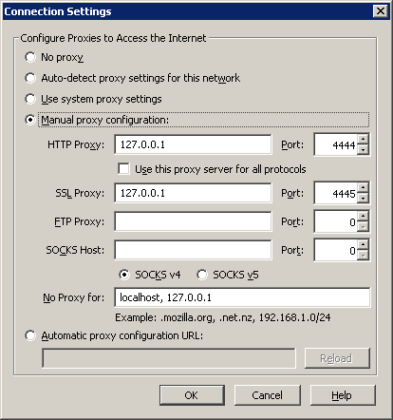
I2P HTTP Proxy Settings
HTTP:
4444
HTTPS:
4445

Slide 42
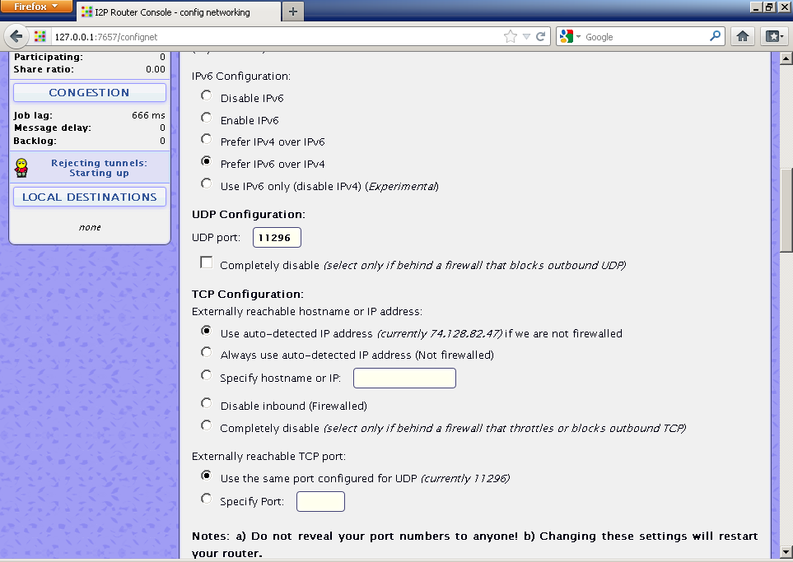
Tweak:
Note bandwidth and port settings

Slide 43
I2P, connection and Firewall settings
(3A)
1. Click “I2P Internals” (http://127.0.0.1:7657/config) and look around.
2. Scroll down and note UDP Port.
3. By default, TCP port will be the same number.
4. Adjust your firewall accordingly, but this varies.

Slide 44
Proxy Settings for I2P
(1D)
Set HTTP proxy to 4444 on local host (127.0.0.1)
SSL to 4445 on local host (127.0.0.1)

Slide 45
Name Service subscripts to add (also show profile path)
(3B)
Go to http://127.0.0.1:7657/dns
and paste in:
http://www.i2p2.i2p/hosts.txt
http://i2host.i2p/cgi-bin/i2hostetag
http://stats.i2p/cgi-bin/newhosts.txt
http://tino.i2p/hosts.txt
http://inr.i2p/export/alive-hosts.txt

Slide 46
Install Tor in Windows
(2A)
1. Grab Tor Browser or Vidalia Bundle
Tor Browser Bundle
https://www.torproject.org/dist/torbrowser/
OR
Tor Vidalia Bundle
https://www.torproject.org/dist/vidalia-bundles/
2. Run and take the defaults, except perhaps the path.

Slide 47
Install Tor in Linux
(2B)
Lots of options
Package manager:
apt-get install vidalia
Then make sure you choose the users that can control Tor, and restart the X server.
Browser Bundle:
https://www.torproject.org/dist/torbrowser/linux
One of many options here:
https://www.torproject.org/download/download-unix

Slide 48
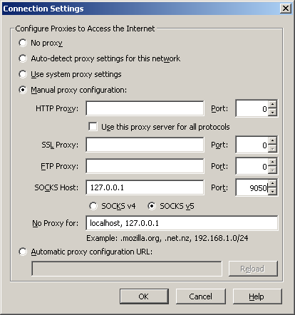
Tor HTTP Proxy Settings
Tor SOCKS5:
9050
If using Tor
browser bundle
the port it 9150

Slide 49
Proxy Settings for Tor
(2C)
Set HTTP and SSL proxy to 9050 on local host (127.0.0.1)
SOCKS v5 to 9050 on local host (127.0.0.1)
If you are using Firefox make sure that you go to about:config and set network.proxy.socks_remote_dns to true

Slide 50
DNS Leaks
Monitored DNS Server
If I don’t use the proxy for DNS, I may send the query to a DNS server. It won’t see my traffic to/from the destination, but may now know I’m visiting someplace.com/.onion/.i2p
DNS
Query

Slide 51
Setup FoxyProxy to use Tor and I2P at the same time
(7)
This assumes you are using the Tor Browser Bundle
1. Search for FoxyProxy or https://addons.mozilla.org/en-US/firefox/addon/foxyproxy-standard/
2. Continue to Download-> Add to Firefox->Allow
3. Restart.
4. Right click FoxyProxy icon, click Options.
5. Edit Default, choose Proxy Details tab, click manually configure, set ip to 127.0.0.1 and port to 9150.
6. Check "SOCKS Proxy?" and radio button "SOCKS5". Click OK.
7. Add proxy. Under General, set a name like "I2P", and a color.
8. Switch to Proxy Details tab. Set IP to 127.0.0.1 (or a remote proxy) and port to 4444.
9. Switch to URL Patterns tab. Add a new pattern, call it I2P and enter *.i2p/* as pattern. OK, OK to get back to proxy list.
10. Add New Proxy. Choose "Direct internet connection".
11. Switch to URL Patterns tab. Make a URL pattern for localhost like http://127.0.0.1:*. Move it to the top of the list.
12. Right click FoxyProxy icon, click "Use Proxies based on their predefined patterns and priorities".

Slide 52


How People Got Caught Interlude 1:
LulzSec
Hector Xavier Monsegur (Sabu) normally used Tor for connecting to IRC but was caught not using it once and FBI found his home IP. After being caught, he started to collaborate.
Hector spoke with Jeremy Hammond (sup_g) on IRC, and Jeremy casually let slip where he had been arrested before and groups he was involved with. This narrowed the suspect pool, so the FBI got a court order to monitor his Internet access.
Hammond used Tor, and while the crypto was never busted, FBI correlated times sup_g was talking to Subu on IRC with when Hammond was at home using his computer.
Lessons Learned: Use Tor consistently. Don’t give personal information. Correlation attacks are still a bitch!
More Details:
http://arstechnica.com/tech-policy/2012/03/stakeout-how-the-fbi-tracked-and-busted-a-chicago-anon/

Slide 53
Places to go
Data to see

Slide 54
Tor Hidden Service Websites
Check if you are using Tor
https://check.torproject.org/?lang=en-US&small=1
Core.onion
http://eqt5g4fuenphqinx.onion
TorDir
http://dppmfxaacucguzpc.onion
Hidden Wiki
http://kpvz7ki2v5agwt35.onion
Onion List
http://jh32yv5zgayyyts3.onion
TorLinks
http://torlinkbgs6aabns.onion
The New Yorker Strong Box
http://tnysbtbxsf356hiy.onion

Slide 55
Tor Hidden Service IRC
FTW
irc://ftwircdwyhghzw4i.onion
Nissehult
irc://nissehqau52b5kuo.onion
Renko
irc://renko743grixe7ob.onion
OFTC
irc://37lnq2veifl4kar7.onion
Gateway to I2P’s IRC?
irc://lqvh3k6jxck6tw7w.onion

Slide 56
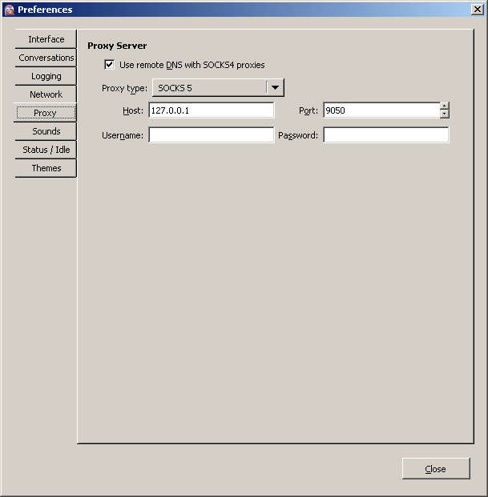
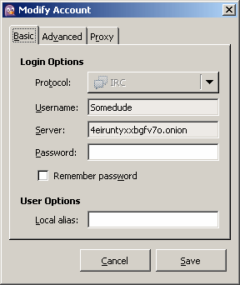
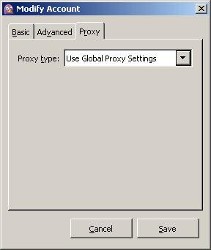
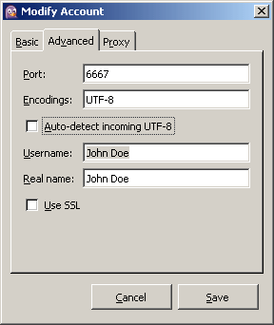
Tor IRC Proxy Settings

Slide 57
Tor IRC
(4A)
1. Set Tools->Preferences-Proxy
Type: SOCKS 5/Host:127.0.0.1/Port 9050
2. Accounts->Manage accounts->add
3. set server without protocol prefix
4. set proxy to use global

Slide 58
Specify an Exit Node in Tor
(4B)
1. View network.
(Vidalia or http://torstatus.blutmagie.de/ )
2. Right click on a node and copy it’s Finger Print.
3. Add this to your torrc and restart Vidalia/Tor
ExitNodes $253DFF1838A2B7782BE7735F74E50090D46CA1BC
Or to do a country
ExitNodes {US}
May have to use
StrictExitNodes 1
To force it to be more than a preference
More options & info at https://www.torproject.org/docs/faq#ChooseEntryExit

Slide 59
Tor Bridges
Bridges are unadvertised Tor entry nodes where there is no complete list
Find them via:
https://bridges.torproject.org
Tor Button->Open Network Settings->My Internet Service Provider (ISP) blocks connections to the Tor network
Enter the bridge string

Slide 60
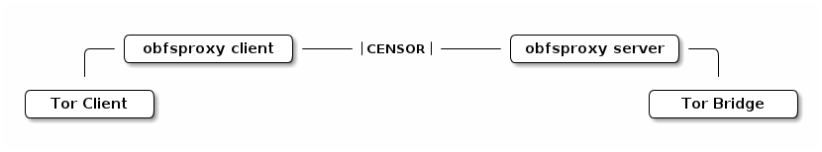
Obfsproxy: Pluggable Transports
Even with bridges and Tor looking mostly like SSL web traffic, packet characteristic's can be keyed on to know it’s Tor using Deep Packet Inspection (DPI)
Answer: Make traffic look like HTTP, Skype, or just breaking up the patterns or normal Tor traffic
Obfsproxy Tor Browser Bundle
https://www.torproject.org/docs/pluggable-transports.html.en#download
Uses obfsproxy bridges
Image from https://www.torproject.org/projects/obfsproxy.html.en

Slide 61
I2P Services/Apps
IRC on 127.0.0.1 port 6668
Syndie
SusiMail
http://127.0.0.1:7657/susimail/susimail
Bittorrent
http://127.0.0.1:7657/i2psnark/
eMule/iMule
http://echelon.i2p/imule/
Tahoe-LAFS
More plugins at http://i2plugins.i2p/

Slide 62
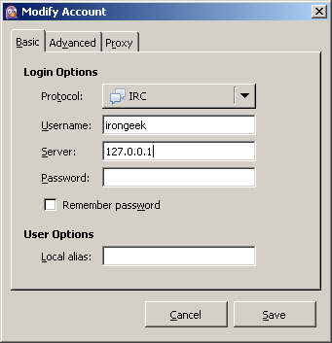
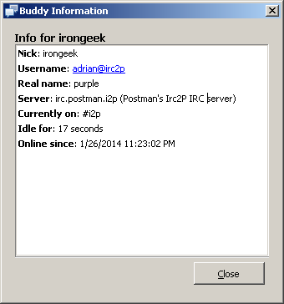
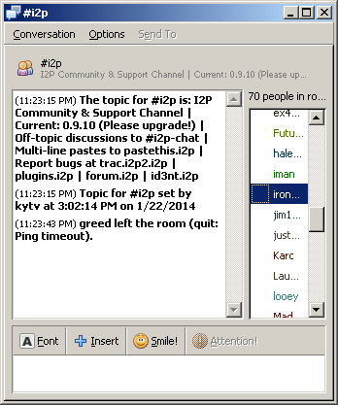
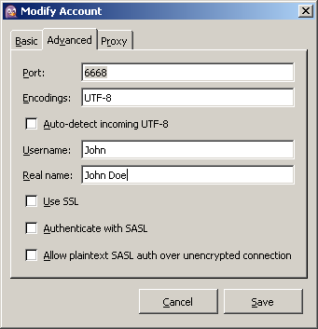
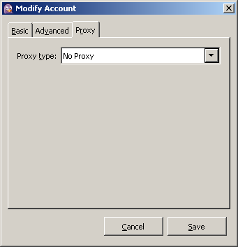
I2P IRC Proxy Settings
Already listening on port 6668/TCP

Slide 63
I2P eepSites
Project site
http://www.i2p2.i2p/
Forums
http://forum.i2p/
http://zzz.i2p/
Ugha's Wiki
http://ugha.i2p/
Search engines
http://eepsites.i2p/
http://search.rus.i2p/
General Network Stats
http://stats.i2p/
Site Lists &Up/Down Stats
http://inproxy.tino.i2p
http://perv.i2p
http://direct.i2p
http://no.i2p
http://inr.i2p
http://identiguy.i2p

Slide 64



How People Got Caught Interlude 2:
Freedom Hosting
Freedom Hosting hosted, amongst other things, many child porn related hidden service websites.
Freedom Hosting had previously come under attack by Anonymous during Op Darknet because of it hosting CP.
In July of 2013, the FBI compromised Freedom Hosting, and inserted malicious Java Script that used Firefox bug CVE-2013-1690 in version 17 ESR. The Tor Browser Bundle is based on Firefox, and the newest version was already patched, but not everyone updates in a timely fashion.
The payload was “Magneto”, which phoned home to servers in Virginia using the hosts public IP. It also reported back the computer’s MAC address, Windows host name, and a unique serial number to tie a user to a site.
An Irish man, Eric Eoin Marques, is alleged to be the operator of Freedom Hosting. The servers hosting Freedom Hosting were tied to him because of payment records.
Marques was said to have dived for his laptop to shut it down when police raided him.
Lessons Learned: Patch, follow the money, leave encrypted laptops in a powered down state.
More Details:
http://www.wired.com/threatlevel/2013/09/freedom-hosting-fbi/

Slide 65
Make hidden server contact you over public Internet
Let’s see if the hidden server app is vulnerable to an exploit (buffer overflow/web app shell exec/etc).
Send a payload that contacts an IP I monitor.
Exploit &
Payload

Slide 66
Part 2:
Hosting Services

Slide 67
To Make I2P accessible to your network
(3C)
1. Click through to I2PTunnel, then the “Name: I2P HTTP Proxy” settings.
2. In the Access Point->Reachable Dropdown, set it to 0.0.0.0 if you wish, but only on a private network.
Could also just edit i2ptunnel.config
3. You could also export the web console to the network and enable a password if you wish:
http://www.i2p2.de/faq.html#remote_webconsole

Slide 68
Make Tor accessible to your network
(4C)
1. Edit your torrc. (/etc/tor/torrc)
2. Add line:
SocksPort 0.0.0.0:9050
3. Restart Tor.

Slide 69
Run I2P as a service in Windows
(3D)
Windows:
Configure it at install time or use
install_i2p_service_winnt.bat
net start i2p
and
uninstall_i2p_service_winnt.bat
from the installed I2P directory.

Slide 70
Run I2P as a service in Ubuntu Linux
(3D)
Linux (Ubuntu):
See https://help.ubuntu.com/community/I2P if you did a normal install.
If you did the APT method above:
1. Edit the default I2P files
gedit /etc/default/i2p
2. Set RUN_DAEMON to "true"
RUN_DAEMON="true"
3. Start the I2P service
service i2p start
4. Make sure /etc/rc5.d/ has a I2P symbolic link in it.

Slide 71
Run Tor as service in Windows
(4D)
Windows:
1. Run:
cd "c:\Program Files\Vidalia Bundle\Tor"
2. Then:
tor -install
3. Other commands for stoping, starting and removing later:
tor -service start
tor -service stop
tor -remove

Slide 72
To make Vidalia work again in Window after making Tor a service
(4E)
1. CD into c:\Program Files\Vidalia Bundle\Tor and run:
tor --hash-password somepassword
Note: This output contains is the hash you will use.
2: Add this to the torrc you will locate in C:\
ControlPort 9051
HashedControlPassword 16:B0AB72FC4E3A30D560A3524C79E7F26CF350A8504E73210426CCBE2373
3. If the service is already installed, run:
tor -remove
4. Not run this to set up your config:
tor -install -options -f C:\torrc ControlPort 9051
5. Now when you start, Vidalia will ask for the password to connect.

Slide 73
Run Tor as service in Ubuntu Linux
(4F)
1. Install Vidalia and dependencies.
2. edit /etc/default/tor.vidalia and set:
RUN_DAEMON="yes”
3. Make sure /etc/rc5.d/ has a Tor symbolic link in it.
4. May have to use
sudo /etc/init.d/tor start
to get it going, but it should start on the next reboot also.

Slide 74
To make Vidalia work again in Linux after making Tor a service
(4G)
1. Edit torrc
nano /etc/tor/torrc
and add
ControlPort 9051
HashedControlPassword 16:B0AB72FC4E3A30D560A3524C79E7F26CF350A8504E73210426CCBE2373
2. then restart the daemon:
/etc/init.d/tor restart

Slide 75
Setting up a Tor Hidden Service
(5A)
1. In Vidalia go to Settings->Services
2. Click the plus symbol and configure Virtual Port, Target and Directory Path. For example:
Virtual Port: 80
Target: 127.0.0.1:80 or just 127.0.0.1
Directory Path: c:\torhs or /home/username/torhs
3. Click ok, then go back into Services to copy out your .onion address.

Slide 76
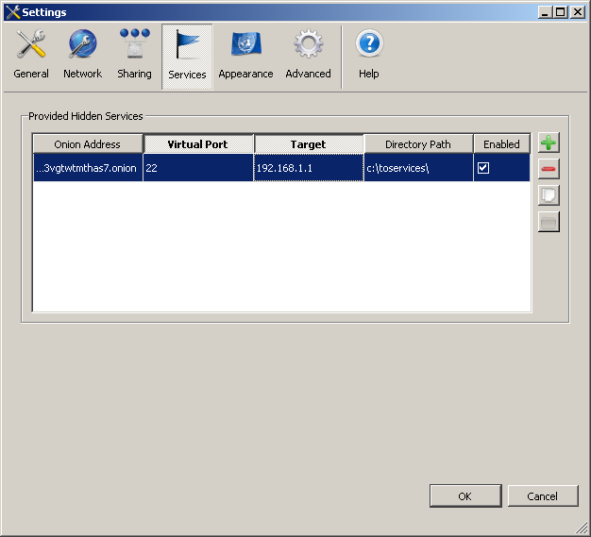
Setting up a Tor Hidden Service
From Vidalia go to Settings->Services

Slide 77
Setting up a Tor Hidden Service
On Linux, edit torrc file:
nano /etc/tor/torrc
Add lines:
HiddenServiceDir /var/lib/tor/other_hidden_service/
HiddenServicePort 80 192.168.1.1:80
Find your host name:
cat /var/lib/tor/other_hidden_service/hostname 3nimxh5oor7m72ig.onion

Slide 78
Using the built in web server (Jetty) I2P Tunnel
(6A)
1. Find the eepsite\docroot folder under your I2P profile (location varies depending on how you installed I2P, see notes at end).
2. Edit the HTML files to your liking.
3. Go into I2P Tunnel (http://127.0.0.1:7657/i2ptunnel/) and start the built in I2P Webserver.
4. When it is up, click the Preview button to see your site and its Base32 address.
5. You may want to enable the “Auto Start(A):” check box.

Slide 79
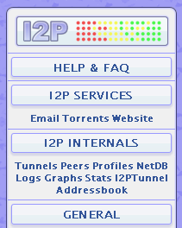
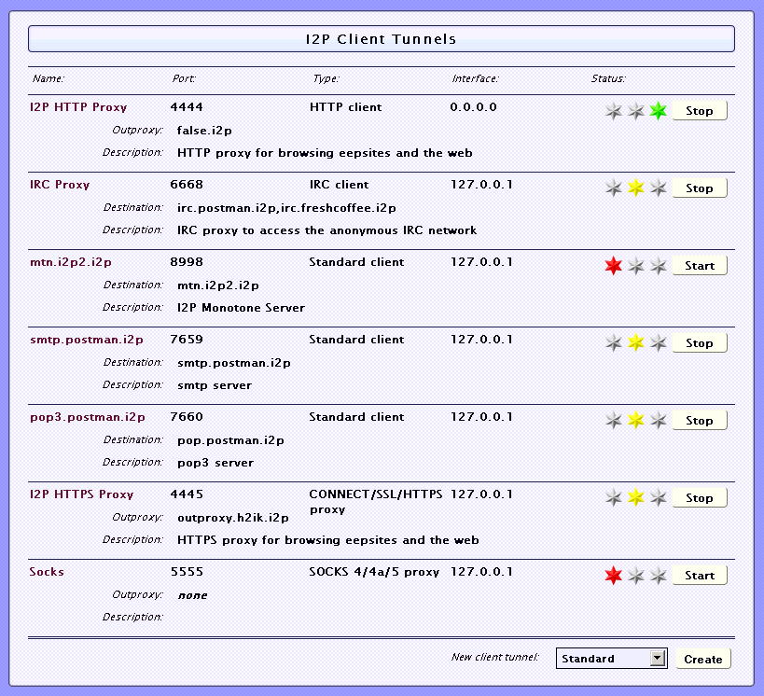
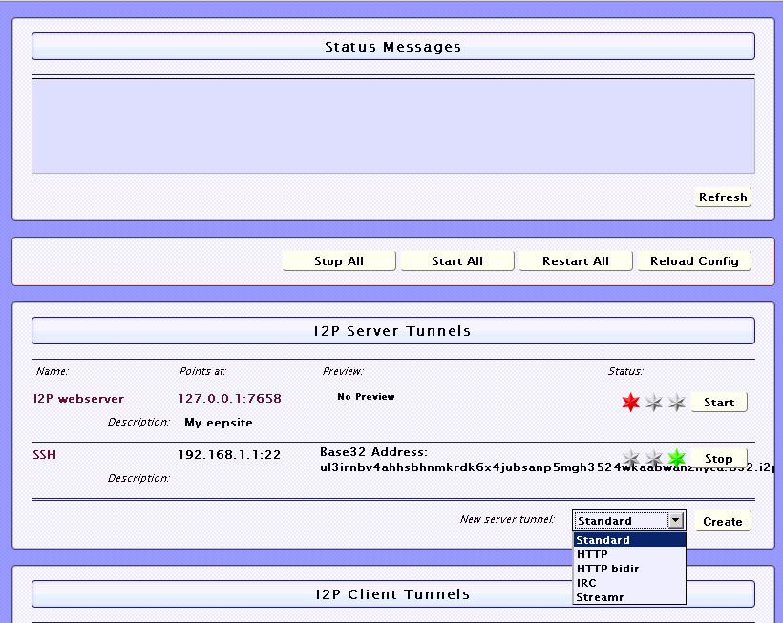
Making I2P Tunnels

Slide 80
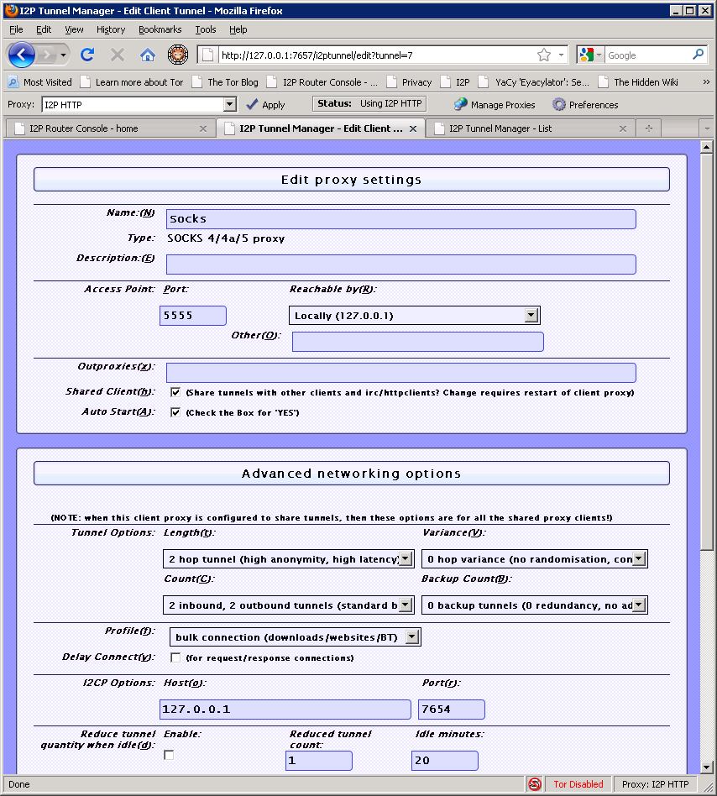
Making I2P Tunnels
Simple SOCKS
client
tunnel

Slide 81
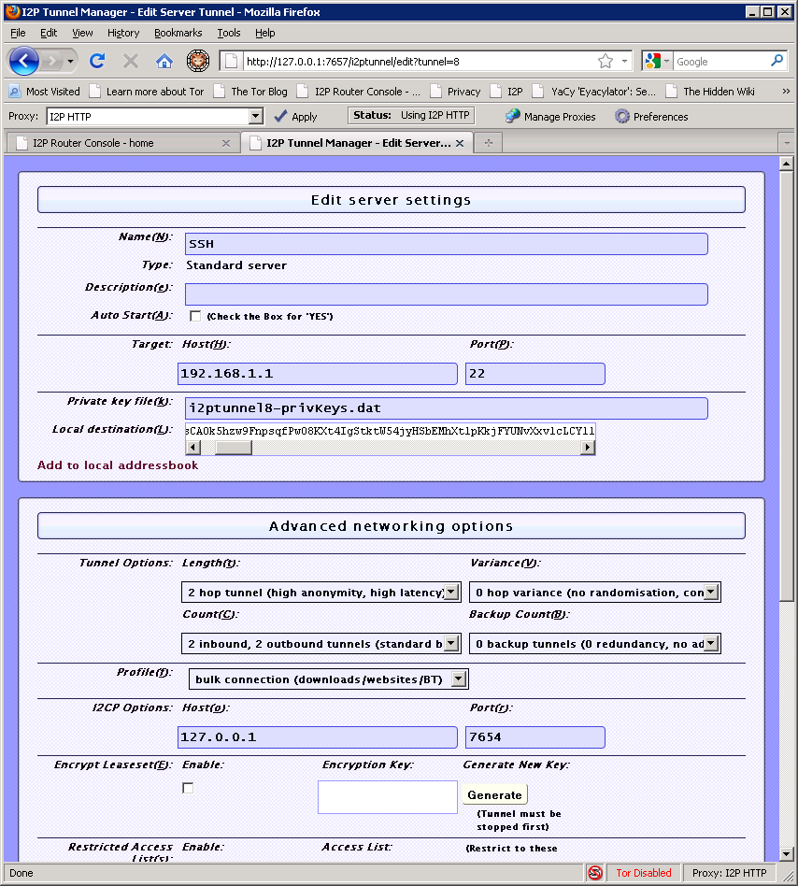
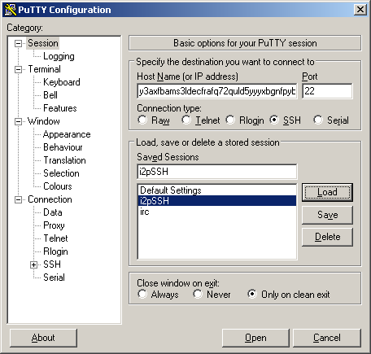
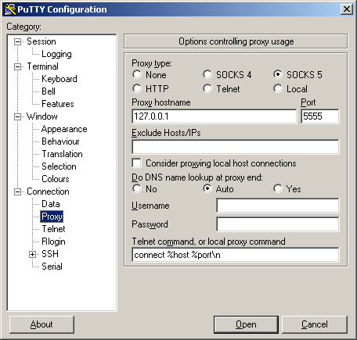
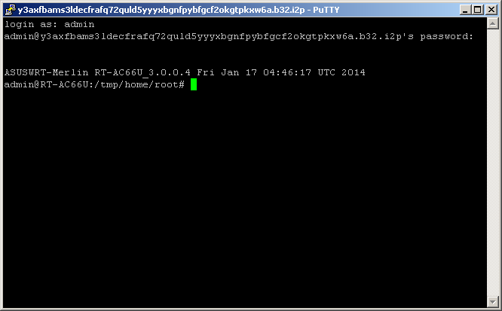
Making I2P Tunnels
SSH Example

Slide 82
Make SSH Server and SOCKS Tunnel
(6B)
1. Make a Standard server tunnel, set target and port.
2. Create client tunnel of type SOCKS 4/4a/5, take defaults other than setting port (I use 5555).
3. In Putty, under connection, set the proxy to 127.0.0.1 on port 5555 and set “Do DNS name lookup at proxy” to yes.

Slide 83
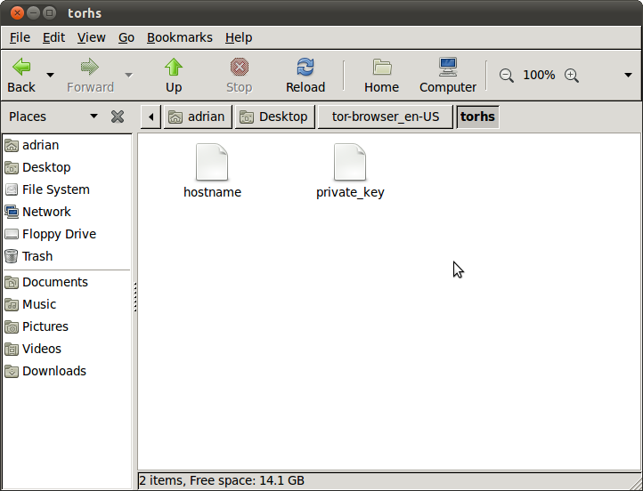
Backing Up Tor Hidden Service Keys
In the relative or absolute path you set

Slide 84
Backing up Tor Hidden Server Key
(5B)
1. In Vidalia go to Settings->Services, and note the location set in “Directory Path:“.
2. In this path you should find two file to backup, hostname and private_key.
3. To restore on a new Tor install you can just copy these files to a new path, and create a Hidden Service that points to the directory they are placed in.

Slide 85
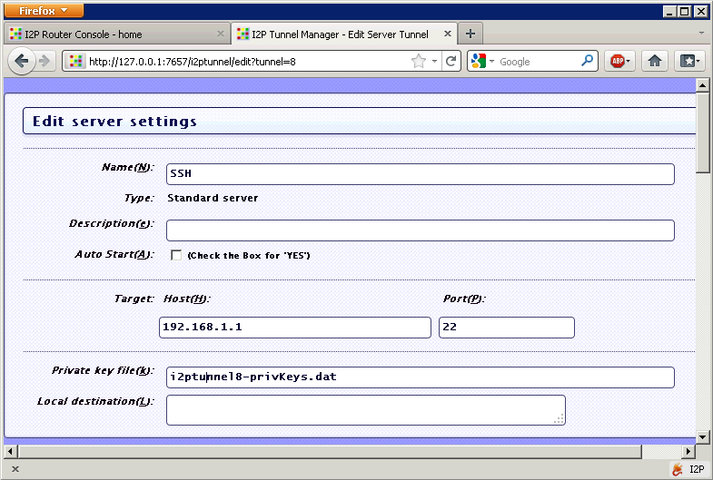
Backing Up I2P Tunnel Key
Notice the file name, relative to I2P’s path
Look in C:\ProgramData\i2p\i2ptunnel-keyBackup or
/var/lib/i2p/i2p-config/i2ptunnel-keyBackup/

Slide 86
Backing up I2P Tunnel Key
(6C)
1. Under a server tunnels settings, note its “Private key file(k)” setting.
2. This is the path, or path relative to the active I2P profile, to the file you need to backup.
3. To restore on a new I2P install you can just copy it to the new install’s profile and make sure the new tunnel’s settings are mapped to it.

Slide 87

How People Got Caught Interlude 3:
SilkRoad
Big thanks to Nate Anderson for the original article.
Ross William Ulbricht is alleged to be “Dread Pirate Roberts”, operator of the SilkRoad, which allows sellers and buyers to exchange less than legal goods and services.
With about $1.2 Billion in exchanges on SilkRoad, FBI wanted to know who was behind it. They started to look for the earliest references to the SilkRoad on the public Internet.
The earliest they could find was from “altoid” on the Shroomery.org forums on 01/27/11.
An account named “altoid” also made a post on Bitcointalk.org about looking for an “IT pro in the bitcoin community” and asked interested parties to contact “rossulbricht at gmail dot com” (10/11/11).
"Ross Ulbricht.” account also posted on StackOverflow asking for help with PHP code to connect to a Tor hidden service. The username was quickly changed to “frosty” (03/16/12).
More Details:
http://arstechnica.com/tech-policy/2013/10/how-the-feds-took-down-the-dread-pirate-roberts/

Slide 88
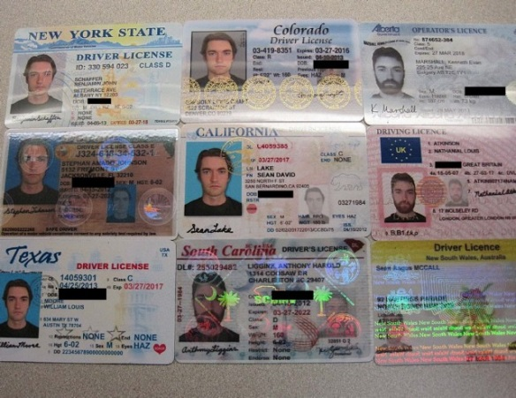
How People Got Caught Interlude 3:
SilkRoad (continued)
On 07/10/13 US Customs intercepted 9 IDs with different names, but all having a picture of Ulbricht. Homeland Security interviewed Ulbricht, but he denied having ordered them. Allegedly he told them anyone could have ordered them from the “Silk Road” using Tor.
FBI starts taking down SilkRoad servers, though I’m are not sure how they were found. Could have been money trail to aliases, or as Nicholas Weaver conjectured, they hacked SilkRoad and made it contact an outsides server without using Tor so it revealed it’s real IP. Once located, FBI was able to get a copy of one of the servers.
Server used SSH and a public key that ended in frosty@frosty. Server also had some of the same code posted on StackOverflow.
Eventually, on 10/02/2013 the FBI Landed on him in a Library right after he entered the password for his laptop. More evidence was found on his laptop.
Lessons Learned: Keep online identities separate, keep different usernames. Don’t volunteer information.
More Details:
http://arstechnica.com/tech-policy/2013/10/how-the-feds-took-down-the-dread-pirate-roberts/

Slide 89
More advanced stuff
Torrify/SocksCap/Tsocks/Torsocks type apps (4H)
  SocksCap/Freecap/Widecap for Windows
OnionCat
http://www.cypherpunk.at/onioncat/
Garlicat
http://www.cypherpunk.at/onioncat/browser/branches/garlicat/Garlicat-HOWTO
Svartkast
http://cryptoanarchy.org/wiki/Blackthrow

Slide 90
Many More Links
Talk on Darknets in general
http://www.irongeek.com/i.php?page=videos/aide-winter-2011#Cipherspace/Darknets:_anonymizing_private_networks
I2P FAQ
http://www.i2p2.de/faq.html
Tor FAQ
https://trac.torproject.org/projects/tor/wiki/doc/TorFAQ
Tor Manual
https://www.torproject.org/docs/tor-manual.html.en
I2P Index to Technical Documentation
http://www.i2p2.de/how

Slide 91
Sites of Mine
My Tor/I2P Notes
http://www.irongeek.com/i.php?page=security/i2p-tor-workshop-notes
Cipherspaces/Darknets An Overview Of Attack Strategies
http://www.irongeek.com/i.php?page=videos/cipherspaces-darknets-an-overview-of-attack-strategies
Anonymous proxy to the normal web
http://www.irongeek.com/i.php?page=videos/tor-1
Hidden services
Normally websites, but can be just about any TCP connection
http://www.irongeek.com/i.php?page=videos/tor-hidden-services

Slide 92

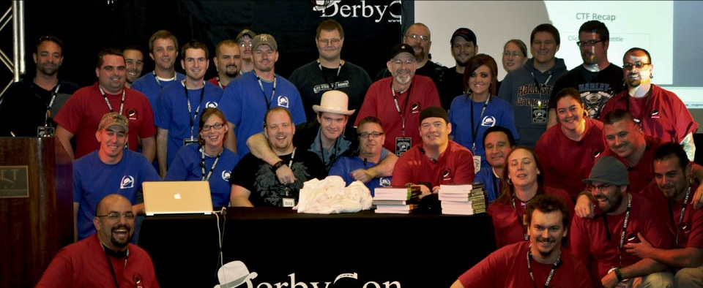
Events
Derbycon
Sept 24th-28th, 2014
http://www.derbycon.com
Others
Derbycon Art Credits to DigiP
Photo Credits to KC (devauto)
http://www.louisvilleinfosec.com
http://skydogcon.com
http://hack3rcon.org
http://outerz0ne.org
http://phreaknic.info
http://notacon.org
Notes:
Beg for hardware donations. ☺

Slide 93
Questions?
42
Twitter: @Irongeek_ADC

