Slide 1

Darknets and hidden servers:
Locating I2P services via Leaks on the Application Layer
Adrian Crenshaw

Slide 2

About Adrian
I run Irongeek.com
I have an interest in InfoSec education
I don’t know everything - I’m just a geek with time on my hands
(ir)Regular on the ISDPodcast
http://www.isd-podcast.com/
Researcher for Tenacity Institute
http://www.tenacitysolutions.com/
Notes:
Take a note from Johnny Long’s book, and Bruce Potter’s book.

Slide 3
Goals
Find items on the application layer that may give away the identity of the operator, or at least reduce their anonymity set
The information above can be used for:
  Making suggestions so as to increase the anonymity of some I do like…
  …And to identify those I don’t
Yes, I know those points are at odds

Slide 4
A little background…
Darknets
There are many definitions, but mine is “anonymizing private networks ”
Use of encryption and proxies (some times other peers) to obfuscate who is communicating to whom

Slide 5

I2P
Invisible Internet Project
(in a nutshell)
Especially as compared to Tor

Slide 6
Overview
Who?
I2P developers, started by Jrandom.
http://www.i2p2.de/
Why?
To act as an anonymizing layer on top of the Internet
What?
Mostly other web sites on I2P (eepSites), but the protocol allows for P2P (iMule, i2psnark), anonymous email and public Internet via out proxies.
How?
Locally ran proxies that you can connect to and control via a web browser. These connect other I2P routers via tunnels. Network information is distributed via a DHT know as NetDB.

Slide 7
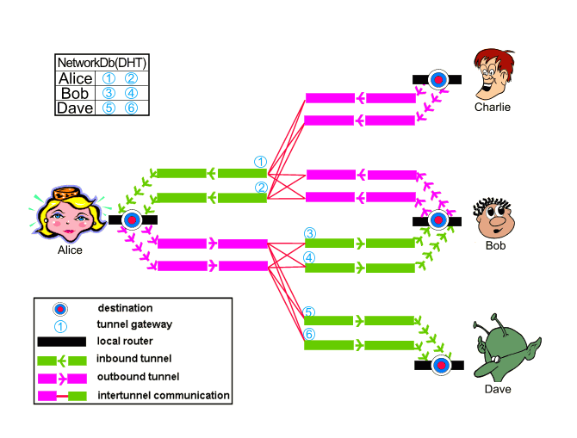
Layout
Image from http://www.i2p2.de/how_intro

Slide 8
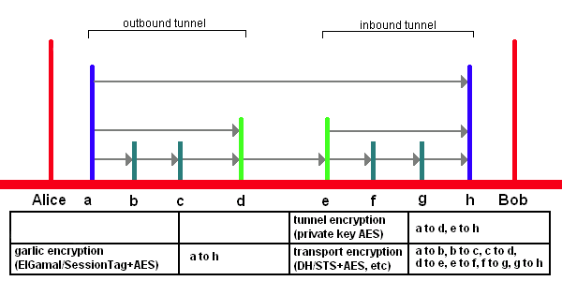
Encryption Layers
EIGamal/SessionTag+AES from A to H
Private Key AES from A to D and E to H
Diffie–Hellman/Station-To-Station protocol + AES
Image from http://www.i2p2.de/

Slide 9
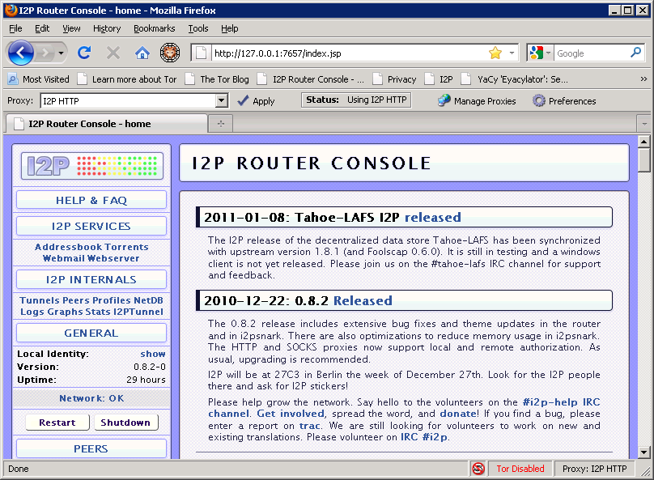
What does it look like to the user?

Slide 10
Naming and Addresses
Details
http://www.i2p2.de/naming.html
516 Character Address
-KR6qyfPWXoN~F3UzzYSMIsaRy4udcRkHu2Dx9syXSzUQXQdi2Af1TV2UMH3PpPuNu-GwrqihwmLSkPFg4fv4y
QQY3E10VeQVuI67dn5vlan3NGMsjqxoXTSHHt7C3nX3szXK90JSoO~tRMDl1xyqtKm94-RpIyNcLXofd0H6b02
683CQIjb-7JiCpDD0zharm6SU54rhdisIUVXpi1xYgg2pKVpssL~KCp7RAGzpt2rSgz~RHFsecqGBeFwJdiko-
6CYW~tcBcigM8ea57LK7JjCFVhOoYTqgk95AG04-hfehnmBtuAFHWklFyFh88x6mS9sbVPvi-am4La0G0jvUJw
9a3wQ67jMr6KWQ~w~bFe~FDqoZqVXl8t88qHPIvXelvWw2Y8EMSF5PJhWw~AZfoWOA5VQVYvcmGzZIEKtFGE7b
gQf3rFtJ2FAtig9XXBsoLisHbJgeVb29Ew5E7bkwxvEe9NYkIqvrKvUAt1i55we0Nkt6xlEdhBqg6xXOyIAAAA
SusiDNS Names
something.i2p
Hosts.txt and Jump Services
Base32 Address
{52 chars}.b32.i2p
rjxwbsw4zjhv4zsplma6jmf5nr24e4ymvvbycd3swgiinbvg7oga.b32.i2p

Slide 11
I2P Pros and Cons
Pros
Lots of supported applications
Can create just about any hidden service if you use SOCKS5 as the client tunnel
Eepsites somewhat faster compared to Tor Hidden Services (Subjective, I know)
No central point of failure
(Example: What happened to Tor when China blocked access to the core directory servers on September 25th 2009)
Cons
Limited out proxies
Sybil attacks a little more likely

Slide 12
Previous Attacks
Clock based attacks
Traffic flow analysis
Sybil/infrastructure attacks
Many more…
http://www.i2p2.de/how_threatmodel.html

Slide 13
Approach
“Specific exploits are temporary, bad configuration mistakes are forever”.
Banner grabs of both eepSites inside of I2P, and against know IPs participating in the Darknet, to reduce the anonymity set of the servers.
Reverse DNS and who is lookups to find out more information concerning the IPs of the I2P nodes.
TCP/IP stack OS finger printing.
Testing I2P virtual host names on the public facing IP of I2P nodes.
Compare the clock of the remote I2P site, and suspected IP hosts on the public Internet, to our own system’s clock. We did this via the HTTP protocols “Date:” header.
Command injection attacks.
Web bugs to attempt to de-anonymize eepSite administrators or users. (This turned out more problematic than we originally thought)

Slide 14
Challenges
Communications with the eepSites is normally done via an HTTP proxy. This restricts our attack options somewhat. Where DNS queries went made a huge difference.
Perhaps because of point one, many of the tools I have experimented with so far have a tendency to give false results or hang while working on spidering an eepSite.
Filtering of client requests makes it somewhat harder to attack the administrator of an eepSite via web bugs, or odd XSS attacks put into the logs.
While spidering I needed to be careful not to download contraband onto my own system.

Slide 15
Improvements/Deliverables
Clearer examples of how leaked information can be found.
A concentration on I2P instead of Tor.
A concentration on the application layer instead of the network or transport layers.
Real world tests on systems that have been implemented for more than just academic purposes.
Less reliance on esoteric attack vectors.

Slide 16
Probing I2P
Data collection and tools

Slide 17
Collecting eepSites
Spider some of the popular portal eepSites like forum.i2p or ugha.i2p for URLs ending in .i2p, then continue spidering from there recursively.
Another option is to parse though the host.txt file I2P uses for name to cryptographic identifier mappings, and check each i2p service for availability.
Or both

Slide 18
Scripts
I2PMassGrabber-headers.py
Checks the status of each I2P host listed in an I2P host.txt file to see if it's up, and then generates CSV and HTML formatted output with the hostname, status, and server banner. Input file and proxies will have to be changed based on user settings. This script also collects page scrapes that can be reviewed.
real-IP-banner.py
Grabs HTTP banners from an Internet facing IP so we can compare, sort and filter later.
dump-and-sort-i2p-router-ips.py
NetDB scraping code used to obtain a list of IPs from our local NetDB cache. The RegEX needs some work as some invalid IPs work their way into the resulting output text. Generates or adds to a file named all-sorted-uniq.txt, so this script can be ran by a scheduler to collect the IPs of I2P nodes over time.
time-stamp-server.py
Compares times stamps found in the HTTP headers of both Internet IPs and I2P sites to the local clock, along with retrieval times, generating a CSV file and a synopsis in HTML.
virtual-server-test.py
I2P Virtual Host checking script. This script uses a large CSV file to try specific I2P host names on a given public IP to see if a different page is returned. It saves scrapes of these pages to a time stamped directory.
Download:
http://www.irongeek.com/host/i2p-probe-scripts.zip

Slide 19
Output Format
CSV, since we can import it just about anywhere
"bitcoin4cash.i2p","200","Apache"
"shpargalko.i2p","200","Apache/2.2.15 (Win32) PHP/5.3.2"
"darrob.i2p","200",""
"ufm.i2p","200","Apache/2.2.8 (Ubuntu) PHP/5.2.4-2ubuntu5.12 with Suhosin-Patch“
Page scraps and headers so we can see the pages incase they are offline later.

Slide 20
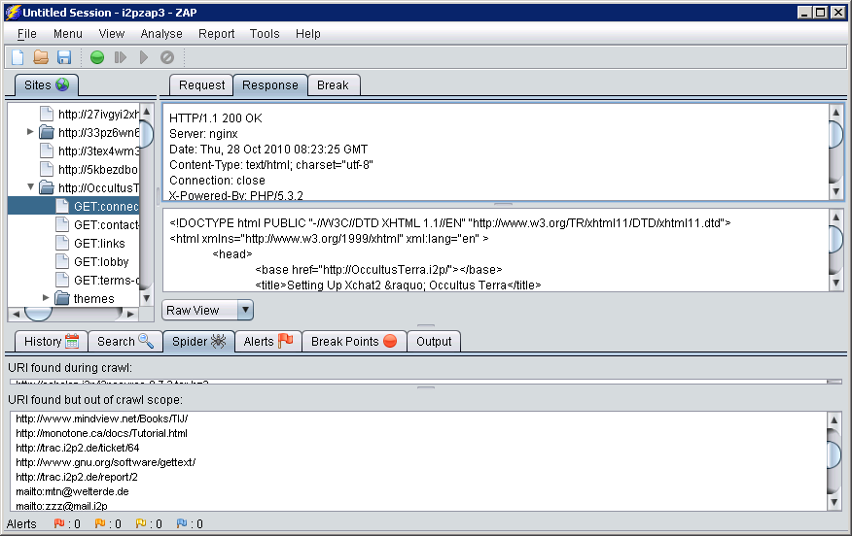
Other Tools:ZAP
ZAP
(ZED Attack Proxy)
Has spidering, file/directory
brute-forcing and scanning
features
Download:
http://www.owasp.org/index.php/OWASP_Zed_Attack_Proxy_Project

Slide 21
Other Tools: Wireshark/Dumpcap
dumpcap -i \Device\NPF_{E97777A0-5863-4741-AA42-FD3E02B2BD4C} -s 0 -f "port 12668" -w g:\dumpcap.pcap -a duration:3600
-i to tell dumpcap which network interface to use (if you are not sure which of your local interfaces to use, see the local interfaces options by using the –D flag)
-s to set the snap length so that we capture the whole packet
-f specifies the capture filter to use, thus emanating packets we may not care about
-w locates the pcap file to output
–a tells dumpcap to stop capturing under certain circumstances (in this case after one hour)
Download:
http://www.wireshark.org/

Slide 22
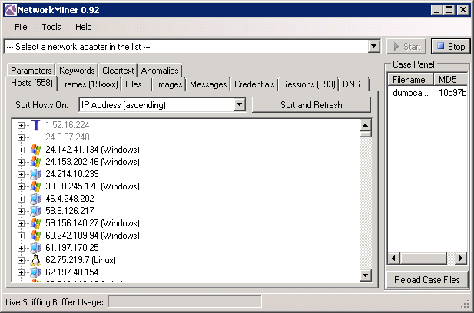
Other Tools: NetworkMiner
NetworkMiner
was used for OS
fingerprinting
Can extract needed
data from a pcap
file
Download:
http://networkminer.sourceforge.net/

Slide 23
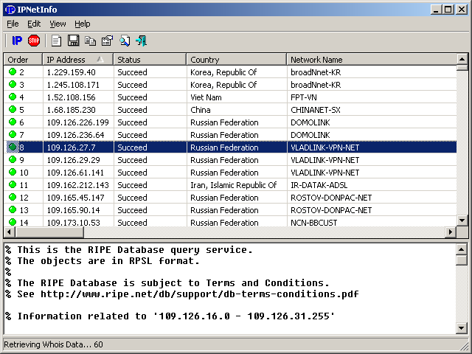
Other Tools: IPNetInfo
Takes output from
dump-and-sort-i2p-router-ips.py
Does a Whois to recover owner,
IP range, contact information,
country, etc.
Download:
http://www.nirsoft.net/utils/ipnetinfo.html

Slide 24
Some general Analysis
Items that may not be that anonymity threatening, but are still useful or interesting

Slide 25
OS stats based on an hour long packet capture
NetworkMinor OS Detection by IP Stack

Slide 26
Organization and Country information

Slide 27
What is in a name?
What does a name like thor.schmelz.com tell you?
NIMBIOS had 44 nodes in I2P on 11/9/2010
Detecting possible Sybil attacks?

Slide 28
Attacks that worked…
…and mitigations

Slide 29
Main Attacks We Focused On
Correlating server banners grabbed from inside of I2P and off of the public Internet
Clock Differences
Command Injection attack

Slide 30
Summary before the details
Caveats:
Exact statistics on the reliability of attacks are not easy
Churn can be somewhat compensated for by collecting data over a longer period of time
Results:
Correlating server banners grabbed from inside of I2P and off of the public Internet
  Out of 119 I2P hostnames we have in our set we found 21 IP/I2P correlations
  See paper for more details
Clock Differences
  Found only 1 new likely IP/I2P correlation
  Helped confirm others
Command Injection attack
  Workable, but highly dependent on site

Slide 31
Correlating server banners grabbed from inside of I2P and off of the public Internet:
What we are looking for?
Venn diagram
People running their
eepSites as VHosts on a public facing webserver
Other accidental banner relationships
I2P Host Banners
(Group 2)
Public IP Host Banners
(Group 1)
People who happen to be running an I2P router and a public web server that has a banner match on I2P, but is not using it for an I2P eepSite

Slide 32
What do I mean by HTTP headers?
Client example:
  GET http://www.i2p2.i2p/ HTTP/1.1
  Host: www.i2p2.i2p
  User-Agent: Mozilla/5.0 (Windows; U; Windows NT 6.1; en-US; rv:1.9.2.12) Gecko/20101026 Firefox/3.6.12
  Accept: text/html,application/xhtml+xml,application/xml;q=0.9,*/*;q=0.8
  Accept-Language: en-us,en;q=0.5
  Accept-Encoding: gzip,deflate
  Accept-Charset: ISO-8859-1,utf-8;q=0.7,*;q=0.7
  Keep-Alive: 115
  Proxy-Connection: keep-alive
  Referer: http://127.0.0.1:7657/index.jsp
Server response:
  HTTP/1.1 200 OK
  Server: nginx/0.6.32
  Date: Wed, 08 Dec 2010 13:48:46 GMT
  Content-Type: text/html; charset=utf-8
  Connection: close
  Etag: "1b2a7b18a524b03f598944143fc7bd52“
  Content-Length: 8701
  Proxy-Connection: close

Slide 33
1 to 1 Banners
Data from 11/09/2010, imported into MS Access and queried
1 to 1 IP to I2P Banners
I2P hostname | IP | Banner
medosbor.i2p | 89.31.112.91 (host-89-31-112-91.academ.org) | Apache/2.2.13 (Linux/SUSE)
ipredia.i2p | 97.74.196.206 (ip-97-74-196-206.ip.secureserver.net) | Apache/2.2.3 (CentOS)
xorbot.i2p | 178.77.75.23 (www.gernot-schulz.com) | Apache/2.2.9 (Debian) PHP/5.2.6-1+lenny9 with Suhosin-Patch
trac.i2p2.i2p | 46.4.248.202 (bilbo.srv.welterde.de) | nginx/0.6.32
lurker.i2p | 178.63.47.16 (fleshless.org) | nginx/0.7.65
(although we later found ipredia.i2p on a different IP once we had collected more Internet facing hosts to test against)

Slide 34
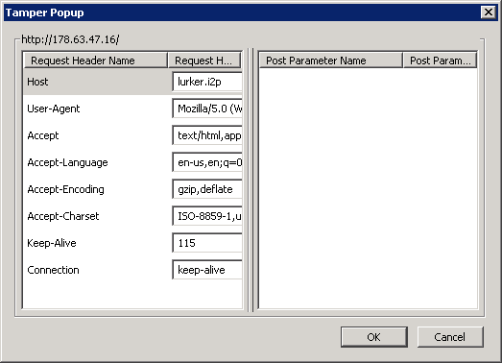
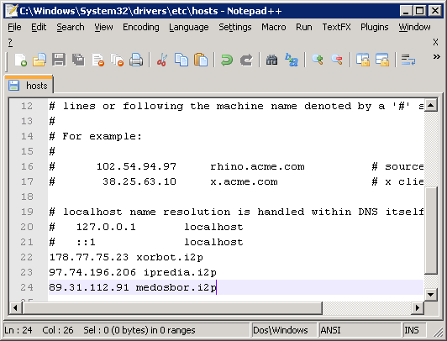
Ways to modify the host header
Tamperdata or a local proxy
like ZED
Modify your hosts file
Curl:
curl 178.63.47.16
curl -H "Host: lurker.i2p" 178.63.47.16

Slide 35
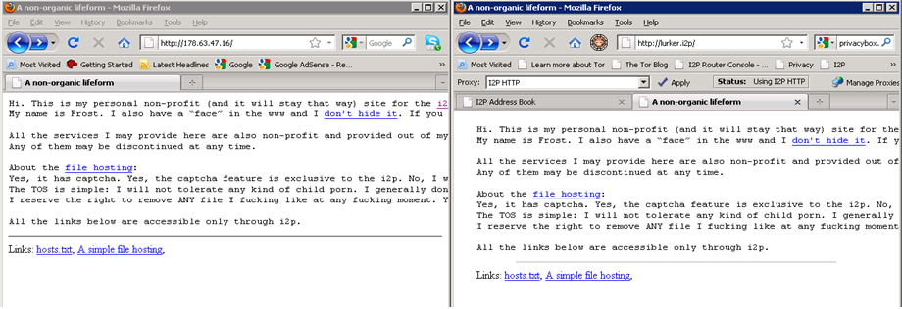
Results of modifying host header
Same site, found on IP and I2P

Slide 36
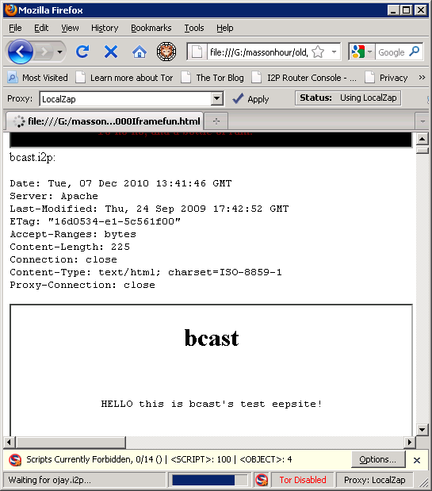
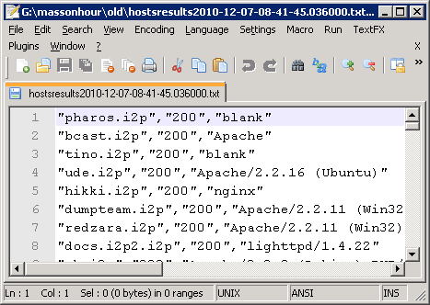
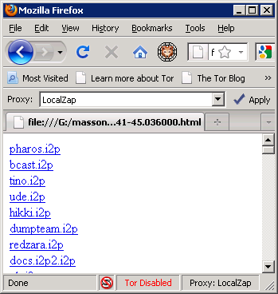
Automating
virtual-server-test.py
Download and compare
while changing host headers
Multiple forms of output

Slide 37
Some Results
  Out of 119 I2P hostnames we have in our set we found 21 IP/I2P correlations
I2P Hostname | Likely Real IP
lurker.i2p | 178.63.47.16
bzr.welterde.i2p | 188.40.181.33
docs.i2p2.i2p | 188.40.181.33
openmusic.i2p | 188.40.181.33
paste.i2p2.i2p | 188.40.181.33
syndie.welterde.i2p | 188.40.181.33
www.i2p2.i2p | 188.40.181.33
matterhorn.i2p | 188.165.45.229
awxcnx.i2p | 62.75.219.7
directedition.i2p | 68.33.184.167
forum.i2p | 82.103.134.192
ugha.i2p | 82.103.134.192
bolobomb.i2p | 83.222.124.19
ipredia.i2p | 84.55.73.228
teknogods.i2p | 84.234.26.123
jonatan.walck.i2p | 85.229.85.244
medosbor.i2p | 89.31.112.91
colombo-bt.i2p | < redacted >
www.i2p2.i2p (mirror?) | 94.23.12.210, 94.23.46.106, 46.4.248.202
mathiasdm.i2p | 94.23.52.151
privacybox.i2p | 94.75.228.29

Slide 38
Mitigations for Vhost comparing
Don’t run the eepSite on a web server with a public facing IP, or to make sure that the virtual host for the I2P site is only set to respond to requests from the localhost .
Configure HTTP service not to return a server banner or to just return a very non-distinctive banner such as the aforementioned “Server: Apache” (ServerTokens directive set to ProductOnly).
Mathiasdm read a draft of this paper, and spurred a change in the I2P code base. Starting with I2P version 0.8.2 the server header is stripped.

Slide 39
Related
X-Powered-By headers can also give away information:
Date: Wed, 01 Dec 2010 21:02:21 GMT
Server: Apache
X-Powered-By: PHP/5.2.13-pl0-gentoo
Want to see historical records of headers?
http://i2p.to/frame.php?page=info&host=somesite.i2p
Public header search engine:
http://www.shodanhq.com/
Bing and the IP: search parameter

Slide 40
Clock Differences
We are not really looking a skew here, more total clock differences.
For skew, see: Steven J. Murdoch, "Hot or Not: Revealing Hidden Services by their Clock Skew," University of Cambridge, Cambridge, 2006
Some of these techniques may work better in I2P than Tor.

Slide 41
Clock Differences
Time Difference | Retrieval Time | Host | Header
40.417 | 0.436 | 89.31.112.91 | Apache/2.2.13 (Linux/SUSE)
50.294 | 10.549 | medosbor.i2p | Apache/2.2.13 (Linux/SUSE)
3.418 | 0.35 | 85.229.85.244 | Apache/2.2.15 (Debian)
4.325 | 5.059 | jonatan.walck.i2p | Apache/2.2.15 (Debian)
-4325.58 | 0.353 | 84.55.73.228 | Apache/2.2.3 (CentOS)
-4321.66 | 8.946 | ipredia.i2p | Apache/2.2.3 (CentOS)
4488.434 | 0.702 | 130.241.45.216 | Apache/2.2.9 (Debian) PHP/5.2.6-1+lenny8 with Suhosin-Patch
4490.365 | 4.894 | error.i2p | Apache/2.2.9 (Debian) PHP/5.2.6-1+lenny8 with Suhosin-Patch
2.407 | 4.89 | bolobomb.i2p | Apache/2.2.9 (Debian) PHP/5.2.6-1+lenny9 with Suhosin-Patch mod_ssl/2.2.9 OpenSSL/0.9.8g
2.421 | 0.091 | 83.222.124.19 | Apache/2.2.9 (Debian) PHP/5.2.6-1+lenny9 with Suhosin-Patch mod_ssl/2.2.9 OpenSSL/0.9.8g
3.43 | 0.282 | 188.40.181.33 | lighttpd/1.4.22
5.366 | 2.901 | docs.i2p2.i2p | lighttpd/1.4.22
6.274 | 3.673 | zzz.i2p | lighttpd/1.4.22
53.415 | 0.26 | 93.174.93.93 | Microsoft-IIS/6.0
54.404 | 3.92 | colombo-bt.i2p | Microsoft-IIS/6.0
3.287 | 0.531 | www.i2p2.i2p | nginx/0.6.32
3.429 | 0.285 | 46.4.248.202 | nginx/0.6.32
11.323 | 8.989 | lurker.i2p | nginx/0.7.65
12.433 | 8.882 | 178.63.47.16 | nginx/0.7.65

Slide 42
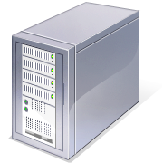

Why not split the difference?
How do you know which tunnel or node caused which percentage of the delay?
?
?
?
?
?
?
?
?

Slide 43
Mitigations for clock differences
Don’t run the eepSite on a web server with a public facing IP, or to make sure that the virtual host for the I2P site is only set to respond to requests from the localhost .
Making sure that the time is properly synchronized with a reliable and widely used NTP server and the time zone is set correctly would help.
The reason we specify a widely used and reliable NTP server is that synchronizing against an NTP system that is significantly off may also reduce the anonymity set.

Slide 44
Command Injection attack
Command injection
Vulnerability occurs when improperly sanitized input, be it from a web form, get request, cookie or header, is fed into an application that then uses the input as part of a command that is to be issued at a shell.
Related attacks:
Code Injection attack
SQL Injection (xp_cmdShell)?

Slide 45
Injection attack example
Set up Mutillidae
Injected command to trace route
Read the results

Slide 46
Mitigations for injection attacks
Keep up to date with your software
Do a code review
Review the OWASP Top 10
http://www.owasp.org/index.php/Category:OWASP_Top_Ten_Project
Another solution may be to massively lock down the eepSite’s firewall rules not to allow any sort of egress to the outside Internet
Look in Web Application Firewalls (bandaid)

Slide 47
You don’t have to see the results on the page
Make the server contact you outside of I2P
Sniff for connection or expected traffic
Ping/Netcat
Connection outside of I2P

Slide 48
Future
Look at other protocols IRC, eMule and BitTorrent
Targeting the administrators via whatever contact information they provide and enticing them to visit a site the attacker controls could be fruitful
  Decloak.net (plugins like Flash)
Metadata
Look more into clock difference based attacks

Slide 49
Events
Louisville Infosec
http://www.louisvilleinfosec.com/
DerbyCon 2011, Louisville Ky
Sept 30 - Oct 2
http://derbycon.com/
Skydogcon/Hack3rcon/Phreaknic/Notacon/Outerz0ne
http://www.skydogcon.com/
http://www.hack3rcon.org/
http://phreaknic.info
http://notacon.org/
http://www.outerz0ne.org/
Notes:
Beg for hardware donations. ☺

Slide 50
Questions?
42
Project Page:
http://www.irongeek.com/i.php?page=security/darknets-i2p-identifying-hidden-servers
Installing:
http://www.irongeek.com/i.php?page=videos/getting-started-with-the-i2p-darknet
http://www.irongeek.com/i.php?page=videos/i2p-darknet-software-in-linux

