Slide 1
Homemade Hardware Keylogger/PHUKD Hybrid
Adrian Crenshaw

Slide 2


About Adrian
I run Irongeek.com
I have an interest in InfoSec education
I don’t know everything - I’m just a geek with time on my hands
I’m an (Ir)regular on the InfoSec Daily Podcast: http://isdpodcast.com
Co-Founder of Derbycon
http://www.derbycon.com/
Twitter: @Irongeek_ADC
Notes:
Take a note from Johnny Long’s book, and Bruce Potter’s book.

Slide 3
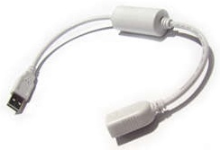

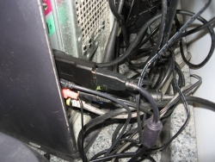
Hardware keyloggers
Hardware keyloggers are fairly simple devices conceptually
Essentially they are installed between the keyboard and the computer, and then log all of the keystrokes that they intercept to their onboard flash memory
A snooper can then come along later to pick up the key logger and extract the captured data (passwords, documents, activity, etc.)

Slide 4

How this all started
Irongeek, the quest for free stuff!!!
Web traffic = toys!!!

Slide 5

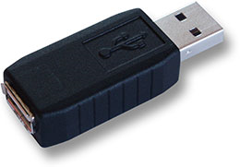
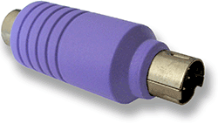
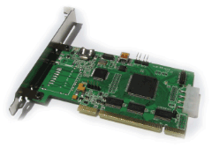
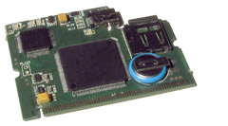
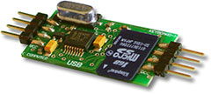
What is a Hardware Key Logger?
External
Internal
Pics http://www.keelog.com/ and http://www.keycarbon.com

Slide 6
Advertised Uses
(Come on vendors, admit it)
Writers: Users can install them on their own systems as a backup for the work they've typed in. :S
Businesses: Some companies may use keyloggers for monitoring employees for misconduct. :S
Parents: Some parents may choose to use a hardware keylogger to monitor their kids. :S
Pen-testers/Crackers/Spies/Jealous Significant Others:
If an attacker is trying to get someone else's password or proprietary information hardware keyloggers can come in quite handy. :)
Legal?

Slide 7
Cons
Harder to recover keystrokes remotely
There's no chance of emailing or grabbing the keystroke logs from over a network; the device has to be physically recovered to obtain the logs.
(well, there are a few little exceptions of sorts, Bluetooth, some TEMPEST/Van Eck phreaking, 27MHz interception, and maybe Seeing using the “licensing dongle” scheme)
Less information
The hardware keylogger gives little to no information on what app was active when the keystrokes happened.
$$$$
Hardware keyloggers are rather expensive.
Easy to remove, if found
If found, external hardware keyloggers are much easier to remove than software keyloggers. You just pluck them off the keyboard's cord. Removing software keyloggers depends on the user’s privilege level, or how knowledgeable they are about how to gain a higher privilege level. ☺

Slide 8
Pros
Stealth
Most software keyloggers are detected by anti-malware apps. Depending on which software package is used, the anti-virus system will likely detect the keylogger and remove it, or at the very least report it to the user. Hardware keyloggers, on the other hand, are very hard to detect without physical inspection. That's not to say it's impossible.
All keystrokes, independent of boot state
Hardware keystroke loggers can get keystrokes from before the OS is even loaded (hello bios password), or from around software that limits what processes can access the keystrokes (like the Windows GINA logon after the old three finger salute of Ctrl-Alt-Del).
OS Independent
Hardware keyloggers can support logging of almost any OS, as long as the keyboard is a fairly standard USB HID (Human Interface Device). Windows, Linux, Mac OS X - it makes little difference to a hardware keylogger.

Slide 9
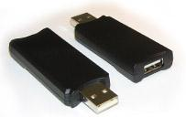
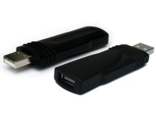


Models
Got mine awhile back, so I’m trying to match up prices with current offerings.
Name | Keys | Type | Price (may not be accurate) | Picture
KeyCarbon | Type: phxlog | Virtual keyboard and rapid downloader software | $147 - $297
KeyGhost Plug | Type: vghostlog | Virtual keyboard | $249
KeyGhost Cable | Type: vghostlog | Virtual keyboard | $349
KeeLog | Hold down: k+b+s | Flash Drive | $44.99
KeeLogUSB (KeyLlama rebrand) | Hold down: k+b+s | Flash Drive | $44.99
KeeLogPS/2 (KeyLlama rebrand) | Hold down: k+b+d | Virtual keyboard and Flash Drive with adapter | $38.99

Slide 10
Detection and Mitigation
Physical security
Lockdown what hardware can be installed may work in some cases but not many
Physical inspection
Notice odd problems that could mean there is a USB keylogger present
  Odd USB vendor/product IDs?
  Inline devices not working from a keyboard’s built-in hub?
  Reports of slow USB speed with inline devices?

Slide 11
How about making your own?

Slide 12
Objective: Combining Keyloggers and Programmable HIDs
Log all the keys using a MicroSD card
Vary payloads based on keystrokes
Log username/password and use them later
Screw with the person who is typing
Flexible hobbyist platform to add new functionality
  WiFi
  Bluetooth
  Ethernet

Slide 13
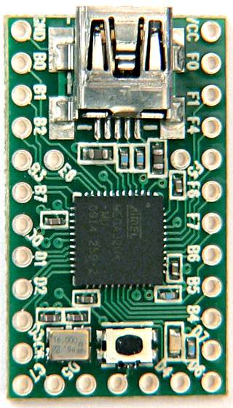
Programmable HID
Pre-Program Keystrokes
Auto-run being disabled does not matter
Cheap ($16 Teensy)
Payloads:
Add a user
Run a program
Copy files to your thumb drive for later retrieval
Upload local files
Download and install apps
Go to a website they have a cookie/session for, and do a sort of CSRF (sic)

Slide 14
Setup Development Environment
Get the following files and install in this order
(I assume you already have a working Java RE)
  Arduino Dev Package
  http://arduino.cc/en/Main/Software
  Teensyduino and the serial drivers
  http://www.pjrc.com/teensy/td_download.html
  Teensy Loader
  http://www.pjrc.com/teensy/loader.html
  PHUKD Library
  http://www.irongeek.com/i.php?page=security/programmable-hid-usb-keystroke-dongle
Put the Phuked folder in the \arduino-1.0\libraries directory
Set the board type

Slide 15
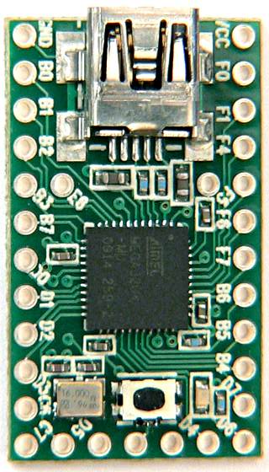
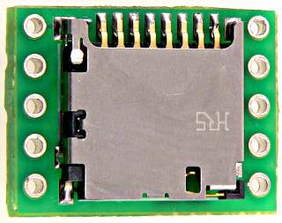
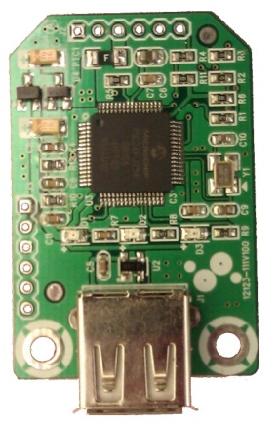
Parts
Teensy ($16)
http://pjrc.com/store/teensy.html
PS/2 Female Cable (Free?)
(Cut it off a KVM cable or something)
SD Adapter ($8)
http://pjrc.com/store/sd_adaptor.html
USB Host Adapter ($14.90)
http://www.sure-electronics.com/goods.php?id=1140

Slide 16
Libraries
PHUKD Library
http://www.irongeek.com/i.php?page=security/programmable-hid-usb-keystroke-dongle#Programming_examples_and_my_PHUKD_library
Teensy PS/2 Library
(I have my own mod of this which comes with the PS/2 Key Logger source code)
http://www.pjrc.com/teensy/td_libs_PS2Keyboard.html
SDFat16Lib (I used the Wrapper that comes with Arduino)
http://code.google.com/p/sdfatlib/

Slide 17
PS/2 Keylogger
Going old school!

Slide 18
PS/2 Scan Codes
Scan Codes read from the PS/2 Connection
Defined in the Teensy PS/2 Library with #Defines and Arrays
Have to translate to USB, which makes things tougher
Key | Code | Release
A | 1C | F0, 1C
B | 32 | F0, 32
C | 21 | F0, 21
D | 23 | F0, 23
E | 24 | F0, 24
F | 2B | F0, 2B
G | 34 | F0, 34

Slide 19
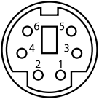
PS/2 Keylogger
+CLK/IRQ
+DATA
Pin 1 | +DATA | Data
Pin 2 | Not connected | Not connected*
Pin 3 | GND | Ground
Pin 4 | VCC | +5 V DC at 275 mA
Pin 5 | +CLK | Clock
Pin 6 | Not connected | Not connected**
Info and PS/2 pic from Wikipedia

Slide 20
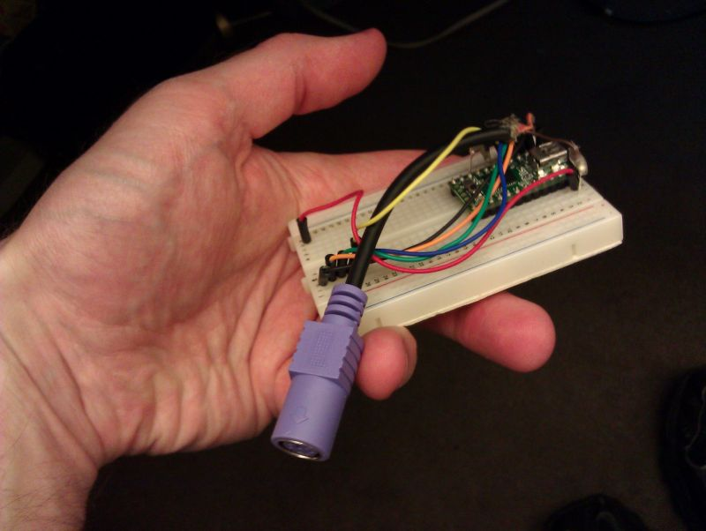
PS/2 Keylogger Code and Demo

Slide 21
USB Keylogger
User Recording Programmable HID USB Keyboard Dongle
=
UR PHUKD

Slide 22
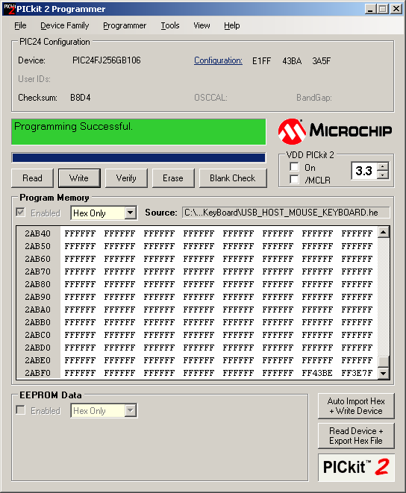
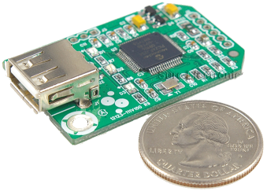
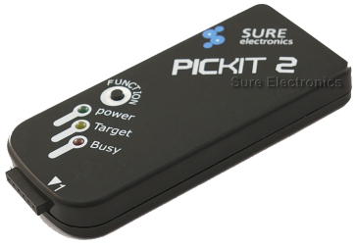
Programming: What you will need
We will need something to program it with
PICKit 2 Programmer (clone)
http://www.sureelectronics.net/goods.php?id=21
PICkit 2 Development Programmer/Debugger Official Software
http://www.microchip.com/stellent/idcplg?IdcService=SS_GET_PAGE&nodeId=1406&dDocName=en023805
MPLAB IDE X Beta 7.02MPLAB C30 Lite Compiler for dsPIC DSCs
and PIC24 MCUs (Use lite options)
http://www.microchip.com/en_us/family/mplabx/index.html

Slide 23

USB Keylogger
RX on USB Module to TX on Teensy
TX on USB Module to RX on Teensy

Slide 24
Getting the source…
Had to get Sure Electronics
to send me the source
Took some convincing
Your mostly on your own
for support
Code and HEX files
http://www.sure-electronics.net/download/index.php?name=MB-CM13111&type=0
HID: Raw Report 00-00-13-00-00-00-00-00-
p
HID: Raw Report 00-00-13-00-00-00-00-00-
p
HID: Raw Report 00-00-13-00-00-00-00-00-
p
HID: Raw Report 00-00-13-00-00-00-00-00-
p

Slide 25
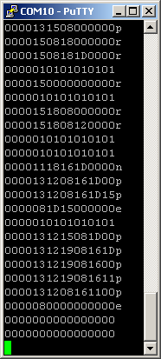
USB To Serial To USB
HID Keyboard Reports
Key(s) | Code
a | 0000040000000000
Left Ctrl+Shift+Alt | 0700000000000000
Right Ctrl+Shift+Alt | 7000000000000000
a+b+c | 0000050406000000

Slide 26
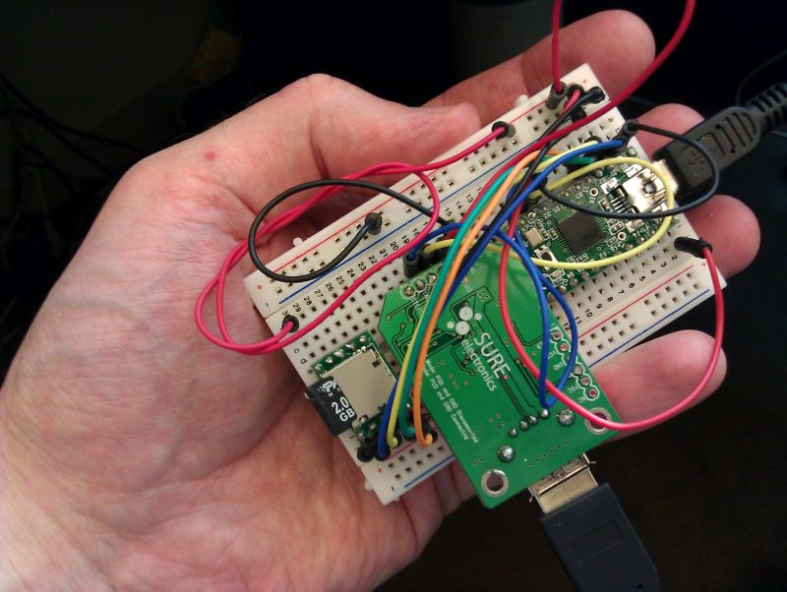
USB Keylogger Code and Demo

Slide 27
More Ideas
Arduino community supports so many peripherals, what might be possible?
Wireless keylogger?
Ethernet keylogger?
Time Stamping
Make the key loggers more passive.

Slide 28
Conclusions/Problems solved
Homemade Key Logger worked
Integrated with Programmable HID
Kept the costs low
PS/2 unit = $24 and USB unit = $39 (Depending)

Slide 29
Current Problems
Not passive
If the keyboard has a USB hub in it, it won’t work with the USB host module I currently use
Kind of hard to package it smaller

Slide 30
Way more links than you ever wanted
AKA: Homework

Slide 31
Useful Tools/Links
Homemade Keylogger/PHUKD Hybrid
http://www.irongeek.com/i.php?page=security/homemade-hardware-keylogger-phukd
PHUKD Project site
http://www.irongeek.com/i.php?page=security/programmable-hid-usb-keystroke-dongle
Paul’s Teensyduino Docs
http://www.pjrc.com/teensy/teensyduino.html
USBDeview
http://www.nirsoft.net/utils/usb_devices_view.html
Reg From App
http://www.nirsoft.net/utils/reg_file_from_application.html
HAK5’s Rubber Ducky Forum
http://www.hak5.org/forums/index.php?showforum=56

Slide 32
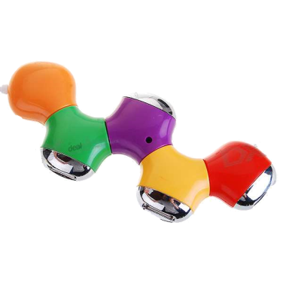
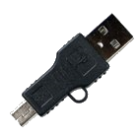
Sources for more parts
Teensy
http://www.pjrc.com/teensy/
Sure Electronics
http://www.sure-electronics.com/
Ebay
http://www.ebay.com/
Photoresistors and other small parts
http://www.bgmicro.com
http://www.mouser.com
LEDs
http://www.ledshoppe.com/
Other stuff
Small USB A to Mini USB
http://www.dealextreme.com/details.dx/sku.2704~r.48687660
Small HUB
http://www.dealextreme.com/details.dx/sku.30564~r.48687660

Slide 33
Keylogger Links
Hardware Keyloggers: Use, Review, and Stealth (Phreaknic 12) http://www.irongeek.com/i.php?page=videos/pn12/irongeek-hardware-keyloggers-use-review-and-stealth
Hardware Key Logging Part 1: An Overview Of USB Hardware Keyloggers, And A Review Of The KeyCarbon USB Home Mini
http://www.irongeek.com/i.php?page=security/usb-hardware-keyloggers-1-keycarbon
Hardware Key Logging Part 2:A Review Of Products From KeeLog and KeyGhost
http://www.irongeek.com/i.php?page=security/usb-hardware-keyloggers-2-keyghost-keelog
Hardware Key Logging Part 3: A Review Of The KeyLlama USB and PS/2 Keyloggers
http://www.irongeek.com/i.php?page=security/ps2-and-usb-hardware-keyloggers-3-keyllama
Hardware Keyloggers In Action 1: The KeyLlama 2MB PS/2 Keylogger
http://www.irongeek.com/i.php?page=videos/keyllama-ps2-keylogger
Hardware Keyloggers In Action 2: The KeyLlama 2GB USB Keylogger
http://www.irongeek.com/i.php?page=videos/keyllama-USB-keylogger

Slide 34

Malicious USB Links
Plug and Prey: Malicious USB Devices
http://www.irongeek.com/i.php?page=security/plug-and-prey-malicious-usb-devices
Malicious USB Devices: Is that an attack vector in your pocket or are you just happy to see me?
http://www.irongeek.com/i.php?page=videos/malicious-usb-devices-phreaknic-14

Slide 35

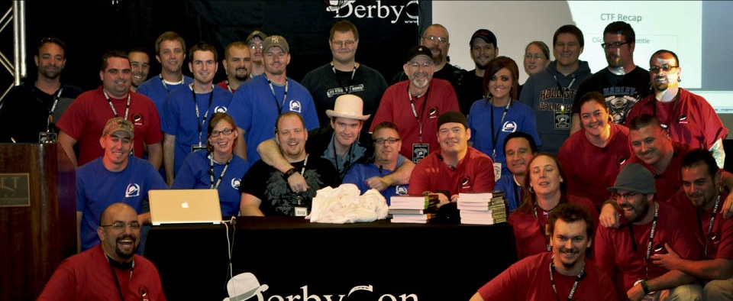
Events
Derbycon
Sept 27th-30th 2012
http://www.derbycon.com
Others
Derbycon Art Credits to DigiP
Photo Credits to KC (devauto)
http://www.louisvilleinfosec.com
http://skydogcon.com
http://hack3rcon.org
http://phreaknic.info
http://notacon.org
http://outerz0ne.org
Notes:
Beg for hardware donations. ☺

Slide 36
Questions?
42
Twitter: @Irongeek_ADC

