Slide 1
Building a Hacklab
(and a little about the CTF setup)
Adrian Crenshaw

Slide 2
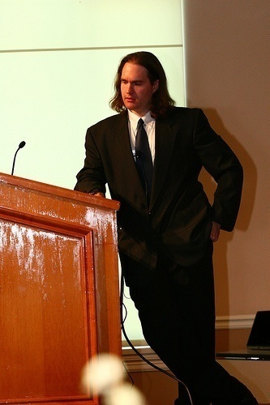
About Adrian
I run Irongeek.com
I have an interest in InfoSec education
I don’t know everything - I’m just a geek with time on my hands
Notes:
Take a note from Johnny Long’s book, and Bruce Potter’s book.

Slide 3
What is this talk about
Building a “HackLab”
Inexpensive ways to acquire hardware and software.
Learning about tools, vulnerabilities and exploits without getting to know Bubba.
Software and items built for learning.

Slide 4
Useful things to have
A NAT box
WiFi Routers (DD-WRT)
Lots of network cable
Switches
Any networkable junk you can find
KVMs
Oh, and computers

Slide 5
Inexpensive Hardware
Institution
Out of date PCs and Servers
Private
Dumpster diving
School disposals
Government disposals
Friends giving you old hardware in exchange for help
Run a blog and just ask for it

Slide 6
More source for cheap hardware and network nick knacks
http://www.govdeals.com
http://www.dealextreme.com
http://www.techbargains.com

Slide 7
Cheap software
Go open source
Linux, FreeBDS, Apache, etc.
Microsoft
https://www.dreamspark.com/default.aspx
Run a blog and just ask for it

Slide 8
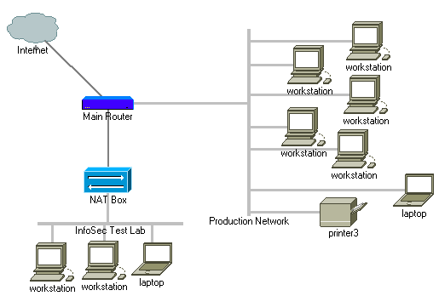
Lab Layout

Slide 9
A bit about NAT
To public Internet
NAT = Network Address Translation
1 public IP can be used as the outside connection to many internal IPs
Reserved non-routable IP ranges
192.168.*.*
172.16.*.*-172.31.*.*
10.*.*.*
You can stack NAT boxes, but it’s best not to have IP range conflicts
192.168.1.2
To first NAT Box
192.168.1.3
192.168.1.4
10.0.0.2
10.0.0.2

Slide 10
Network Layout:
The importance of separation
Air gap is best, but NAT will do
Forward ports on the router for VPN/RDP/VNC
You don’t want to accidentally attack boxes outside of your lab
Inside the lab you may have deliberately insecure boxes you don’t want others to get to

Slide 11
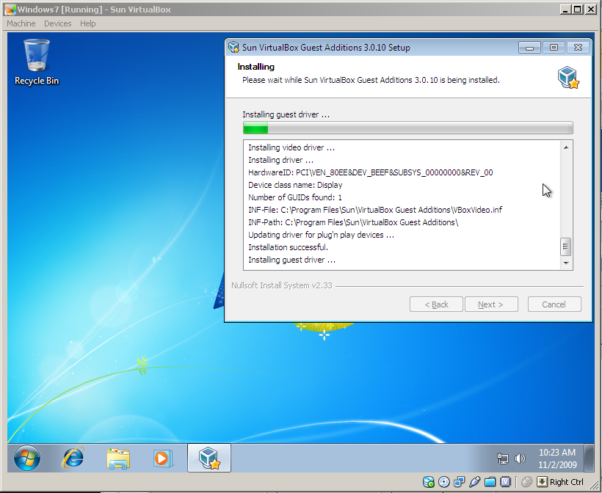
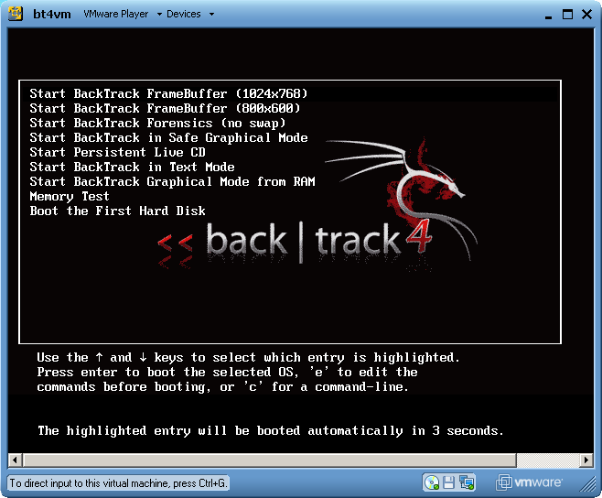
Virtual Machines

Slide 12
Reasons why VMs are so great
One computer can act like many
You can hose a system, and easily recover from backup
Somewhat safer from a sandbox standpoint
Easy to hand out a custom environment to a class

Slide 13
Options, Options, Options
Comparisons http://en.wikipedia.org/wiki/Comparison_of_platform_virtual_machines
VMPlayer
http://www.vmware.com/products/player/
Plus
http://vmxbuilder.com/
VirtualBox
http://www.virtualbox.org/

Slide 14
VM Concepts
Host OS vs. Guest OS
Snapshots
Networking modes
Bridged: The VM acts as if it's part of your real network.
NAT: Your VM is behind a virtual NAT router, protecting it from the outside LAN, but still allowing other VMs ran on the same machine to contact it.
Host-Only: You would want to choose this option if you don't want the VM to be able to bridge to the Internet using NAT. It would be a good idea to use this option if you are testing out any worm or viral code.
VM Tools
Sparse drive space
USB Support

Slide 15
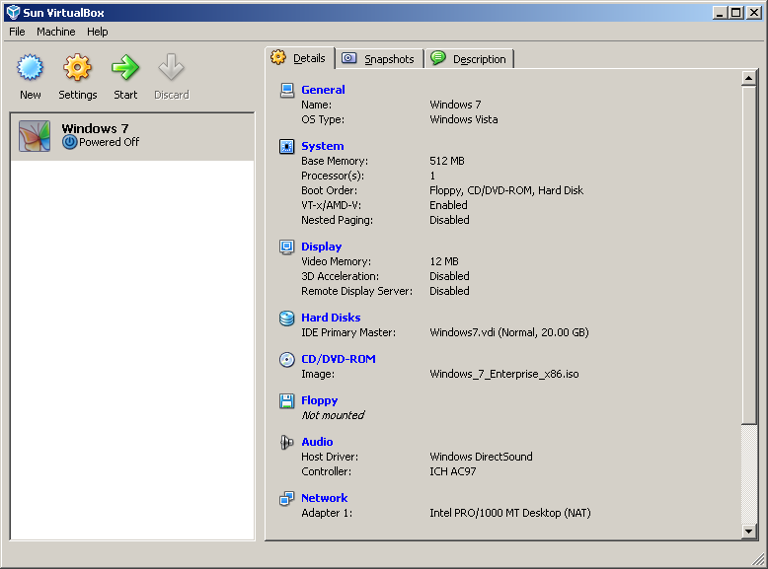
Virtual Box Demo

Slide 16
Sources for VMs if you don’t want to roll your own
VM Appliances
http://www.vmware.com/appliances/
http://ovfappliances.com/
Formats
OVF:Open Virtualization Format
VMX/VMDK: VMWare
XML/VDI: VirtualBox
C:\Users\adrian\.VirtualBox

Slide 17
Memory Needs
Linux 128MB: Could be more or less depending on the desktop interface you use and what services you decide to run.
Windows 9x, 64MB: It should feel quite spry.
Windows 2000/2003/XP, 128MB: yes, you would want more if you can get it, but you can get away with 128MB if necessary.
Windows Vista, 256MB: Don't send me hateful emails, it can be done. You have to set it to at least 512MB to install Vista, but thereafter you can shrink it down to only 256MB. It's ugly, but it works.
Windows 7: Just go with 512.

Slide 18
Things to hack
Deliberately vulnerably web apps
Old software
Specially build scenarios

Slide 19
Deliberately vulnerably web apps
Hacme Series from Foundstone (Hacme Travel, Hacme Bank, Hacme Shipping, Hacme Books)
http://www.foundstone.com/us/resources-free-tools.asp
WebGoat
http://www.owasp.org/index.php/Category:OWASP_WebGoat_Project
Mutillidae
http://www.irongeek.com/i.php?page=security/mutillidae-deliberately-vulnerable-php-owasp-top-10

Slide 20
Old software
Check the vendors site for old versions
Old, not slipstreamed OS CDs
Old Apps Repository
http://oldapps.com/

Slide 21
Specially built scenarios
De-ICE & pWnOS Live CDs
http://heorot.net/livecds/
Damn Vulnerable Linux
http://www.damnvulnerablelinux.org/

Slide 22
Things to hack with
So many tools, so little time to install them all:
Great list of security tools
http://sectools.org/
  Nmap
  http://nmap.org/
  Metasploit
  http://www.metasploit.com/
  Wireshark
  http://www.wireshark.org/
  Kismet
  http://www.kismetwireless.net/
  Nessus
  http://www.nessus.org/nessus/
  Cain
  http://www.oxid.it/cain.html
  Netcat\Ncat
  http://netcat.sourceforge.net/
  Ettercap
  http://ettercap.sourceforge.net/
  Nikto
  http://cirt.net/nikto2
  Paros Proxy
  http://www.parosproxy.org
  Burp Suite
  http://www.portswigger.net/suite/
  XSS Me
  https://addons.mozilla.org/en-US/firefox/addon/7598
  SQL Inject Me
  https://addons.mozilla.org/en-US/firefox/addon/6727?src=reco
  Tamper Data
  https://addons.mozilla.org/en-US/firefox/addon/966

Slide 23

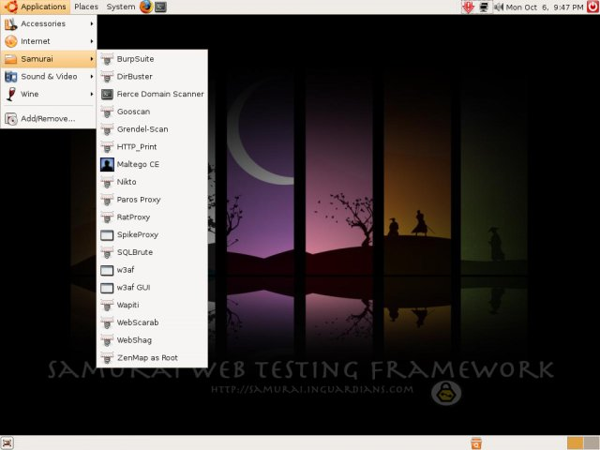
Easy way with Live CDs and VMs
BackTrack
http://www.remote-exploit.org/backtrack_download.html
Samurai WTF
http://samurai.inguardians.com/
DEFT Linux
http://www.deftlinux.net/

Slide 24
Staying up to date on trends and exploits
Milw0rm
http://www.milw0rm.com/
SANS Internet Storm Center
http://isc.sans.org/
PacketStorm
http://www.packetstormsecurity.org/
BugTraq
http://www.securityfocus.com/archive/1
RootSecure
http://www.rootsecure.net/

Slide 25
Podcasts: Learn about new tools as they come out
Pauldotcom
http://www.pauldotcom.com/
Exotic Liability
http://www.exoticliability.com/
Security Justice
http://securityjustice.com/
Securabit
http://www.securabit.com/

Slide 26
Links
Original Article:
http://www.irongeek.com/i.php?page=security/building-an-infosec-lab-on-the-cheap
Insecure web apps
http://www.irongeek.com/i.php?page=security/deliberately-insecure-web-applications-for-learning-web-app-security
Hackerspaces
http://hackerspaces.org

Slide 27

The CTF Setup:
A Hacklab in Action
Lets watch the video
http://www.irongeek.com/i.php?page=videos/louisville-infosec-ctf-2009
2 VMs,
1 Laptop
Postit
Box to attach via WiFi so folks can sniff the SSID

Slide 28
Plan for next year?
King-Of-The-Hill!!!
Keep a box and hold it
Set your flag by defacing the website with your team’s name
Must keep services running to get points
Can patch to keep others out
Can attack network layer
Windows Box
Linux Box
OS X
Scoring Box

Slide 29
Events
Free ISSA classes
ISSA Meeting
http://issa-kentuckiana.org/
Louisville Infosec
http://www.louisvilleinfosec.com/
Phreaknic/Notacon/Outerz0ne
http://phreaknic.info
http://notacon.org/
http://www.outerz0ne.org/
Notes:
Beg for hardware donations. ☺

Slide 30
Thanks
Folks at Binrev and Pauldotcom
Louisville ISSA
Free ISSA Classes

Slide 31
Helping with the free classes
Got old hardware you would like to donate?
Is there a subject you would like to teach?
Let others know about upcoming classes, and the videos of previous classes.

Slide 32
Questions?
42

