Slide 1

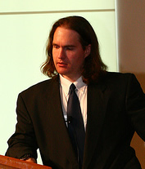
OSInt, Cyberstalking, Footprinting and Recon: Getting to know you
Adrian Crenshaw

Slide 2
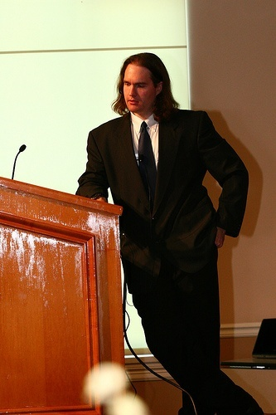

About Adrian
I run Irongeek.com
I have an interest in InfoSec education
I don’t know everything - I’m just a geek with time on my hands
(ir)Regular on the ISDPodcast
http://www.isd-podcast.com/
Sometimes my presentations
are like this.
And sometimes my presentations
are like this.
Notes:
Take a note from Johnny Long’s book, and Bruce Potter’s book.

Slide 3
Class Structure
Mile wide, 2.5 feet deep
Feel free to ask questions at any time
There will (hopefully) be many long breaks to play with the tools mentioned
I’ll try not to drop anyone's docs but my own, but volunteers for “victims” will help

Slide 4
So, what info is out there?
Other names and related concepts:
OSInt (Open Source Intelligence)
Scoping
Footprinting
Discovery
Recon
Cyberstalking

Slide 5
Subtopics
DNS, Whois and Domain Tools
Finding general Information about an
organization via the web
Anti-social networks
Google Hacking
Metadata
Other odds and ends
Notes:
The topics will be somewhat out of order since they are so interlinked.

Slide 6
Why?
For Pen-testers and attackers:
Precursor to attack
Social Engineering
Disgruntled Employees
User names and passwords
Web vulnerabilities
Internal IT structure (software, servers, IP layout)
Spearphishing
For everyone else:
You want to keep attackers from finding this info and using this against you. ☺
Notes:
It’s all about making connections, finding information that may be useful later.

Slide 7
Dropping Docs
All these techniques are legal as far as I know, but IANAL
Sorry if I “drop someone’s docs” other than my own
Please don’t misuse this information

Slide 8
Backtrack 5
Tons of fun tools to play with
http://www.backtrack-linux.org/
Username: root
Password: toor
Many of the DNS tools are in
/pentest/enumeration/dns/
Notes:
Demo Time!!!

Slide 9
DNS, Whois and Domain Tools
Who-do the voodoo that you do so well

Slide 10
DNS
Glue of the Internet
Think of it as a phone book of sorts
Maps names to IPs, and IPs to names
(and other odds and ends)
Organization information is also kept
www.irongeek.com
69.163.177.249
Notes:
Dan Kaminsky sniffs it. ☺

Slide 11
Simple DNS Lookups
Host name to IP lookup:
nslookup www.irongeek.com
Reverse lookup:
nslookup 208.97.169.250
Notes:
We get an “A” record for first, and a “PTR” for a single IP.
Mention that one IP may have multiple host names.
If you exploit one web app on a share hosting provider, you may be able to mess with the sites of other domains hosted there.
http://serversniff.net/content.php?do=hostonip

Slide 12
DNS Record Types
Just a few record types cribbed from: http://en.wikipedia.org/wiki/List_of_DNS_record_types
Code | Number | Defining RFC | Description | Function
A | 1 | RFC 1035 | address record | Returns a 32-bit IPv4 address, most commonly used to map hostnames to an IP address of the host, but also used for DNSBLs, storing subnet masks in RFC 1101, etc.
AAAA | 28 | RFC 3596 | IPv6 address record | Returns a 128-bit IPv6 address, most commonly used to map hostnames to an IP address of the host.
MX | 15 | RFC 1035 | mail exchange record | Maps a domain name to a list of mail exchange servers for that domain
CNAME | 5 | RFC 1035 | Canonical name record | Alias of one name to another: the DNS lookup will continue by retrying the lookup with the new name.
PTR | 12 | RFC 1035 | pointer record | Pointer to a canonical name. Unlike a CNAME, DNS processing does NOT proceed, just the name is returned. The most common use is for implementing reverse DNS lookups, but other uses include such things as DNS-SD.
AXFR | 252 | RFC 1035 | Full Zone Transfer | Transfer entire zone file from the master name server to secondary name servers.
Notes:
May want to go to the page at the top.

Slide 13
Getting a list of host names
Zonetransfers
Bruteforcing from a dictionary
Nmap –sL <some-IP-range>

Slide 14
DIGing for data
dig irongeek.com any
dig @ns1.dreamhost.com irongeek.com any
Notes:
Demo Time!!!
Windows users must run the installer for the resolv.conf file.

Slide 15
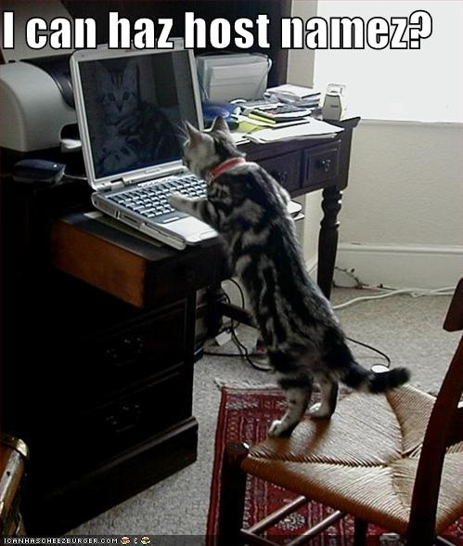
Zone Transfer:Give me all your records!

Slide 16
Zone Transfer: NSLOOKUP
(Windows version)
C:\Documents and Settings\Adrian>nslookup
Default Server: resolver1.opendns.com
Address: 208.67.222.222
> set type=ns
> irongeek.com
Server: resolver1.opendns.com
Address: 208.67.222.222
Non-authoritative answer:
irongeek.com nameserver = ns1.dreamhost.com
irongeek.com nameserver = ns2.dreamhost.com
irongeek.com nameserver = ns3.dreamhost.com
> server ns1.dreamhost.com
Default Server: ns1.dreamhost.com
Address: 66.33.206.206
> ls irongeek.com
[ns1.dreamhost.com]
*** Can't list domain irongeek.com: Query refused
> exit

Slide 17
Zone Transfer: Can you DIG it?
Domain Internet Groper
dig ugent.be ns
dig @ugdns1.ugent.be ugent.be axfr
Notes:
Demo Time!!!
Windows users must run the installer for the resolv.conf file.
Explain about the –t option.

Slide 18
Zone Transfer: Others
Other tools in BackTrack
./dnsrecon.py -d ugent.be –x
./dnsenum.pl ugent.be
ServerSniff:
http://serversniff.net/nsreport.php
http://serversniff.net/content.php?do=subdomains
GUI Dig for Windows
http://nscan.org/dig.html
Notes:
Demo Time for ServerSniff!!!
Tell them about hackme1.irongeek.com

Slide 19
Bruteforcing
Fierce
http://ha.ckers.org/fierce/
./fierce.pl -threads 100 -dns irongeek.com
./fierce.pl -dns irongeek.com -wordlist dictionary.txt

Slide 20
Nmap Demo
nmap -sL <some-IP-range>
nmap -sL 192.0.32.1-10
Notes:
Demo Time!!!
Not as good as a zone transfer because it returns only continuous IPs.

Slide 21
Whois: Whooo, are you? Who-who-who-who.
Great for troubleshooting, bad for privacy
Who owns a domain name or IP
E-mail contacts
Physical addresses
Name server
IP ranges
Who is by proxy?

Slide 22
Whois Demo
apt-get install whois
whois example.com
whois 208.97.169.250
Notes:
Demo Time!!!
Can’t whois a host name, but a domain name or IP works fine.

Slide 23
Whois Tools
*nix Command line
Nirsoft’s
http://www.nirsoft.net/utils/whois_this_domain.html http://www.nirsoft.net/utils/ipnetinfo.html
Pretty much any network tools collection
Notes:
Show the different ways to “whois”. Both domains and IPs.

Slide 24
Whois and domain tools sites
RobTex
http://www.robtex.com
ServerSniff
http://www.serversniff.net

Slide 25
Traceroute
(ok, not really a DNS tool, but I was too lazy to make another section)
Windows (ICMP):
tracert irongeek.com
*nix (UDP by default, change with –I or -T):
traceroute irongeek.com
Just for fun:
http://www.nabber.org/projects/geotrace/
Notes:
Great for finding out who uses what ISP, or how networks are peered (Social engineering time!).
Also, if you can compromise someone in the route, traffic can be sniffed or altered.
Find out info about the network layout, and host names can be of interest.
More options can be found with “tracert -?” in Windows, “man traceroute” in Linux.
ICMP time exceeded (type 11) packet

Slide 26
Finding general Information about an organization via the web
So, you have a job posting for an
Ethical Hacker huh?
Notes:
Mention “Satan is on my friends list” presentation.

Slide 27
Sites about the organization
The organization’s website (duh!)
Corp Info
http://www.pentest-standard.org/index.php/PTES_Technical_Guidelines#Corporate
Wayback Machine
http://www.archive.org
Monster (and other job sites)
http://www.monster.com/
Zoominfo
http://www.zoominfo.com/
Google Groups (News groups, Google Groups and forums)
http://groups.google.com/
Boards
http://boardreader.com
http://omgili.com
http://groups.google.com
LinkedIn
http://www.linkedin.com/
Notes:
Look at the organizations' current site, and old versions of their site.
Once it’s on the net, it’s there forever (more or less).
As for Job sites: So, you are looking for a MySQL admin, huh? What does that tell me about your organization’s infrastructure?
All sorts of info can be found out by looking at job postings.
Search for forum and usenet posts about the companies' tech problems. Strange what admins will ask in public.

Slide 28



Anti-social networks
It’s all about how this links to that links to some other thing…
Notes:
Mention “Satan is on my friends list” presentation.

Slide 29

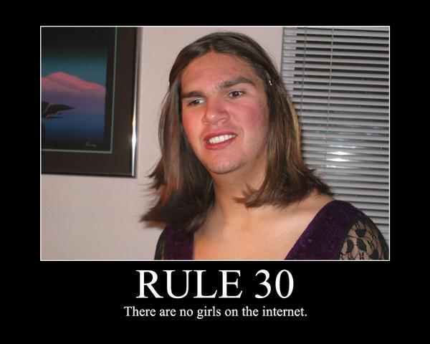

Let’s get to know Ester
Fake profile I made up to use for class
Dropped some Dox at a few places
May sound creepy, but you can practice with names from dating sites
Remember what you learned from 4chan:

Slide 30
Cyberstalking Sites
Large list at:
http://www.irongeek.com/i.php?page=security/doxing-footprinting-cyberstalking
Useful:
http://com.lullar.com
http://www.peekyou.com
http://www.checkusernames.com / http://knowem.com
http://www.isearch.com
http://www.whitepages.com
Not quite related, but cool:
http://tineye.com
http://pipes.yahoo.com/pipes/
Crap:
Most of them
Notes:
Show top 3, and Tin Eye. Let’s use Ester Pent for most. Irongeek on iSearch.

Slide 31
Other
General
http://youropenbook.org
Geolocation
http://www.bing.com/maps
http://twittermap.appspot.com
http://www.fourwhere.com/
http://icanstalku.com
http://ip2geolocation.com
Neighbors
http://www.whitepages.com/find_neighbors
Notes:
Mention good apps for the phone

Slide 32
Tools
Maltego
http://www.paterva.com/web5/
See differences:
http://www.paterva.com/web5/client/difference.php
Covers a large cross section of what this class is about
Notes:
Show Maltego.

Slide 33

Story Time
George Bronk
Found info on women’s Facebook profiles
Used information to answer security question at mail providers
Found nudes
Posted some, sent them to contacts lists, asked for more

Slide 34

To be social or anti-social
Should you have a profile?
What if you don’t?
Impersonators
Robin Sage (by Thomas Ryan)
  Get in peoples friends list to probe their connections

Slide 35
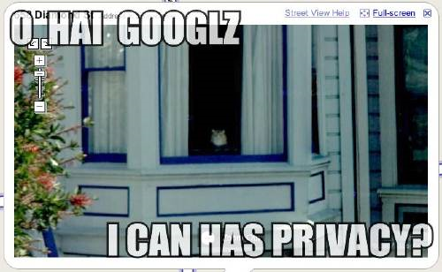
Google Hacking
More than just turning off safe search (though that’s fun too)

Slide 36
So, do you really know what’s shared online about your organization?
PII (Personally identifiable information)
Email address
User names
Vulnerable web services
Web based admin interfaces for hardware
Much more……..
YOU HAVE TO USE YOUR IMAGINATION

Slide 37
Google Advance Operators
Operators | Description
site: | Restrict results to only one domain, or server
inurl:/allinurl: | All terms must appear in URL
intitle:/allintitle: | All terms must appear in title
cache: | Display Google’s cache of a page
ext:/filetype: | Return files with a given extension/file type
info: | Convenient way to get to other information about a page
link: | Find pages that link to the given page
inanchor: | Page is linked to by someone using the term
http://www.googleguide.com/advanced_operators.html

Slide 38
More Operators
Operators | Description
- | Inverse search operator (hide results)
~ | synonyms
[#]..[#] | Number range
* | Wildcard to put something between something when searching with “quotes”
+ | Used to force stop words
OR | Boolean operator, must be uppercase
| | Same as OR

Slide 39
General Examples
inurl:nph-proxy site:edu
intitle:index.of.etc
intitle:index.of site:irongeek.com
filetype:pptx site:irongeek.com
"vnc desktop" inurl:5800
adrian crenshaw -site:irongeek.com
Notes:
Demo Time!!!

Slide 40
More General Examples
SSN filetype:xls | filetype:xlsx
"dig @* * axfr”
inurl:admin
inurl:indexFrame.shtml Axis
inurl:hp/device/this.LCDispatcher
“192.168.*.*” (but replace with your IP range)
Notes:
Demo Time!!!

Slide 41
Facebook Images
195608_100002238375103_5292346_n.jpg
inurl:100002238375103

Slide 42
Google Hacking For People
inurl:ester.pent
inurl:ester1337
intitle:ester1337
inurl:user inurl:irongeek -site:irongeek.com
inurl:account "irongeek“
site:facebook.com inurl:group (ISSA | Information Systems Security Association)
site:linkedin.com inurl:company (NSA | National Security Agency)
Notes:
Last few based on Tom Eston’s notes

Slide 43
Google Hacking DB
Exploit DB Google Dorks
http://www.exploit-db.com/google-dorks/
Old School
http://www.hackersforcharity.org/ghdb/
Notes:
Demo Time!!!

Slide 44
Google Hacking Tools
Metagoofil
http://www.edge-security.com/metagoofil.php
The Harvester
./theHarvester.py -d irongeek.com -l 100 -b google
Online Google Hacking Tool
http://www.secapps.com/a/ghdb
Spiderfoot
http://www.binarypool.com/spiderfoot/
Goolag
http://goolag.org
Notes:
Show off theHarvester, maybe Spiderfoot (mention Metagoofil).

Slide 45
More Google Hacking Tools
Gooscan
Should be on BackTrack CD/VM
Wikto
http://www.sensepost.com/research/wikto/
SiteDigger
http://www.mcafee.com/us/downloads/free-tools/sitedigger.aspx
BiLE
http://www.sensepost.com/research_misc.html
MSNPawn
http://www.net-square.com/msnpawn/index.shtml
Notes:
I’ve often had the problem of automated Google hacking tools that use scraping making Google list me as a bot, causing me to have to enter a CAPTCHA to search.
Show Sitedigger
Show Harvester
Other tools require the old, now depreciated, Google SOAP APIs. More on that in a bit.

Slide 46
Google APIs and proxies
JSON/Atom
http://code.google.com/apis/customsearch/v1/overview.html
Old
http://code.google.com/apis/websearch/
Really Old SOAP:
EvilAPI
http://evilapi.com/ (defunct?)
Spud
http://www.sensepost.com/labs/tools/pentest/spud
I can Haz API keyz?
https://github.com/search

Slide 47

Metadata
Data about data

Slide 48

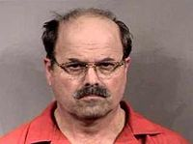

Pwned by Metadata
Cat Schwartz
Is that an unintended thumbnail in your EXIF data, or are you just happy to see me?
Dennis Rader (BTK Killer)
Metadata in a Word DOC he sent to police had the name of his church, and last modified by “Dennis” in it.
Darkanaku/Nephew chan
A user on 4chan posts a pic of his semi-nude aunt taken with an iPhone, Anonymous pulls the EXIF GPS info from the file and hilarity ensues.
More details can be on the following VNSFW site:
http://encyclopediadramatica.com/User:Darkanaku/Nephew_chan
http://web.archive.org/web/20090608214029/http://encyclopediadramatica.com/User:Darkanaku/Nephew_chan

Slide 49
Examples of file types that contain metadata
MAC addresses, user names, edits, GPS info. It all depends on the file format.
JPG
EXIF (Exchangeable image file format)
IPTC (International Press Telecommunications Council)
PDF
DOC
DOCX
EXE
XLS
XLSX
PNG
Too many to name them all.
Notes:
Show EXE metadata. Dev environment.
Show Word metadata.
Show EXIF data in jpg. Jihadist cat. Zombie EXIF Data. Adrian Beer.
Show Office 2007 metadata in this presentation by unzipping it.
Show PDF metadata. http://regex.info/exif.cgi.
Show Radical kitty cat in EXIFRead. My Zombie an Beer pick as well.

Slide 50
Metadata Tools
Strings
FOCA (use compatibility mode if needed)
http://www.informatica64.com/DownloadFOCA/
Metagoofil
http://www.edge-security.com/metagoofil.php
EXIF Tool
http://www.sno.phy.queensu.ca/~phil/exiftool/
EXIF Viewer Plugin
https://addons.mozilla.org/en-US/firefox/addon/3905
Jeffrey's Exif Viewer
http://regex.info/exif.cgi
Notes:
Show EXIF data with plugin. Show Foca.

Slide 51
Metadata Tools
EXIF Reader
http://www.takenet.or.jp/~ryuuji/minisoft/exifread/english/
Flickramio
http://userscripts.org/scripts/show/27101
Cree.py
http://ilektrojohn.github.com/creepy/
Pauldotcom http://www.google.com/search?hl=en&q=metadata+site%3Apauldotcom.com&btnG=Search
Notes:
Shoy Cree.py

Slide 52
Other odds and ends
Stuff that does not quite fit anywhere else

Slide 53
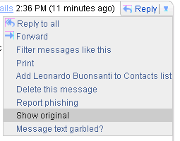
Off with their Headers
http://www.irongeek.com/i.php?page=security/how-to-cyberstalk-potential-employers
Also let us not forget HTTP headers
HTTP/1.1 200 OK
Content-Type: text/javascript; charset=UTF-8
Cache-Control: no-cache, no-store, max-age=0, must-revalidate
Pragma: no-cache
Expires: Fri, 01 Jan 1990 00:00:00 GMT
Date: Wed, 18 May 2011 15:34:03 GMT
Content-Encoding: gzip
X-Content-Type-Options: nosniff
X-Frame-Options: SAMEORIGIN
X-XSS-Protection: 1; mode=block
Content-Length: 1269
Server: GSE
LiveHeaders Plugin
http://www.shodanhq.com/
https://panopticlick.eff.org/
Notes:
Use Ester’s email to show headers.

Slide 54
Robots.txt
http://www.irongeek.com/robots.txt
User-agent: *
Disallow: /private
Disallow: /secret
This is my Robots.txt file.
for the love of Cthulhu,
don’t go there!

Slide 55
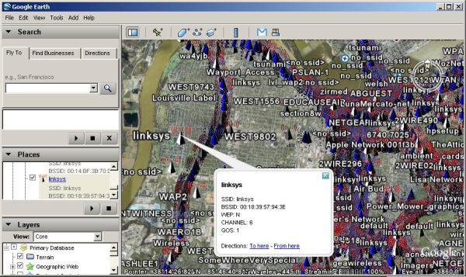
IGiGLE and WiGLE
http://www.irongeek.com/i.php?page=security/igigle-wigle-wifi-to-google-earth-client-for-wardrive-mapping
Notes:
So, what WiFi is in the area, and based on BSSID who provides the WAPs.

Slide 56
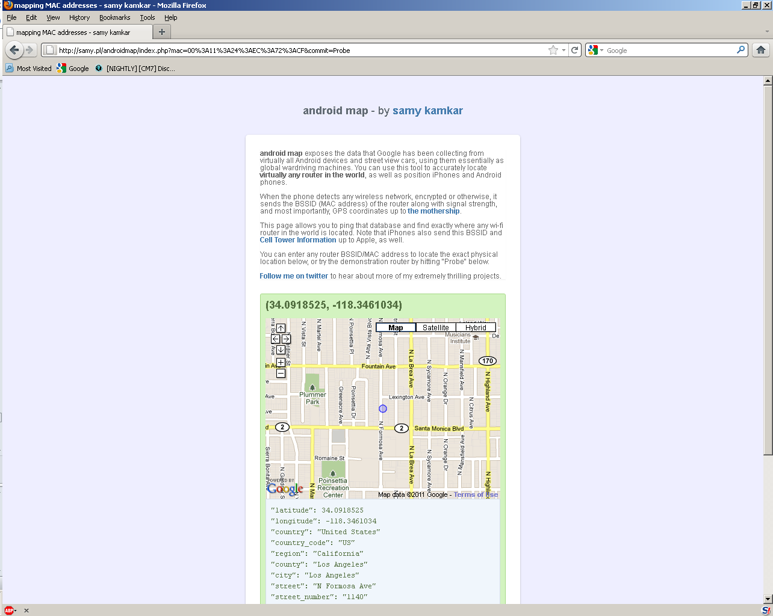
Android Location?
http://samy.pl/androidmap

Slide 57
More Links
Links for Doxing, Personal OSInt, Profiling, Footprinting, Cyberstalking
http://www.irongeek.com/i.php?page=security/doxing-footprinting-cyberstalking
PTES Technical Guidelines
http://www.pentest-standard.org/index.php/PTES_Technical_Guidelines
VulnerabilityAssessment.co.uk - An information portal for Vulnerability Analysts and Penetration Testers
http://www.vulnerabilityassessment.co.uk/Penetration%20Test.html

Slide 58
Videos/Talks/Presentations
Social Zombies - Kevin Johnson and Tom Eston
http://www.youtube.com/watch?v=l79q2G3E8HY
http://www.youtube.com/view_play_list?p=C591646E9B0CF33B
http://vimeo.com/18827316
Satan is on my Friends List - Shawn Moyer and Nathan Hamiel
http://www.youtube.com/watch?v=asj8yzXihcc
Using Social Networks To Profile, Find and 0wn Your Victims - Dave Marcus
http://www.irongeek.com/i.php?page=videos/dojocon-2010-videos#Using%20Social%20Networks%20To%20Profile,%20Find%20and%200wn%20Your%20Victims

Slide 59
Events
DerbyCon 2011, Louisville Ky
Sept 30 - Oct 2
http://derbycon.com/
Louisville Infosec
http://www.louisvilleinfosec.com/
Other Cons:
http://www.skydogcon.com/
http://www.dojocon.org/
http://www.hack3rcon.org/
http://phreaknic.info
http://notacon.org/
http://www.outerz0ne.org/
Notes:
Beg for hardware donations. ☺

Slide 60
Questions?
42

