Slide 1
Cipherspace/Darknets: anonymizing networks
Adrian Crenshaw

Slide 2
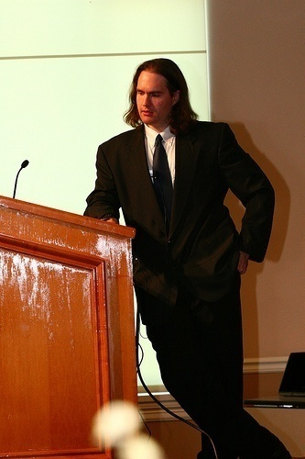
About Adrian
I run Irongeek.com
I have an interest in InfoSec education
I don’t know everything - I’m just a geek with time on my hands
(ir)Regular on the ISDPodcast
http://www.isd-podcast.com/
Notes:
Take a note from Johnny Long’s book, and Bruce Potter’s book.

Slide 3
A little background…
Darknets
There are many definitions, but mine is “anonymizing private networks ”
Use of encryption and proxies (some times other peers) to obfuscate who is communicating to whom
Sometimes referred to as Cipherspace (love that term)

Slide 4
Isn’t the Internet anonymous enough?
Not really
IPs can be associated with ISPs
Bills have to be paid
Websites log IPs as a matter of course
ISPs can look at their logs for who was leased an IP
Lots of plain text protocols allow for easy sniffing
http://www.irongeek.com/i.php?page=security/ipinfo
http://www.irongeek.com/i.php?page=security/AQuickIntrotoSniffers
http://www.irongeek.com/i.php?page=videos/footprinting-scoping-and-recon-with-dns-google-hacking-and-metadata

Slide 5
Who cares?
Privacy enthusiasts and those worried about censorship
Firms worried about policy compliance and leaked data
Law enforcement

Slide 6


Average Citizen
Why do you care?
Do you want to stay anonymous?
P2P
Censorship
Privacy

Slide 7
Corporations
Why do you care?
Is someone sneaking out private data?
Trade secrets
Personally identifiable information

Slide 8

Law Enforcement
Why do you care?
Contraband and bad people?
Criminals
Terrorists
Pedos

Slide 9
Some key terms
Proxy
Something that does something for something else
Encryption
Obfuscating a message with an algorithm and one or more keys
Signing
Using public key cryptography, a message can be verified based on a signature that in all likelihood had to be made by a signer that had the secret key
Small world model
Ever heard of six degrees of Kevin Bacon?

Slide 10

Tor
The Onion Router

Slide 11
Overview
Who?
First the US Naval Research Laboratory, then the EFF and now the Tor Project (501c3 non-profit).
http://www.torproject.org/
Why?
“Tor is free software and an open network that helps you defend against a form of network surveillance that threatens personal freedom and privacy, confidential business activities and relationships, and state security known as traffic analysis.” ~ As defined by their site
What?
Access normal Internet sites anonymously, and Tor hidden services.
How?
Locally run SOCKS proxy that connects to the Tor network.

Slide 12
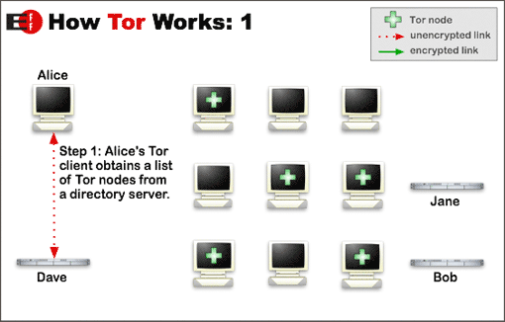
Layout to connect to Internet
Image from http://www.torproject.org/overview.html.en

Slide 13
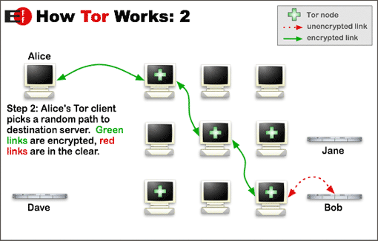
Layout to connect to Internet
Image from http://www.torproject.org/overview.html.en

Slide 14
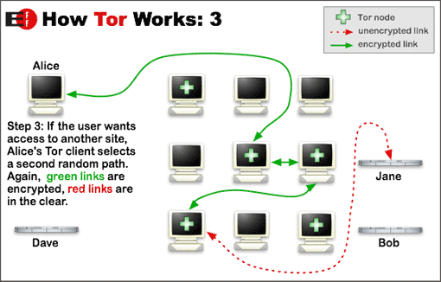
Layout to connect to Internet
Image from http://www.torproject.org/overview.html.en

Slide 15
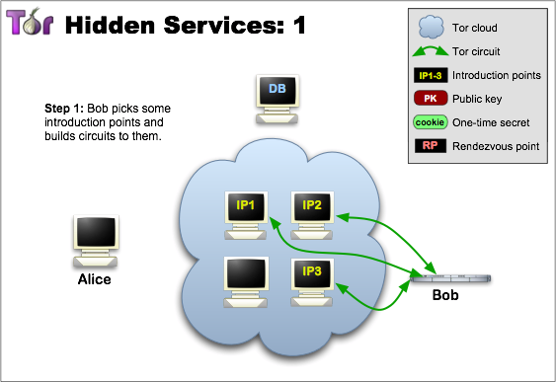
Layout to connect to Hidden Sevice
Image from http://www.torproject.org/hidden-services.html.en

Slide 16
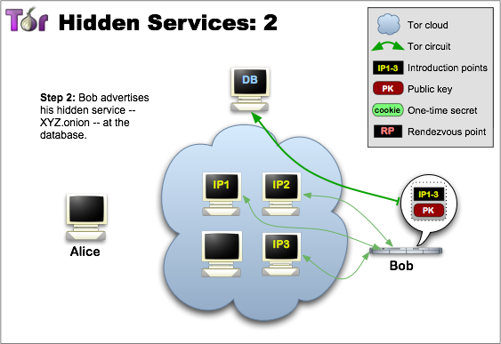
Layout to connect to Hidden Sevice
Image from http://www.torproject.org/hidden-services.html.en

Slide 17
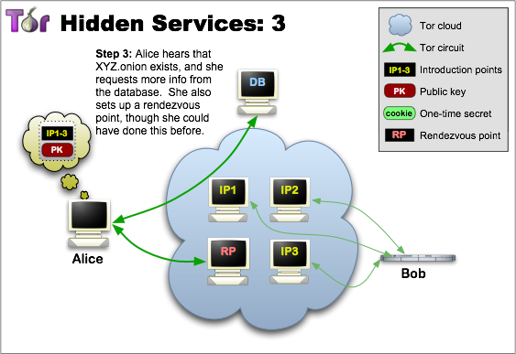
Layout to connect to Hidden Sevice
Image from http://www.torproject.org/hidden-services.html.en

Slide 18
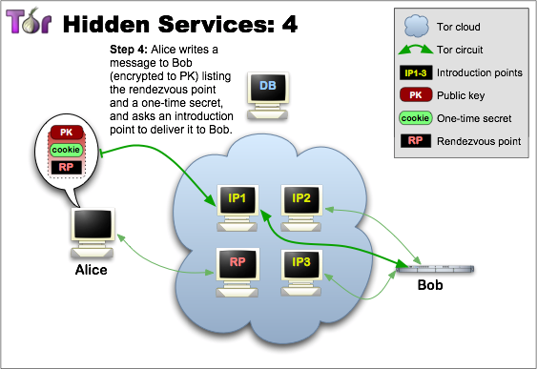
Layout to connect to Hidden Sevice
Image from http://www.torproject.org/hidden-services.html.en

Slide 19
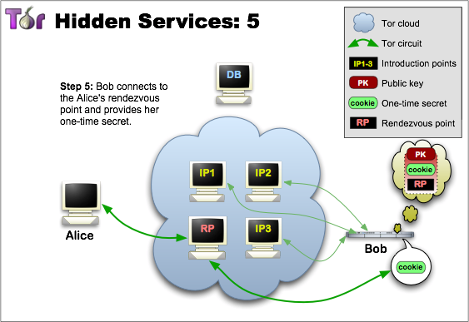
Layout to connect to Hidden Sevice
Image from http://www.torproject.org/hidden-services.html.en

Slide 20
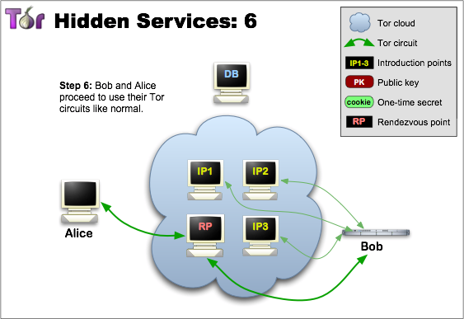
Layout to connect to Hidden Sevice
Image from http://www.torproject.org/hidden-services.html.en

Slide 21
Node types
Client
Just a user
Relays
These relay traffic, and can act as exit points
Bridges
Relays not advertised in the directory servers, so harder to block
Guard Nodes
Used to mitigate some traffic analysis attacks
Introduction Points
Helpers in making connections to hidden services
Rendezvous Point
Used for relaying/establishing connections to hidden services

Slide 22
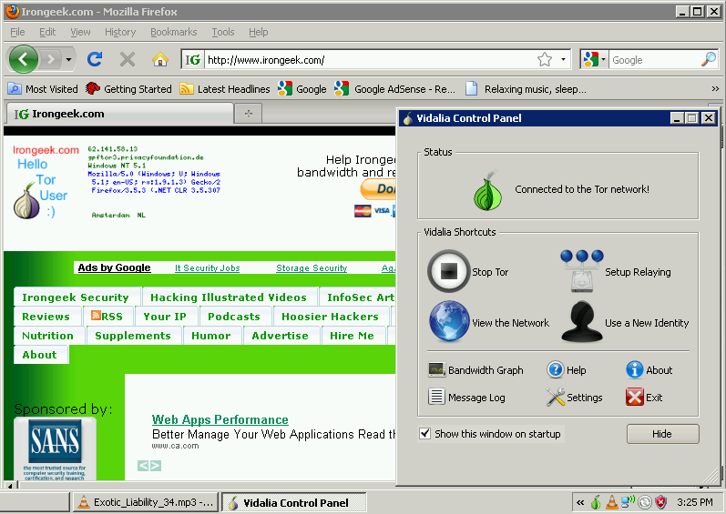
What does it look like to the user?

Slide 23
Applications/Sites
Anonymous proxy to the normal web
http://www.irongeek.com/i.php?page=videos/tor-1
Hidden services
Normally websites, but can be just about any TCP connection
http://www.irongeek.com/i.php?page=videos/tor-hidden-services
Tor2Web Proxy
http://tor2web.com
Tor Hidden Wiki:
http://kpvz7ki2v5agwt35.onion
Onion Cat
http://www.cypherpunk.at/onioncat/

Slide 24
Tor Pros and Cons
Pros
If you can tunnel it through a SOCKS proxy, you can make just about any protocol work.
Three levels of proxying, each node not knowing the one before last, makes things very anonymous.
Cons
Slow
Do you trust your exit node?
Semi-fixed Infrastructure:
Sept 25th 2009, Great Firewall of China blocks 80% of Tor relays listed in the Directory, but all hail bridges!!!
https://blog.torproject.org/blog/tor-partially-blocked-china
http://yro.slashdot.org/story/09/10/15/1910229/China-Strangles-Tor-Ahead-of-National-Day
Fairly easy to tell someone is using it from the server side
http://www.irongeek.com/i.php?page=security/detect-tor-exit-node-in-php

Slide 25
What does the traffic look like?
(Keep in mind, this is just the defaults)
Local
9050/tcp Tor SOCKS proxy
9051/tcp Tor control port
8118/tcp Polipo
Remote
443/tcp and 80/tcp mostly
Servers may also listen on port 9001/tcp, and directory information on 9030.
More details
http://www.irongeek.com/i.php?page=security/detect-tor-exit-node-in-php
http://www.room362.com/tor-the-yin-or-the-yang

Slide 26

Private Tor based network
Ironkey’s Secure Sessions
https://www.ironkey.com/private-surfing
Much faster than the public Tor network
How much do you trust the company?

Slide 27
Anonet
Roll your own, with OpenVPN and BGP routers

Slide 28
Overview
Who?
AnoNet 1/2: Good question
http://www.anonet2.org
http://anonetnfo.brinkster.net
Why?
To run a separate semi-anonymous network based on normal Internet protocols. Started using 1.0.0.0/8 because it was unused at the time, but that was allocated January 2010 to APNIC.
What?
Other sites and services internal to the network, but gateways to the public Internet are possible.
How?
OpenVPN connection to the network. Peering could be done with other VPN like tinc or QuickTun.

Slide 29
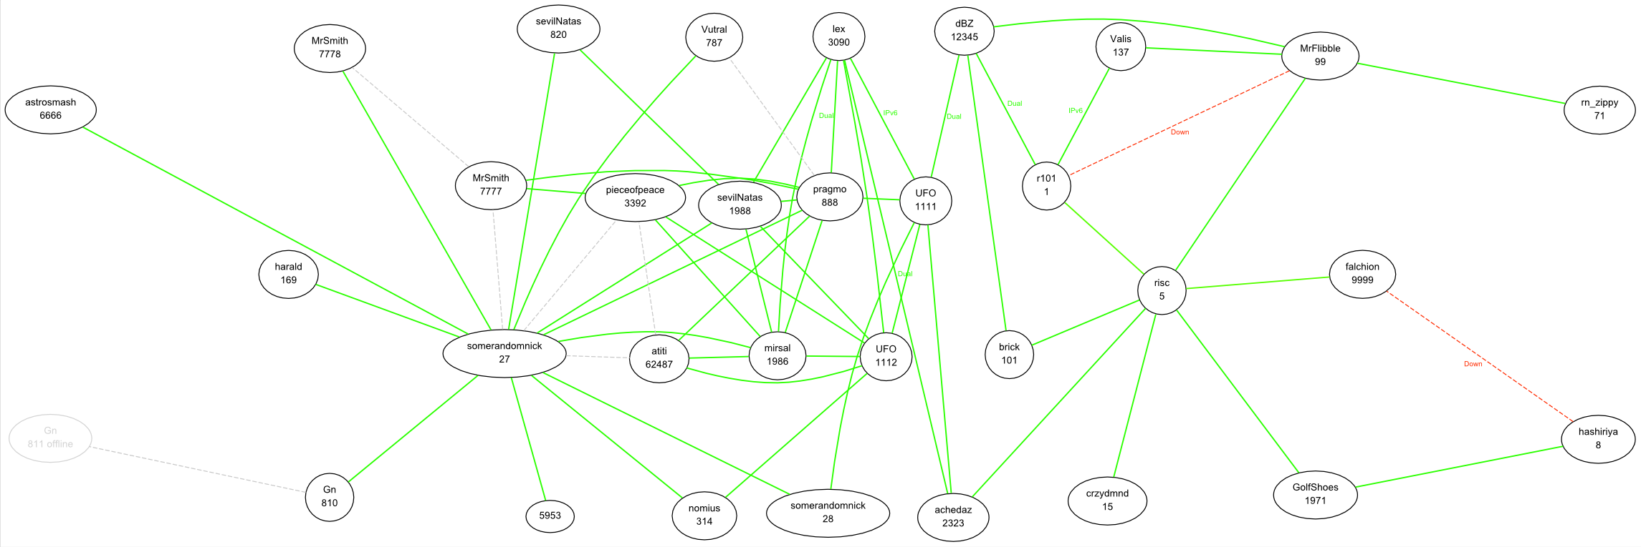
BGP peering and routing
From: http://1.3.9.1/.stats/anonet.svg

Slide 30
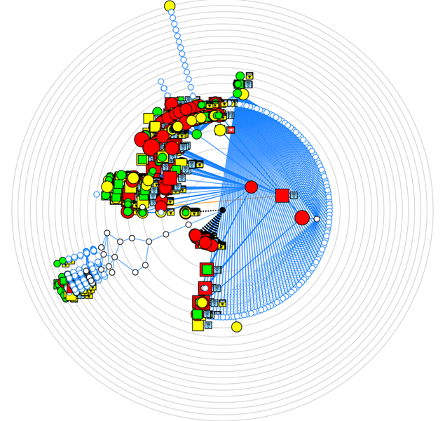
Nmap scan using UFO client port
Thanks to Alex Kah of Question-defense.com for the render, my computer had issues. ☺

Slide 31
Tools links to get started
Read
http://www.anonet2.org/
Client ports
(UFO client port)
http://ix.ucis.nl/clientport.php
OpenVPN
http://openvpn.net/
VNE/DNRouter
http://wiki.ucis.nl/VNE/DNRouter
QuickTun
http://wiki.qontrol.nl/QuickTun
HTTP access to the git repository
http://anogit.ucis.ano/
Outside access via Internet proxy
http://powerfulproxy.com/
List of some services
http://www.anonet2.org/services/
http://www.sevilnatas.ano/

Slide 32
Anonet and DarkNET Conglomeration Pros and Cons
Pros
Fast
Just about any IP based protocol can be used
Cons
Not as anonymous as Tor since peers “know” each other
Not a lot of services out there (DC)
Entry points seem to drop out of existence (AN)

Slide 33
What does the traffic look like?
(Keep in mind, this is just the defaults)
Whatever the OpenVPN clients and servers are configured for. I’ve seen:
AnoNet
5555/tcp
5550/tvp
22/tcp

Slide 34
Similar networks
Darknet Conglomeration
http://darknet.me
Dn42
https://dn42.net
VAnet
http://www.vanet.org
ChaosVPN
http://wiki.hamburg.ccc.de/index.php/ChaosVPN
http://chaosvpn.net
http://www.youtube.com/watch?v=Lx2w9K6a6EE

Slide 35

Freenet
All the world will be your enemy, Prince of a Thousand enemies. And when they catch you, they will kill you. But first they must catch you…
~ Watership Down

Slide 36
Overview
Who?
The Freenet Project, but started by Ian Clarke.
http://freenetproject.org/
Why?
“Freenet is free software which lets you anonymously share files, browse and publish "freesites" (web sites accessible only through Freenet) and chat on forums, without fear of censorship.”
What?
Documents and Freenet Websites for the most part, but with some extensibility.
How?
Locally run proxy of a sort (FProxy) that you can connect to and control via a web browser.

Slide 37
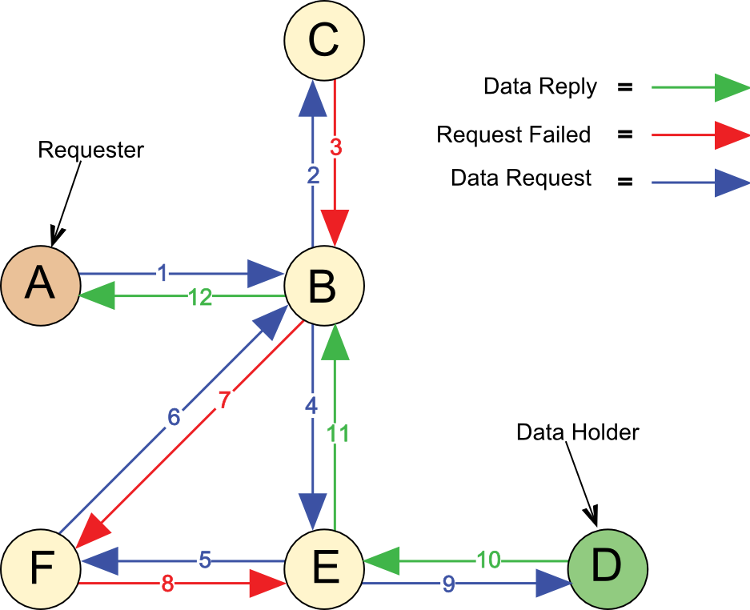
Layout
Image from http://en.wikipedia.org/wiki/File:Freenet_Request_Sequence_ZP.svg

Slide 38
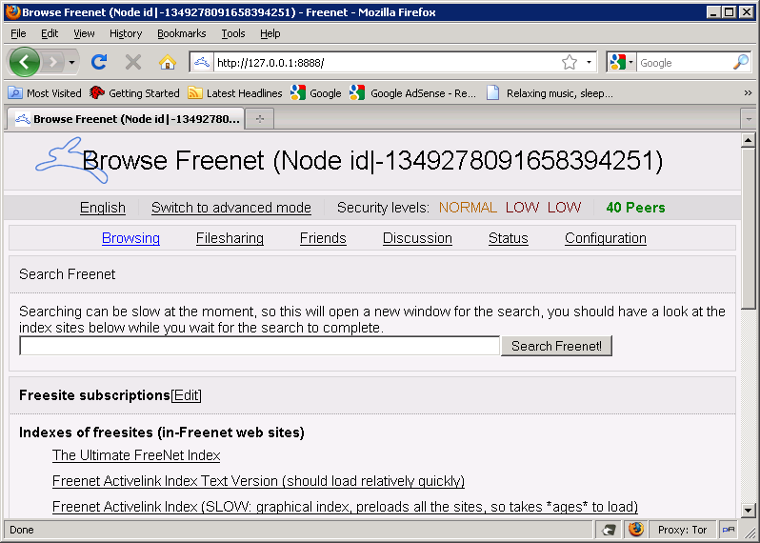
What does it look like to the user?

Slide 39
Key types
URI Example: http://127.0.0.1:8888/USK@0I8gctpUE32CM0iQhXaYpCMvtPPGfT4pjXm01oid5Zc,3dAcn4fX2LyxO6uCnWFTx-2HKZ89uruurcKwLSCxbZ4,AQACAAE/Ultimate-Freenet-Index/52/
CHK - Content Hash Keys
These keys are for static content, and the key is a hash of the content.
SSK - Signed Subspace Keys
Used for sites that could change over time, it is signed by the publisher of the content. Largely superseded by USKs.
USK - Updateable Subspace Keys
Really just a friendly wrapper for SSKs to handle versions of a document.
KSK - Keyword Signed Keys
Easy to remember because of simple keys like “KSK@myfile.txt” but there can be name collisions.

Slide 40
Modes of operation
Opennet
Lets any one in
Darknet
Manually configured “friend to friend”

Slide 41
Applications
jSite
A tool to create your own Freenet site
http://freenetproject.org/jsite.html
Freemail
Email system for Freenet
http://freenetproject.org/freemail.html
Frost
Provides usenet/forum like functionality
http://jtcfrost.sourceforge.net/
Thaw
For file sharing
http://freenetproject.org/thaw.html

Slide 42
Freenet Pros and Cons
Pros
Once you inject something into the network, it can stay there as long as it is routinely requested
Does a damn good job of keeping one anonymous
Awesome for publishing documents without maintaining a server
Cons
Slow
Not really interactive
Not used for accessing the public Internet
UDP based, which may be somewhat more noticeable/NAT issues
Not meant for standard IP protocols

Slide 43
What does the traffic look like?
(Keep in mind, this is just the defaults)
Local
FProxy: 8888/TCP (web interface)
FCP: 9481
Remote
Random UDP for Opennet and Darknet modes?
Darknet FNP: 37439/UDP (used to connect to trusted peers i.e. Friends; forward this port if you can)
Opennet FNP: 5980/UDP (used to connect to untrusted peers i.e. Strangers; forward this port if you can)
FCP: 9481/TCP (for Freenet clients such as Frost and Thaw)

Slide 44


I2P
Invisible Internet Project

Slide 45
Overview
Who?
I2P developers, started by Jrandom.
http://www.i2p2.de/
Why?
“I2P is an effort to build, deploy, and maintain a network to support secure and anonymous communication. People using I2P are in control of the tradeoffs between anonymity, reliability, bandwidth usage, and latency.” ~ from the I2p web site
What?
Mostly other web sites on I2P (Eepsites), but the protocol allows for P2P (iMule, i2psnark), anonymous email and public Internet via out proxies.
How?
Locally ran proxy of a sort that you can connect to and control via a web browser.

Slide 46
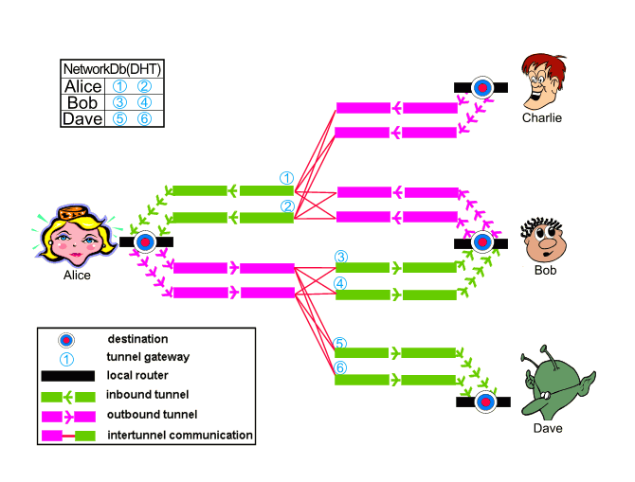
Layout
Image from http://www.i2p2.de/how_intro

Slide 47
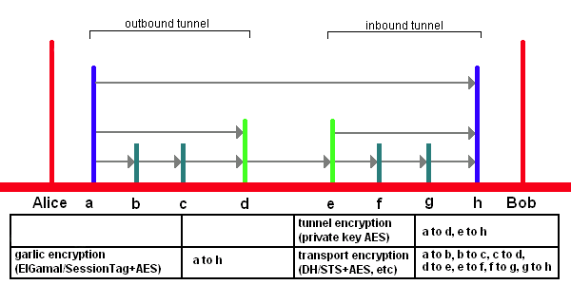
Encryption Layers
EIGamal/SessionTag+AES from A to H
Private Key AES from A to D and E to H
Diffie–Hellman/Station-To-Station protocol + AES
Image from http://www.i2p2.de/

Slide 48
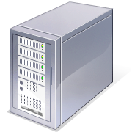

Ins and Outs
Tunnels are not bidirectional

Slide 49
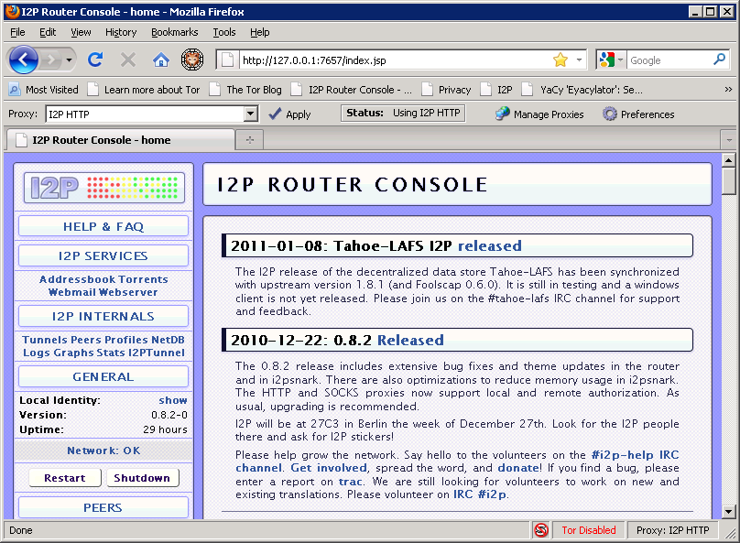
What does it look like to the user?

Slide 50
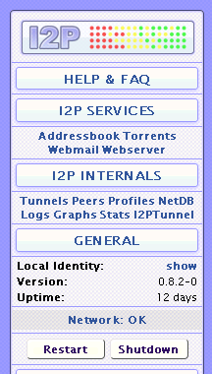
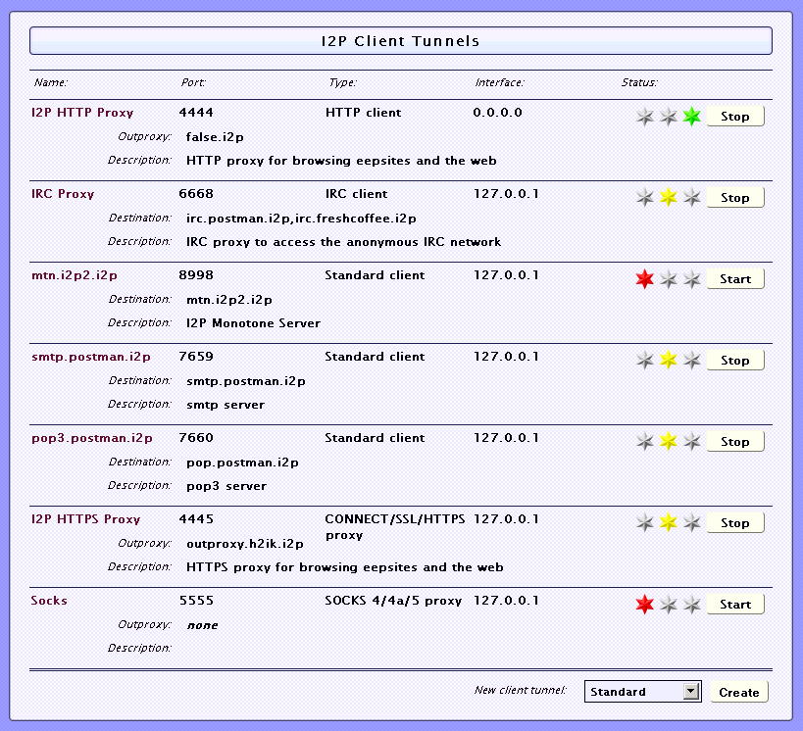
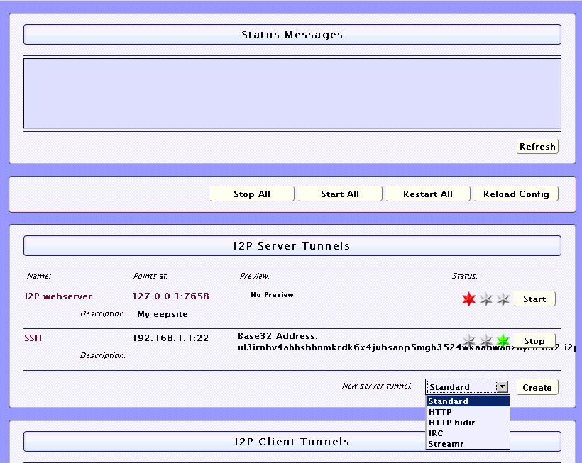
Making Tunnels

Slide 51
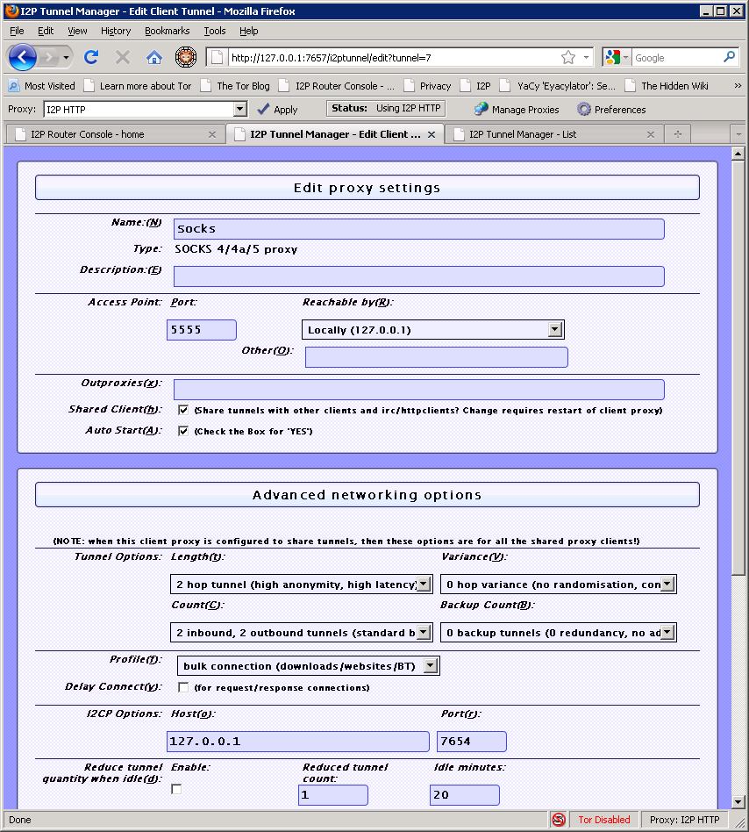
Making Tunnels
Simple SOCKS
client tunnel

Slide 52
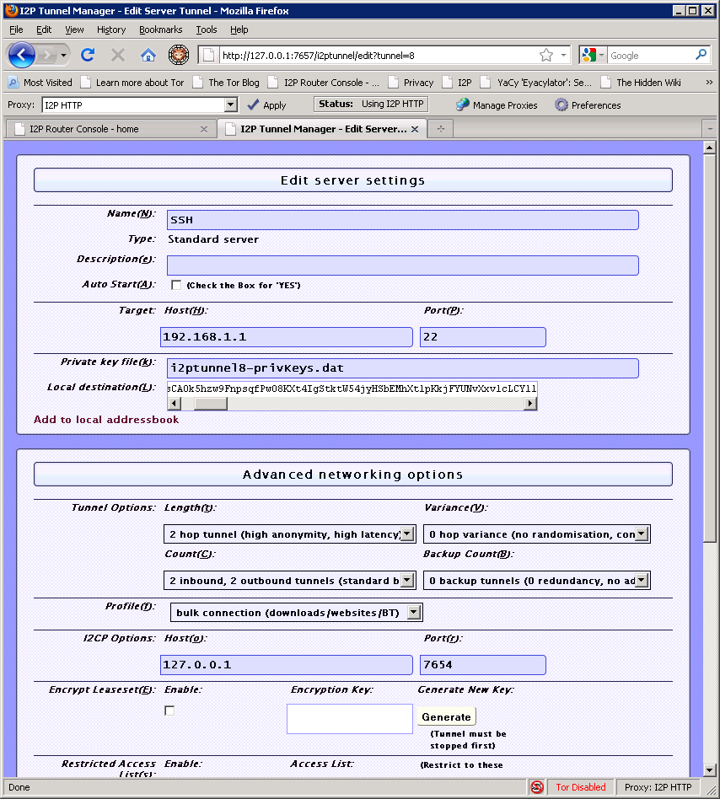
Making Tunnels
SSH Example

Slide 53
Naming and Addresses
Details
http://www.i2p2.de/naming.html
516 Character Address
-KR6qyfPWXoN~F3UzzYSMIsaRy4udcRkHu2Dx9syXSzUQXQdi2Af1TV2UMH3PpPuNu-GwrqihwmLSkPFg4fv4y
QQY3E10VeQVuI67dn5vlan3NGMsjqxoXTSHHt7C3nX3szXK90JSoO~tRMDl1xyqtKm94-RpIyNcLXofd0H6b02
683CQIjb-7JiCpDD0zharm6SU54rhdisIUVXpi1xYgg2pKVpssL~KCp7RAGzpt2rSgz~RHFsecqGBeFwJdiko-
6CYW~tcBcigM8ea57LK7JjCFVhOoYTqgk95AG04-hfehnmBtuAFHWklFyFh88x6mS9sbVPvi-am4La0G0jvUJw
9a3wQ67jMr6KWQ~w~bFe~FDqoZqVXl8t88qHPIvXelvWw2Y8EMSF5PJhWw~AZfoWOA5VQVYvcmGzZIEKtFGE7b
gQf3rFtJ2FAtig9XXBsoLisHbJgeVb29Ew5E7bkwxvEe9NYkIqvrKvUAt1i55we0Nkt6xlEdhBqg6xXOyIAAAA
SusiDNS Names
something.i2p
Hosts.txt and Jump Services
Base32 Address
{52 chars}.b32.i2p
rjxwbsw4zjhv4zsplma6jmf5nr24e4ymvvbycd3swgiinbvg7oga.b32.i2p

Slide 54
Applications/Sites
Services
IRC on 127.0.0.1 port 6668
Syndie
Bittorent
http://127.0.0.1:7657/i2psnark /
eMule/iMule
http://echelon.i2p/imule/
Tahoe-LAFS
More plugins at
http://i2plugins.i2p/
Susimail
http://127.0.0.1:7657/susimail
Garlic Cat
http://www.cypherpunk.at/onioncat/wiki/GarliCat
eepSites
Project site
http://www.i2p2.i2p/
Forums
http://forum.i2p/
http://zzz.i2p/
Ugha's Wiki
http://ugha.i2p/
Search engines
http://eepsites.i2p/
http://search.rus.i2p/
General Network Stats
http://stats.i2p/
Site Lists & Up/Down Stats
http://inproxy.tino.i2p
http://perv.i2p
I2P.to, like Tor2Web, but for Eepsites
http://i2p.to
example: eepsitename.i2p.to

Slide 55
I2P Pros and Cons
Pros
Lots of supported applications
Can create just about any hidden service if you use SOCKS5 as the client tunnel
Eepsites somewhat faster compared to Tor Hidden Services (Subjective, I know)
Cons
UDP based, which may be somewhat more noticeable/NAT issues
Oops, I was wrong, it can use UDP but TCP is preferred
Limited out proxies
Out proxies don’t handle all protocols (http/s should be good to go though)

Slide 56
What does the traffic look like?
These are defaults that can be changed in many cases
Local
1900: UPnP SSDP UDP multicast listener.
2827: BOB bridge
4444: HTTP proxy
4445: HTTPS proxy
6668: IRC proxy
7652: UPnP HTTP TCP event listener.
7653: UPnP SSDP UDP search response listener.
7654: I2P Client Protocol port
7655: UDP for SAM bridge
7656: SAM bridge
7657: Your router console
7658: Your eepsite
7659: Outgoing mail to smtp.postman.i2p
7660: Incoming mail from pop.postman.i2p
8998: mtn.i2p2.i2p (Monotone - disabled by default)
32000: local control channel for the service wrapper
Remote
UDP from the random port (between 9000 and 32000) noted on the configuration page to arbitrary remote UDP ports, allowing replies
TCP from random high ports (between 9000 and 32000) to arbitrary remote TCP ports
UDP on port 123
As copied from: http://www.i2p2.de/faq.html#ports but heavily edited. Check the I2P site for more details.

Slide 57
Some common Darknet weaknesses
Not all Darknets have all of these, but all of them have some of them ☺
Remote:
Traffic analysis
DNS leaks
Cookies from when not using the Darknet
http://www.irongeek.com/browserinfo.php
http://irongeek.com/downloads/beenherebefore.php
http://irongeek.com/downloads/beenherebefore.txt
Plug-ins giving away real IP
http://decloak.net/
http://ha.ckers.org/weird/tor.cgi
http://evil.hackademix.net/proxy_bypass/
http://www.frostjedi.com/terra/scripts/ip_unmasker.php
http://www.frostjedi.com/terra/scripts/phpbb/proxy_revealer.zip

Slide 58
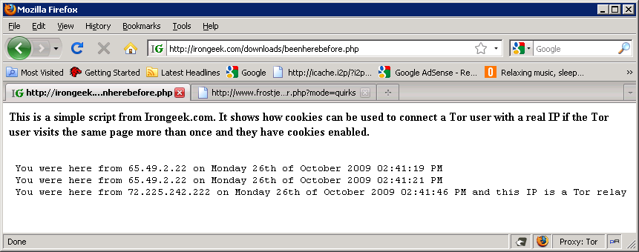
Cookie Example

Slide 59
Some common Darknet weaknesses
Not all Darknets have all of these, but all of them have some of them ☺
Remote (continued):
Un-trusted exit points
Dan Egerstad and the "Hack of the year“
http://www.schneier.com/blog/archives/2007/11/dan_egerstad_ar.html
http://encyclopediadramatica.com/The_Great_Em/b/assy_Security_Leak_of_2007
The snoopers may not know what you are sending, or to who, but they may know you are using a Darknet and that could be enough to take action.
Clock based attacks
Metadata in files
Sybil/infrastructure attacks
Many more…
http://www.i2p2.de/how_threatmodel.html
Local:
Cached data and URLs (Privacy mode FTW)
http://www.irongeek.com/i.php?page=videos/anti-forensics-occult-computing

Slide 60
I2P Specific attacks
Darknets and hidden servers: Identifying the true IP/network identity of I2P service hosts
http://www.irongeek.com/i.php?page=security/darknets-i2p-identifying-hidden-servers

Slide 61
Things to worry about if you decide to research Darknets
(IANAL)
Opening holes into your network
Encryption laws of your country
http://rechten.uvt.nl/koops/cryptolaw/
Inadvertently possessing child porn/contraband
  Wipe and forget?
  Tell the authorities?
  IANAL 18 USC § 2252
(c) Affirmative Defense.— It shall be an affirmative defense to a charge of violating paragraph (4) of subsection (a) that the defendant—
  (1) possessed less than three matters containing any visual depiction proscribed by that paragraph; and
  (2) promptly and in good faith, and without retaining or allowing any person, other than a law enforcement agency, to access any visual depiction or copy thereof—
    (A) took reasonable steps to destroy each such visual depiction; or
    (B) reported the matter to a law enforcement agency and afforded that agency access to each such visual depiction.

Slide 62
Other things to check out
Tor Bundle
http://www.torproject.org/projects/torbrowser.html.en
Multiproxy Switch
https://addons.mozilla.org/en-US/firefox/addon/7330
Wippien
http://www.wippien.com/
Blackthrow/Svartkast/Pivot/Dropbox
http://cryptoanarchy.org/wiki/Svartkast
HP Veiled
Matt Wood & Billy Hoffman’s Blackhat Slides
http://www.blackhat.com/presentations/bh-usa-09/HOFFMAN/BHUSA09-Hoffman-VeilDarknet-SLIDES.pdf

Slide 63
Events
DerbyCon 2011, Louisville Ky
Sept 30 - Oct 2
http://derbycon.com/
Louisville Infosec
http://www.louisvilleinfosec.com/
Other Cons:
http://www.skydogcon.com/
http://www.dojocon.org/
http://www.hack3rcon.org/
http://phreaknic.info
http://notacon.org/
http://www.outerz0ne.org/
Notes:
Beg for hardware donations. ☺

Slide 64
Questions?
42

