Slide 1

Boot Devices:
Or in Canadian, what is this all aboot
Adrian Crenshaw

Slide 2

About Adrian
I run Irongeek.com
I have an interest in InfoSec education
I don’t know everything - I’m just a geek with time on my hands
(ir)Regular on the ISDPodcast
http://www.isd-podcast.com/
Prepare yourselves for a disorganized boot CD/DVD/UFD braindump, but as notes they may help you to avoid my mistakes
Notes:
Take a note from Johnny Long’s book, and Bruce Potter’s book.

Slide 3
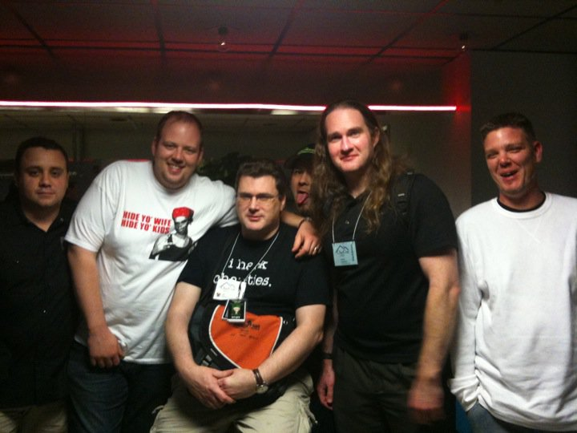
Why care?
Malware removal
Forensics
Privacy
Access to restricted tools
Imaging
Physical access = pwnage
These guys may come to visit

Slide 4
Dumbed down boot process
Something like this
System Start
Primary Boot Loader:
BIOS, UEFI
Secondary Boot Loader:
SYSLINUX, Grub, NTLDR, BCD, Chainboot from one loader to another
OS:
Linux, Windows, Rule34OS

Slide 5


RAM Disks
Why use memory?
For optical media, it’s read only (mostly)
For USB, it only has so many write cycles
For both: Speed
For some hardware, RAM disk
just works better than UFD
Not quite the same thing
UnionFS, AuFS or EWF, which redirect writes to what would otherwise be a read only file system

Slide 6
Distros/Boot environments
Just a few:
BackTrack Linux
http://www.backtrack-linux.org
Tails (The Amnesic Incognito Live System)
http://tails.boum.org/
Bart’s PE/UBCD4Win
http://www.nu2.nu/pebuilder/
http://www.ubcd4win.com/
Winbuilder/Win7PE SE
http://winbuilder.net/ & http://reboot.pro/12427/
Konboot
http://www.piotrbania.com/all/kon-boot/

Slide 7
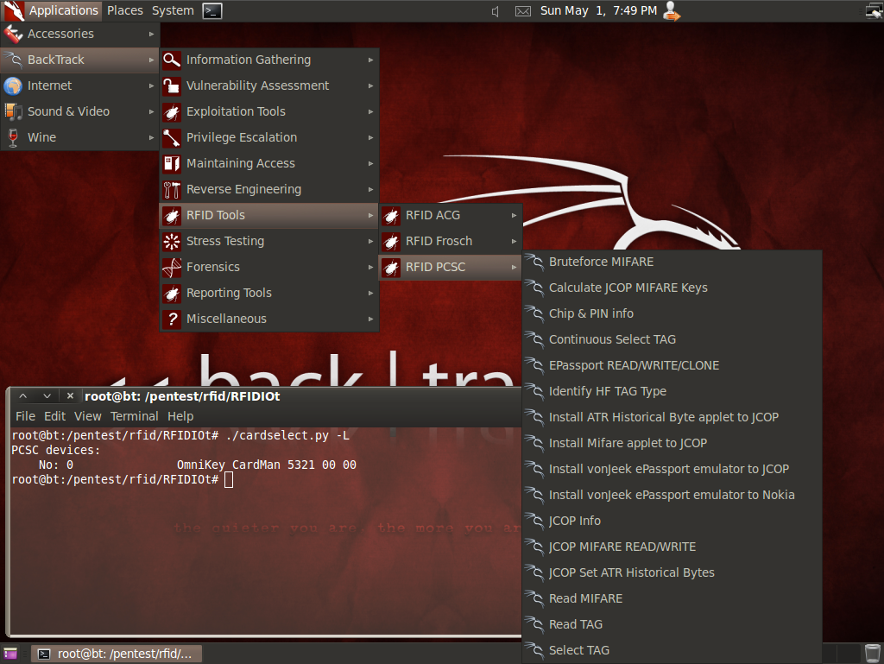
BackTrack Linux
Tons of security tools
Awesome hardware support for odd wireless needs
Well maintained
Can do a hard drive install if you wish
Image from http://www.backtrack-linux.org/screenshots/

Slide 8
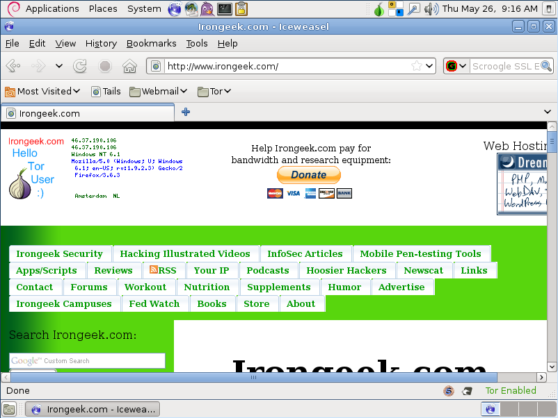
Tails
Boot from CD/DVD to leave less of a trail
Use Tor to anonymize traffic

Slide 9
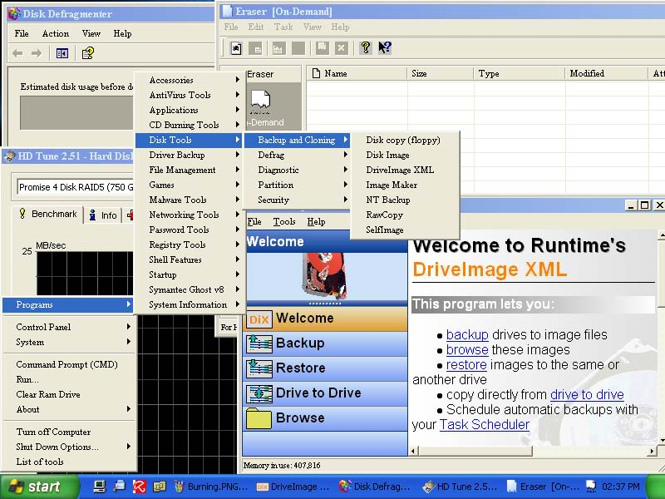
Bart’s PE/UBCD4Win
Bart’s PE can be build from the files on a Windows XP CD
UBCD4Win is Bart’s Pe with a bunch of extras + Multi-boot (DBAN)
Plugins can be made to add functionality
Image from http://www.ubcd4win.com/screen.htm

Slide 10
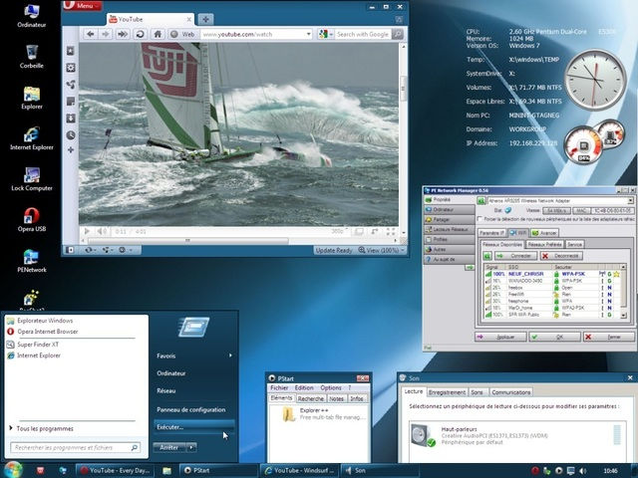
Winbuilder/Win7PE SE
Make a Windows based boot USB/CD/DVD
Starting OS needed depends on build
Plugins can be made to add functionality
Build even up to Win7 SP1 32/64bit
Hardcore roll your own
Image from http://reboot.pro/12427/

Slide 11

Konboot
Bypass password on some versions of Windows and Linux
Changes kernel on boot
Login to Linux with “kon-usr” as username.
Use a blank password in Windows
Meant to run from a CD/Floppy, sometimes works from a UFD using instructions found here: http://www.irongeek.com/i.php?page=security/kon-boot-from-usb
Image from http://www.piotrbania.com/all/kon-boot/

Slide 12

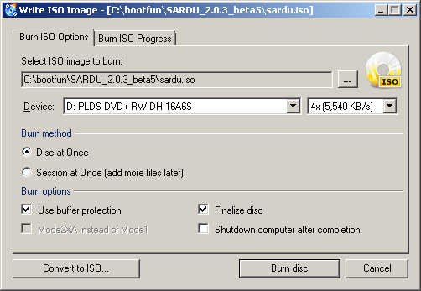
Burn an ISO
Windows
CD Burner XP
http://cdburnerxp.se/
ImgBurn
http://www.imgburn.com/
Linux
Brasero
http://projects.gnome.org/brasero/
https://help.ubuntu.com/community/Brasero
Don’t forget to close an finalize!!!

Slide 13
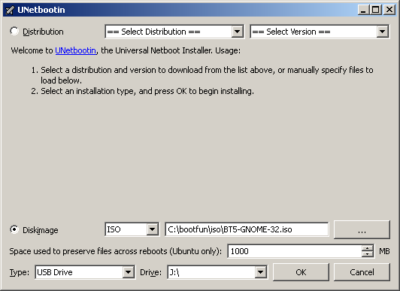
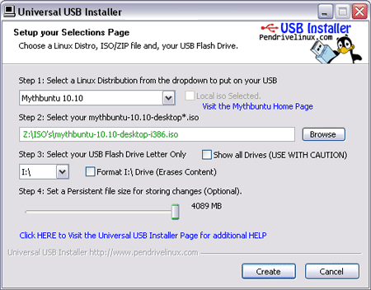
Make that Linux ISO a bootable USB
UNetBootin (multiplatform)
http://unetbootin.sourceforge.net/
Universal USB Installer
http://www.pendrivelinux.com/universal-usb-installer-easy-as-1-2-3/
Persistence
Image from http://www.pendrivelinux.com

Slide 14
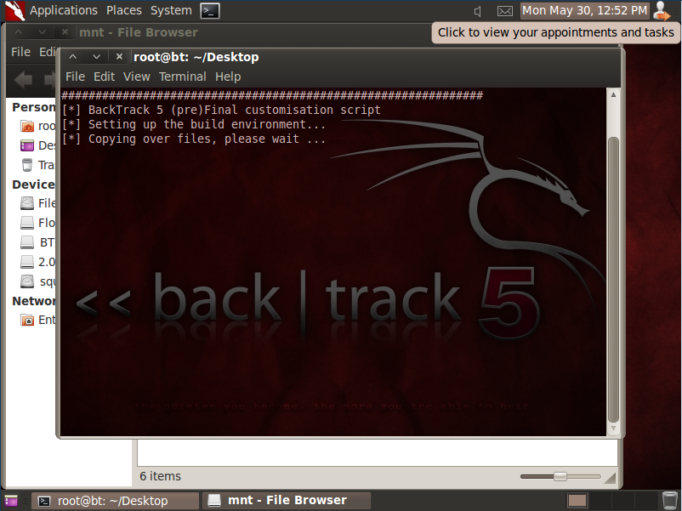
Linux Remastering
Mount the ISO , Chroot, Edit, make a new ISO
Made a script base on morning_wood’s post here: http://www.backtrack-linux.org/forums/backtrack-5-beginners-section/40515-customise-script-bt5.html

Slide 15
Windows based bootables
What is Windows PE?
  Windows Preinstallation Environment
  Part of Microsoft's Windows Automated Installation Kit (WAIK)
  Cut down version of Windows for installs/repairs/diagnostics
  Not all Windows features are available
Other PE based tools give us extra capabilities

Slide 16
A few notes on the Windows based tools and AV
May want to turn off anti-virus while building
Speed reasons
Some tools trip it, like Nir’s password tools

Slide 17
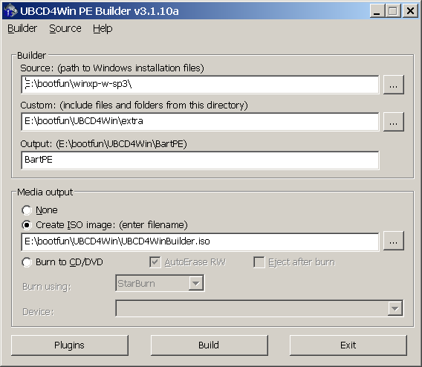
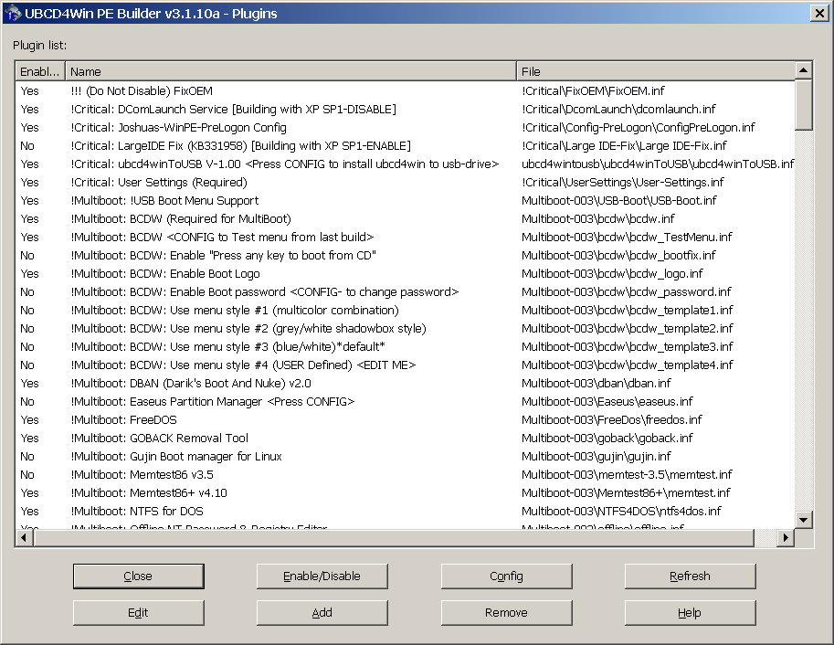
UBCD4Win/Bart’s PE

Slide 18
UBCD4Win/Bart’s PE
Demo/Overview

Slide 19
Common issues with UBCD4Win
Problems may be cause by building from Vista/Win 7
PreLogon File Not Found
Copy C:\Windows\Registration\R000000000001.clb to USB at \MININT\Registration\R000000000001.clb
Blue Screen of Death 0x0000007B error may require a hacked ntdetect.com

Slide 20
Putting UBCD4Win to a USB
UBUSB Utility (act’s like it’s locked up, just give it time)
http://www.ezpcfix.net/ubcd4win/UBUSB.exe
UBUSB Instructions
http://ubcd4win.com/forum/index.php?showtopic=11375
Other options:
RMPrepUSB (Nice details on problems) http://sites.google.com/site/rmprepusb/tutorials/ubcd4win
Bootable USB-Drive Utility http://www.911cd.net/forums//index.php?showtopic=21702

Slide 21
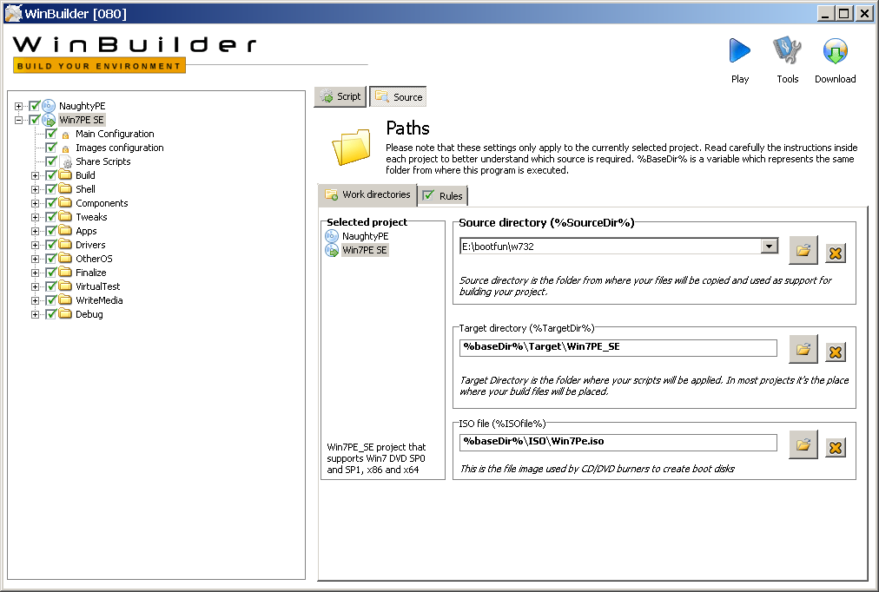
WinBuilder/Win7PE SE
Tons of scripts to roll your own
Demo is the best way to show you
Download from http://winbuilder.net/

Slide 22
Needed files to build
Download and install KB3AIK_EN.iso from http://www.microsoft.com/downloads/en/details.aspx?FamilyID=696dd665-9f76-4177-a811-39c26d3b3b34&displaylang=en
After install copy the following files from C:\Program Files\Windows AIK\Tools\amd64\
  bcdedit.exe
  imagex.exe
  wimgapi.dll
  wimmount.inf
  wimmount.sys
  wimserv.exe
to C:\bootfun\winbuilder\Projects\Tools\Win7PE_SE\x64
Path will vary depending on build platform
WinFE may already have the needed tools

Slide 23
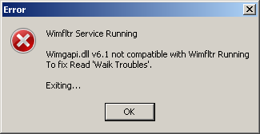
If you get this error, reboot and try again
Some of the WIM tools may be mismatched

Slide 24
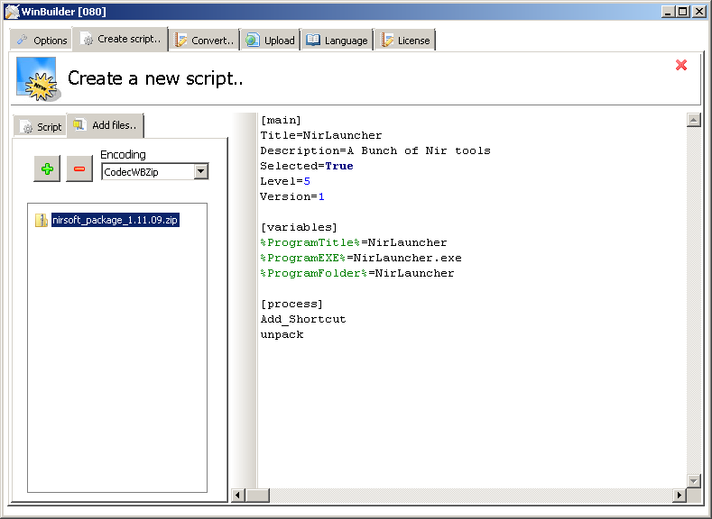
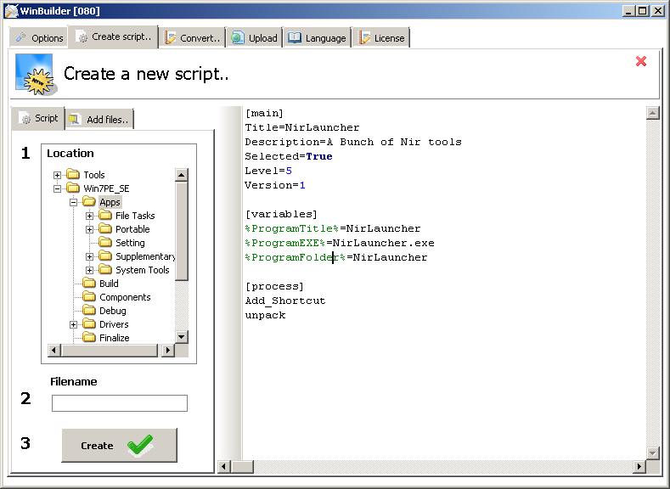
WinBuilder Scripts
Best of luck

Slide 25
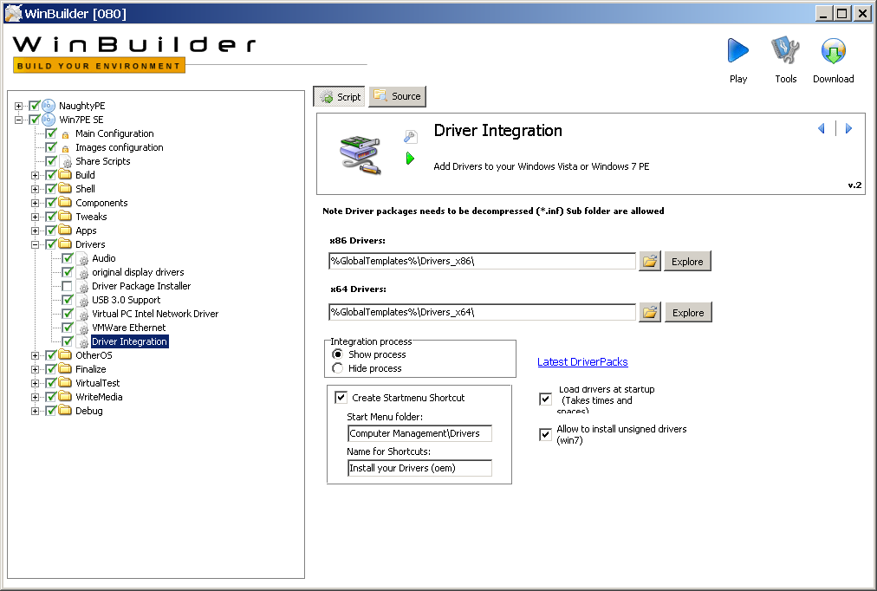
Driverpacks
Grab some drivers
http://driverpacks.net

Slide 26
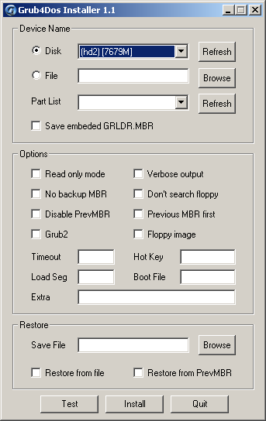
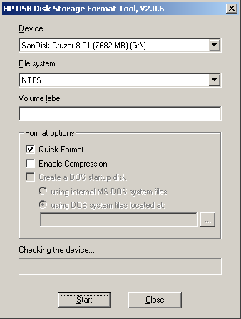
Putting WinBuilder to a USB
Using Built-in USB creator

Slide 27
WinBuilder/Win7PE SE
Demo/Overview

Slide 28
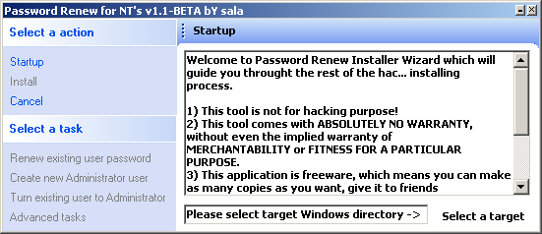
A few key tools
Runscanner for registry redirection
http://www.paraglidernc.com/winbuilder/Scripts/scripts.htm
Portable Apps
http://portableapps.com/
Sala’s Password Renew
http://www.kood.org/windows-password-renew/
http://thuun.boot-land.net/WinBldr/XP-2K3/Projects/
Tons more scripts for Winbuilder can be found at
http://reboot.pro/forum/65/

Slide 29
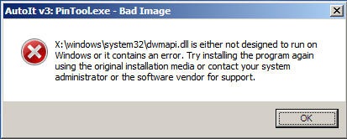
Other Winbuilder Projects
NaughtyPE
http://reboot.pro/3866/
WinFE
http://winfe.wordpress.com/
Note on building FE with the wrong sources…

Slide 30
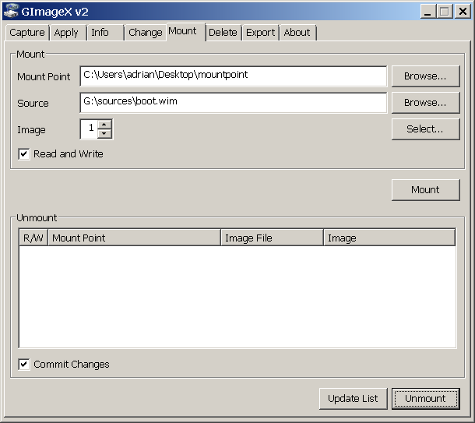
Edit a WMI file
Might me easier to do than writing a script
May have to use “subst y: f:\” or the like to get paths to match for shortcuts

Slide 31
Saving your WinBuilder project for later USB creation
Saving:
Zip up all the files
Re-deploying to a new USB:
Unzip to a new USB
Reinstall GRUB4DOS boot loader with
http://download.gna.org/grubutil/grubinst-1.1-bin-w32-2008-01-01.zip
You could also make an image, but that might be space restrictive

Slide 32
Multibooting
Katana
http://www.hackfromacave.com/katana.html
YUMI
http://www.pendrivelinux.com/yumi-multiboot-usb-creator/
Xboot
http://sites.google.com/site/shamurxboot/
SARDU
http://www.sarducd.it/

Slide 33

Katana Notes
Bear to download, but has a bunch of ISOs already there
May have to update yourself
Image from http://www.hackfromacave.com

Slide 34
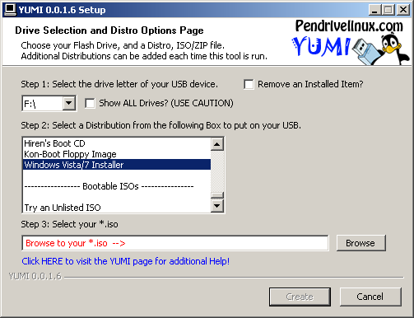
YUMI Notes ver. 0.0.1.6
WinBuilder from ISO with “Windows 7/Vista Installer” works fine
UBCD4Win from ISO fails/Bluescreens/locks up/reboots
  Windows 7/Vista Installer
  Try an Unlisted ISO
  Try an Unlisted ISO (from memory)
Backtrack sometimes works, sometime fails

Slide 35
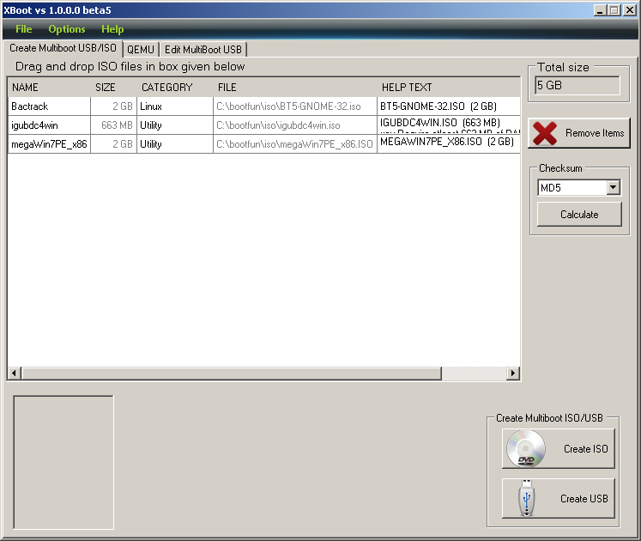
XBOOT Notes ver. 1.0.0.0 beta 6
Create ISO or UFD
Look at ErrorLog(CreateISO).txt
Edit category
Rename Bactrack to Backtrack
From USB:
  WinBuilder from ISO with “Windows 7/Vista Installer” works fine
  UBCD4Win with (PE, MSDART, ERD (Windows XP Only)) copies to memory but seems to work
  Backtrack fails to pass 2nd boot menu
From ISO:
  Had to use VMWare to emulate the DVD from the ISO, Burned both a DVD-R and a DVD+RW and neither worked
  Same results as USB above in VM

Slide 36
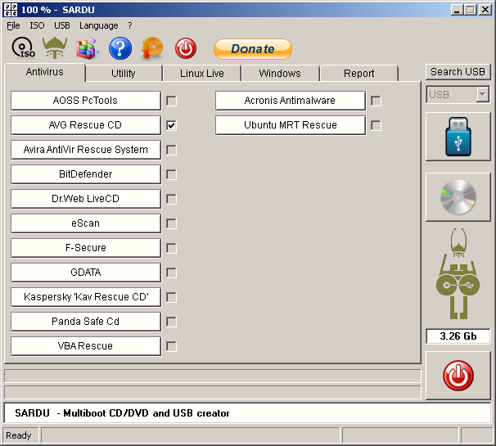
SARDU Notes ver. 2.0.3 beta 5
Create ISO or UFD
Auto-download, like some others
Having to give the ISOs a certain name suck
Seems to update regularly
UFD defrag option
From USB:
  Had problems getting BT5 to fully load
  UBCD4Win rebooted
  Even Win7PE SE dies
From ISO:
  UBCD4Win Bluescreens 0x0000007B
  BT5 works
  Win7FE SE works (slowly)

Slide 37
Best way to dual boot Backtrack and Win7PE SE
Install Backtrack 5 to the UFD with Unetbootin
Copy over the Win7PE files
Get chain.c32 from http://www.kernel.org/pub/linux/utils/boot/syslinux/syslinux-4.04.zip in \com32\modules
Add something like the following to your syslinux.cfg:
LABEL WinPE via Grub
COM32 /chain.c32
APPEND ntldr=/grldr

Slide 38
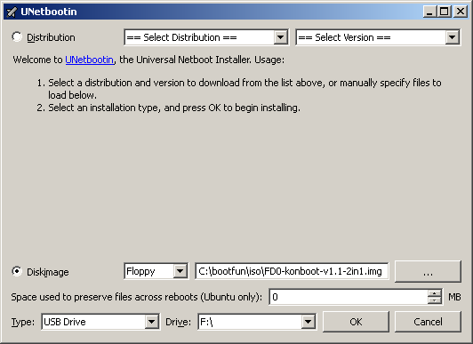
Putting Konboot on a USB
Details at
http://www.irongeek.com/i.php?page=security/kon-boot-from-usb
Use Unetbootin to write the floppy image to the drive
Chain booting to HD
Best to show you the
syslinux.cfg

Slide 39
Other distros of interest
GParted
http://gparted.sourceforge.net/
WinFE (Windows Forensic Environment)
http://winfe.wordpress.com/
Hiren's Boot CD
Seems to be partly pirated, Google if you care
Ultimate Boot CD
http://www.ultimatebootcd.com/
Symantec Ghost Boot Wizard

Slide 40

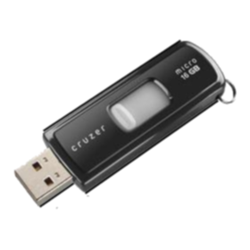
U3 Notes
Yet to ever get an ISO on a U3 to boot
Still useful for “read only” feature
Grab the following tools:
http://u3-tool.sourceforge.net/
http://code.google.com/p/create-iso-file/

Slide 41
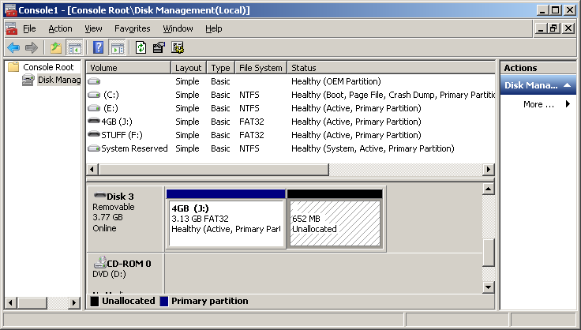
Making/Loading your own U3
Make an ISO from a directory (ImgBurn is also an option):
CDIMAGE.EXE -lU3 -nt -h nirsoft_package_1.11.09 myU3.iso
See u3-tool options by running it without parameters.
See information about thumb drive K: (or whatever)
u3-tool.exe -i k
Find the size of your ISO:
dir myU3.iso
Repartition:
u3-tool.exe -p 14655488 k
Load ISO:
u3-tool.exe -l myU3.iso k
If you have issues getting rid of partitions, use Linux
instead of Windows drive tools

Slide 42
More resources
My guide and files for Konboot from a USB:
http://www.irongeek.com/i.php?page=security/kon-boot-from-usb
Pen Drive Linux
http://www.pendrivelinux.com
Reboot Pro (change the default skin)
http://reboot.pro
My dated Pebuilder tutorial
http://www.irongeek.com/i.php?page=security/pebuildertutorial
Live CD List
http://www.livecdlist.com/?order=field_lastrelease_value&sort=desc
Linux Live scripts
http://www.linux-live.org
USB Flash Drive Speed Tests
http://usbspeed.nirsoft.net/

Slide 43
Booting Demos
Not sure if there will be time…

Slide 44


Thanks
ISSA Kentuckiana for having me
By buddies from Derbycon and the ISDPodcast

Slide 45
Events
DerbyCon 2011, Louisville Ky
Sept 30 - Oct 2
http://derbycon.com/
Louisville Infosec
http://www.louisvilleinfosec.com/
Other Cons:
http://www.skydogcon.com/
http://www.dojocon.org/
http://www.hack3rcon.org/
http://phreaknic.info
http://notacon.org/
http://www.outerz0ne.org/
Notes:
Beg for hardware donations. ☺

Slide 46
Questions?
42

