Slide 1
Beyond Nmap: Other network scanners
Adrian Crenshaw

Slide 2
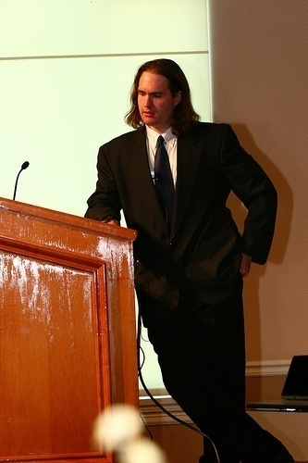
About Adrian
I run Irongeek.com
I have an interest in InfoSec education
I don’t know everything - I’m just a geek with time on my hands
(ir)Regular on the ISDPodcast http://www.isd-podcast.com/
Notes:
Take a note from Johnny Long’s book, and Bruce Potter’s book.

Slide 3
Boring Background
For people who’s glasses are not so thick

Slide 4
TCP/UDP/IP Basics
To use an analogy, if IPs are an apartment complex’s address, ports are the apartment number
Both UDP and TCP use incoming and outgoing ports
Most IP based services listen on standard ports (HTTP 80tcp, SMTP 25tcp, SMB 139/445tcp, DNS port 53tcp and udp)

Slide 5
What and Why of Port Scanning
Since ports are fairly standard, if port 80tcp is listening on a host, more than likely it’s running web services
By sending packets to these port numbers, you can see what services are running on the host
Knowing what services are running lets you know something about the potential attack surface
What about finger printing?

Slide 6
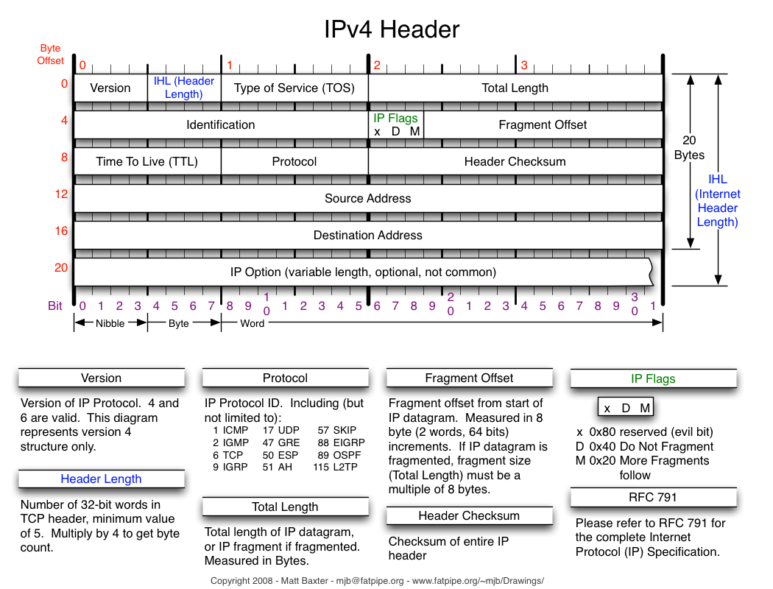

Slide 7
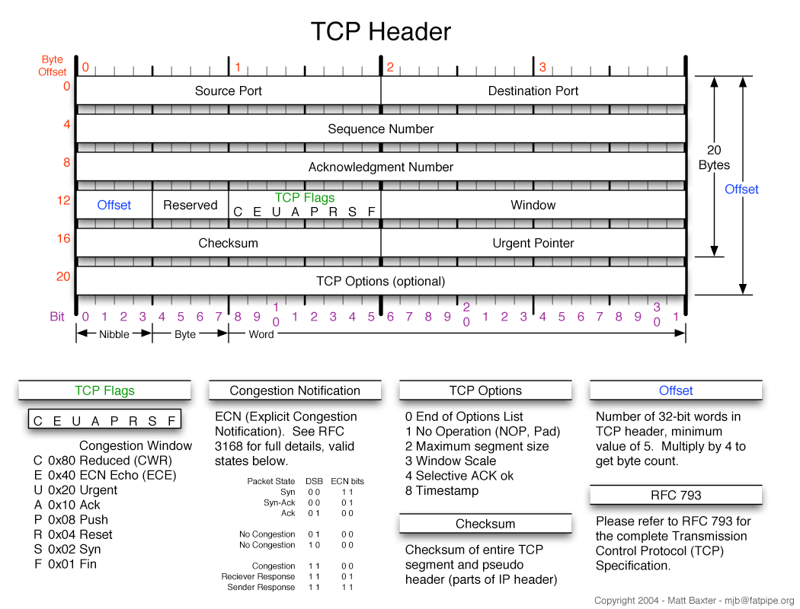

Slide 8
Targeting
Wildcards 192.168.*.*
Range 192.168.0-255.0-255
Mask Notation (CIDR) 192.168.0.0/16
Classless Inter-Domain Routing
Not all of the above range would be valid
Decimal | Binary
192.168.1.1 | 11000000.10101000.00000001.00000001
/16 | 11111111.11111111.00000000.00000000
Binary AND the above together | 11000000.10101000.00000000.00000000
192.168.0.0 | 11000000.10101000.00000000.00000000
192.168.255.255 | 11000000.10101000.11111111. 11111111

Slide 9
Port Scan in Action
tcp-syn-connect.swf
Use --packet_trace to see what going on

Slide 10
So, what about UDP?
Problems:
Packets to open ports don’t have to be acknowledged
Closed ports may send back ICMP_PORT_UNREACH messages, but don’t have to
RFC 1812 section 4.3.2.8 if implemented may limit ICMP packets returned

Slide 11
Nmap
One of the most popular port scanners
Started by Gordon Lyon (Fyodor) back in 1997, as an article for Phrack Magazine 51
Started as a fairly simple port scanner, and has suffered some pretty serious feature creep since. ☺
Multiplatform (Linux, Windows, BSD, OS X)
Open Source and available from http://nmap.org/

Slide 12
Simple Scan Example
nmap -sS -A 192.168.1.*

Slide 13
But, let’s move on
Hping http://www.hping.org/
Unicorn Scan http://www.unicornscan.org/
AutoScan http://autoscan-network.com/
Netscan http://www.softperfect.com/products/networkscanner/
Metasploit http://www.metasploit.com/
NetworkMiner http://networkminer.sourceforge.net/

Slide 14
Hping
Nice for packet creation
Also good for rolling your own tests, and seeing what returns what
Only for one IP at a time
Demo commands:
hping –S microsoft.com –c 1 –p 80
hping –S 192.168.1.1 –p ++20

Slide 15
Unicorn Scan
Use CIDR notation
Really not sure about about the logo
Demo commands:
unicornscan 192.168.1.1:0-100 -z

Slide 16
AutoScan
Nice GUI and Wizard
Intrusion alert
Can be agent based
Nokia N770, N800 or N810 versions
Demo:
Basic Wizard/GUI
Alert

Slide 17
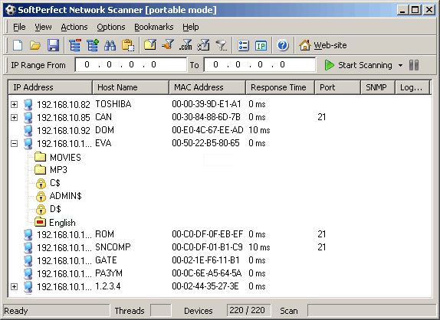
Netscan
Nice GUI, easy to use
Great at scanning for open SMB file shares
Demo:
Basic config and scan

Slide 18
Metasploit Auxiliary Scans
More than just point, click, exploit
Lots of Auxiliary modules for extra functionality
Seems to be able to use Nmap style targeting
Don’t forget to use msfupdate
use auxiliary/scanner/discovery/arp_sweep
set SHOST 192.168.1.1
set SMAC 00:0c:29:e3:39:f5
set RHOSTS 192.168.1.1/24
exploit -j
use auxiliary/scanner/smb/smb_version
set RHOSTS 192.168.1.1/24
exploit -j
use auxiliary/scanner/portscan/syn
set THREADS 1000
set RHOSTS 192.168.1.1/24
set TIMEOUT 5
exploit -j

Slide 19
More Metasploit
More Metasploit than you can stand, with instructors David "ReL1K" Kennedy, Martin "PureHate" Bos, Elliott "Nullthreat" Cutright, Pwrcycle and Adrian "Irongeek" Crenshaw. http://www.irongeek.com/i.php?page=videos/metasploit-class

Slide 20
Roll your own
Nmap NSE/LUA Scripts
-sC Performs a script scan using the default set of scripts.
--script <script-categories> |<directory>|<filename>|all
Categories: safe, intrusive, malware, version, discovery, vuln, auth, default
Fyodor did a talk at Defcon 18 on the subject
Metasploit
If you can learn Ruby, write your own script and add it to auxiliary

Slide 21
Sample NSE Script
description = [[
Let's try to print something. Based this on the pptp script
]]
-- rev 0.1 (08-23-2010)
author = "Adrian Crenshaw"
license = "Same as Nmap--See http://nmap.org/book/man-legal.html"
categories = {“safe"}
require "comm"
require "shortport"
portrule = shortport.version_port_or_service(9100)
action = function(host, port)
local payload = "Did I print?\n\n\027"; -- Just print this
comm.exchange(host, port, payload, {timeout=5000})
return ("Hope for the best")
end
Test with: nmap --script printsomething localhost
ncat -l -p 9100 NSE docs: http://nmap.org/nsedoc/

Slide 22
NetworkMiner
Not a scanner, but great for OS detection
NetworkMiner + application = less suspicious finger printing
Demo: Simple, semi-passive fingerprinting
More info: http://www.irongeek.com/i.php?page=videos/networkminer-for-network-forensics

Slide 23
Links
Nmap http://nmap.org/
Nmap Videos http://irongeek.com/i.php?page=videos/nmap-louisville-issa http://irongeek.com/i.php?page=videos/nmap1 http://irongeek.com/i.php?page=videos/nmap2
BackTrack Live CD and VM http://www.backtrack-linux.org

Slide 24
More Links
Hping http://www.hping.org/
Unicorn Scan http://www.unicornscan.org/
AutoScan http://autoscan-network.com/
Netscan http://www.softperfect.com/products/networkscanner/
Metasploit http://www.metasploit.com/
NetworkMiner http://networkminer.sourceforge.net/

Slide 25
Events
Louisville Infosec http://www.louisvilleinfosec.com/
DerbyCon 2011, Louisville Ky http://derbycon.com/
Skydogcon/Hack3rcon/Phreaknic/Notacon/Outerz0ne http://www.skydogcon.com/ http://www.hack3rcon.org/ http://phreaknic.info http://notacon.org/ http://www.outerz0ne.org/
Notes:
Beg for hardware donations. ☺

Slide 26
Questions?
42

