Slide 1
Occult Computing and anti-forensics
Adrian Crenshaw
Notes:
Spit out gum, slow down and enunciate. ☺
For those others reading this, yes I put lots of side notes for myself in the slides. ☺

Slide 2
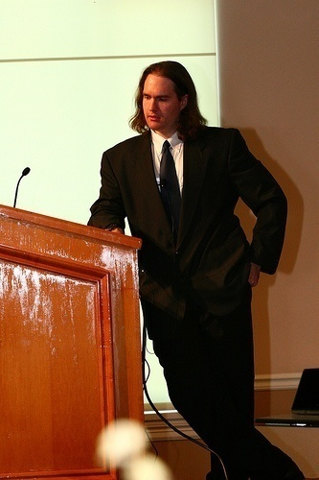

About Adrian
I run Irongeek.com
I have an interest in InfoSec education
I don’t know everything - I’m just a geek with time on my hands
I’m an (Ir)regular on the InfoSec Daily Podcast: http://isdpodcast.com
Co-Founder of Derbycon
http://www.derbycon.com/
Twitter: @Irongeek_ADC
Notes:
Take a note from Johnny Long’s book, and Bruce Potter’s book.

Slide 3
Short Version
Here is a longer talk I did on this subject:
http://www.irongeek.com/i.php?page=videos/anti-forensics-occult-computing
For those that want to leave early, here is the VERY short version:
Maintain physical control of your computer.
Use full hard drive encryption.
Keep things separate.

Slide 4
Why Occult Computing?
Occult comes from the Latin word occultus (clandestine, hidden, secret), referring to "knowledge of the hidden".
Forensic: Relating to the use of science and technology in the investigation and establishment of facts or evidence in a court of law.
Since hiding activities is what we are doing, Occult Computing seems like a good name.
Since people are not necessarily hiding their activities from a court of law, the term anti-forensics may not always apply.
Occult Computing sounds cooler than Anti-forensics ☺
Cthulhu fhtagn
Thanks to Wikipedia and Wiktionary for wording of definitions

Slide 5
What’s this talk about?
Why:
Not about just hiding your stash from the Fuzz…
Law/policy enforcement may find it useful to know how folks hide their computer activities
Users may want to know how to hide their activities from invasive law/policy enforcement
Companies may want to know how to clear boxes before donating them
What:
Mostly Windows, but most ideas are applicable to other operating systems
Not going to cover malware analysis, nor network anti-forensics (at least not much)
Mostly we will cover hiding tracks left on storage media

Slide 6
Four categories
Don’t leave tracks in the first place
Selective file removal and encryption tools
Parlor Tricks
Nuke it from orbit, it's the only way to be sure

Slide 7
Irongeek’s first two rules of personal security/privacy
If it’s not easy, folks won’t do it.
If it’s not secure there’s no point in doing it.

Slide 8
What anti-forensic techniques are likely to be seen?
Bow down before my Venn diagram of doom!!!
Just deleting a file
Selective file wiping and encryption
Full drive wiping and encryption
Hidden partitions
Stego
Secure
All of anti-forensics research
Convenient
Comprehensive
2
Weak
Technical
5
3
1
4

Slide 9
Background Info
Stuff that’s useful to know

Slide 10
Interesting legal stuff
IANAL
Julie Amero
http://en.wikipedia.org/wiki/State_of_Connecticut_v._Julie_Amero
http://www.securityfocus.com/columnists/434/
Sebastien Boucher
http://en.wikipedia.org/wiki/United_States_v._Boucher
The “Hacker Defense”
http://www.forensicswiki.org/wiki/Legal_issues
http://exforensis.blogspot.com/2008/07/troljan-horse-defense.html
If the system is set to wipe data at regular intervals normally, that may be ok. Wiping data once an investigation is about to be underway will make things worse.
Spoliation: Someone screwed up the evidence
CSI effect
http://en.wikipedia.org/wiki/CSI_effect
Plausible Deniability Tool Kit (PDTK)
http://www.nmrc.org/pub/pdtk/
http://www.defcon.org/html/links/dc-archives/dc-14-archive.html#weasel

Slide 11
Tech Stuff
It’s hard to cover this in order.
You need to understand some things before you understand others, but which you have to understand first is questionable.
Windows jams data in all sorts of places, and there are tools to make this data fairly easy to recover.

Slide 12
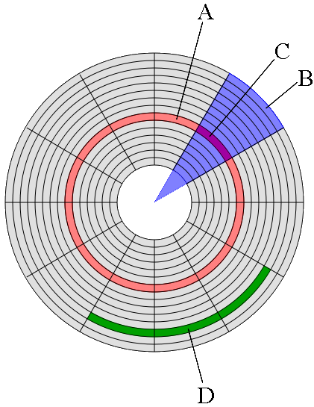
Disks, Tracks, Sectors
A. Track
B. Geometric Sector
C. Track Sector
D. Cluster

Slide 13
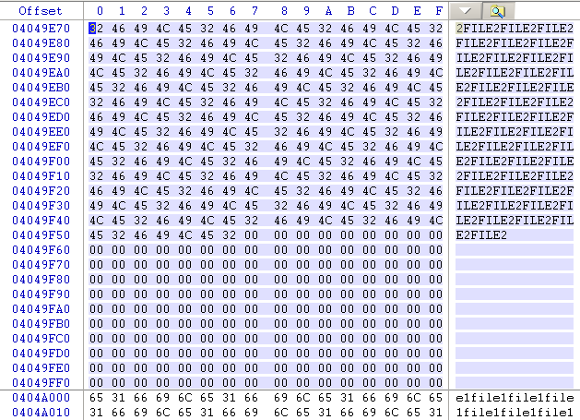
Slack Space
Yum…Leftovers!!!
RAM slack (but name no longer really applies) and Residual slack
Notes:
Demo:
Show some slackspace, via search
Show formats by different OS

Slide 14
Hash
One way functions:
Easy:
md5("I am a string") = "1710528bf976601a5d203cbc289e1a76“
Hard:
String("1710528bf976601a5d203cbc289e1a76“) =
("I am a string")
Can be used to fingerprint files, or see if they have changed

Slide 15
Host-Protected Areas and Disk Configuration Overlay
Parts of the drive that can be set aside that normal OS and BIOS functions can’t see
Possible to hide data there, but it’s a pain
Taft (he’s one bad mother….)
http://www.vidstrom.net/stools/taft/
More info
http://www.forensicswiki.org/wiki/DCO_and_HPA

Slide 16
Forensically interesting areas in the Windows file system
Way too many to list, but lets check some out:
http://www.irongeek.com/i.php?page=security/windows-forensics-registry-and-file-system-spots
Nirsoft has a lot of tools for grabbing data:
http://www.nirsoft.net/
Deft Linux
http://www.deftlinux.net/
Notes:
Demo:
Go to link, show some
Use:
Track-covering\Cleanafterme
Bin\mylastsearch
Deft\Cookie viewers
Bin\pasco

Slide 17
Don’t leave tracks in the first place
Pr0n mode and places data hides

Slide 18




Privacy mode (aka porn mode) in browsers
Firefox (Private Browsing)
  Keyboard shortcut: Ctrl+Shift+P
  Command line: No command line, but can be set on start via Tools>Options>Privacy “Use custom setting”
IE (InPrivate)
  Keyboard shortcut: Ctrl+Shift+P
  Command line: -private
Chrome (Incognito mode)
  Keyboard shortcut: Ctrl+Shift+N
  Command line: --incognito
Opera (kiosk mode)
  Ok, not quite the same thing, but maybe someone will email me a solution
Do some research online to see how good your browser’s “porn mode” really is.
Notes:
Demo:
Firefox and IE Ctrl+Shift+P

Slide 19
Private portable browsers
Portable Apps
http://portableapps.com/apps/internet
Tor Browser Bundle http://www.torproject.org/easy-download.html.en
Firefox based, comes with Tor and Pidgin
OperaTor
http://archetwist.com/opera/operator
Opera based, comes with Tor
Keep in mind, Tor != Secure
Notes:
Demo:
Tor Browser in web-browsers

Slide 20
Other Darknets
Darknets Talk:
http://www.irongeek.com/i.php?page=videos/darknets-i2p-tor-phreaknic
I2P
http://www.i2p2.de/

Slide 21


Boot media
Linux:
Knoppix
http://www.knoppix.net/
Ubuntu
http://www.ubuntu.com/
Unetbootin
http://unetbootin.sourceforge.net/
And so many more… Look up the noswap option
Windows:
Bart PE
http://www.nu2.nu/pebuilder/
Ultimate Boot CD for Windows
http://www.ubcd4win.com/
WinBuilder
http://winbuilder.net/
Notes:
Demo:
Boot some?

Slide 22
Selective file removal and encryption
For those that don’t want to go all the way

Slide 23
Links to automated selective wiping tools
Clean After Me
http://www.nirsoft.net/utils/clean_after_me.html
CCleaner
http://www.ccleaner.com/
And many more….
Notes:
Demo:
track-covering\*
Options on both to wipe

Slide 24
Tools for selective file wiping
DD
dd if=/dev/zero of=f:\Notes.docx bs=12940 count=1
I like this Windows version:
http://www.chrysocome.net/dd
Sdelete
http://technet.microsoft.com/en-us/sysinternals/bb897443.aspx
Eraser
http://eraser.heidi.ie/
*nix guys, look into Shred
http://en.wikipedia.org/wiki/Shred_%28Unix%29
Notes:
Demo:
selective-file-wiper\eraser
selective-file-wipers\sdelete

Slide 25
Just slack and unused space
Eraser
Cipher that comes with Windows as a command line EFS tool
Run once:
cipher /w:g:
Schedule script:
REM at 2:00 /every:m,t,w,th,f,s,su c:\defragandcipher.bat
defrag c: /f
defrag c: /f
defrag c: /f
cipher /w:c:\

Slide 26
Selective File Encryption
EFS
http://en.wikipedia.org/wiki/Encrypting_File_System
  Hash insertion does not help (Pnordahl)
  Can read file names
  Best to use a SYSKEY password or boot key
TrueCrypt
http://www.truecrypt.org/
http://sourceforge.net/projects/tcexplorer/
FreeOTFE
http://www.freeotfe.org/
Good encryption does not compress much
Notes:
Demo:
EFS
TrueCrypt
And hidden volume

Slide 27
Reasons why relying on selective file wiping is not a good idea
Windows jams data in all sorts of places, it’s hard to get them all
You got the main file, but what about the temp?
Defrag, moving files and abandoned clusters
USB device logs
Page and hibernation files
Data carving ☺

Slide 28
Defrag issues
You defrag a drive
You wipe a file on that drive
What about the remnants of the file from before the defrag?
Notes:
Demo:
Defrag
Winhex
Diskview

Slide 29
USB device log
Ah, so the suspect has a camera/thumbdrive/iPod/etc
USBDeview
http://www.nirsoft.net/utils/usb_devices_view.html
HKEY_LOCAL_MACHINE\SYSTEM\CurrentControlSet\Enum\USB
HKEY_LOCAL_MACHINE\SYSTEM\CurrentControlSet\Enum\USBSTOR
Search for “USBSTOR” in c:\windows\inf\setupapi.dev.log
Notes:
Demo:
bin\USBDeview.exe

Slide 30
Page file
File used for swapping memory:
pagefile.sys
Linux folks, investigate swap space

Slide 31
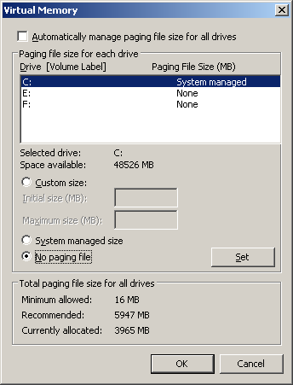
Disable page file
Disable:
Control Panel->System and Security->System->Advanced System Settings->Performance->Advanced->Virtual Memory->Change

Slide 32
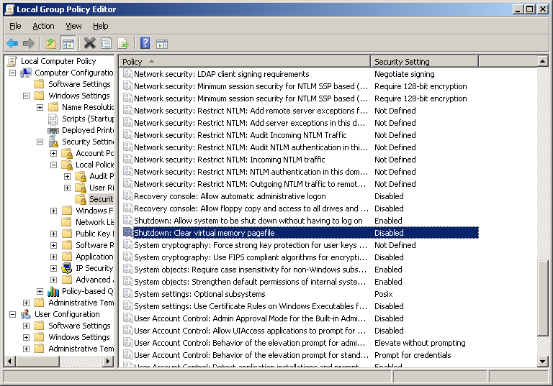
Wipe page file
Set HKEY_LOCAL_MACHINE\SYSTEM\CurrentControlSet\Control\Session Manager\Memory Management\ ClearPageFileAtShutdown to 1

Slide 33
Hibernation file
File used for storing active memory when going into hibernation mode:
hiberfil.sys
Go into power settings to disable

Slide 34
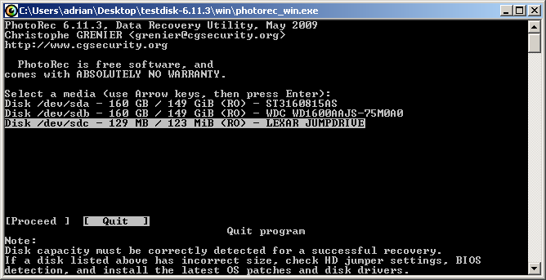
Data carving
Go down the drive bit by bit looking for file headers
DiskDigger
http://dmitrybrant.com/diskdigger
Photorec
http://www.cgsecurity.org/wiki/PhotoRec
Other file carving tools
http://www.forensicswiki.org/wiki/Tools:Data_Recovery#Carving
File system compression makes file carving far less reliable!
Notes:
Demo:
DiskDigger Demo
Photorec Demo (on page file?)

Slide 35
So, what is writing where?
What needs to be wiped? What is this tool doing?
Process Monitor
http://technet.microsoft.com/en-us/sysinternals/bb896645.aspx
RegFromApp
http://www.nirsoft.net/utils/reg_file_from_application.html
ProcessActivityView
http://www.nirsoft.net/utils/process_activity_view.html
Notes:
Demo:
Bin\Procmon
Bin\RegFromApp
Bin\ProcessActivityView

Slide 36
parlor Tricks
Maybe useful sometimes, but mostly fluff

Slide 37
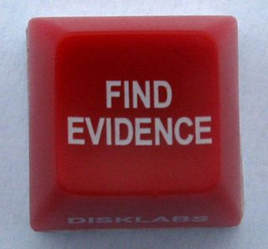
Tool/Solution Kiddies
Does the examiner understand the concepts, or just the tool?
Think back to the Julie Amero case
What is their case load like?

Slide 38
Timestomp
Making the chain of events hard to manage http://www.metasploit.com/research/projects/antiforensics/
  -m <date> M, set the "last written" time of the file
  -a <date> A, set the "last accessed" time of the file
  -c <date> C, set the "created" time of the file
  -e <date> E, set the "mft entry modified" time of the file
  -z <date> set all four attributes (MACE) of the file
  -v show the UTC (non-local time) MACE values for file
  -b sets the MACE timestamps so that EnCase shows blanks -r does the same recursively , Know as the Craig option
For setting an arbitrary time recursively:
Command:
for /R c:\users\ %i in (*) do timestomp.exe %i -z "Monday 3/12/2099 10:00:00PM"
Notes:
Demo:
Bin\timestomp
Timestop filename –option date

Slide 39
AltDS
Alternate data streams
type mypr0n.jpg disney.jpg:hide
mspaint disney.jpg:hide
Hit or miss with file carving
Practical Guide to Alternative Data Streams in NTFS
http://www.irongeek.com/i.php?page=security/altds
Notes:
Demo:
type mypr0n.jpg disney.jpg:hide
mspaint disney.jpg:hide
Bin\AlternateStreamView

Slide 40
Shadow Copy
Tim Tomes and Mark Baggett Lurking in the Shadows from Hack3rcon II
http://www.irongeek.com/i.php?page=videos/hack3rcon2/tim-tomes-and-mark-baggett-lurking-in-the-shadows
vssown.vbs
Not sure how long a file will stick around

Slide 41
Steganography
(Hiding stuff in stuff so people don’t find your stuff)
With encryption, most times people know that some data is there, just not what it is.
With Stego, they hopefully will not even know it’s there.
http://www.irongeek.com/i.php?page=videos/steganography-intro
Notes:
Demo:
Demo Zip
Demo DOCX
Demo Vecna

Slide 42
Steganography
(Tacked on)
Since jpegs care about what is in the first part of a file, and zips care about what is at the end, you can try the following:
copy /B image.jpg+putty.zip test.jpg
Please note, not all jpeg viewers will accept the file.
Notes:
Demo:
Demo Zip
Demo DOCX
Demo Vecna

Slide 43
Steganography
(Insertion)
Example: Putting a file inside of a DOCX, it’s just a ZIP file with some XML, just add your inserted file name into [Content_Types].xml so the DOCX does not report as corrupted. Or use my code at:
http://www.irongeek.com/i.php?page=security/ms-office-stego-code
Notes:
Demo:
Demo Zip
Demo DOCX
Demo Vecna

Slide 44
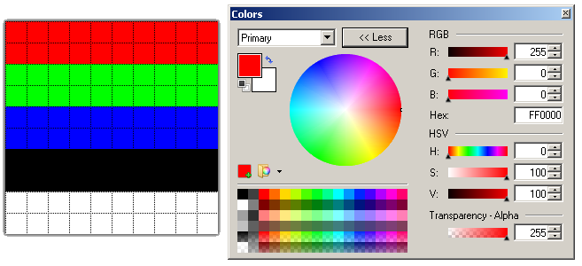

Steganography
(Additive)
LSB (Least Significant Bit), for example making imperceptible changes to a format that can take loss and still be useful (audio, images, video).
http://www.irongeek.com/i.php?page=security/unicode-and-lsb-stego-code
Original
Same file with “I should be able to hold 37 bytes!!!” encoded
Notes:
Demo:
Demo Zip
Demo DOCX
Demo Vecna

Slide 45
Lemonwipe
(rude and crude)
Not recommended from a legal standpoint, but funny.
Repeat script to feed into DD:
@Echo Off
:TOP
type %1
Goto TOP
Command:
repeat.bat adrianbeer.jpg | dd of=\\.\f:
Create one big file:
@Echo Off
:TOP
type %1 >>%2\%1
if not %errorlevel%==0 goto :error
Goto TOP
:error
echo Exiting and deleting %2\%1
del %2\%1
exit /B -1
Command:
Smack.bat image.jpg f:

Slide 46
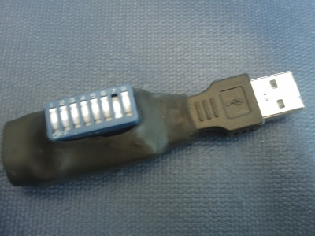
Booby Trapped Device?
Programmable HID USB Keyboard/Mouse Dongle
PHUKD http://www.irongeek.com/i.php?page=security/programmable-hid-usb-keystroke-dongle

Slide 47
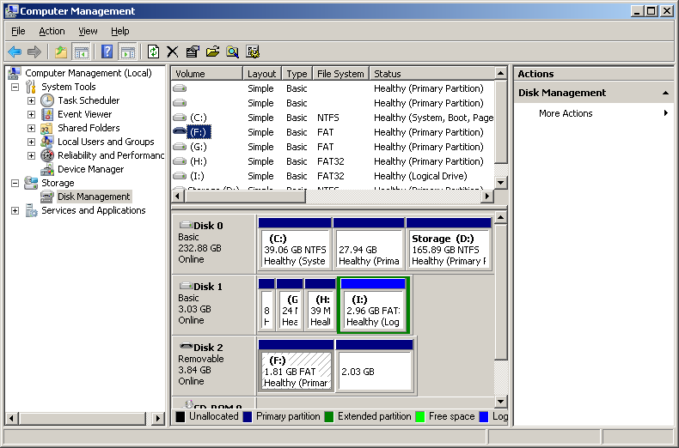
Two partitions on a thumbdrive
Two partitions on a thumb drive? Windows sees one.
Notes:
Gdisk

Slide 48
Cloud Computing?
Use the browser’s privacy mode, and SSL
If it’s not on the drive, they can’t find it on the drive
Less 4th amendment protection?
Find a country that does not play nice with US law enforcement

Slide 49
Attack the forensic software?
XSS, not just for web forms anymore
http://www.irongeek.com/i.php?page=security/xss-sql-and-command-inject-vectors
Breaking Forensics Software: Weaknesses in Critical Evidence Collection (Encase and Sleuth Kit)
ISEC Partners presentation at Defcon 15
http://www.defcon.org/html/links/dc-archives/dc-15-archive.html#Palmer
42.zip = 4.5 PetaBytes
http://www.unforgettable.dk/
http://en.wikipedia.org/wiki/Zip_bomb
Two comments on these attacks:
  If the examiner sees the data attacking him, they will know something is up.
  Do you really think it’s a good idea to piss off the forensic examiner?

Slide 50
Thermite
http://hackaday.com/2008/09/16/how-to-thermite-based-hard-drive-anti-forensic-destruction/
Uhm, just no.
Destruction of evidence charges
Fire hazard
Just use full drive encryption
While we are on that topic:
http://www.youtube.com/watch?v=Bv5LHamqAsI

Slide 51
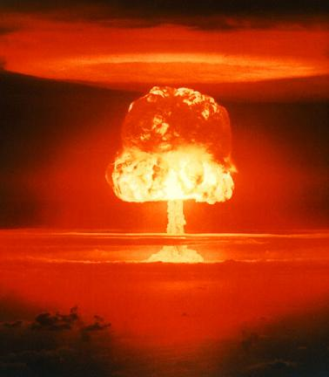
Nuke it from Orbit
It’s the only way to be sure

Slide 52
Wipe Tools
DD
dd if=/dev/zero of=\\.\f: --progress bs=1M
dd if=/dev/zero of=\\.\Volume{de891b6a-8432-11de-86d4-005056c00008} bs=1M –progress
DBAN
http://www.dban.org/
HDD Wipe Tool
http://hddguru.com/content/en/software/2006.04.13-HDD-Wipe-Tool/
Notes:
Demo:
DD Demo
Dban Demo
"dataset definition“ “disk/data destroyer”

Slide 53
One wipe?
Magnetic Force Microscopy
http://sansforensics.wordpress.com/2009/01/15/overwriting-hard-drive-data/
On a pristine modern drive 92% chance to recover the correct previous bit , 56% on a used drive
Probabilities multiply, so to get one byte:
.92^8=51% (more or less)
For 1 Kilobyte= 2.238e-297
N
S
S
N
S
N
N

Slide 54
Enhanced Secure Erase
Not only is it faster, but it can wipe remapped blocks (bad sectors) from the G-LIST
HDParm
http://ata.wiki.kernel.org/index.php/ATA_Secure_Erase
MHDD
http://hddguru.com/content/en/software/2005.10.02-MHDD/
http://hddguru.com/content/en/software/2006.02.10-Magic-Boot-Disk/
HDDErase
http://cmrr.ucsd.edu/people/Hughes/SecureErase.shtml
Notes:
Demo MHDD

Slide 55
Full System Drive Encryption
BitLocker
http://www.microsoft.com/windows/windows-vista/features/bitlocker.aspx
  Built in to Windows Vista/7
  AES CBC
  Pain to setup in Vista
  Look into Bitlocker To Go to secure your USB drive
  To enable Bitlocker without TPM in Win 7, gpedit.msc > Computer Configuration > Administrative Templates > Windows Components > BitLocker Drive Encryption > Operating System Drives > Require Additional Authentication at Startup > Enable
  Bitlocker Modes:
  TPM only
  TPM + PIN
  TPM + PIN + USB Key
  TPM + USB Key
  USB Key
TrueCrypt
http://www.truecrypt.org/
  Open source
  (for review of a lot of eyes)
  Read from other platforms
  Works on XP
  More cipher options
  Uses XTS which is better than CBC, but ask a cryptographer why
Also, look into hardware based options
http://www.enovatech.net/
Thanks Doubleback for the Win 7 without TPM info
Notes:
Demo:
Demo Bitlocker to go?
Truecrypt
cipher block chaining
Trusted Platform Module

Slide 56
How about running a VM form an encrypted volume?
Easy to do
I have some concern about data leaking into swap/ page file. This needs more testing.
A few suggested tweaks:
MemAllowAutoScaleDown = "FALSE"
mainMem.useNamedFile = "FALSE“
Use some of the page file wiping techniques mentioned before
Thanks to Nicholas for some input on this

Slide 57
Other tools
Deft Linux
http://www.deftlinux.net/
FTK Imager http://www.accessdata.com/downloads.html
WinHex
http://www.x-ways.net/winhex/

Slide 58
How do I know someone had ran anti-forensics software on a computer?
No 100% positive way
Look for files names I mentioned in this presentation
Leftovers from the tool, for example:
HKCU\Software\Sysinternals\SDelete\EulaAccepted
I need to work on some tools to do this sort of detection…
Look at the drive for large sections of all zeros/random bytes, but this could be for other reasons (Vista & < after full format, Solid-state Drives)
Hash search of know anti-forensics tools
HashMyFiles
http://www.nirsoft.net/utils/hash_my_files.html
Notes:
Demo:
Bin\hashmyfiles

Slide 59
Change the hash of the file ☺
If it’s just the hash, change a few bytes, preferably in strings
Compile from source if you have it
Use a packer
UPX
http://upx.sourceforge.net/
http://sourceforge.net/projects/upxer/files/
Shikata Gai Nai from Metasploit
http://www.metasploit.com

Slide 60
Thanks
Scott Moulton
http://www.myharddrivedied.com/
Tyler “Trip” Pitchford
Folks at ISD and Pauldotcom podcasts

Slide 61

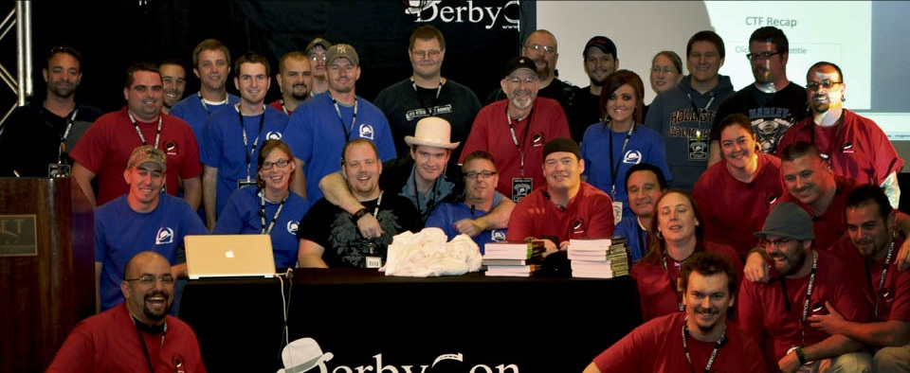
Events
Derbycon
Sept 27th-30th 2012
http://www.derbycon.com
Others
Derbycon Art Credits to DigiP
Photo Credits to KC (devauto)
http://www.louisvilleinfosec.com
http://skydogcon.com
http://hack3rcon.org
http://outerz0ne.org
http://phreaknic.info
http://notacon.org
Notes:
Beg for hardware donations. ☺

Slide 62
Questions?
42
Twitter: @Irongeek_ADC

