Slide 1
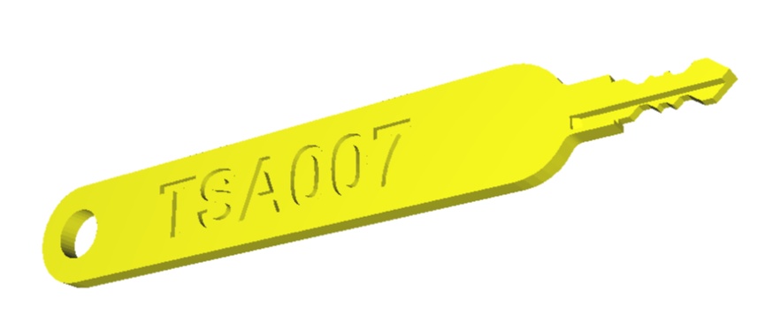
TSA Luggage Locks: Details, Flaws & Making The Best Of A Bad Lock
Adrian Crenshaw

Slide 2
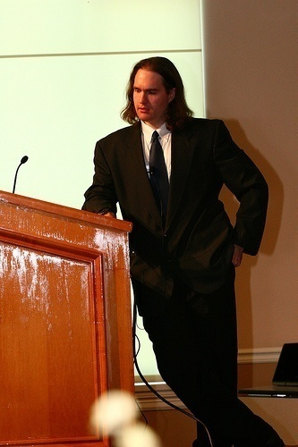


About Adrian
I run Irongeek.com
I have an interest in InfoSec education
I don’t know everything - I’m just a geek with time on my hands
Sr. Information Security Consultant at TrustedSec
Co-Founder of Derbycon
http://www.derbycon.com
Twitter: @Irongeek_ADC
Notes:
Take a note from Johnny Long’s book, and Bruce Potter’s book.

Slide 3
Thanks
@darksim905
@deviantollam
@ladymerlin
@J0hnnyXm4s
@Xylit0l
@WinnetkaCA
@dosman33

Slide 4
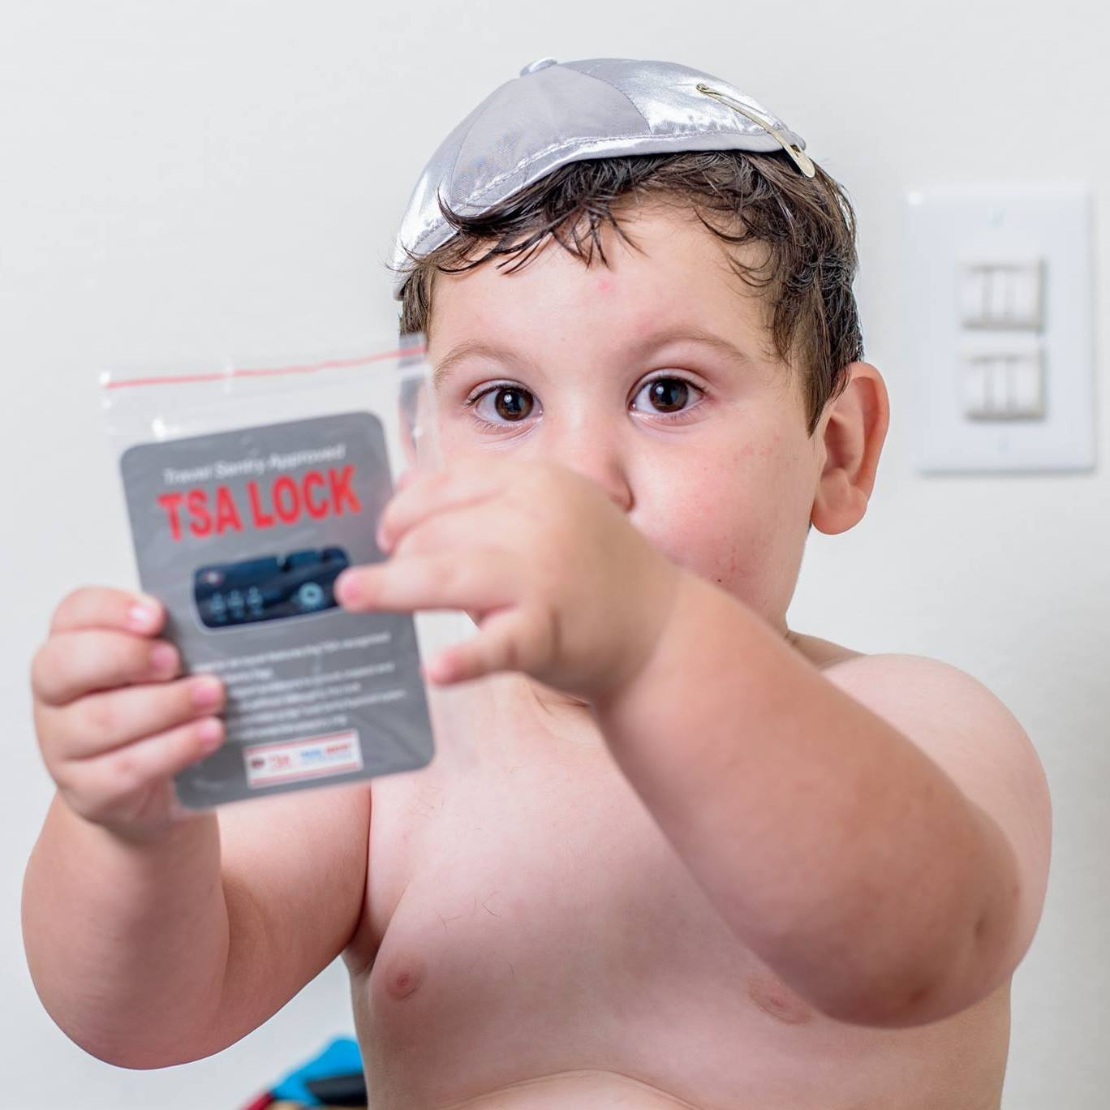
Why this talk?
Why not this talk
  Yes ,they are easy to rake/pick
  Yes, baggage is easy to open other ways
While lock sport people know TSA approved locks are weak, I've never seen a talk done on them
Interest in technical challenge of reverse engineering the key
Some people made a big deal about photo leak, but really all you need is the lock.
Why security through obscurity fails

Slide 5
What Are TSA Approved Locks
TSA demanded ability to inspect all luggage Jan 1st 2003
They started clipping a lot of locks, pissing off flyers.

Slide 6


Brands
Travel Sentry
  John Vermilye
  Oversees standards for other
  people who manufature
SafeSkies
  David Tropp
  Owns patents 7,021,537 & 7,036,728
  Makes own locks

Slide 7
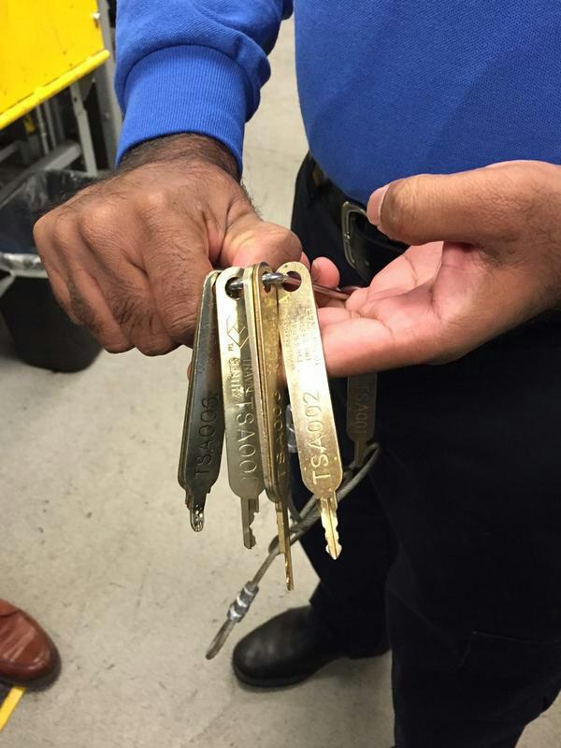
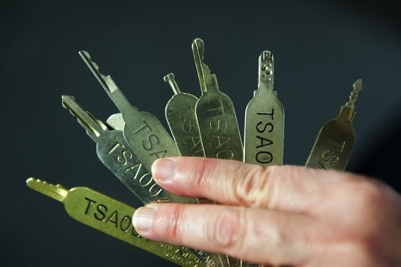
Recent Interest
Images from
https://pbs.twimg.com/media/CMYygALUwAAKZzu.jpg:large
http://www.heraldnet.com/article/20141130/NEWS02/141139966
https://www.flickr.com/photos/ryetronics/6198061107
http://imgur.com/a/JQD7l

Slide 8
Patents
TSA 001
TSA 002
http://www.google.com/patents/US7380427
TSA 003
TSA 004
https://www.google.com/patents/US7363782
TSA 005
TSA 006
http://www.google.com/patents/US20100050716
https://www.google.com/patents/EP2161396A2
TSA 007

Slide 9
Designers?
TSA 001 NING BO XIANFENG (China)
TSA 002 SINOX (Taipei , Taiwan) and Master Lock
TSA 003 Fullyear Brothers (Taiwan)
TSA 004 CCL PRESTO LOCK and ILLINOIS LOCK COMPANY
TSA 005 SUNLOCK COMPANY ( Hong Kong )
TSA 006 ABUS August Bremicker Söhne KG
TSA007 Yi Feng
Sources:
http://www.stantonconcepts.us/TSA%20Luggage%20Lock/SCI_G2_Luggage_032510.pdf http://www.securoseal.com/main.php?pg=news&news_id=2017

Slide 10
Functionality

Slide 11
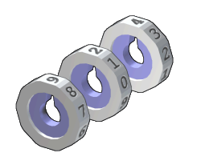
Combination
Dual Function Locks
User uses combination
TSA agent uses key
Image Source https://en.wikipedia.org/wiki/Combination_lock#/media/File:Combination_discs.png

Slide 12
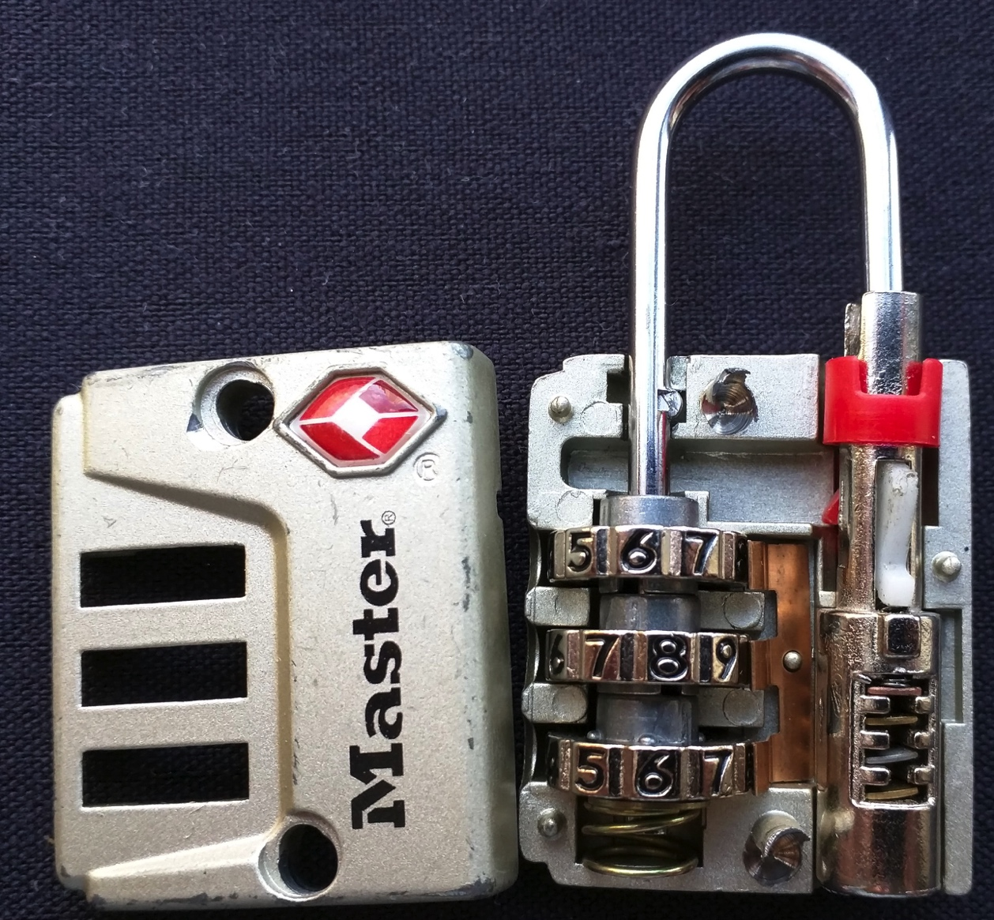
Dual Function

Slide 13
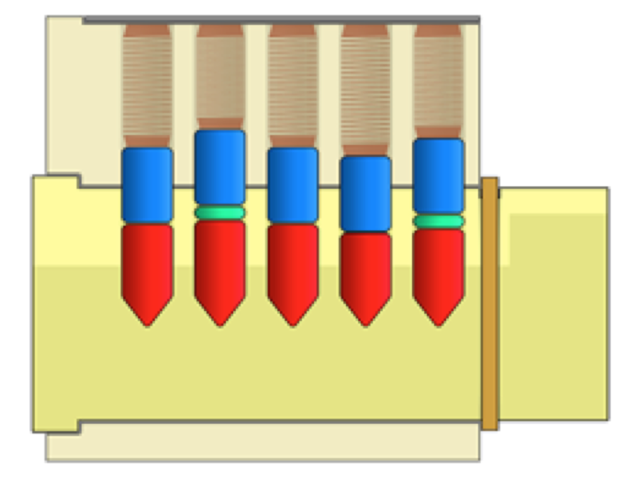
Master Keyed Pin Tumbler
Image from http://toool.us/deviant/

Slide 14
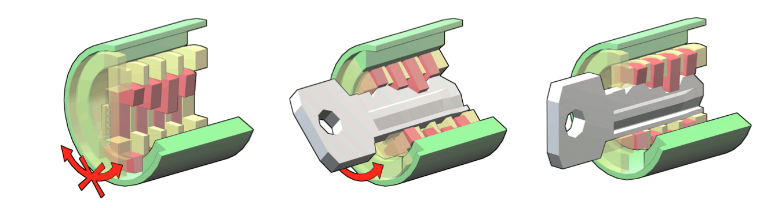
Wafer Lock

Slide 15


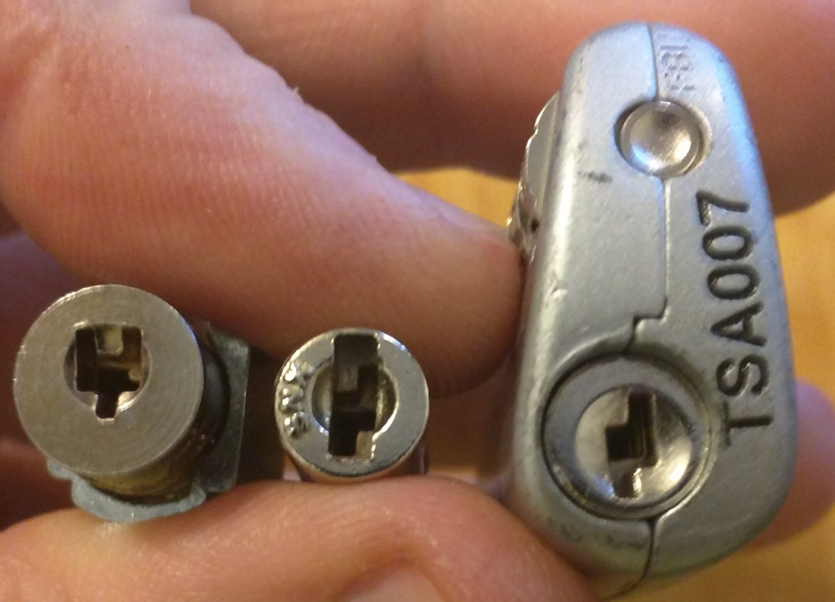
Mastered Wafer

Slide 16
Example locks
001-007

Slide 17

TSA 001
Only one I don’t have
May be discontinued by most vendors?
Key blank may be an Ilco 1092VR

Slide 18
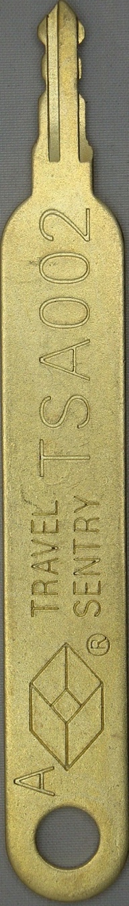
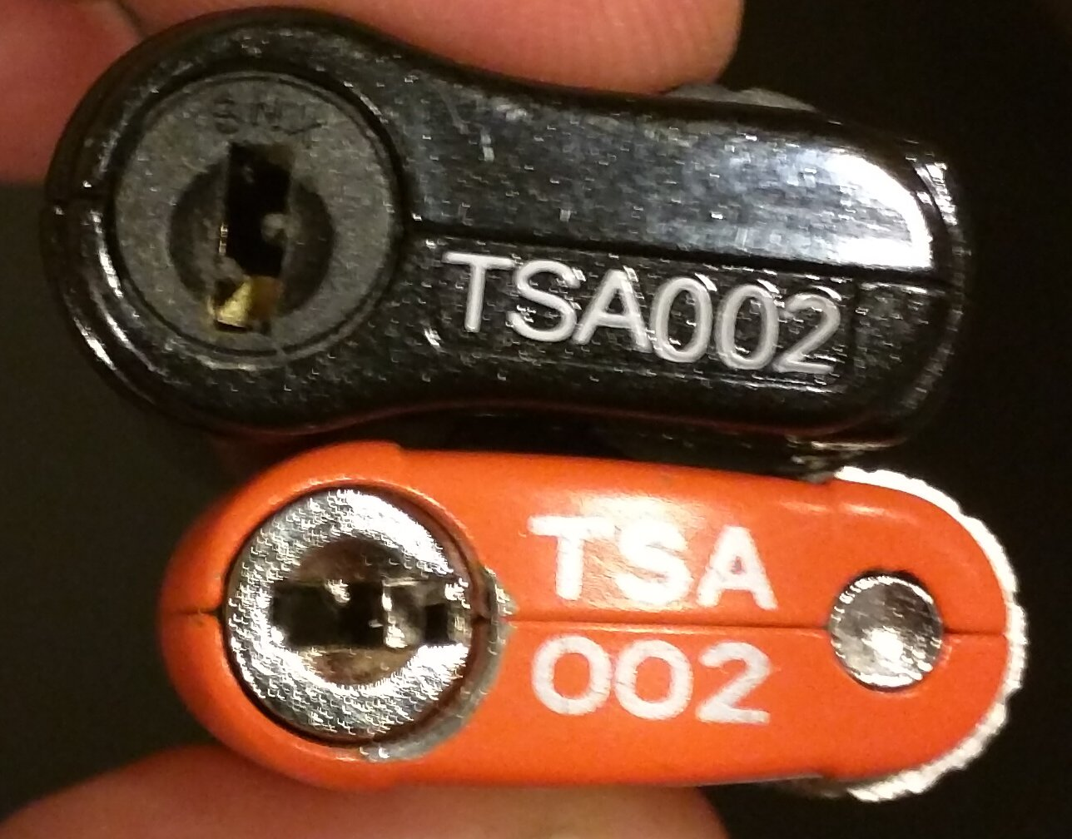
TSA 002
2nd most common TSA keyway
Often built into luggage
Ilco 1611R key blank is just about perfect

Slide 19
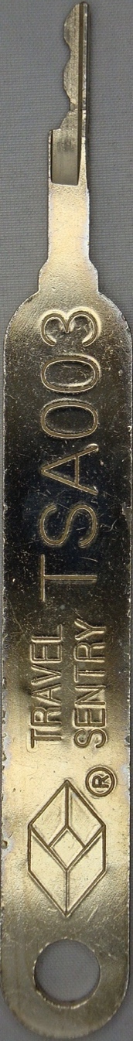
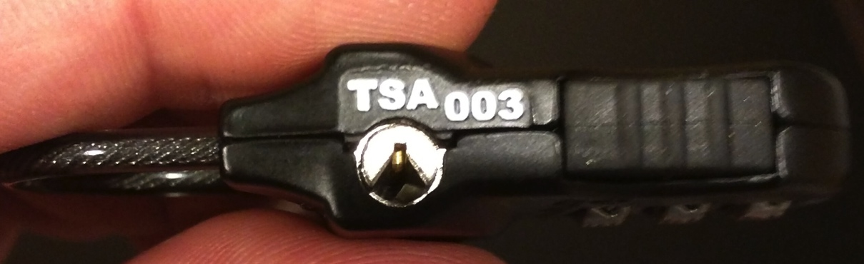
TSA 003
Pretty rare
Keyway is triangle shaped

Slide 20
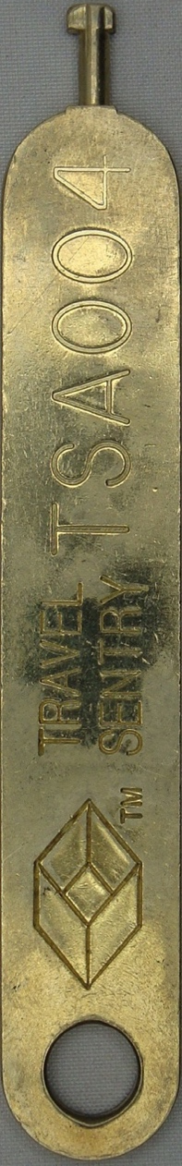
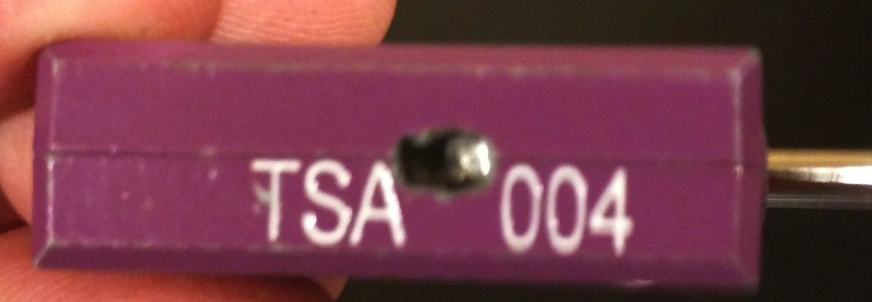
TSA 004
Basically a bulbous screw driver
Made by CCL and sold as Prestolock
Easy to make from a warded key

Slide 21
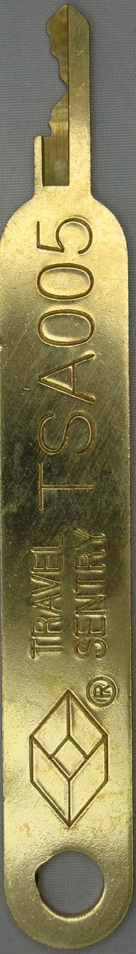
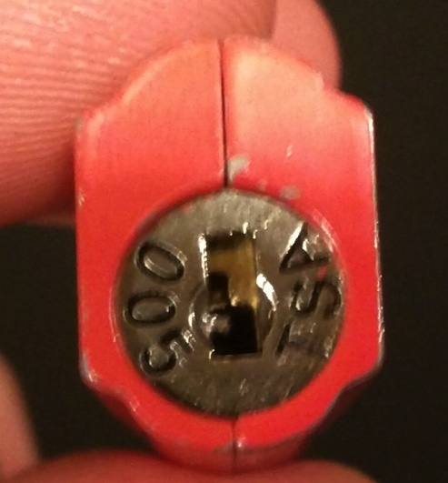
TSA 005
Third most common in my experience
M2/Ilco 1092B key blank works great

Slide 22
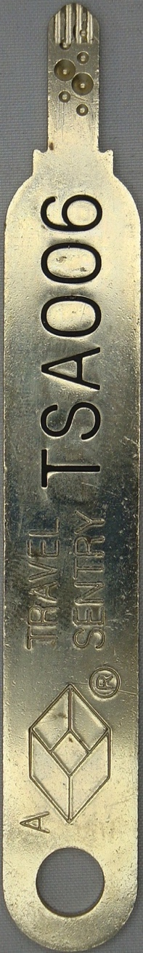
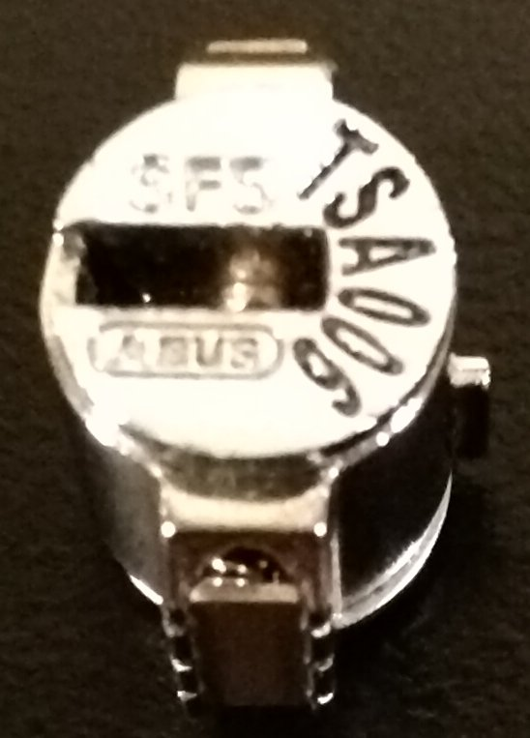
TSA 006
Is a double sided dimple lock
Only seems to come built into Rimowa & Proteca luggage
Designed by ABUS August Bremicker Söhne KG
I’ve never been able to pick it, and have no idea on the key blank

Slide 23
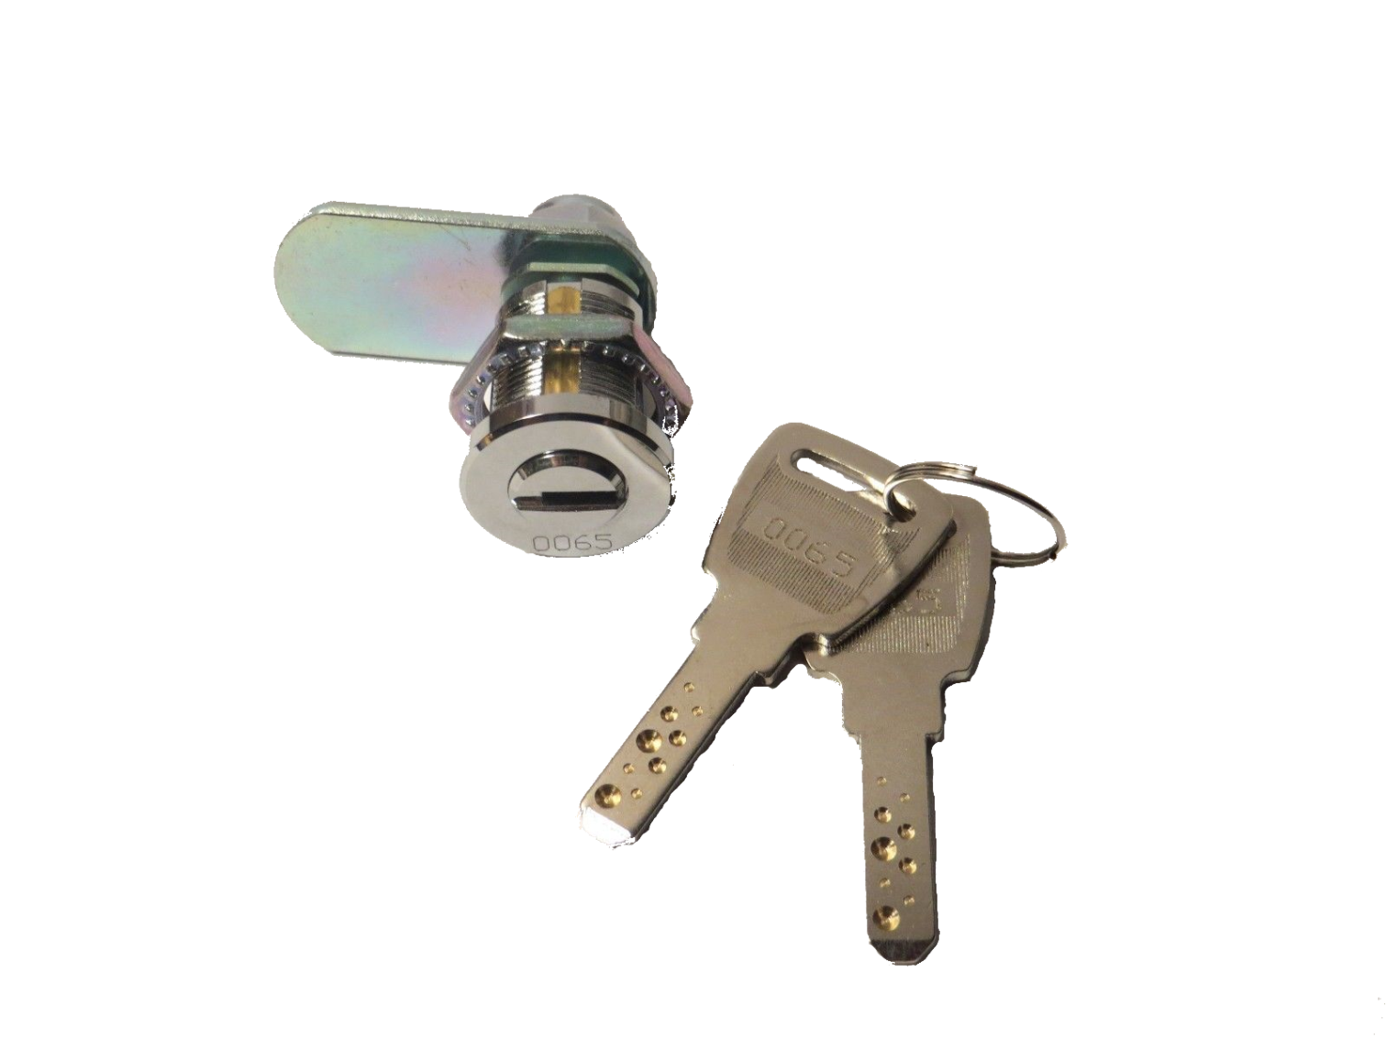
Principle: Pretty much the same as a normal pin tumbler lock

Slide 24
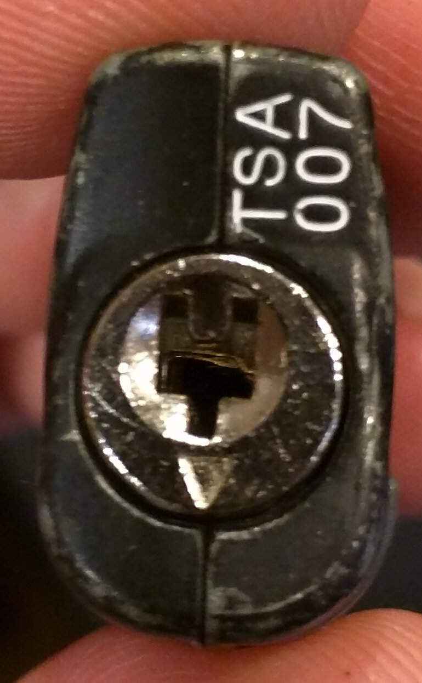
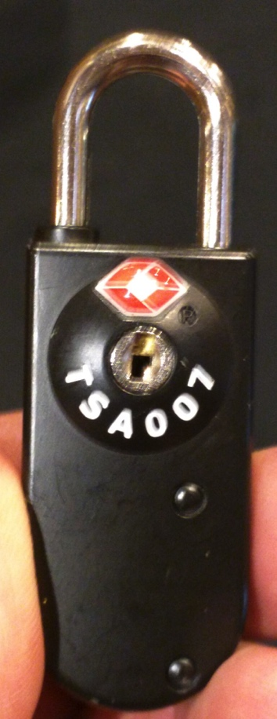
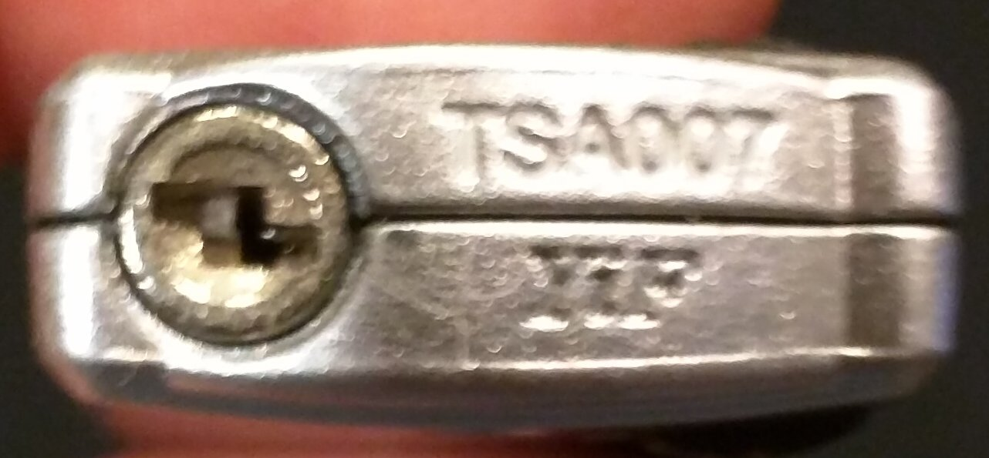
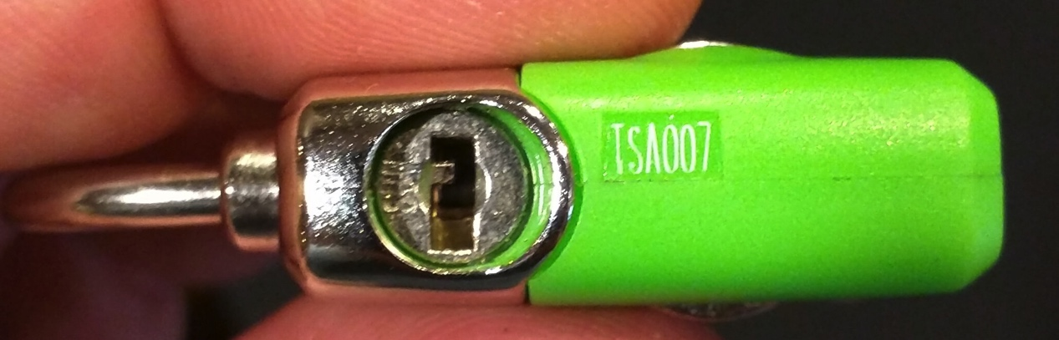
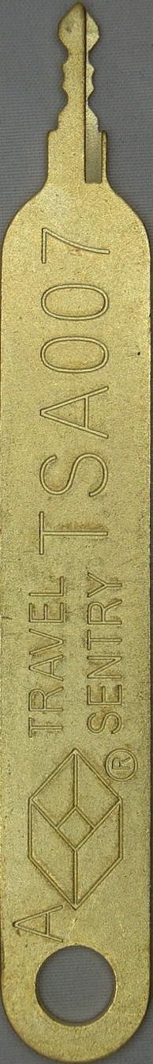
TSA 007
By far the most common
Can’t find the key blank, I can find profile, but never small enough. 1092vr can somewhat work if you mill both sides.
Keys from some brands can be filed down to work as masters:
  Embark from Target
  Travel Smart Conair from Meijer’s

Slide 25
Classic Ways In

Slide 26
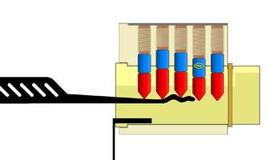

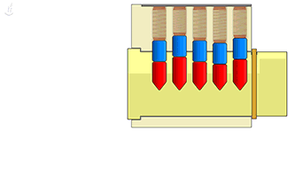
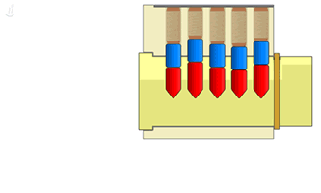
Pick It/Rake It
Picking
Images from http://toool.us/deviant/

Slide 27
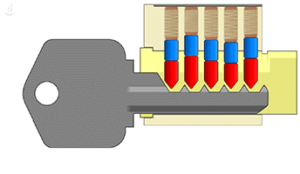
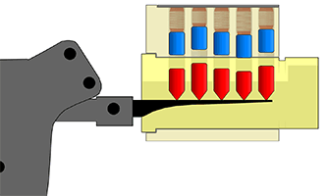
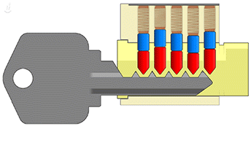
Bumping Pin Tumbler Locks
Bump!
Images from http://toool.us/deviant/

Slide 28
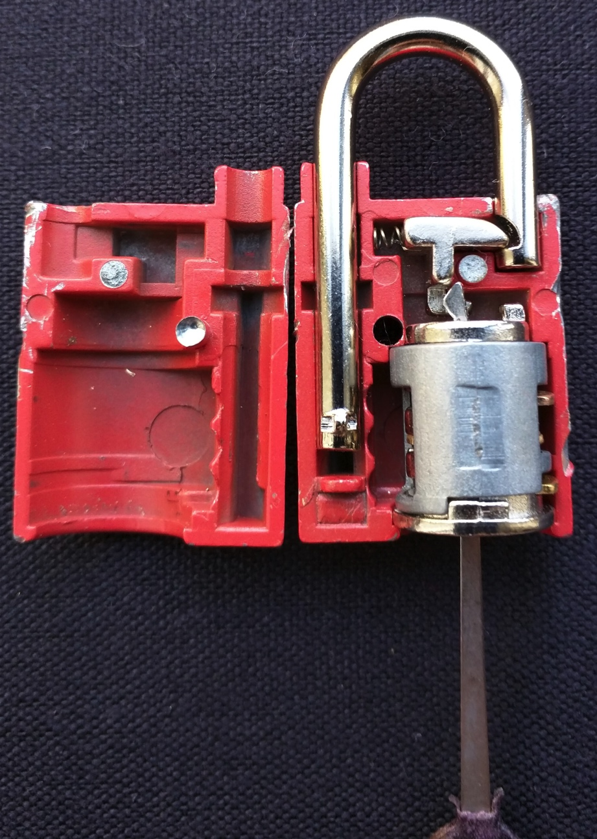
Shiving
Pull aside locking pawl
Back of keyway needs to be open
Can’t be using a ball bearing

Slide 29
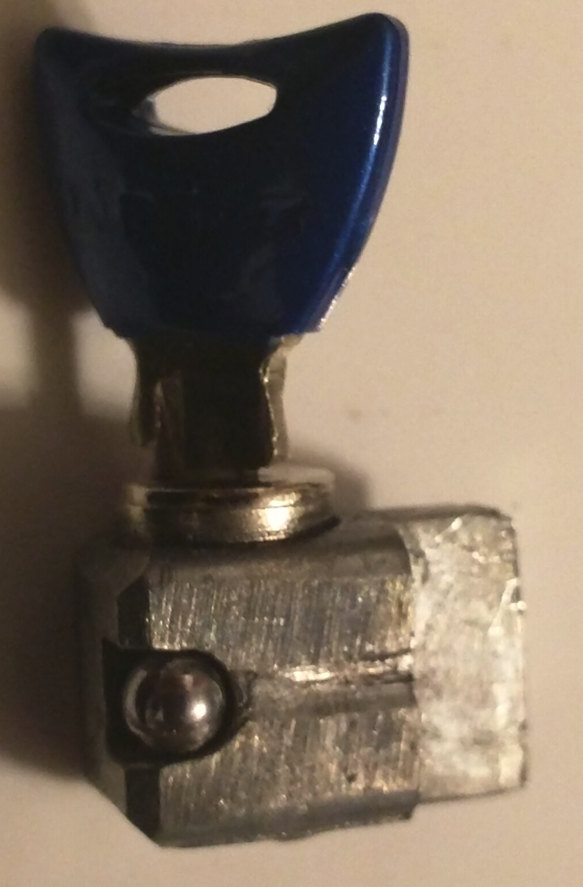
Shimming
Likely most TSA locks are too small to shim
Master Lock 4630Q uses ball bearing, so could not shim anyway

Slide 30
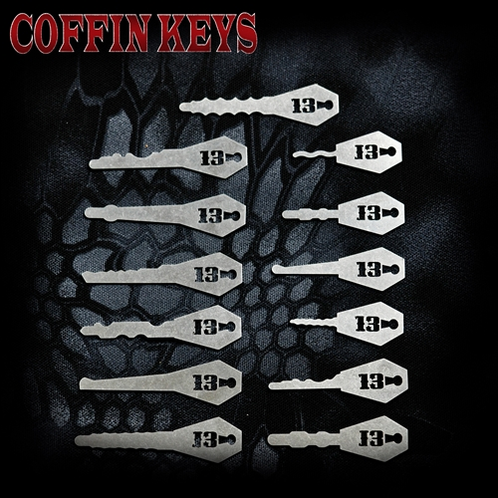
Jigglers
Jigglers/Tryout keys/Rocker Picks
Sparrow Lock Picks
http://www.sparrowslockpicks.com/product_p/ck-13.htm

Slide 31
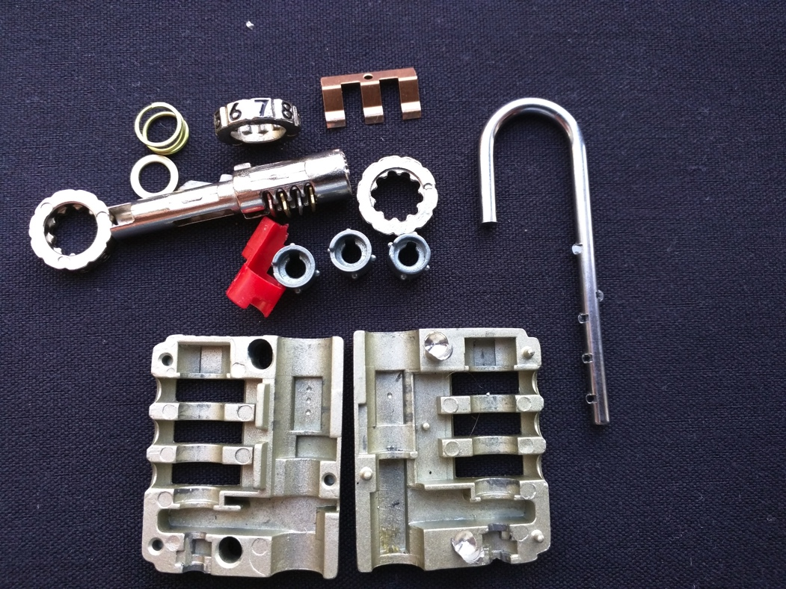

Decoding
For combination locks, use a small thin knife to find gates
Line up gates, then turn one position till it opens

Slide 32
Making Keys

Slide 33
Photos
Yes, photos can help
You don’t need them
Online key duplicators likely do not have the proper blanks for them

Slide 34
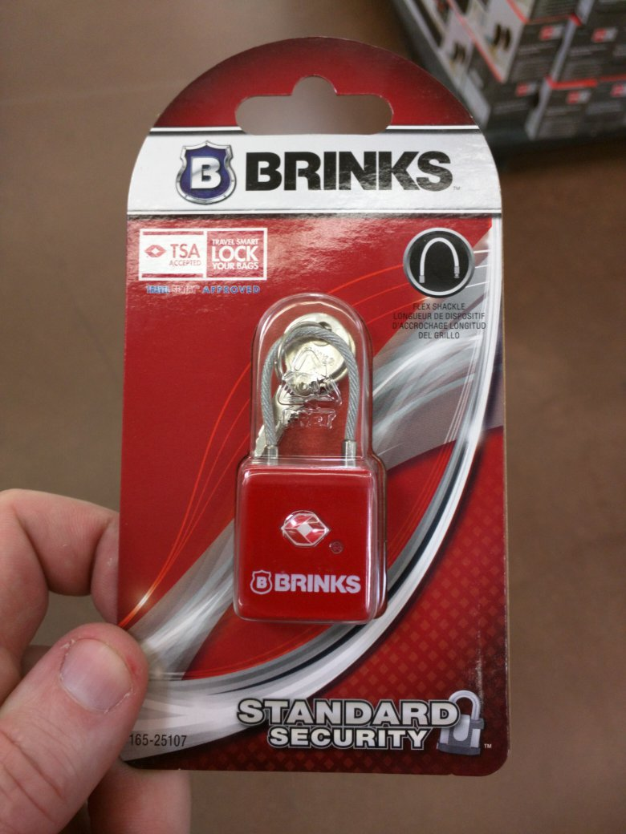
Tearing down a lock
Brinks 165-25107

Slide 35
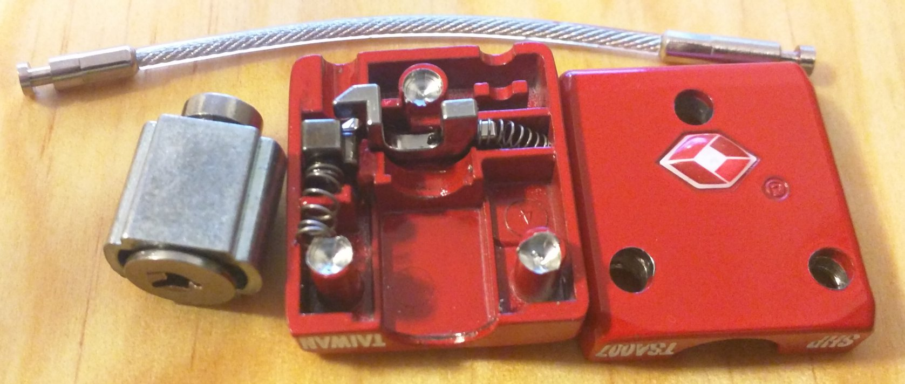
Drill Out Rivets

Slide 36
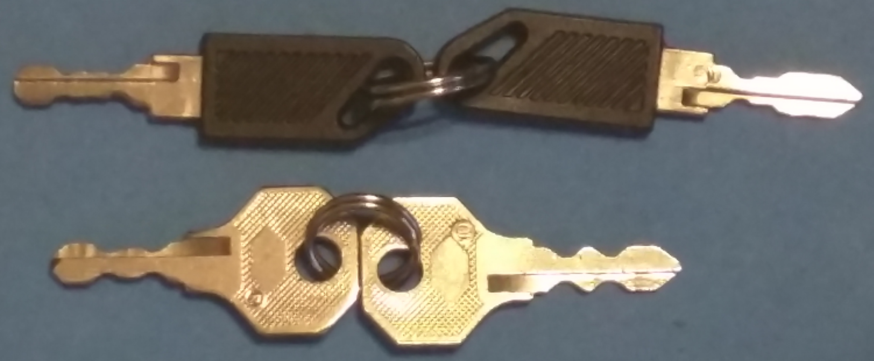
Key “Blanks”
Travel Sentry locks by Embark from Target or Travel Smart Conair from Meijer’s were double sided, so I bought those which included keys that had the shallowest cuts in their bitting.

Slide 37
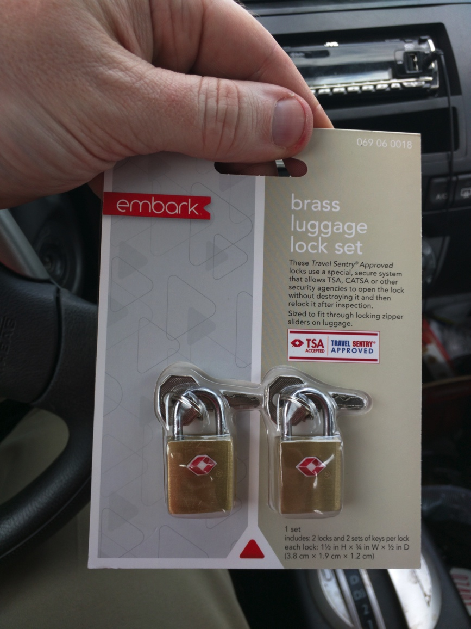
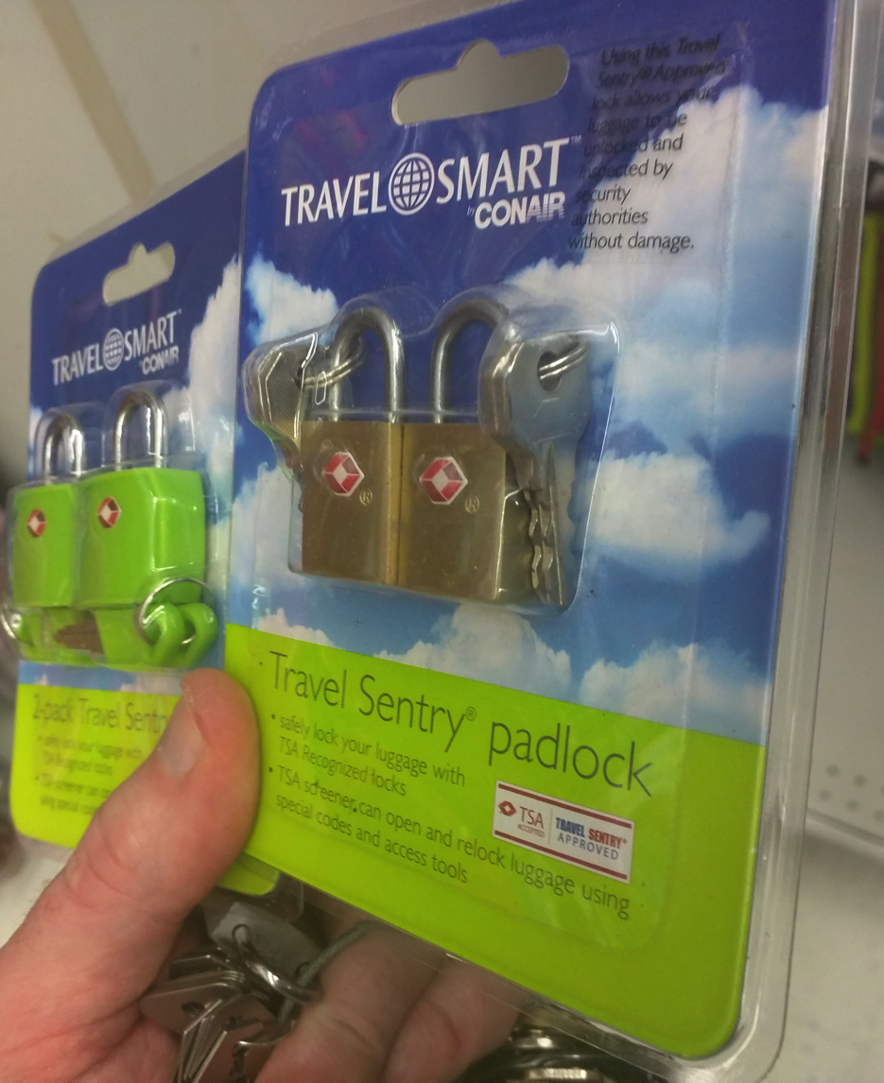
“Blank” Sources

Slide 38
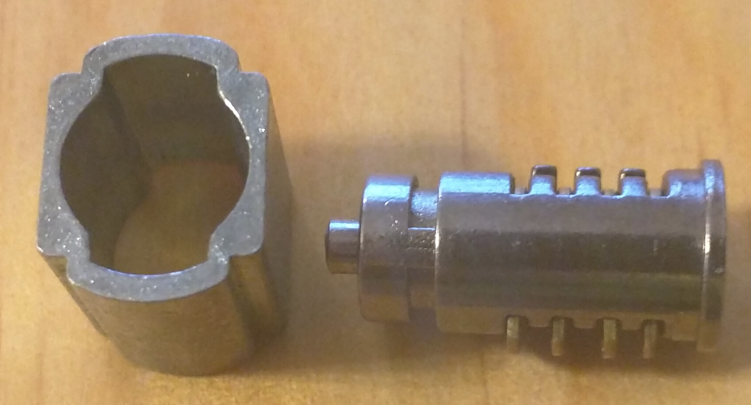
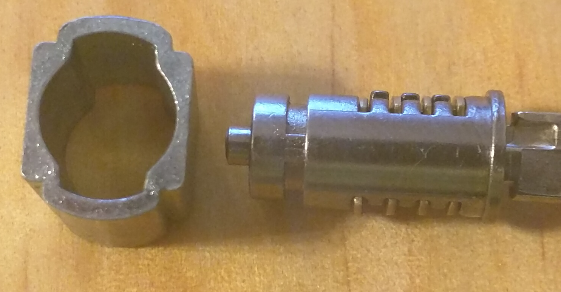
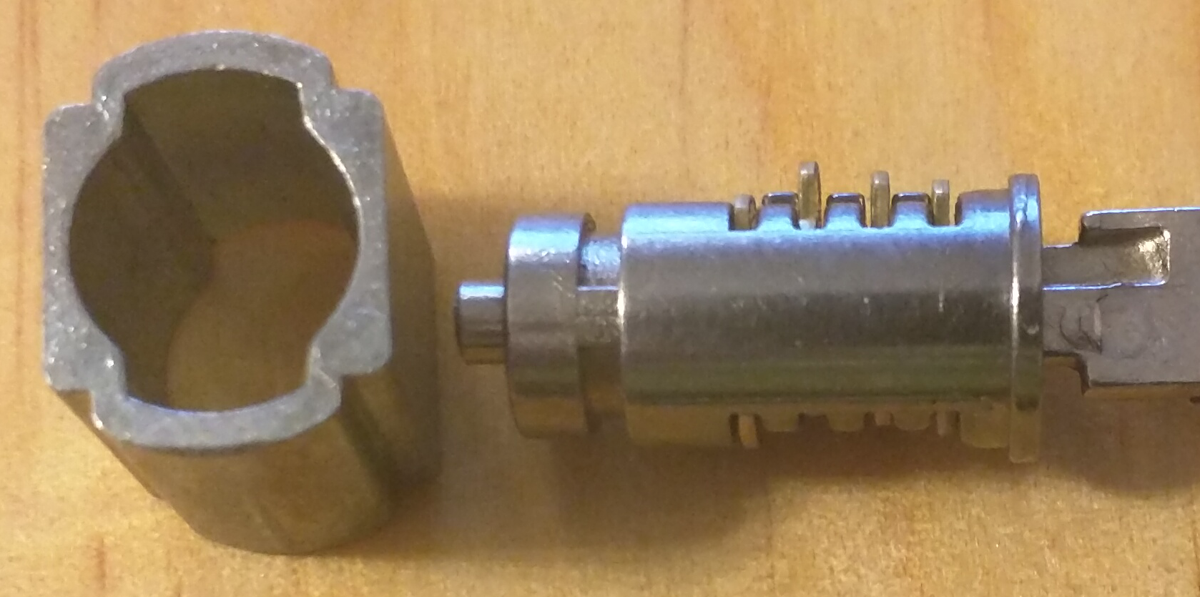
File Down Till Wafers Are Flush

Slide 39
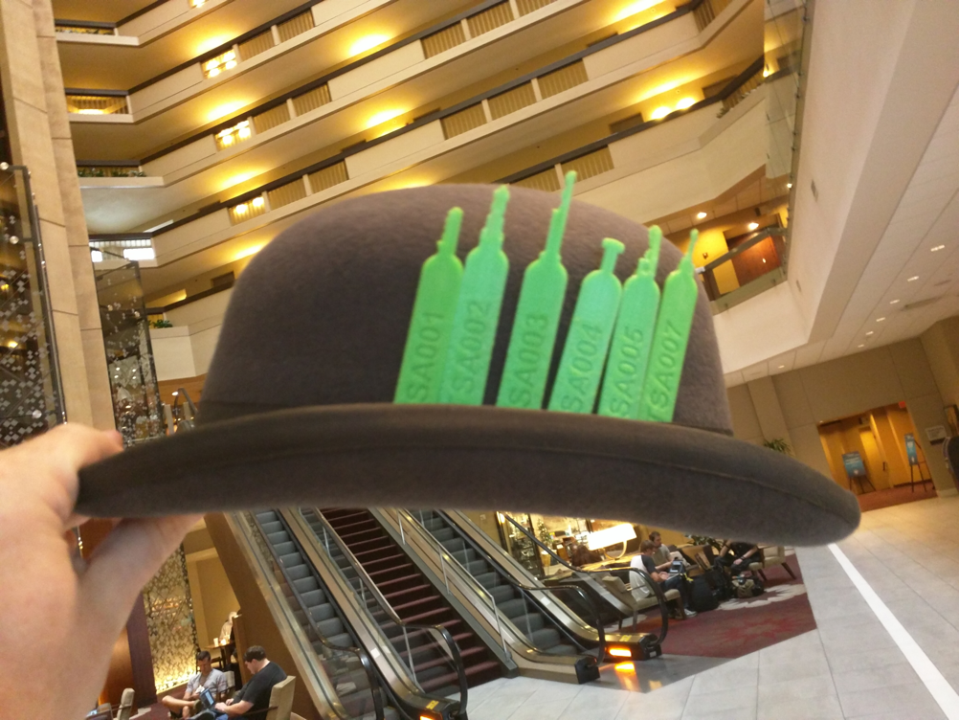
3d Printed
Xyl2k, MS3FGX, j0hnnyXm4s
Size issues
Breakage
Repository
https://github.com/Xyl2k/TSA-Travel-Sentry-master-keys

Slide 40
Random Stuff

Slide 41
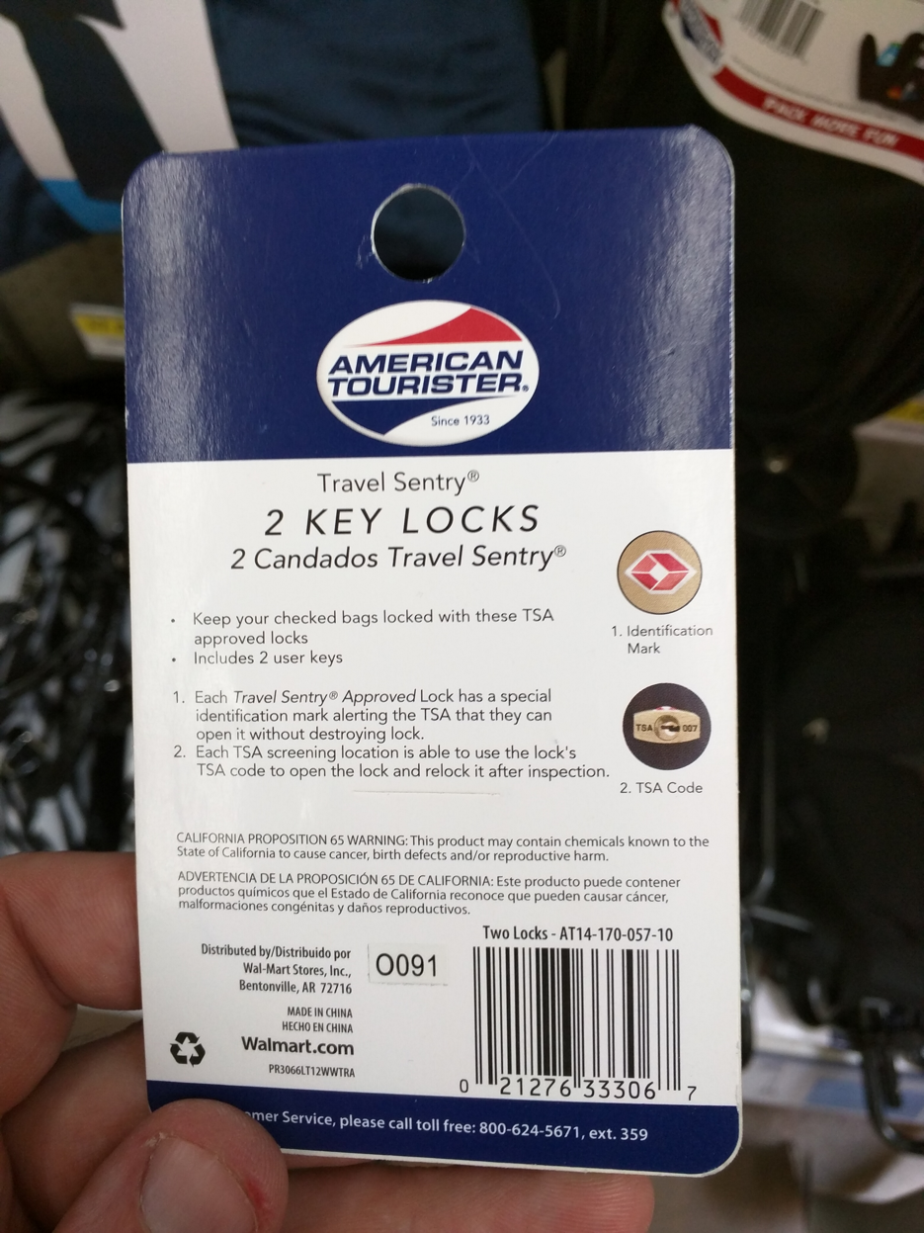
Key Code?

Slide 42

Keyway for 007
Help me find a blank!
Key Blank Directories
http://www.imlss.com/images/pdf/KBD12.pdf
http://www.hykokeys.com/uploads/files/key_replacement_catalog.pdf

Slide 43
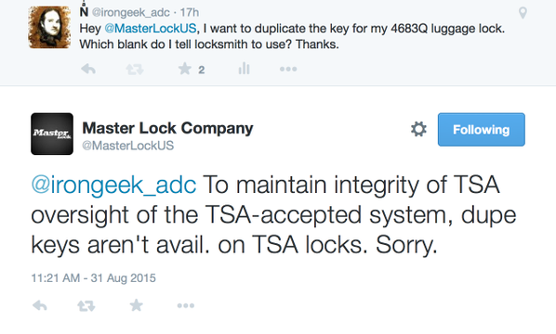
Trolling Master Lock
https://twitter.com/irongeek_adc/status/638375075683692544

Slide 44
Links
TSA Master Key Duplication & Why “Security Through (Not So) Obscurity” Fails
https://www.trustedsec.com/august-2015/master-key-duplication/
DarkSim’s timeline
http://darksim905.com/tsakeys.php
REPORT ON TSA-APPROVED LOCKS - Marc Weber Tobias (2004)
http://www.securoseal.com/main.php?pg=news&news_id=2017

Slide 45

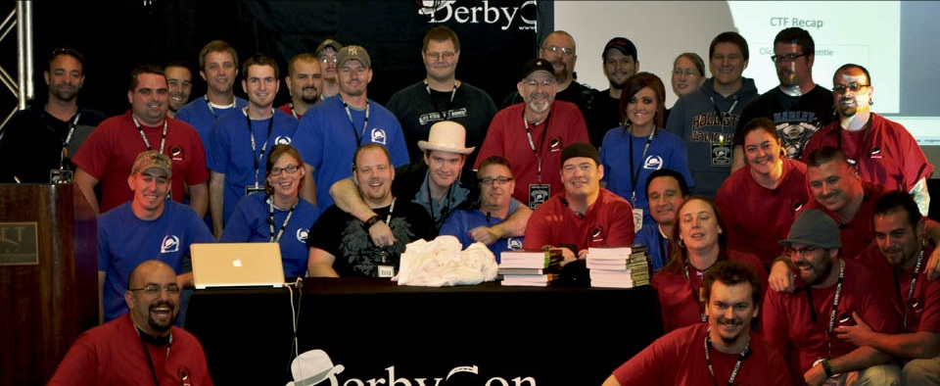
Events
Derbycon
Sept 28th-Oct 2nd, 2016
http://www.derbycon.com
Others
Derbycon Art Credits to DigiP
Photo Credits to KC (devauto)
http://louisvilleinfosec.com
http://skydogcon.com
http://grrcon.com
https://circlecitycon.com
http://showmecon.com
Notes:
Beg for hardware donations. ☺

Slide 46
Questions?
42
Twitter: @Irongeek_ADC

