Slide 1
Recording Hacker Cons: Picture in Picture on the cheap
Adrian Crenshaw

Slide 2
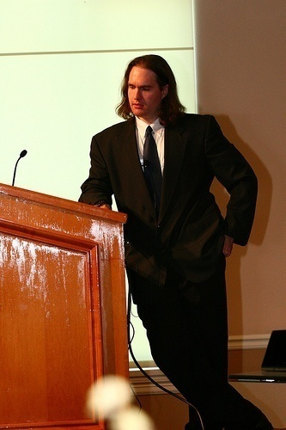
About Adrian
I run Irongeek.com
I have an interest in InfoSec education
I don’t know everything - I’m just a geek with time on my hands
(ir)Regular on the ISDPodcast
http://www.isd-podcast.com/
Notes:
Take a note from Johnny Long’s book, and Bruce Potter’s book.

Slide 3
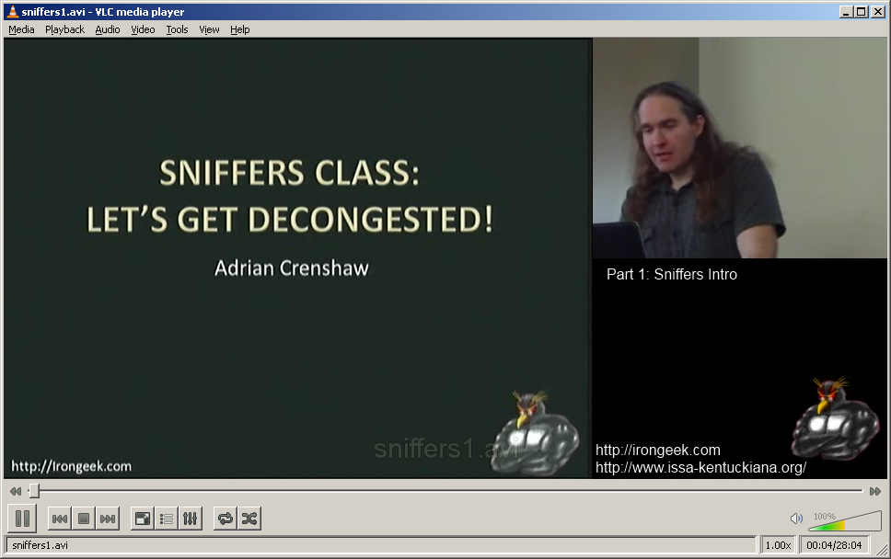
So, how do I make these?

Slide 4
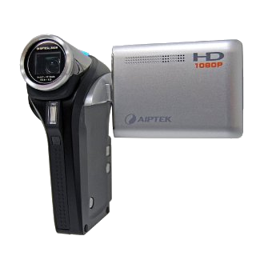
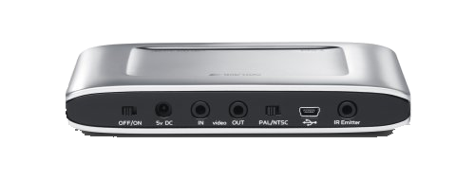
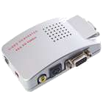
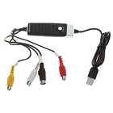
Hardware
Laptop
Video Camera
USB Video Capture Device
http://www.dealextreme.com/p/usb-2-0-video-audio-grabber-capture-49146
VGA to S-Video converter
http://www.dealextreme.com/p/usb-powered-vga-to-composite-s-video-converter-box-1280-1024px-max-26804
SanDisk V-Mate

Slide 5


Setups
Irongeek’s Rig
Live Capture
Skydog’s Rig
Presenter’s Laptop
Presenter’s Laptop
Live Capture
Slide Capture Laptop
VGA to
S-Video
VGA to
Composite
USB Video Capture
V-Mate
V-Mate

Slide 6
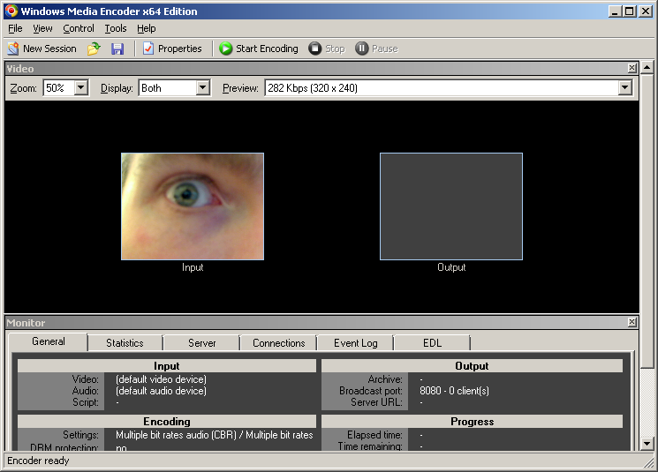
Windows Media Encoder x64 Edition
Download: Google for it. It’s been replaced on Microsoft’s site with Expression Encoder.

Slide 7
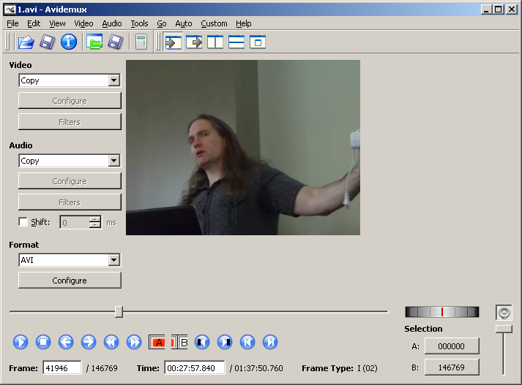
AVIDemux
Download: http://fixounet.free.fr/avidemux/

Slide 8
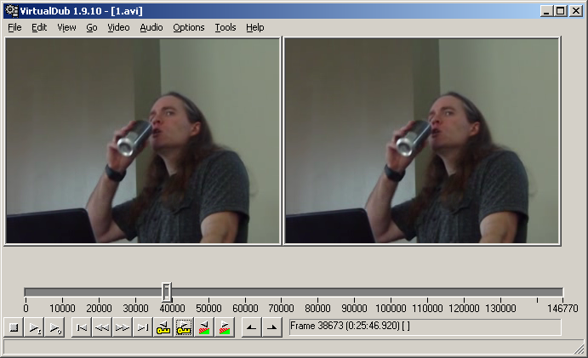
VirtualDub
http://www.virtualdub.org/

Slide 9
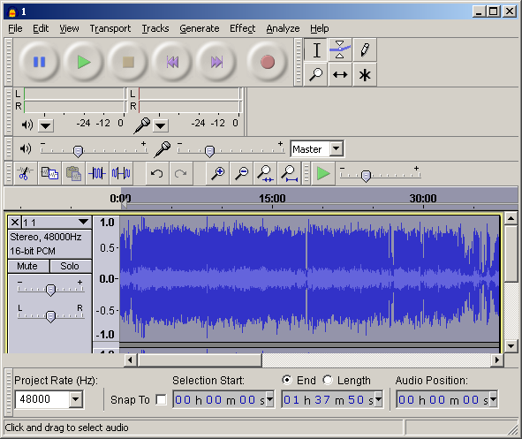
Audacity
http://audacity.sourceforge.net/
Also download LAME and FFMpeg while at the site

Slide 10
AVISynth and Accessories
Avisynth
http://avisynth.org
AVISynth Virtual File System
http://www.turtlewar.org/avfs/
BeHappy Plugins
http://behappy.codeplex.com/

Slide 11
Codecs and Filters
(Install order and version to use is confusing as hell)
Ffdshow
http://ffdshow-tryout.sourceforge.net/
http://x264.nl/
XVID
http://www.xvid.org/Downloads.15.0.html
Video for Windows x264
http://sourceforge.net/projects/x264vfw/
Haali Media Splitter (for working with MP4s)
http://haali.su/mkv/
Lame
http://lame.buanzo.com.ar/
DSFMgr (remove filters)
http://www.softella.com/dsfm/index.en.htm
K-lite should be avoided

Slide 12
Stop! Demo Time!
livevid = DirectShowSource("big1.avi", fps=25, convertfps=true).ConvertFPS(25).ConvertToRGB24().LanczosResize(320,240).Trim(50,0,false)
#The line tells the script what to use for the large section of the video where I put the slide show/what was being projected
v1 = DirectShowSource("sniffers1.wmv", fps=25, convertfps=true, audio=false).ConvertToRGB24().LanczosResize(640,480).ConvertFPS(25).Trim(0,0,false)
b1 = ImageSource("x.png",pixel_type="RGB24", start = 0, end = 24).ConvertFPS(25).Loop(613,0,24)
v2 = DirectShowSource("sniffers3.wmv", fps=25, convertfps=true, audio=false).ConvertToRGB24().LanczosResize(640,480).ConvertFPS(25).Trim(0,0,false)
slides = UnalignedSplice(v1,b1,v2)
#slides = DirectShowSource("sniffers1.wmv", fps=25, convertfps=true, audio=false).ConvertToRGB24().LanczosResize(640,480).ConvertFPS(25).Trim(0,0,false)
corner = ImageSource("corner2.png",pixel_type="RGB24").ConvertFPS(25)
#Now to add all the file together
livepluscorner = StackVertical(livevid,corner)
StackHorizontal(slides,livepluscorner).AudioDub(livevid)

Slide 13
Future work
Live composite
  http://www.ws4gl.org
  http://vidblaster.com

Slide 14
More Useful Sites
AVISynth Wiki
http://avisynth.org/mediawiki/
Video Help (great for tools and forums)
http://www.videohelp.com/
Doom 9 Forums
http://forum.doom9.org/

Slide 15
Events
Louisville Infosec
http://www.louisvilleinfosec.com/
DerbyCon 2011, Louisville Ky
http://derbycon.com/
Skydogcon/Hack3rcon/Phreaknic/Notacon/Outerz0ne
http://www.skydogcon.com/
http://www.hack3rcon.org/
http://phreaknic.info
http://notacon.org/
http://www.outerz0ne.org/
Notes:
Beg for hardware donations. ☺

Slide 16
Questions?
42

