Slide 1
Fuck These Guys: Practical Countersurveillance
Lisa Lorenzin
Notes:
I am NOT speaking for my employer.
I am NOT speaking for any standards body or any other organization, professional or non-professional (and believe me, some of them are _very_ unprofessional) in which I participate.
I am ONLY speaking for myself.

Slide 2
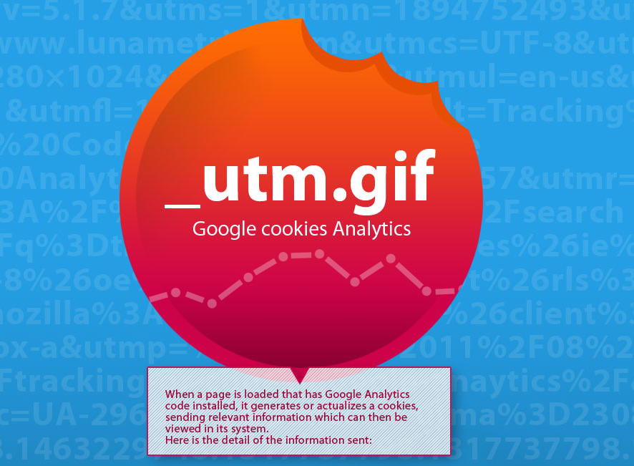
Notes:
I used to think Google was the enemy, privacy-wise…
http://blog.attachmedia.com/las-cookies-de-google-analytics-infografia/

Slide 3
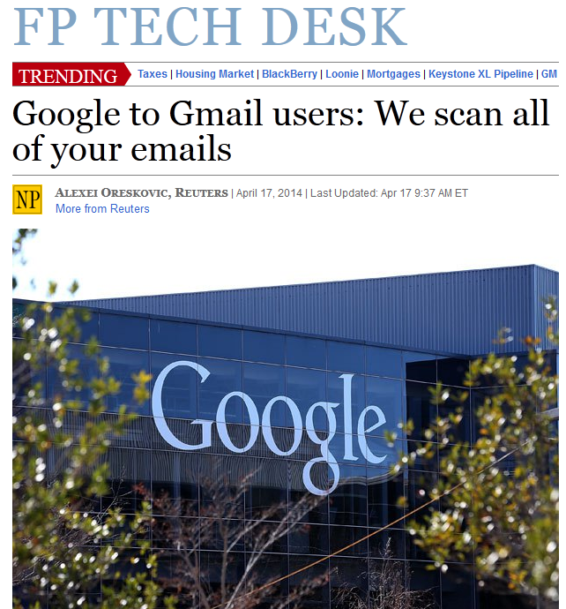
Notes:
…and sometimes they certainly acted like it.
https://business.financialpost.com/2014/04/17/google-inc-gmail-scans/

Slide 4
Notes:
Then Snowden came along, and we all learned who the REAL enemy is.
https://www.washingtonpost.com/world/national-security/nsa-infiltrates-links-to-yahoo-google-data-centers-worldwide-snowden-documents-say/2013/10/30/e51d661e-4166-11e3-8b74-d89d714ca4dd_story.html
(I want to make it clear here that I work with some incredibly driven, dedicated, and brilliant NSA colleagues in various standards bodies who are working very hard to make the Internet more secure. When I say NSA throughout this presentation, I’m not talking about them – I’m talking about the NSA leadership and those employees who are evangelizing and implementing the secretive, questionably legal, and unquestionably unilateral programs of bulk collection and targeted surveillance.)

Slide 5
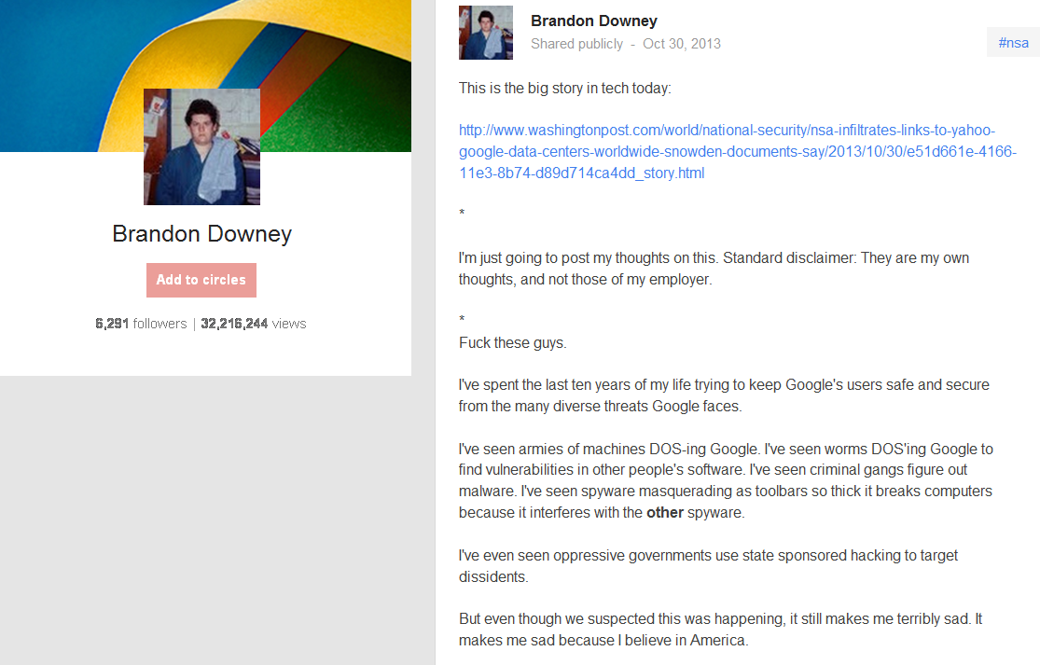
Notes:
This Google engineer said it best…
https://plus.google.com/108799184931623330498/posts/SfYy8xbDWGG

Slide 6
Notes:
Google was bad enough, but our own government?
https://www.washingtonpost.com/blogs/the-switch/wp/2013/12/10/nsa-uses-google-cookies-to-pinpoint-targets-for-hacking/

Slide 7
Notes:
Over the 2013 holidays, we learned about TAO / ANT catalog – Der Spiegel led with an example of products from my former employer. Now it’s personal.
https://secure.flickr.com/photos/brucesterling/11686351495/?rb=1
http://www.spiegel.de/international/world/catalog-reveals-nsa-has-back-doors-for-numerous-devices-a-940994.html
https://www.youtube.com/watch?v=sW-N7qQU-tA
https://www.youtube.com/watch?v=vILAlhwUgIU
https://www.youtube.com/watch?v=ndx0eox0Lkg

Slide 8
Notes:
This is how I spent my holidays, that year. I wanted to burn it all down.

Slide 9
The Three Laws of Thermodynamics:
1. You can't win.
2. You can't break even.
3. You can't quit the game.
Notes:
But the problem seemed insurmountable -
Not going to give up my Android phone, not going to stop sending email
Would like to at least send encrypted email, but 99.44% of people I correspond with aren't!
(As restated by Allen Ginsberg)

Slide 10
Notes:
So I ranted unproductively to my friends for a few months, until…
https://blog.inside.com/blog/2014/3/10/edward-snowden-sxsw-full-transcription-and-video

Slide 11
“When we think about what is happening at the NSA for the past decade, the result has been an adversarial internet - a sort of global free fire zone for governments that is nothing that we ever asked for. It is not what we want. It is something that we need to protect against.”
- Edward Snowden
Notes:
Snowden gave us a stirring call to arms – and I wanted to answer it!
https://www.eff.org/nsa-spying/timeline

Slide 12
Notes:
But how? I’m not a cryptologist or a communications security guru – I was a medieval history major, math is something I do on a calculator when splitting a dinner check (and I’m not alone).
Greenwald blew off Snowden 2-3 times because Snowden wanted him to use encryption, too complicated
https://richard67915.blogspot.com/2011_08_07_archive.html

Slide 13
Notes:
So I’m the sorcerer’s apprentice. What can I do that won’t result in a parade of brooms and a flood? Research!

Slide 14
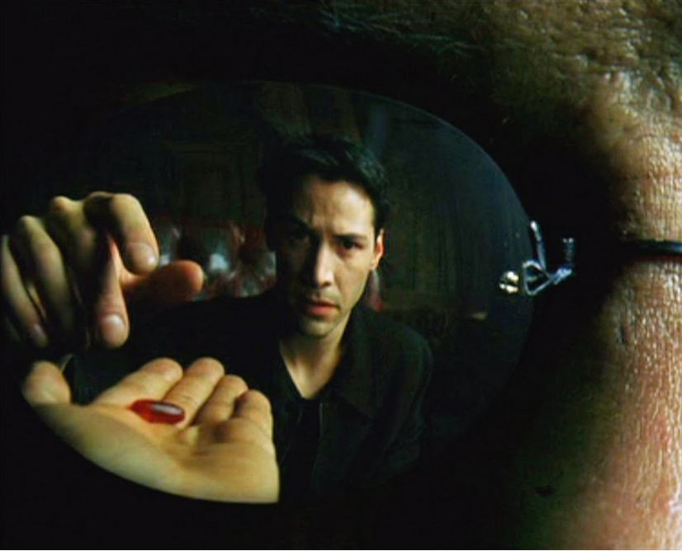
Notes:
That’s when I found out how deep the rabbithole goes…
When I started, my hope was to address entire topic of surveillance – that would take a lifetime!
I figured out pretty quickly that targeted surveillance = game over
Bulk collection is more tractable (maybe)
"You take the blue pill and the story ends. You wake in your bed and believe whatever you want to believe. You take the red pill and you stay in Wonderland and I show you how deep the rabbit-hole goes." – The Matrix

Slide 15
Notes:
Initially, I focused on metadata – WTF is it, and why do I care?
Smarter people than me gently pointed out that many of the tools here don't address metadata
So the tools I talk about help protect against bulk collection in general, but very few protect against metadata collection specifically.
https://www.theguardian.com/technology/interactive/2013/jun/12/what-is-metadata-nsa-surveillance

Slide 16
Notes:
The more I learned, the scarier metadata collection and analysis became. (seven Boston organizations, adjacency matrix, Paul Revere at the center)
http://kieranhealy.org/blog/archives/2013/06/09/using-metadata-to-find-paul-revere/
https://www.slate.com/articles/news_and_politics/jurisprudence/2013/11/nsa_and_metadata_how_the_government_can_spy_on_your_health_political_beliefs.html

Slide 17
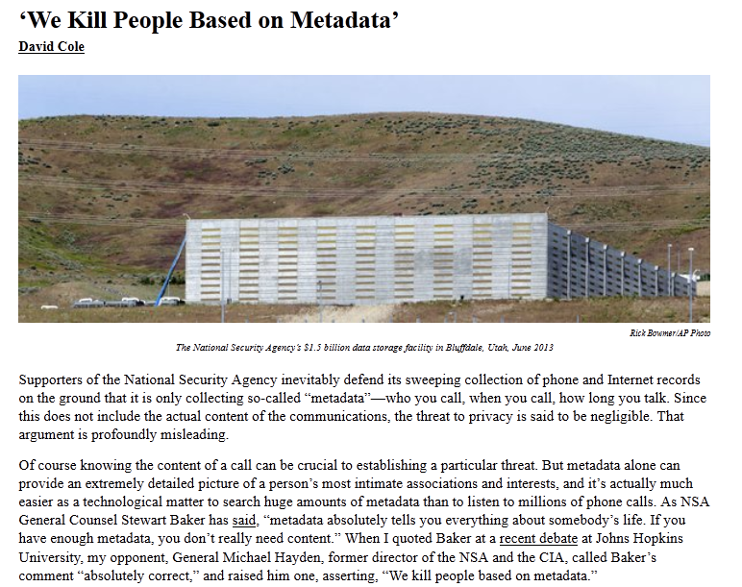
Notes:
We kill people based on metadata – but it’s okay, because we don’t collect on Americans…
https://www.nybooks.com/blogs/nyrblog/2014/may/10/we-kill-people-based-metadata/

Slide 18
Notes:
…except when we collect on Americans. *facepalm*
https://www.washingtonpost.com/opinions/meet-executive-order-12333-the-reagan-rule-that-lets-the-nsa-spy-on-americans/2014/07/18/93d2ac22-0b93-11e4-b8e5-d0de80767fc2_story.html

Slide 19
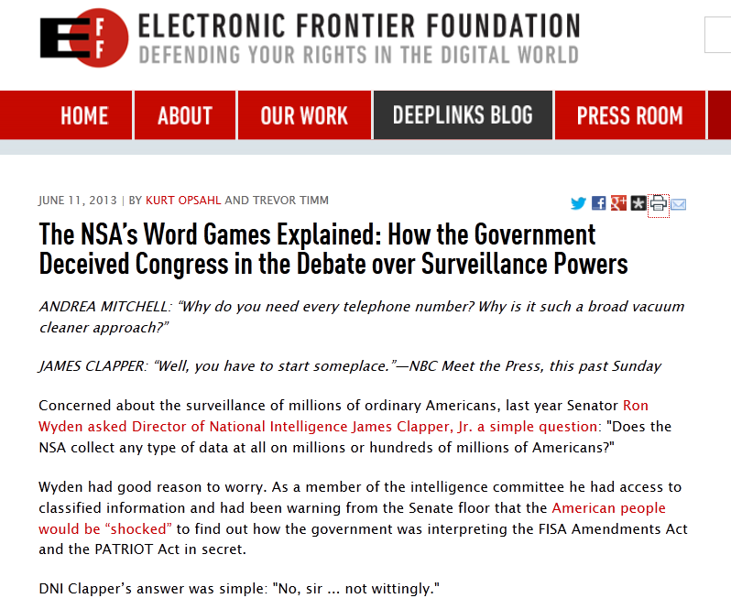
Notes:
In 2012, Ron Wyden asked James Clapper in front of congress whether bulk collection was done against Americans – not wittingly
If you or I lied to Congress, we’d be in jail – he didn’t even lose his job.
Their explanation: we don't consider it collection if we capture information and store it
We only consider it collected if an analyst interacts with it
https://www.eff.org/deeplinks/2013/06/director-national-intelligences-word-games-explained-how-government-deceived
https://www.youtube.com/embed/QwiUVUJmGjs?t=6m1s

Slide 20
Notes:
"When I use a word," Humpty Dumpty said, in a rather scornful tone, "it means just what I choose it to mean—neither more nor less." – Lewis Carroll

Slide 21
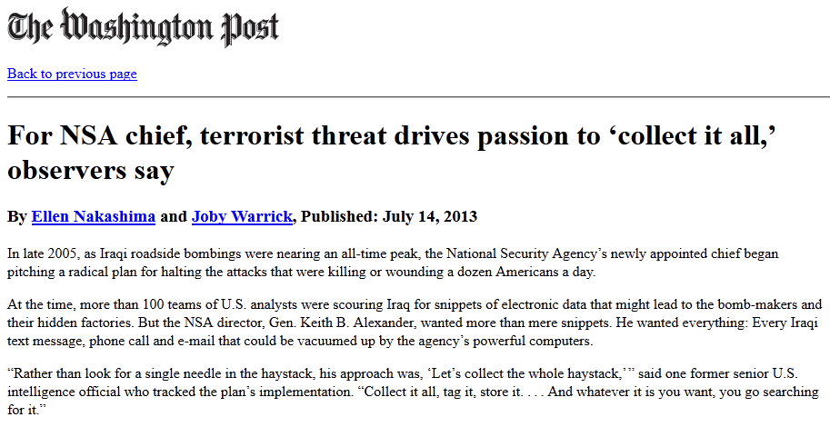
Notes:
This began with no debate; everything we know has been extracted from them kicking and screaming
When I started looking into this, we weren’t having a conversation about suspicionless seizure of our data
Secret law that we can't know about, allowing secret collection of our data, that we can't know they're collecting
Sound like a free country to you?
https://www.washingtonpost.com/world/national-security/for-nsa-chief-terrorist-threat-drives-passion-to-collect-it-all/2013/07/14/3d26ef80-ea49-11e2-a301-ea5a8116d211_story.html

Slide 22
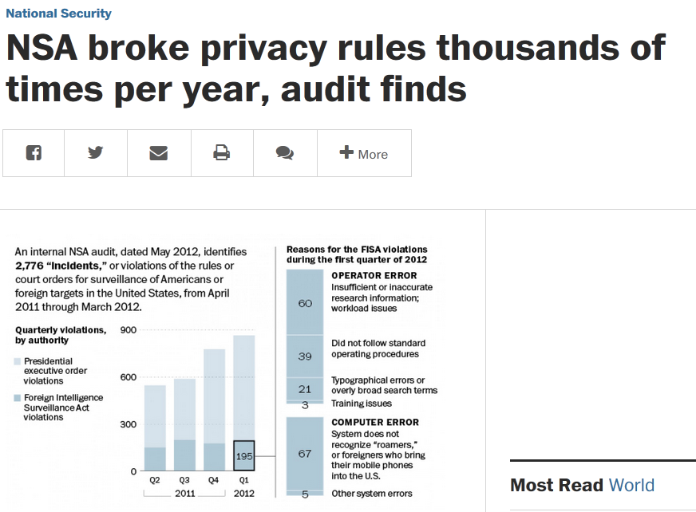
Notes:
LOVEINT
https://www.washingtonpost.com/world/national-security/nsa-broke-privacy-rules-thousands-of-times-per-year-audit-finds/2013/08/15/3310e554-05ca-11e3-a07f-49ddc7417125_story.html

Slide 23
Notes:
7,485 email addresses – 202 tied to US persons
Sounds a lot like COINTELPRO to me
https://firstlook.org/theintercept/article/2014/07/09/under-surveillance/

Slide 24
Notes:
My goal here is to piss you off – if you're not pissed off at this point, you're not paying attention.

Slide 25
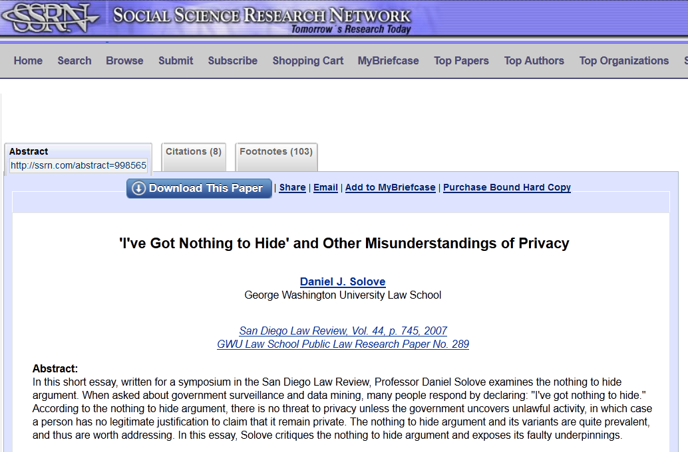
Notes:
Nothing to hide, why do I care?
Privacy law is based on “a reasonable expectation of privacy” - if you accept erosion of your privacy, that changes the law
Permitting surveillance cameras in public locations changes your right to go unobserved
We have a responsibility to pay attention, and to actively push back against invasions of privacy.
https://papers.ssrn.com/sol3/papers.cfm?abstract_id=998565

Slide 26
Notes:
I want to do something about this – I’m tired of signing online petitions and tweeting about my outrage
What's feasible for me to do today to deal with this? To try to opt out, to make it harder…
So I’m trying to educate myself, practice better opsec, and share what I learn.

Slide 27
Notes:
Three things you can do – every person in this room
Free, simple, and little or no hassle.

Slide 28
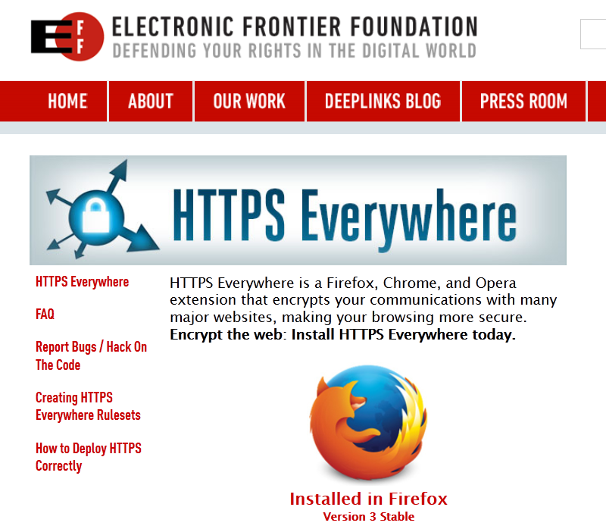
Notes:
Put on our computers, our relatives, our partners, the library, where we work
https://www.eff.org/https-everywhere
https://www.eff.org/pages/tor-and-https

Slide 29
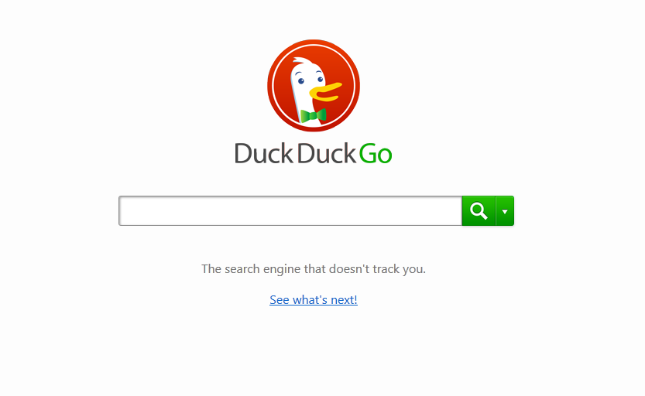
Notes:
Stop using Google!
Government is gathering their logs
Has the side benefit of opting out of their surveillance, too :)
https://duckduckgo.com
But:
https://etherrag.blogspot.jp/2013/07/duck-duck-go-illusion-of-privacy.html
Note that in the comments, CEO Gabriel Weinberg directly stated they had not received any request like that and would fight it if they did

Slide 30
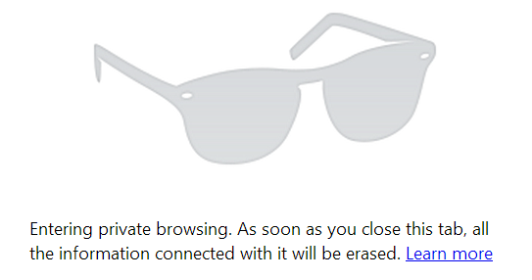
Notes:
I’m usually pretty good about cookie hygiene…
but at one point I bought a Scottevest in an unprotected browser window, started seeing ads for Scottevest everywhere.
It was a strong visible reminder of the iceberg of tracking under the surface of the ‘net.
(Also, if you’re not keeping tracking cookies, the NSA can’t piggy-back on them!)

Slide 31
Notes:
Easy to change default search engine, install a browser plug-in
Other approaches / tools that are a little harder, but still within normal person's reach

Slide 32
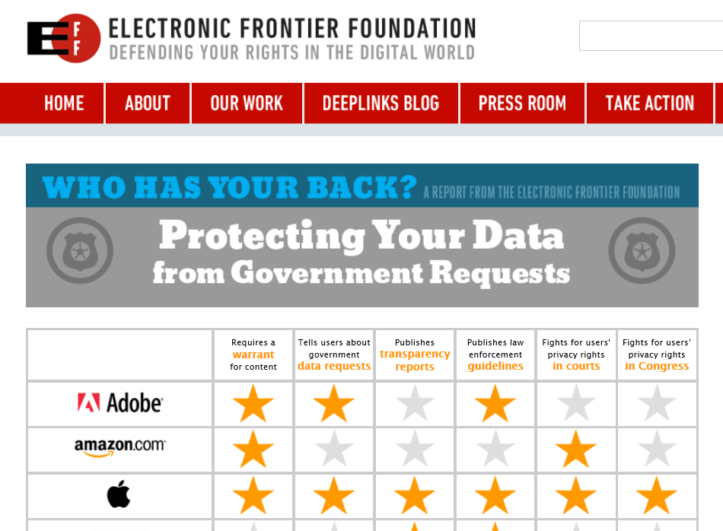
Notes:
Choose to give your money to companies who are pushing back
https://www.eff.org/who-has-your-back-government-data-requests-2014

Slide 33
Notes:
https://www.eff.org/privacybadger
Privacy Badger blocks spying ads and invisible trackers. It's there to ensure that companies can't track your browsing without your consent.
This extension is designed to automatically protect your privacy from third party trackers that load invisibly when you browse the web. We send the Do Not Track header with each request, and our extension evaluates the likelihood that you are still being tracked. If the algorithm deems the likelihood is too high, we automatically block your request from being sent to the domain. Please understand that Privacy Badger is in beta, and the algorithm's determination is not conclusive that the domain is tracking you.
Our extension has three states. Red means Privacy Badger believes this domain is a tracker, and has blocked it. Yellow means the domain is believed to be both a tracker and necessary for the functioning of the page, so Privacy Badger is allowing it but blocking its cookies. Green means that Privacy Badger believes this is not tracker. You can click on the Privacy Badger icon in your browser's toolbar if you wish to override the automatic blocking settings. Or, you can browse in peace as Privacy Badger starts finding and eating up web trackers one by one.
Nothing can stop the Privacy Badger from eating cookies when it's hungry!
Privacy Badger is a project of the Electronic Frontier Foundation.

Slide 34
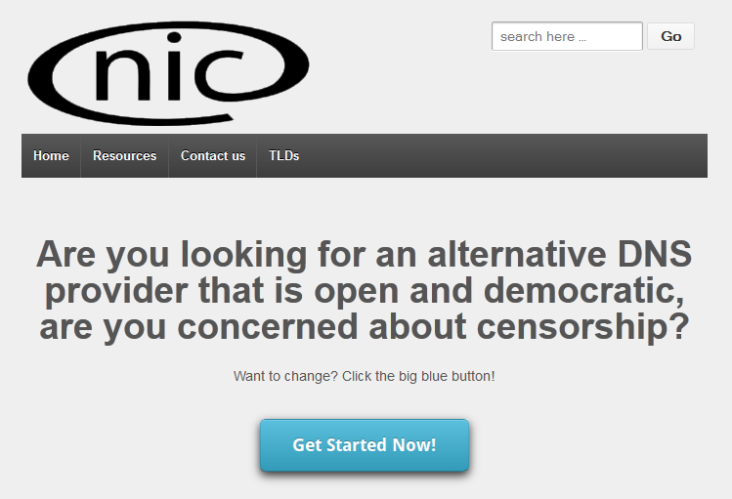
OpenNIC
Notes:
Stop using 8.8.8.8!
http://www.opennicproject.org/

Slide 35
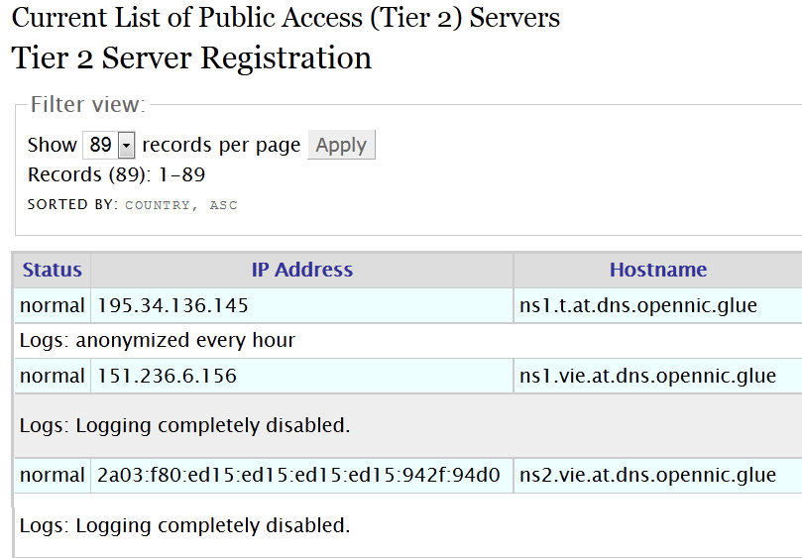
Notes:
Your DNS queries can still be collected on the wire, but at least they’re not sitting in a big fat dataset subject to government access.
http://wiki.opennicproject.org/Tier2

Slide 36
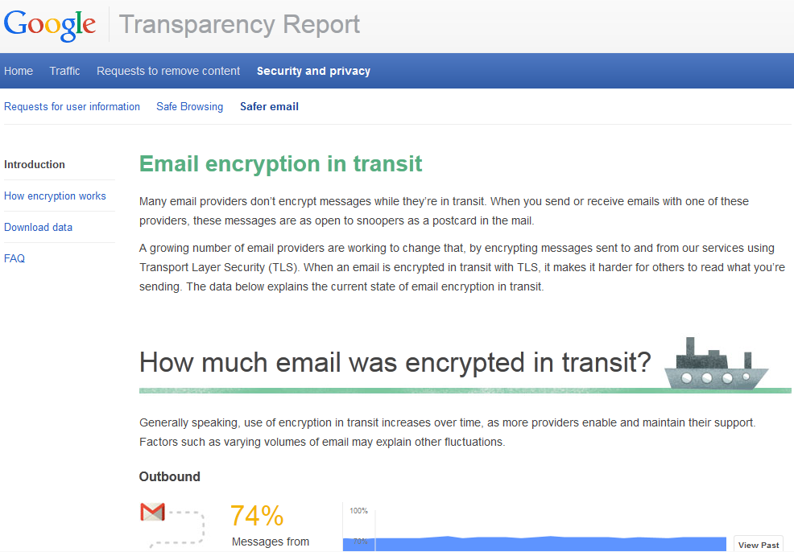
Notes:
https://www.google.com/transparencyreport/saferemail/

Slide 37
Notes:
http://prxbx.com/email/

Slide 38
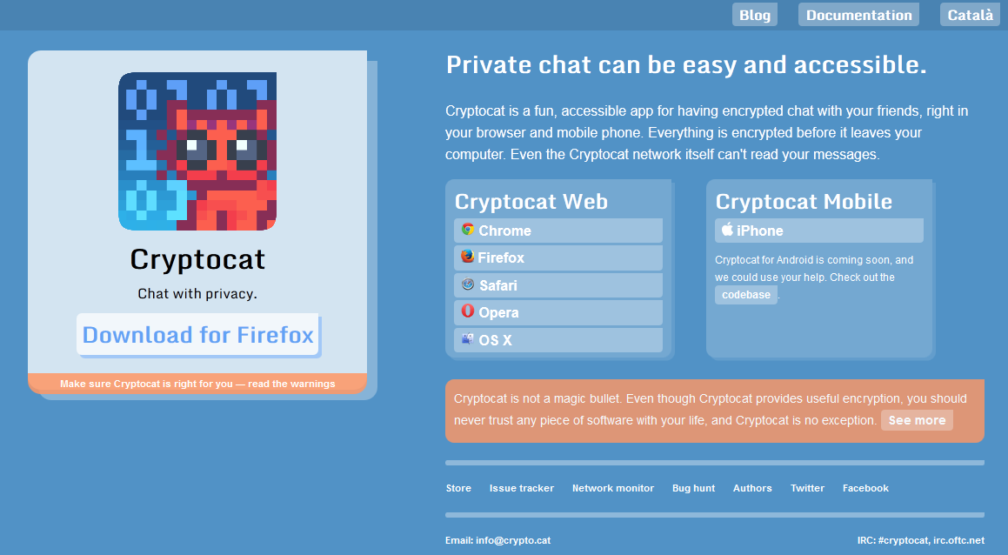
Notes:
https://crypto.cat/

Slide 39
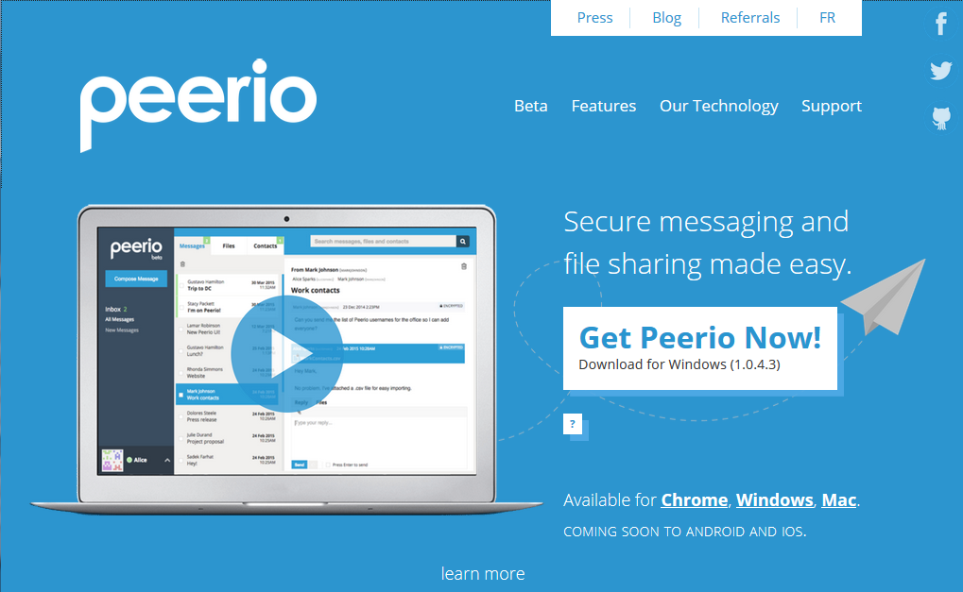
Notes:
https://www.peerio.com/index.shtml

Slide 40
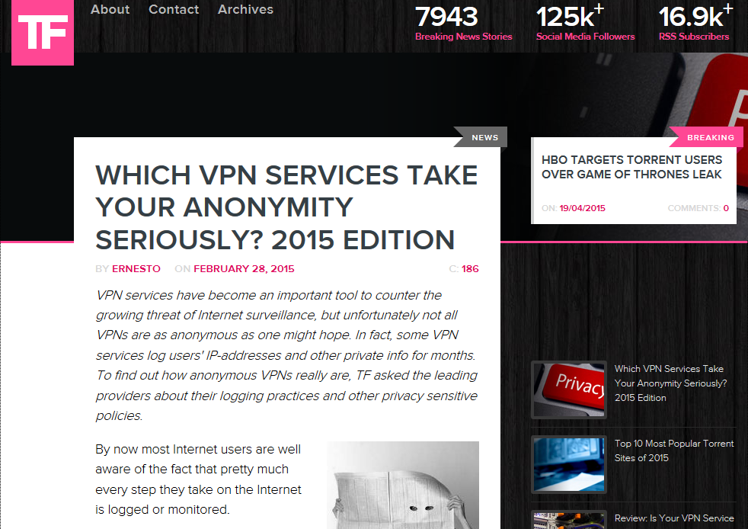
Notes:
https://torrentfreak.com/anonymous-vpn-service-provider-review-2015-150228/

Slide 41
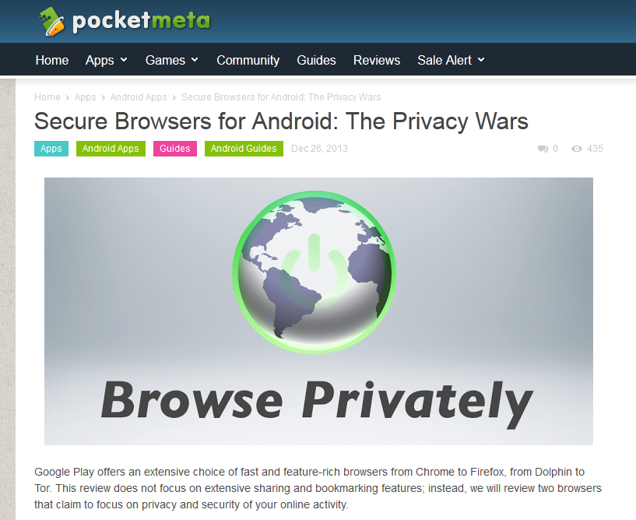
Notes:
http://www.pocketmeta.com/secure-browsers-android-privacy-wars-1862/

Slide 42
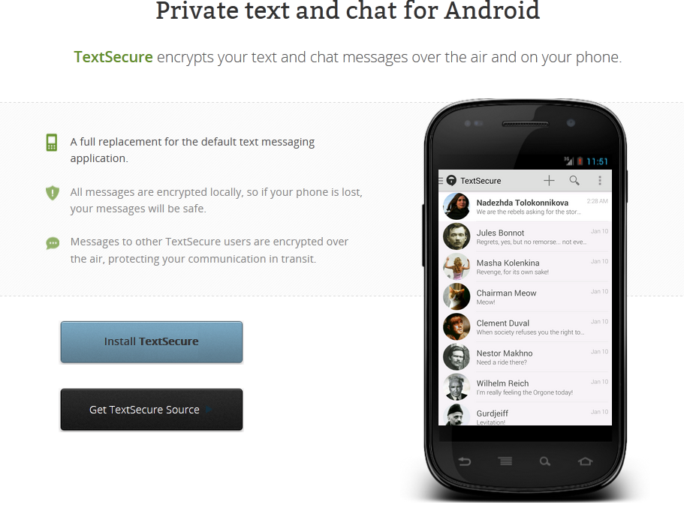
Notes:
https://wickr.com/

Slide 43
Notes:
https://whispersystems.org/#privacy
But…
https://threatpost.com/textsecure-to-drop-support-for-encrypted-sms/111510

Slide 44
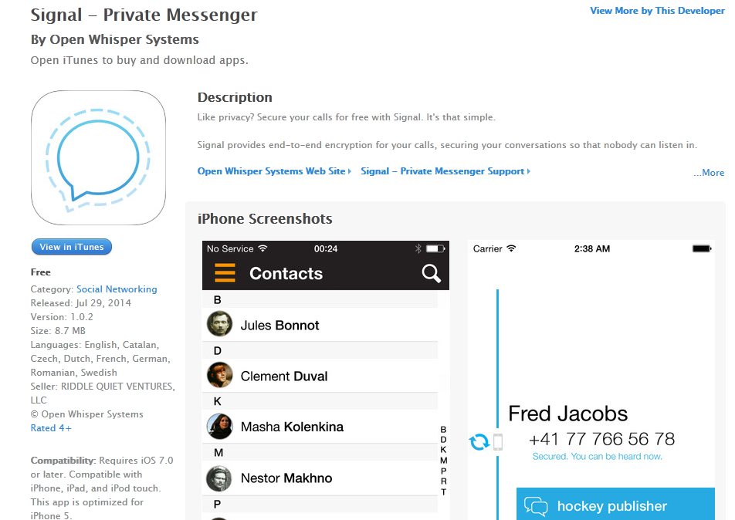
Notes:
https://itunes.apple.com/app/id874139669

Slide 45
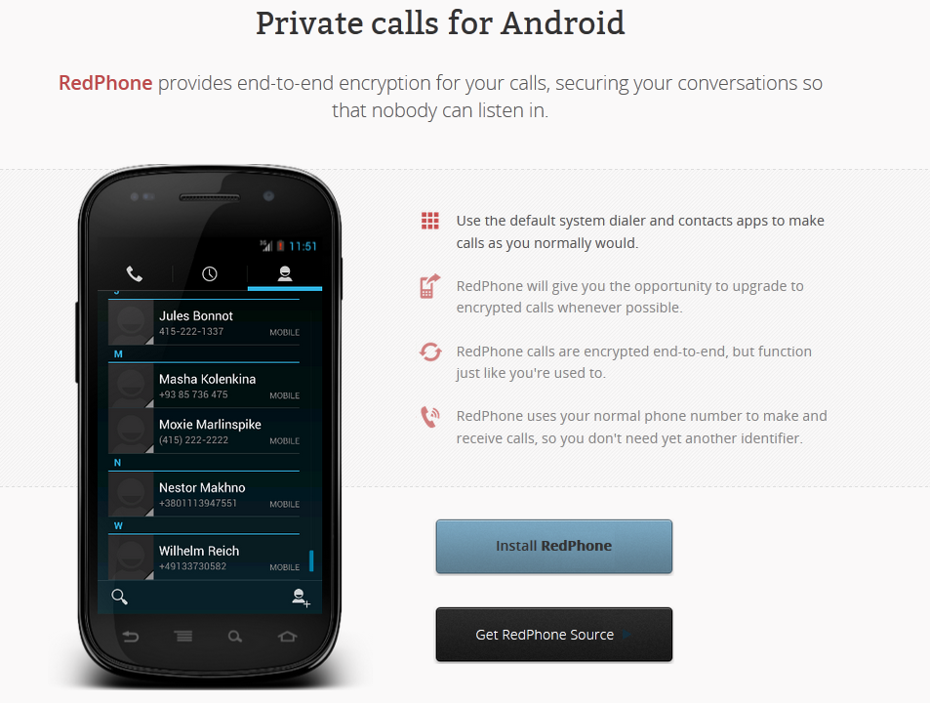
Notes:
https://whispersystems.org/#privacy

Slide 46
Notes:
All of those tools are still relatively low-friction. If you really want to take significant steps towards privacy, you have to be willing to expend more effort. It can be a real pain sometimes – everyone has to make their own decision about how much overhead, and what kind, you’re willing to invest in online privacy.

Slide 47
Notes:
https://www.whitehatsec.com/aviator/

Slide 48
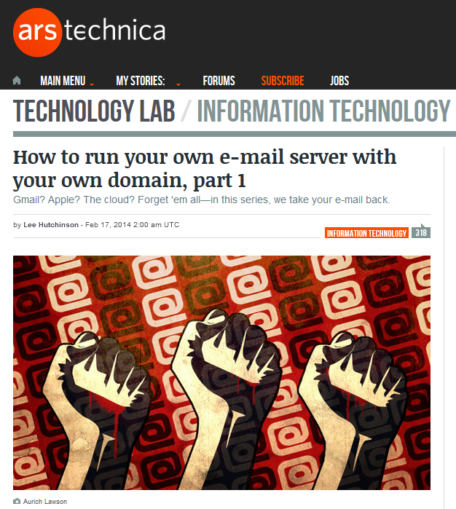
Notes:
https://arstechnica.com/information-technology/2014/02/how-to-run-your-own-e-mail-server-with-your-own-domain-part-1/

Slide 49
Notes:
https://mailinabox.email/

Slide 50
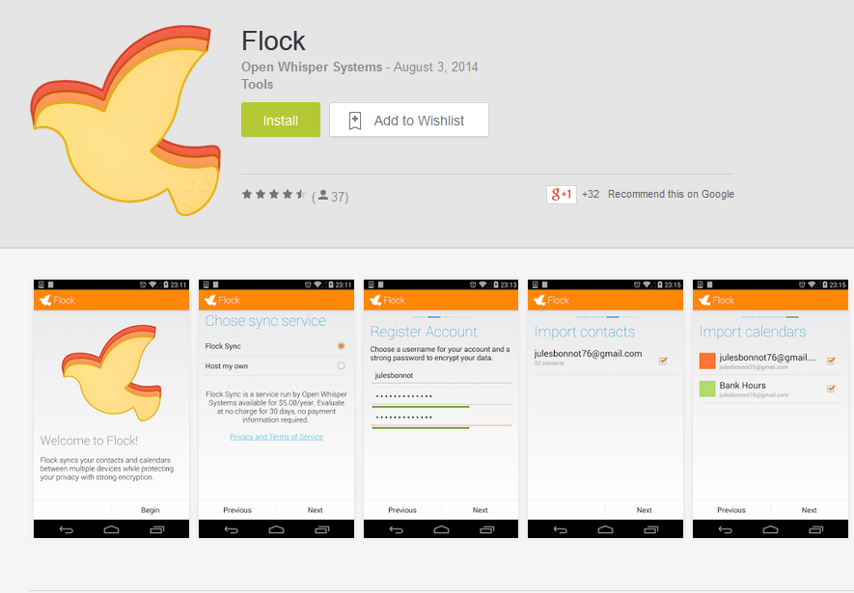
Notes:
https://play.google.com/store/apps/details?id=org.anhonesteffort.flock

Slide 51
Notes:
https://www.zimbra.com/

Slide 52
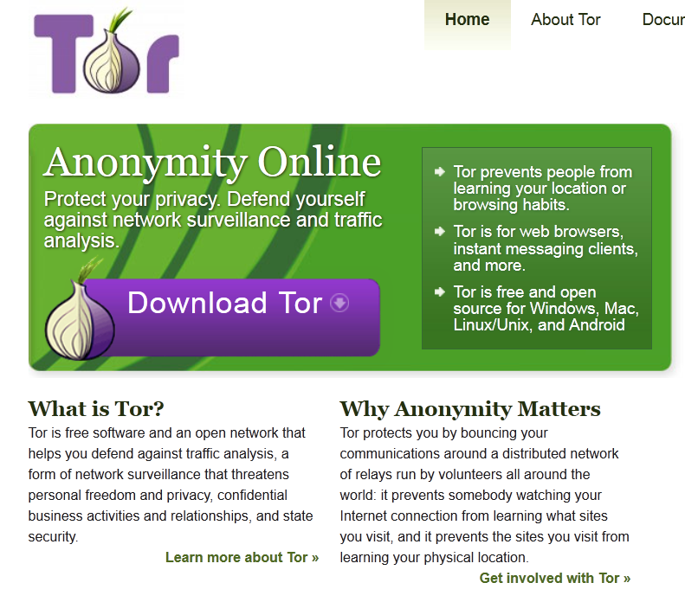
Notes:
https://www.torproject.org/
https://www.eff.org/pages/tor-and-https
https://scottlinux.com/2013/07/02/duckduckgo-tor-hidden-service-over-https/

Slide 53
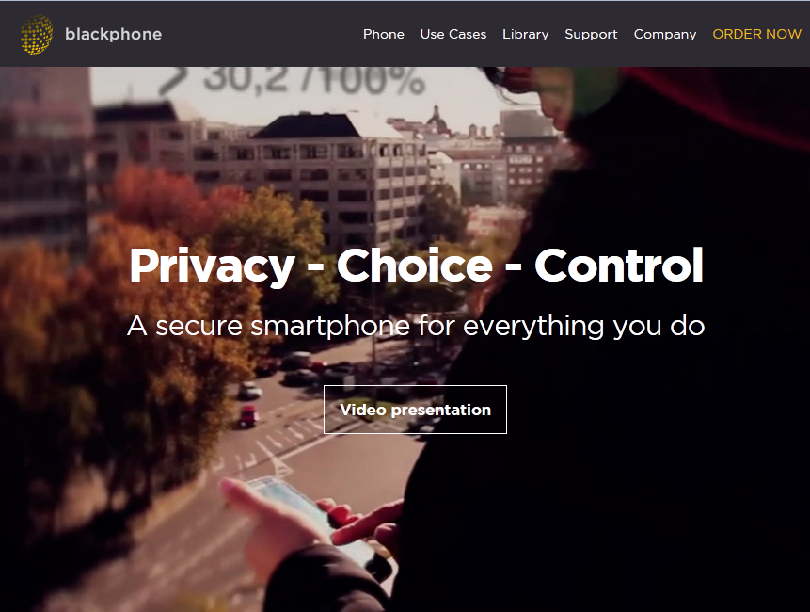
Notes:
https://www.blackphone.ch/

Slide 54
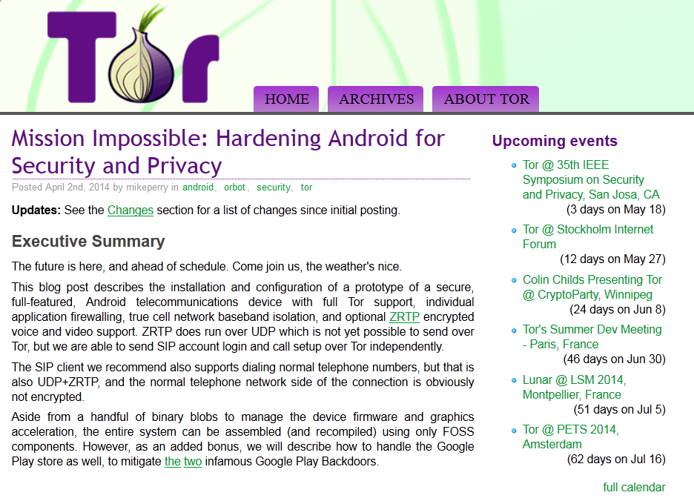
Notes:
https://blog.torproject.org/blog/mission-impossible-hardening-android-security-and-privacy

Slide 56
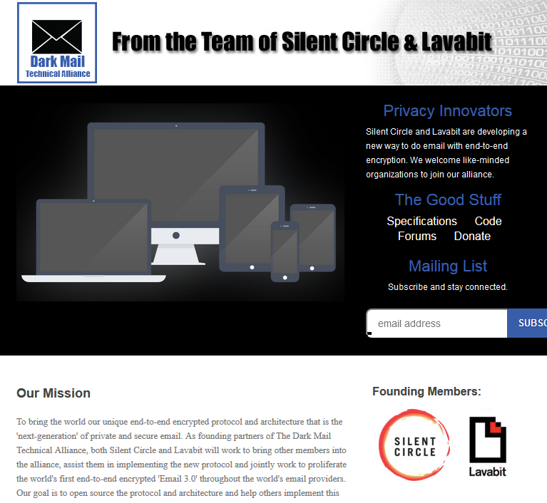
Notes:
DIME
https://darkmail.info/
http://www.bit-tech.net/news/bits/2015/01/02/dark-mail-tech-alliance/1
https://www.youtube.com/watch?v=-By4OnyC4Ig (starts at 49:30)
https://www.youtube.com/watch?v=biulJpOomRc

Slide 57
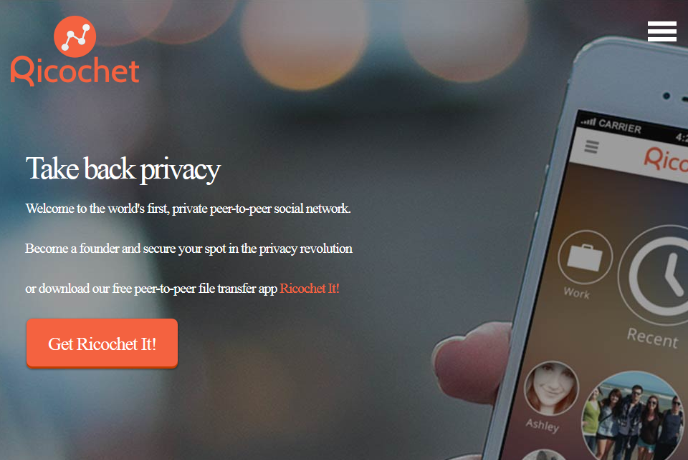
Notes:
https://www.wired.com/2014/09/new-encrypted-chat-program-thwarts-nsa-eliminating-metadata/

Slide 59
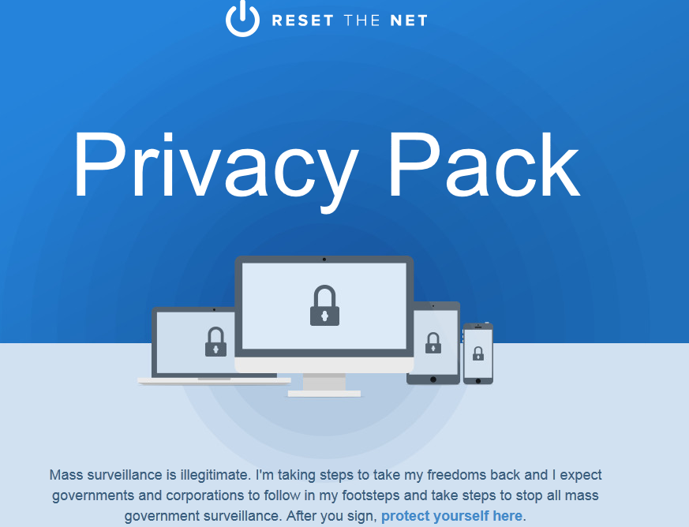
Notes:
https://pack.resetthenet.org/#protect-yourself

Slide 60
Notes:
https://ssd.eff.org/

Slide 61
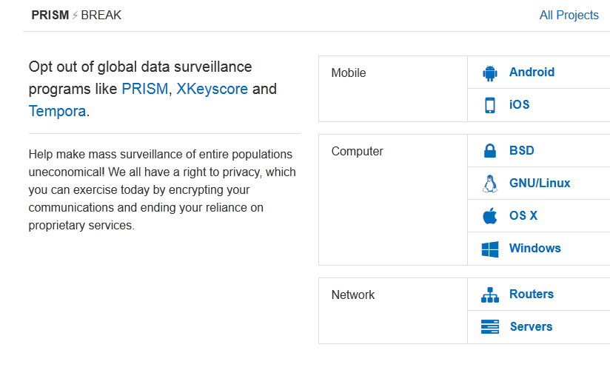
Notes:
https://prism-break.org/en/

Slide 62
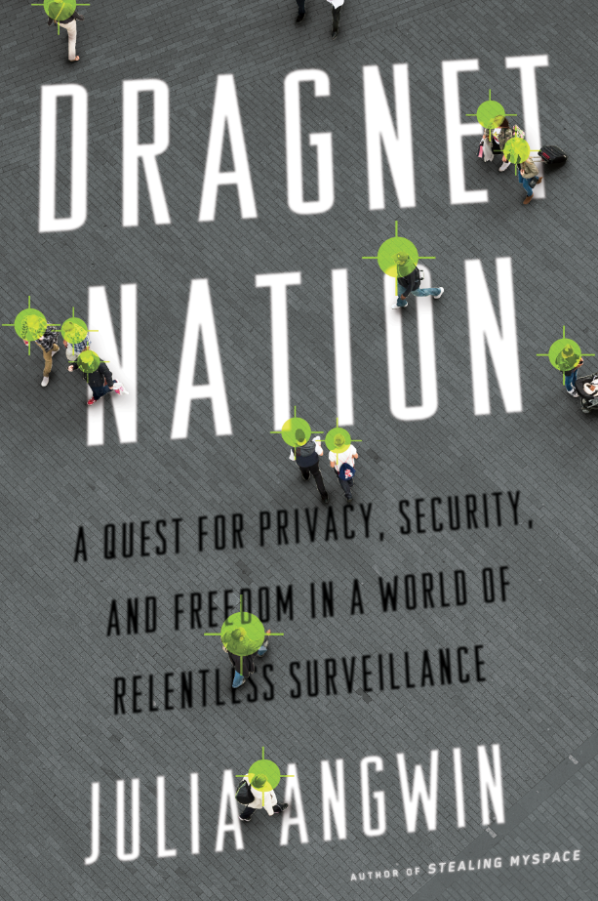
Notes:
http://juliaangwin.com/books/ (and http://juliaangwin.com/privacy-tools/ )
https://www.schneier.com/books/data_and_goliath/
https://global.oup.com/academic/product/intellectual-privacy-9780199946143
https://papers.ssrn.com/sol3/papers.cfm?abstract_id=2554196

Slide 63
Notes:
https://medium.com/message/everything-is-broken-81e5f33a24e1

Slide 64
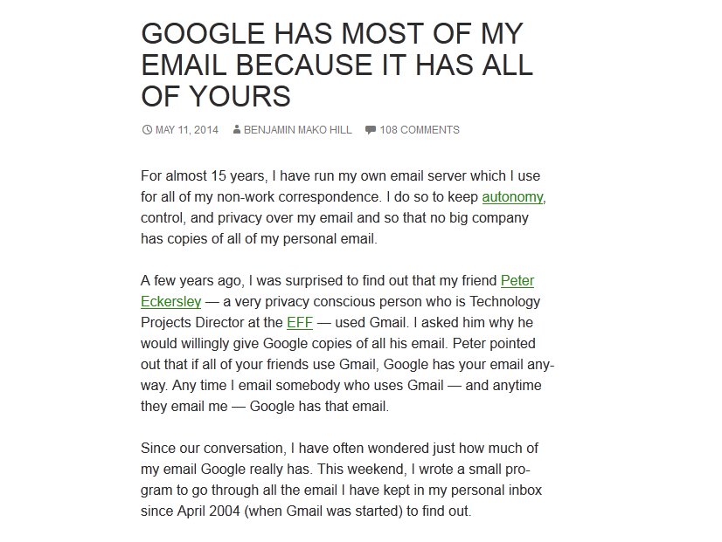
Notes:
http://mako.cc/copyrighteous/google-has-most-of-my-email-because-it-has-all-of-yours

Slide 65
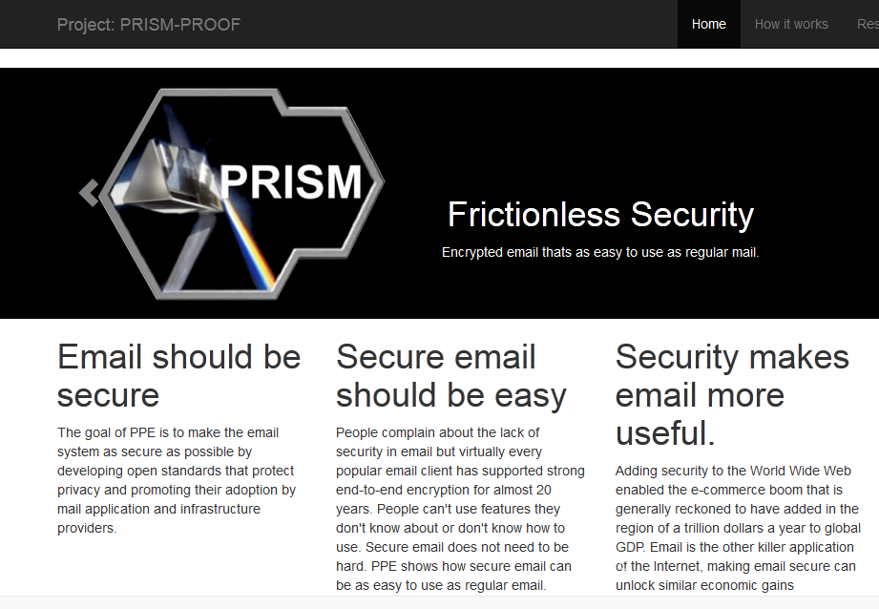
Notes:
http://prismproof.org/

Slide 66
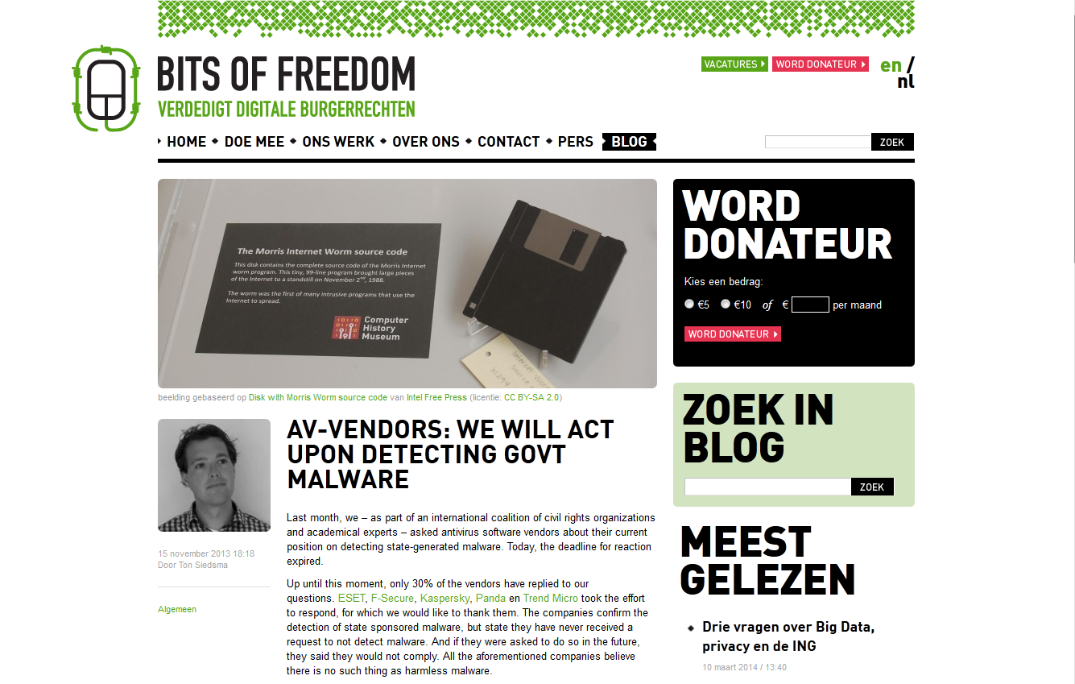
Notes:
https://www.bof.nl/2013/11/15/av-vendors-we-will-act-upon-detecting-govt-malware/

Slide 67
Notes:
https://www.theguardian.com/world/2013/jul/11/microsoft-nsa-collaboration-user-data

Slide 68
The Three Laws of Countersurveillance:
You can’t prevent surveillance.
You can make it harder.
You can limit what they get.

Slide 69
“The bottom line - I have repeated this again and again - is that encryption does work. We need to think of encryption not as this sort of arcane black art. It is a basic protection - a defense against the dark arts - for the digital realm.”
- Edward Snowden
Notes:
https://pressfreedomfoundation.org/encryption-works

Slide 70
Politics
Application
Presentation
Session
Transport
Network
Data Link
Physical

Slide 71
Notes:
https://www.aclu.org/
http://bordc.org/
https://cdt.org/
https://www.eff.org/
https://epic.org/

Slide 72
Notes:
http://www.cagle.com/2014/03/nsa-listens/

Slide 73
Notes:
https://sensenbrenner.house.gov/legislation/theusafreedomact.htm
But:
https://www.eff.org/deeplinks/2014/05/eff-dismayed-houses-gutted-usa-freedom-act

Slide 74
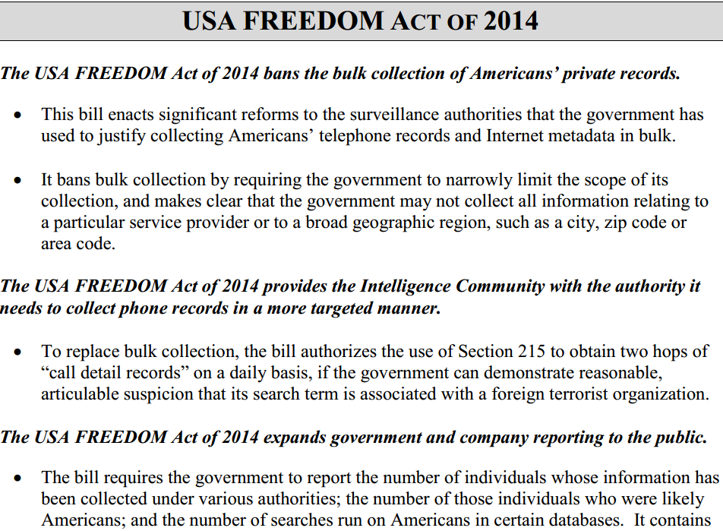
Notes:
https://www.leahy.senate.gov/download/hen14602
https://www.leahy.senate.gov/download/usa-freedom-act_background
https://www.eff.org/deeplinks/2014/07/new-senate-usa-freedom-act-first-step-towards-reforming-mass-surveillance

Slide 75
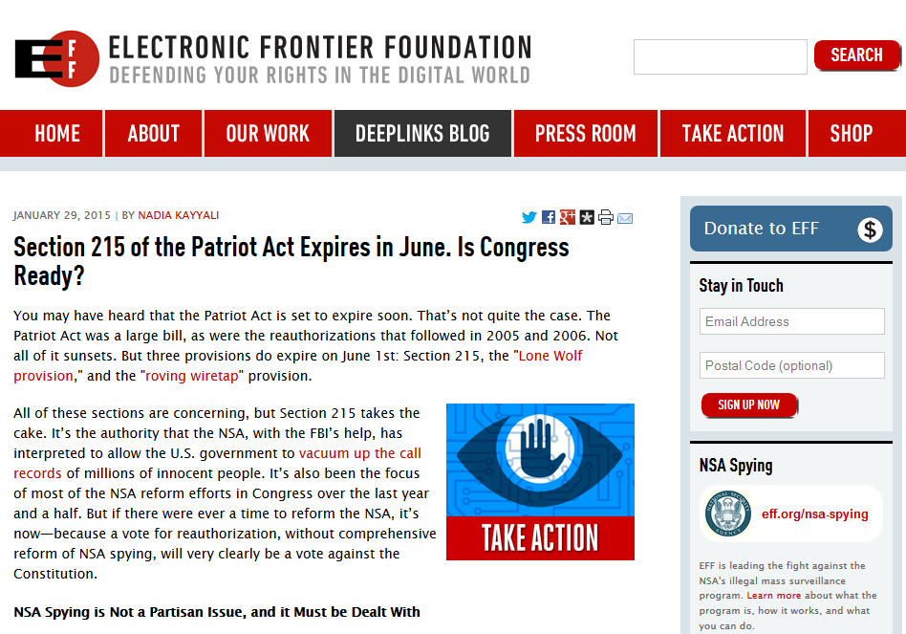
Notes:
Section 215 reauthorization
https://www.theguardian.com/us-news/2015/apr/15/nsa-fbi-surveillance-patriot-action-section-215-expiration
http://www.zerohedge.com/news/2015-04-17/congress-trying-reauthorize-key-patriot-act-provisions-sneaking-it-usa-freedom-act
https://act.eff.org/action/tell-congress-my-phone-calls-are-my-business-reform-the-nsa

Slide 76
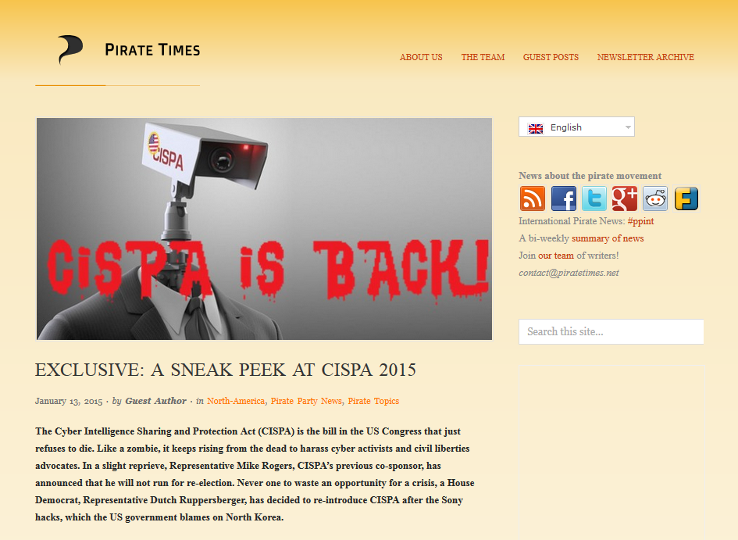
(…and it brought friends)
Notes:
https://cyberlaw.stanford.edu/blog/2015/04/technologists-oppose-cisainformation-sharing-bills
Cyber Intelligence Sharing and Protection Act of 2015 (HR234)
https://www.congress.gov/bill/114th-congress/house-bill/234
https://piratetimes.net/exclusive-a-sneak-peek-at-cispa-2015/
Cybersecurity Information Sharing Act of 2015 (S754)
https://www.congress.gov/bill/114th-congress/senate-bill/754?q={%22search%22%3A[%22Cybersecurity+Information+Sharing+Act+of+2015%22]}
https://www.eff.org/deeplinks/2015/03/senate-intelligence-committee-advances-terrible-cybersecurity-bill-surveillance
National Cybersecurity Protection Advancement Act of 2015 (HR1731)
https://www.congress.gov/bill/114th-congress/house-bill/1731
Cyber Threat Sharing Act, Protecting Computer Networks Act… politicians are full of bad ideas.

Slide 77
cyber cyber cyber
Notes:
https://www.youtube.com/watch?v=Th5JjVPounY

Slide 78
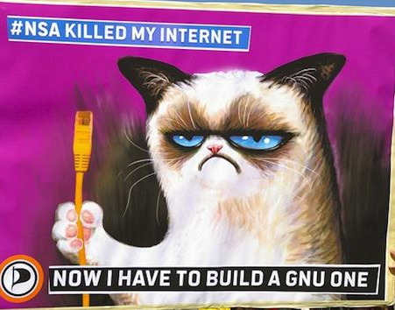
Notes:
https://www.flickr.com/photos/nitot/12248961183/

Slide 79
“The IETF should never again approve a protocol that sends plaintext over the Internet.”
- Ian Goldberg
Notes:
https://archive.org/details/ShmooCon2014_Keynote_Privacy_Online_Now_What

Slide 80
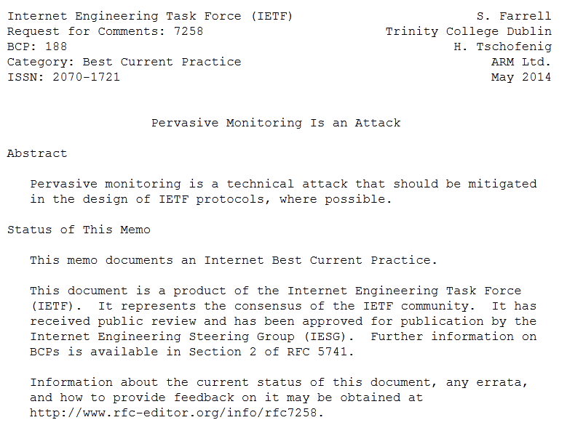
Notes:
https://www.rfc-editor.org/rfc/rfc7258.txt

Slide 81
“They are setting fire to the future of the internet. The people who are in this room now - you guys are all the firefighters and we need you to help us fix this.”
- Edward Snowden
Notes:
https://archive.org/details/ShmooCon2014_NSA_Capabilities_and_Countermeasures
http://smarimccarthy.is/blog/2014/05/28/engineering-our-way-out-of-fascism/
https://idlewords.com/bt14.htm
https://www.theguardian.com/world/2013/sep/05/nsa-how-to-remain-secure-surveillance

Slide 82
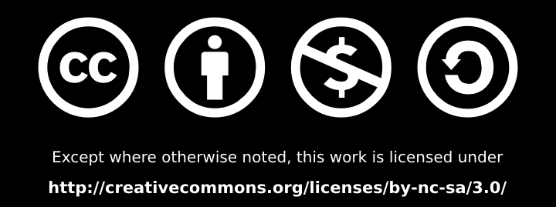
Please attribute Lisa Lorenzin.
Take these slides and do something cool with them! Give a talk at your local school, or library, or hackerspace, or company. Add new tools that I haven’t heard of yet (and then tell me about them, too! I’m @llorenzin on Twitter). Make a website, write a blog post, host a podcast… And use some of the tools here to protect your privacy and help make the Internet a more safe environment for free speech.

