Slide 1
Hacker Con WiFi Hijinx: Protecting Yourself On Potentially Hostile Networks
Adrian Crenshaw

Slide 2

About Adrian
I run Irongeek.com
I have an interest in InfoSec education
I don’t know everything - I’m just a geek with time on my hands

Slide 3

Do you really trust the network you’re on?
I wrote this material originally for coffee shops
Modified it for my Hacker Con Hijinx pamphlet
Applies to pretty much any public WiFi network:
Libraries
Restaurants
Airport
etc.

Slide 4
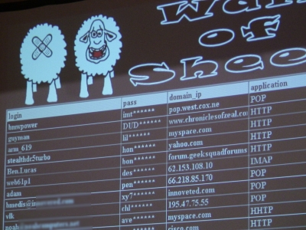

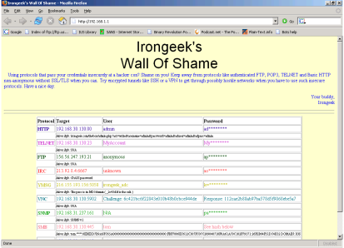
Wall of shame/sheep/social science majors
Plaintext protocols? At a hacker con?
http://www.wallofsheep.com/

Slide 5
What I plan to cover
WiFi on hostile networks
Common remote attack vectors
I’m not really going to cover physical security
(but I will say: encrypt your hard drive, turn off auto-run)

Slide 6

Open File Shares
So, that’s what you look like naked?
Photo: Larry Pesce, http://pauldotcom.com

Slide 7
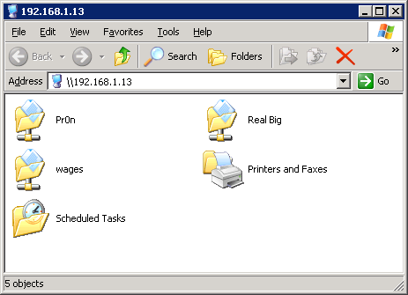

Open File Shares
So, do you know what you’re sharing?
\\your-computer-name
(or IP)

Slide 8
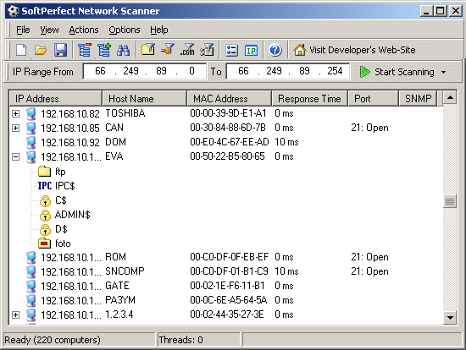
Scanning for shares
Softperfect's NetScan

Slide 9
Netscan Video
Click for Netscan video

Slide 10
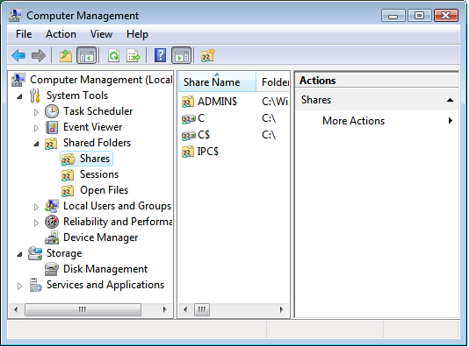
Change your sharing settings
compmgmt.msc
Firewall it off
Click Start->Control Panel->Network Connections, then right click on your wireless connection, choose properties and uncheck "File and Printer Sharing for Microsoft Networks" to disable it.

Slide 11

Patch Before The Con

Slide 12
Patch-Patch-Patch-o-roo
Most modern Operating Systems have some built-in update functions
For 3rd party apps, try:
Secunia PSI http://secunia.com/vulnerability_scanning/
Tools like Ettercap and The-Middler can be used to subvert some online update processes to install malware, so it's much better to apply your patches while you are on a trusted network
Evilgrade for the Win!!!

Slide 13
Unneeded Services
Do you need IIS and MSSQL on your laptop?

Slide 14
Even if you are patched…
Even if you keep your box up to date, there may be a zero day with your name on it
Open ports in and of themselves are not bad
It’s all about limiting the attack surface

Slide 15
Finding Open Ports
Windows:
netstat -b
*nix:
lsof –I
From the local LAN
nmap -p T:0-65535,U:0-65535 yourip
Nmap from another box on the local LAN would be better than https://www.grc.com/x/ne.dll?bh0bkyd2

Slide 16

Solutions to unneeded services
Turn them off before the con!!!
Firewall them off

Slide 17

Sniffers
There will be more sniffers running at a hacker/security conference than at a bloodhound convention

Slide 18
Why worry about how you smell?
  Plaintext protocols can leak passwords:
  Telnet, HTTP, SMTP, SNMP, POP3, FTP, etc
Files can be reassembled
Private messages can be read

Slide 19
Promiscuous mode
Not a network card of questionable sexual morals
Have to be connected, won’t see management frames

Slide 20
Monitor mode
Most of the time this will work:
ifconfig wlan0 down
iwconfig wlan0 mode monitor channel 9
ifconfig wlan0 up
If you have Aircrack-NG installed:
airmon-ng <start|stop> <interface> [channel]
Dump them packets for later perusal:
tcpdump -i wlan0 -s 0 -w montest.pcap
  If you use Windows Vista (NDIS 6) try:
  Microsoft Network Monitor 3.1

Slide 21
A note on chipsets
Some cards will support monitor but not promiscuous, or vice versa
Atheros or RaLink are pretty good
Vendors change chipsets between different reversions of their adapters
Some USB adapters can be used in VMWare
Aircrack-NG chipset list
http://www.aircrack-ng.org/doku.php?id=compatibility_drivers
WinPCap list
http://web.archive.org/web/20080102184219/http://www.micro-logix.com/WinPcap/Supported.asp

Slide 22



Great sniffing tools
Wireshark
good for general purpose sniffing
Ettercap
good for password collection
Cain
good for password collection
Dsniff (and related snarf tools)
good for password collection and file snarfing
NetworkMiner
good for password collection and file snarfing
Driftnet
good for image snarfing

Slide 23
A couple of sniffer videos
Wireshark
Network Miner

Slide 24
Man In The Middle
AKA: Monkey in the Middle

Slide 25

Looks a little like this
Switch
Fritz
Cindy
Hey Cindy, I’m Fritz.
Hey Fritz, I’m Cindy.

Slide 26
ARP Poisoning
On the local subnet, IPs are translated to MAC addresses using ARP (Address Resolution Protocol)
ARP queries are sent and listened for, and a table of IPs to MACs is built (arp -a)
Pulling off a MITM (Man In The Middle) attack
If you MITM a connection, you can proxy it and sometime get around encryption
  SSL
  RDP
  WPA

Slide 27
Tools for MITM
Cain
Ettercap
The-Middler
SSLStrip

Slide 28
Cain Videos
Using Cain to ARP poison, grab telnet and web passwords
Using Cain to sniff RDP

Slide 29
Ettercap Videos
Ettercap ARP poison example
Ettercap filters

Slide 30
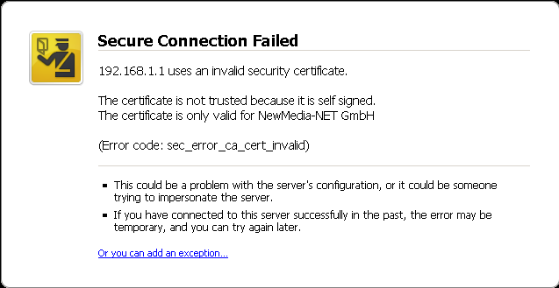
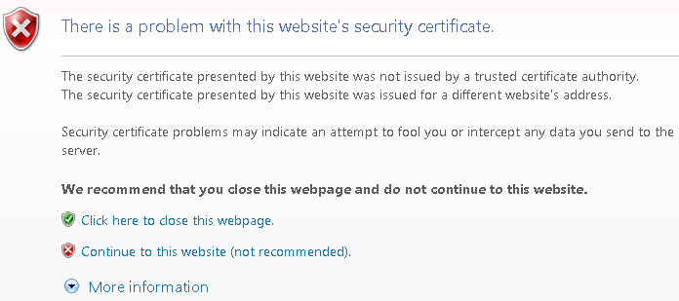
Signs of MITM
SSL/TLS Warnings
Slow connections
IP conflicts
DecaffeinatID: A Very Simple IDS / Log Watching App / ARPWatch For Windows
http://www.irongeek.com/i.php?page=security/decaffeinatid-simple-ids-arpwatch-for-windows

Slide 31
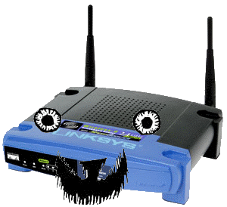
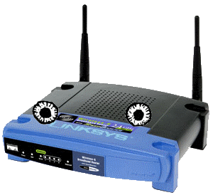
Evil Twin Attack
Do you know for sure who you are attaching to?
Can use tools like Hotspotter or Karma
Who do you auto connect to when in range?
Mention the “AdHock worm”

Slide 32
Giving A Sniffer Congestion
Use your phone EV-DO / HSPA
Don’t check sensitive sites
(Why are you looking at your bank account!?!?)
Avoid plaintext protocols and use encrypted ones like SSH or email/http over SSL/TLS (and hope no one is using SSLStrip)
Different passwords for different kind of sites
Tunnel traffic through encrypted channels

Slide 33
Tunneling
Look into the following:
VPN/Hamachi
SSH port forwarding
DD-WRT has built in VPN support
Tor is not a VPN substitute , but can help with staying anonymous
Watch out for folks “following you home” to your own network

Slide 34
Links
Articles:
My Handout
http://www.irongeek.com/i.php?page=security/hacker-con-handout
Intro to Sniffers
http://www.irongeek.com/i.php?page=security/AQuickIntrotoSniffers
Cain RDP (Remote Desktop Protocol) Sniffer Parser
http://www.irongeek.com/i.php?page=security/cain-rdp-mitm-parser
Caffeinated Computer Crackers: Coffee and Confidential Computer Communications
http://www.irongeek.com/i.php?page=security/coffeecrack
The Basics of Arpspoofing/Arppoisoning
http://www.irongeek.com/i.php?page=security/arpspoof
Fun with Ettercap filters
http://www.irongeek.com/i.php?page=security/ettercapfilter

Slide 35
Links
Videos:
Sniffers Class for the Louisville ISSA
http://www.irongeek.com/i.php?page=videos/sniffers-class-for-the-louisville-issa
DNS Spoofing with Ettercap
http://www.irongeek.com/i.php?page=videos/dns-spoofing-with-ettercap-pharming
More Useful Ettercap Plugins For Pen-testing
http://irongeek.com/i.php?page=videos/ettercap-plugins-find-ip-gw-discover-isolate
Intro to the AirPcap USB adapter, Wireshark, and using Cain to crack WEP
http://www.irongeek.com/i.php?page=videos/airpcap-wireshark-cain-wep-cracking
Using Cain and the AirPcap USB adapter to crack WPA/WPA2
http://www.irongeek.com/i.php?page=videos/airpcap-cain-wpa-cracking
Passive OS Fingerprinting With P0f And Ettercap
http://www.irongeek.com/i.php?page=videos/passive-os-fingerprinting
Network Printer Hacking: Irongeek's Presentation at Notacon 2006
http://www.irongeek.com/i.php?page=videos/notacon2006printerhacking
Sniffing VoIP Using Cain
http://www.irongeek.com/i.php?page=videos/cainvoip1
Cain to ARP poison and sniff passwords
http://www.irongeek.com/i.php?page=videos/cain1

Slide 36
Links
Protection:
SSH Dynamic Port Forwarding
http://www.irongeek.com/i.php?page=videos/sshdynamicportforwarding
An Introduction to Tor
http://www.irongeek.com/i.php?page=videos/tor-1
Encrypting VoIP Traffic With Zfone To Protect Against Wiretapping
http://irongeek.com/i.php?page=videos/encrypting-voip-traffic-with-zfone-to-protect-against-wiretapping
Finding Promiscuous Sniffers and ARP Poisoners on your Network with Ettercap
http://irongeek.com/i.php?page=videos/finding-promiscuous-and-arp-poisoning-sniffers-on-your-network-with-ettercap
DecaffeinatID: A Very Simple IDS / Log Watching App / ARPWatch For Windows
http://www.irongeek.com/i.php?page=security/decaffeinatid-simple-ids-arpwatch-for-windows

Slide 37
Links
Tools:
Softperfect’s NetScan
http://www.softperfect.com/
Wireshark
http://www.wireshark.org/
Cain
http://www.oxid.it/cain.html
Dsniff
http://www.monkey.org/~dugsong/dsniff/
Ettercap
http://ettercap.sourceforge.net/

Slide 38
Links
NetworkMiner
http://networkminer.wiki.sourceforge.net/NetworkMiner
TCPDump
http://www.tcpdump.org/
Hotspotter
http://www.remote-exploit.org/
Karma
http://www.theta44.org/karma/
Tor/Tor Browser Bundle
http://www.torproject.org/

Slide 39
Links
Hamachi
http://www.hamachi.cc/
Anonym.OS
http://theory.kaos.to/projects.html
Nmap
http://nmap.org/
DecaffeinatID : A Simple IDS for Public Hotspots
http://www.irongeek.com/i.php?page=security/decaffeinatidsimple-ids-arpwatch-for-windows
DD-WRT Router Firmware
http://www.dd-wrt.com/

Slide 40
Events
Free ISSA classes
ISSA Meeting
http://issa-kentuckiana.org/
Louisville Infosec
http://www.louisvilleinfosec.com/
Phreaknic/Notacon/Outerz0ne
http://phreaknic.info
http://notacon.org/
http://www.outerz0ne.org/

Slide 41
Thanks
Brian
http://www.pocodoy.com/blog/
Kelly for getting us the room and organizing things
Folks at Binrev and Pauldotcom
Louisville ISSA
Larry “metadata” Pesce
http://pauldotcom.com
John for the extra camera

Slide 42
Questions?
42

