Slide 1

Dropping Docs on Darknets Part 2: Identity Boogaloo
Adrian Crenshaw

Slide 2
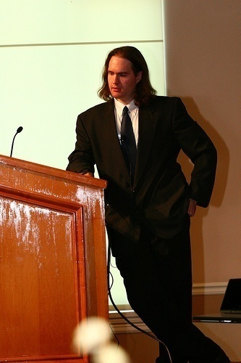


About Adrian
I run Irongeek.com
I have an interest in InfoSec education
I don’t know everything - I’m just a geek with time on my hands
Sr. Information Security Consultant at TrustedSec
Co-Founder of Derbycon
http://www.derbycon.com
Twitter: @Irongeek_ADC
Notes:
Take a note from Johnny Long’s book, and Bruce Potter’s book.

Slide 3
Perspective and General Warnings
I will be taking two perspectives
  People trying to stay anonymous
  People trying to de-anonymize users
I’m not really a privacy guy
IANAL
Be careful where you surf, contraband awaits

Slide 4
Old Cases
Case 0: Harvard Bomb Threat
(Eldo Kim)
Case 1: LulzSec Hector
(Xavier Monsegur "Sabu" & Jeremy Hammond)
Case 2: Freedom Hosting
(Eric Eoin Marques)

Slide 5
Basics of how Tor works

Slide 6
A little background…
Darknets
There are many definitions, but mine is “anonymizing private network ”
Use of encryption and proxies (some times other peers) to obfuscate who is communicating to whom
Sometimes referred to as Cipherspace
(love that term)

Slide 7
Tor
The Onion Router

Slide 8
Overview
Who?
First the US Naval Research Laboratory, then the EFF and now the Tor Project (501c3 non-profit).
http://www.torproject.org/
Why?
“Tor is free software and an open network that helps you defend against a form of network surveillance that threatens personal freedom and privacy, confidential business activities and relationships, and state security known as traffic analysis.” ~ As defined by their site
What?
Access normal Internet sites anonymously, and Tor hidden services.
How?
Locally run SOCKS proxy that connects to the Tor network.

Slide 9
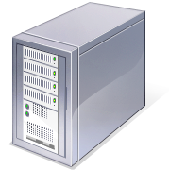


Tor: The Onion Router
Layered encryption
Bi-directional tunnels
Has directory servers
Mostly focused on out proxying to the Internet
More info at https://www.torproject.org
Internet Server
Directory Server

Slide 10



Layers like an Ogre

Slide 11
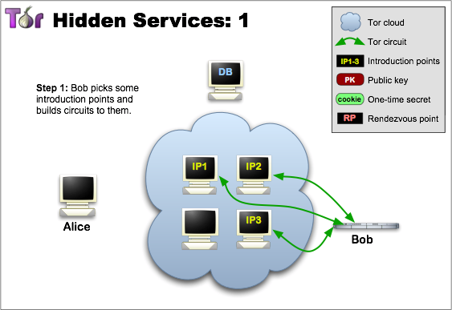
Layout to connect to Hidden Sevice
Image from http://www.torproject.org/hidden-services.html.en

Slide 12
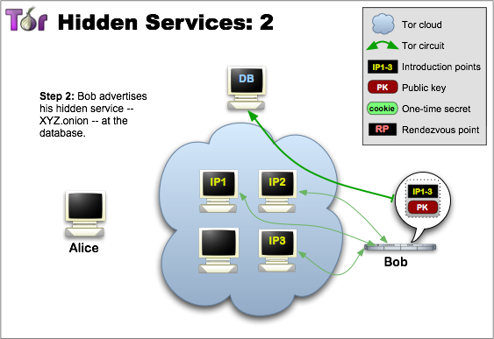
Layout to connect to Hidden Sevice
Image from http://www.torproject.org/hidden-services.html.en

Slide 13
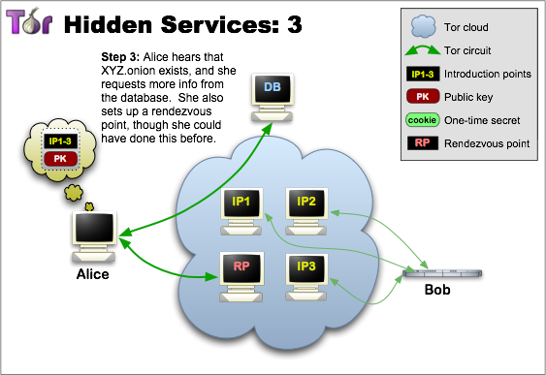
Layout to connect to Hidden Sevice
Image from http://www.torproject.org/hidden-services.html.en

Slide 14
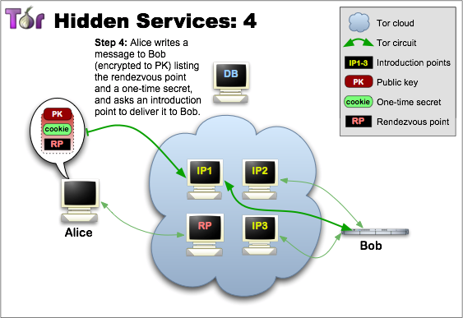
Layout to connect to Hidden Sevice
Image from http://www.torproject.org/hidden-services.html.en

Slide 15
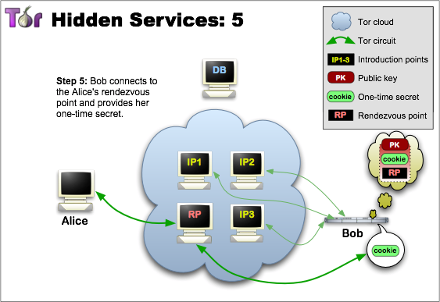
Layout to connect to Hidden Sevice
Image from http://www.torproject.org/hidden-services.html.en

Slide 16
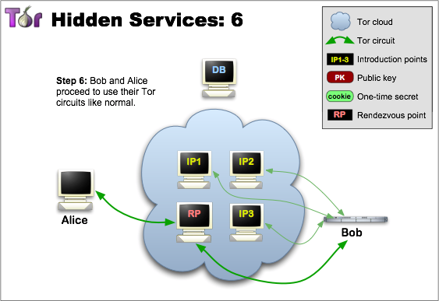
Layout to connect to Hidden Sevice
Image from http://www.torproject.org/hidden-services.html.en

Slide 17
Node types
Client
Just a user
Relays
These relay traffic, and can act as exit points
Bridges
Relays not advertised in the directory servers, so harder to block
Guard Nodes
Used to mitigate some traffic analysis attacks
Introduction Points
Helpers in making connections to hidden services
Rendezvous Point
Used for relaying/establishing connections to hidden services

Slide 18
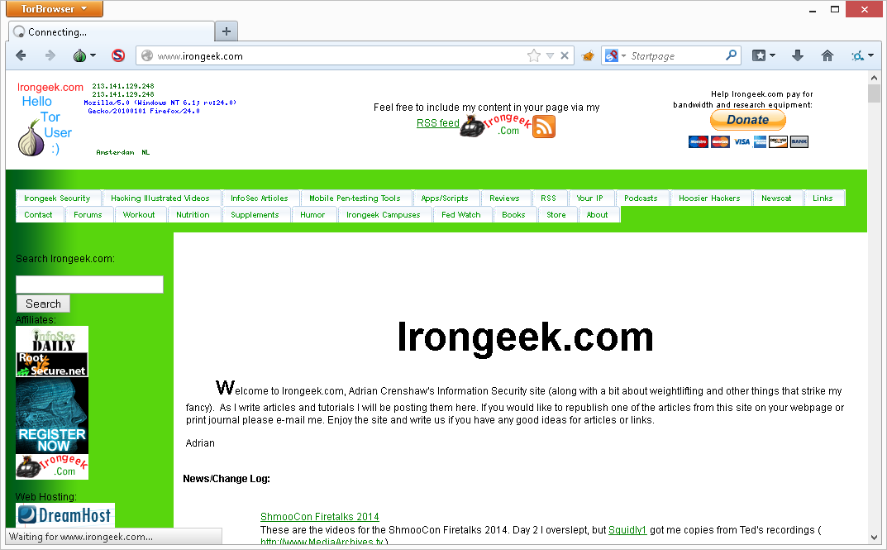
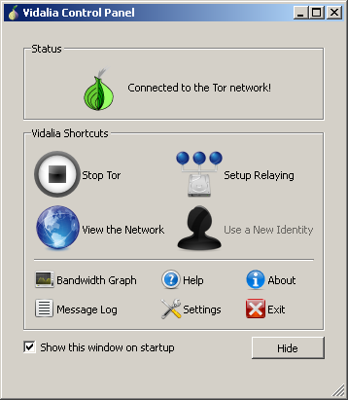
What does it look like to the user?

Slide 19
Applications/Sites
Tails: The Amnesic Incognito Live System
https://tails.boum.org/
Tor2Web Proxy
http://tor2web.org
Tor Hidden Wiki:
http://kpvz7ki2v5agwt35.onion
Scallion (make host names)
https://github.com/lachesis/scallion
Onion Cat
http://www.cypherpunk.at/onioncat/
Reddit Onions
http://www.reddit.com/r/onions

Slide 20
Tor Pros and Cons
Pros
If you can tunnel it through a SOCKS proxy, you can make just about any protocol work.
Three levels of proxying, each node not knowing the one before last, makes things very anonymous.
Cons
Slow
Do you trust your exit node?
Semi-fixed Infrastructure:
Sept 25th 2009, Great Firewall of China blocks 80% of Tor relays listed in the Directory, but all hail bridges!!!
https://blog.torproject.org/blog/tor-partially-blocked-china
http://yro.slashdot.org/story/09/10/15/1910229/China-Strangles-Tor-Ahead-of-National-Day
Fairly easy to tell someone is using it from the server side
http://www.irongeek.com/i.php?page=security/detect-tor-exit-node-in-php

Slide 21
What does the traffic look like?
(Keep in mind, this is just the defaults)
Local
9050/tcp Tor SOCKS proxy
9051/tcp Tor control port
(9150 and 9151 on Tor Browser Bundle)
Remote
443/tcp and 80/tcp mostly
Servers may also listen on port 9001/tcp, and directory information on 9030.
More details
http://www.irongeek.com/i.php?page=security/detect-tor-exit-node-in-php
http://www.room362.com/tor-the-yin-or-the-yang

Slide 22


Shout out to I2P
http://geti2p.net

Slide 23
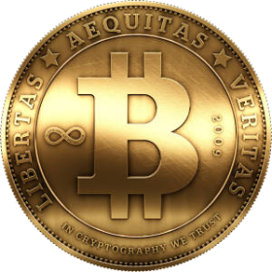

Bitcoin?
Crypto Currency
Proof of work
Bitcoin Addresses & Private Keys
Block Chain (ledger)
Tumblers (laundering)
Way more info by Bob Weiss http://www.irongeek.com/i.php?page=videos/bsidesde2013/2-6-hacking-benjamins-bob-weiss-pwcrack-into-to-bitcoin

Slide 24
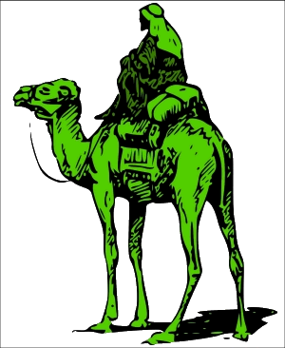
Case 3: The Silk Road
From court documents:
“As of September 23, 2013, there were nearly 13,000 listings for controlled substances on the website, listed under the categories "Cannabis," "Dissociatives," "Ecstasy," "Intoxicants," "Opioids," "Precursors," "Prescription," "Psychedelics," and "Stimulants," among others. “
“There were 159 listings on the site under the category "Services." Most concerned computer-hacking services: for example, one listing was by a vendor offering to hack into Facebook, Twitter, and other social networking accounts of the customer's choosing, so that "You can Read, Write, Upload, Delete, View All Personal Info"; another listing offered tutorials on "22 different methods" for hacking ATM machines. Other listings offered services that were likewise criminal in nature. For example, one listing was for a "HUGE Blackmarket Contact List," described as a list of "connects" for "services" such as "Anonymous Bank Accounts," "Counterfeit Bills (CAD/GBP/EUR/USD) ," "Firearms +Ammunition," "Stolen Info (CC [credit card], Paypal) ," and "Hitmen (10+ countries)." “
“Sellers may not list forgeries of any privately issued documents such as diplomas/certifications, tickets or receipts. Also, listings for counterfeit currency are still not allowed in the money section.”
Someone going by the handle “Dread Pirate Roberts” was the operator of the SilkRoad, which allows sellers and buyers to exchange less than legal goods and services.
http://silkroadvb5piz3r.onion
With about $1.2 Billion in exchanges on SilkRoad, FBI wanted to know who was behind it.
They started to look for the earliest references to the SilkRoad on the public Internet.

Slide 25
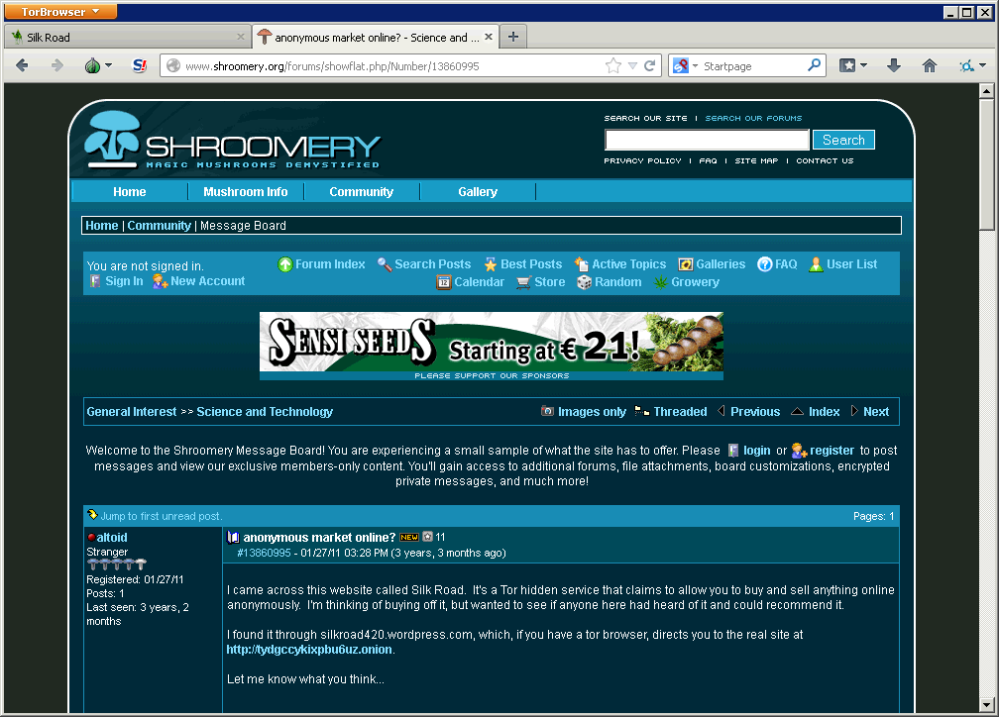
Case 3: The Silk Road
The earliest they could find was from “altoid” on the Shroomery.org forums on 01/27/11.
http://www.shroomery.org/forums/showflat.php/Number/13860995

Slide 26
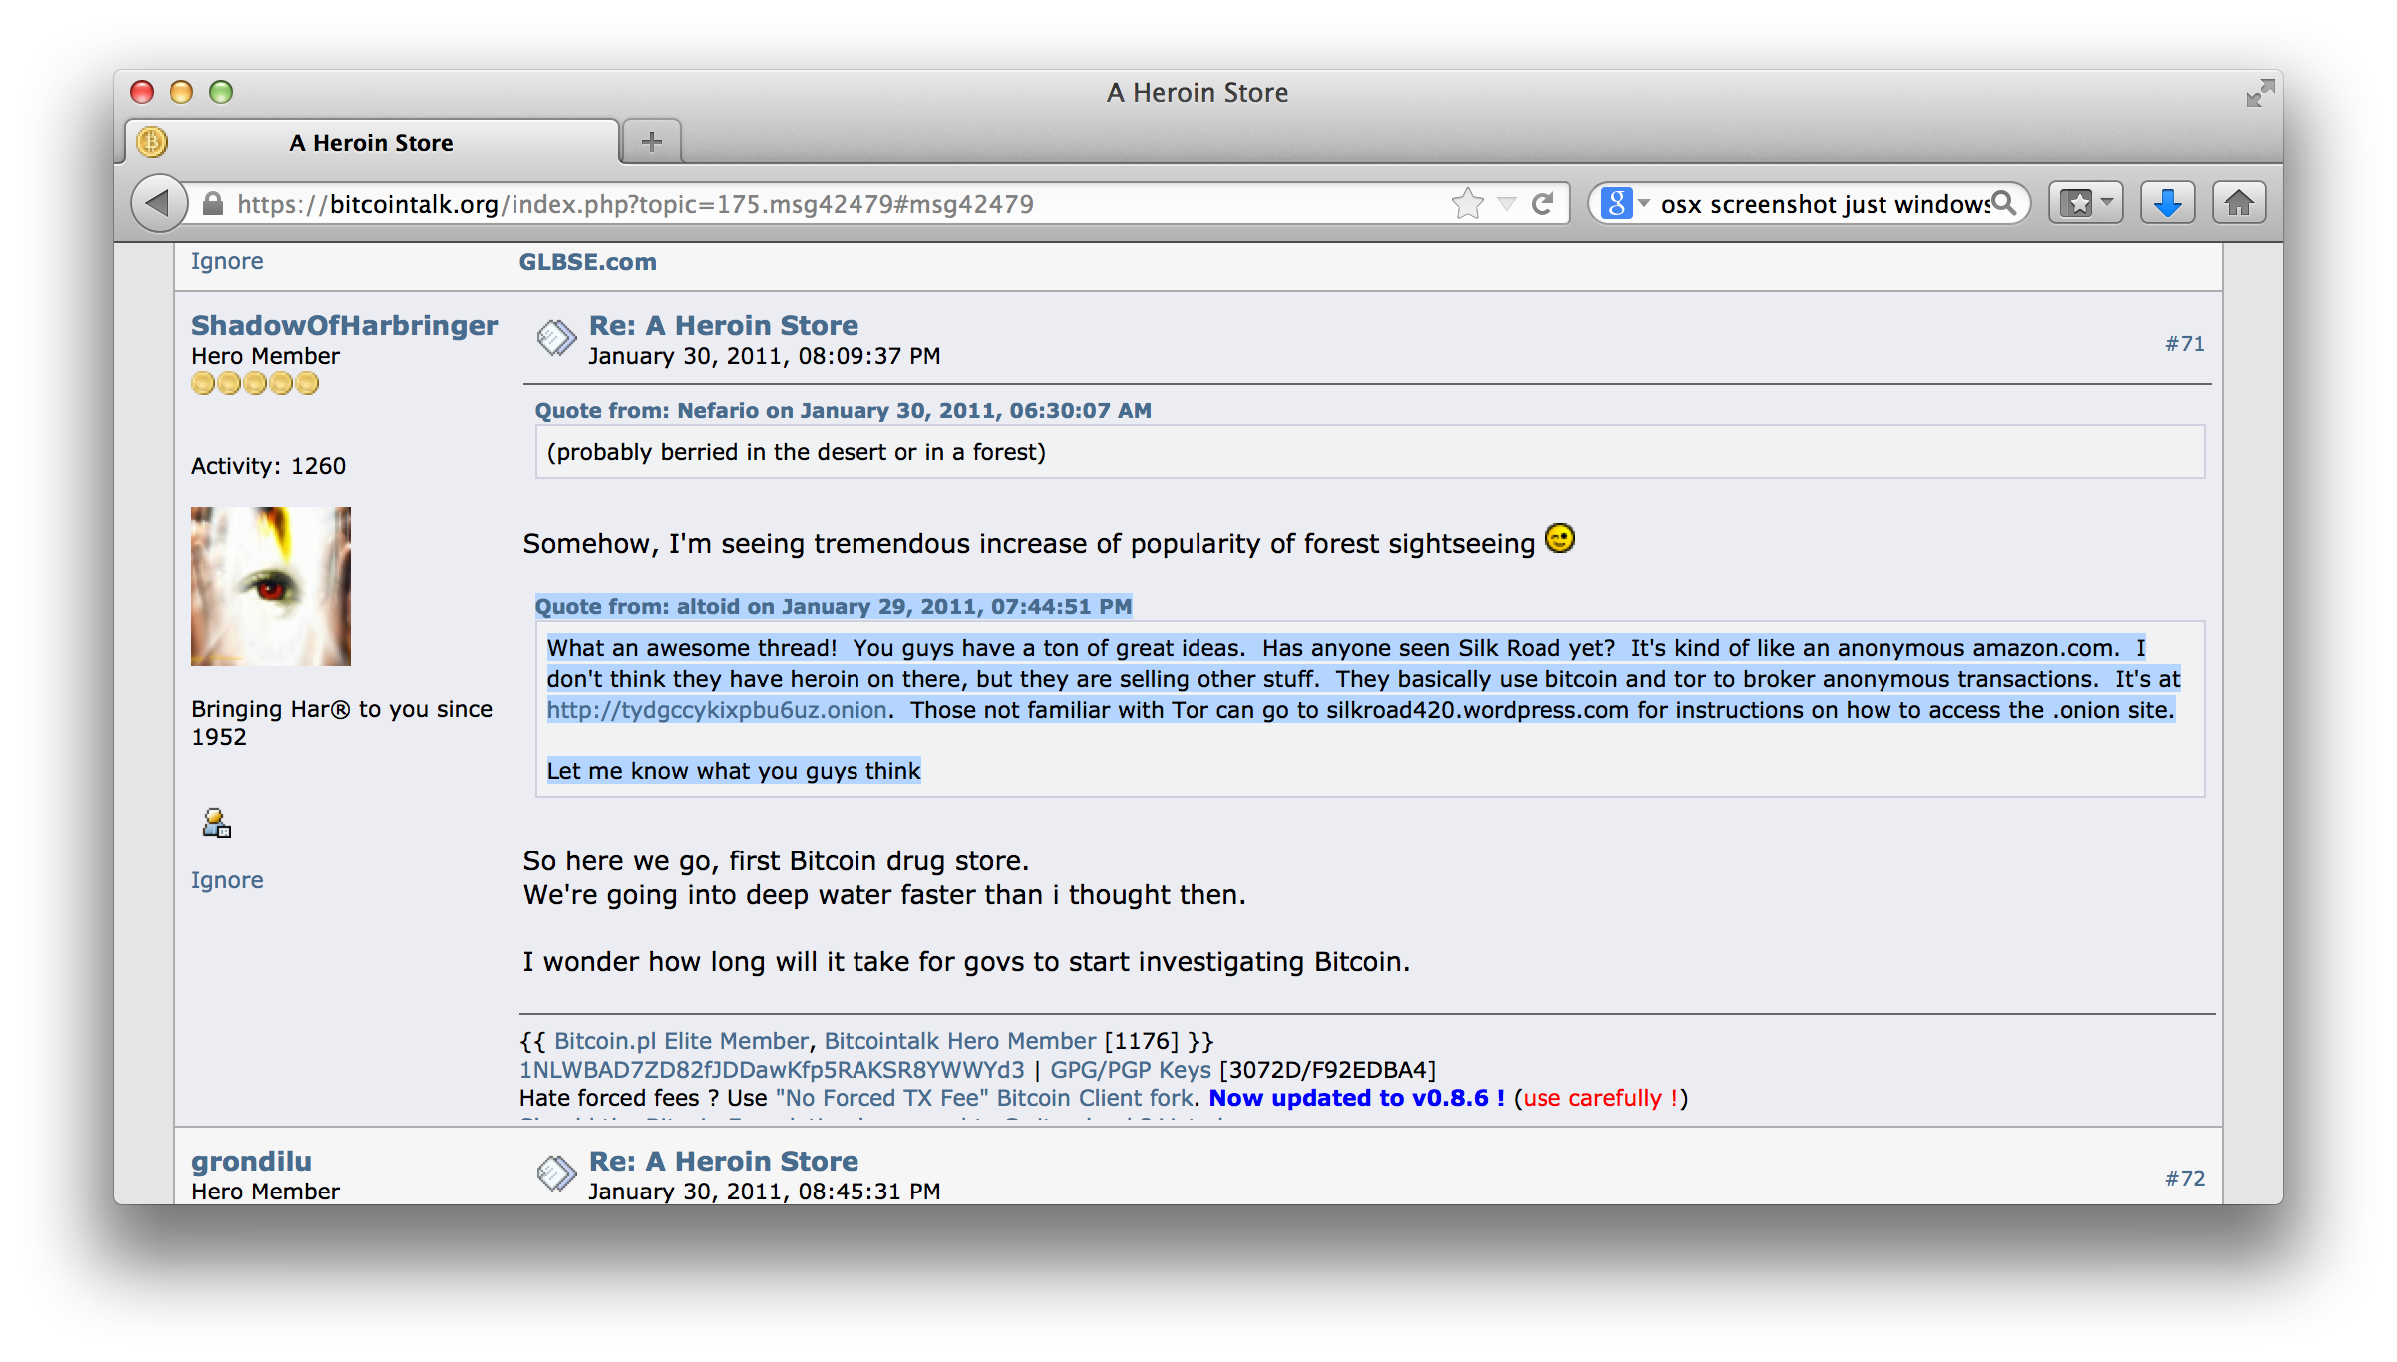
Case 3: The Silk Road
BitCoinTalk.org Post
“Quote from: altoid on January 29, 2011, 07:44:51 PM
What an awesome thread! You guys have a ton of great ideas. Has anyone seen Silk Road yet? It's kind of like an anonymous amazon.com. I don't think they have heroin on there, but they are selling other stuff. They basically use bitcoin and tor to broker anonymous transactions. It's at http://tydgccykixpbu6uz.onion. Those not familiar with Tor can go to silkroad420.wordpress.com for instructions on how to access the .onion site.
Let me know what you guys think”https://bitcointalk.org/index.php?topic=175.msg42479#msg42479

Slide 27
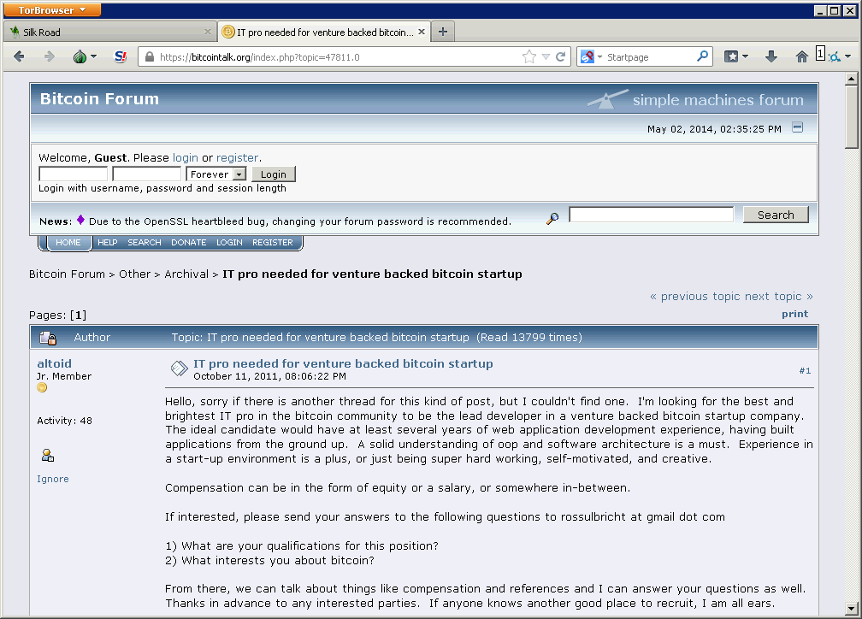
Case 3: The Silk Road
An account named “altoid” also made a post on Bitcointalk.org about looking for an “IT pro in the bitcoin community” and asked interested parties to contact “rossulbricht at gmail dot com” (10/11/11).
https://bitcointalk.org/index.php?topic=47811.0

Slide 28
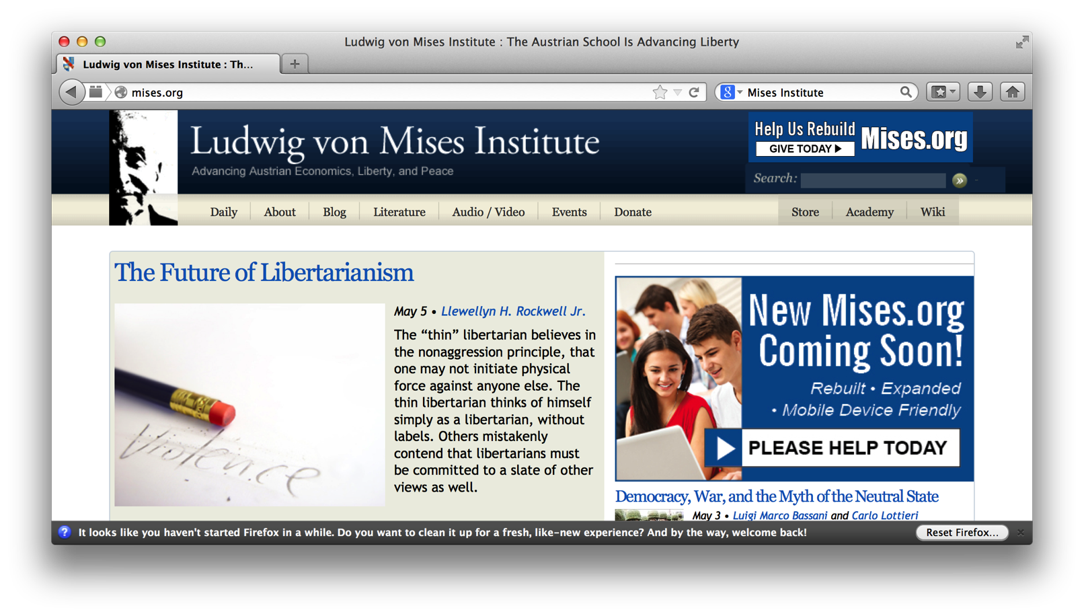
Case 3: The Silk Road
Ulbricht’s Google+ profile show an interest in the “Mises Institute” a “world center of the Austrian School of economics.”
Dread Pirate Roberts’ signature on the Silk Road forums had a link to the Mises Institute. Austrian Economic theory was also stated by Dread Pirate Roberts to be influential to the the Silk Road’s philosophy.

Slide 29
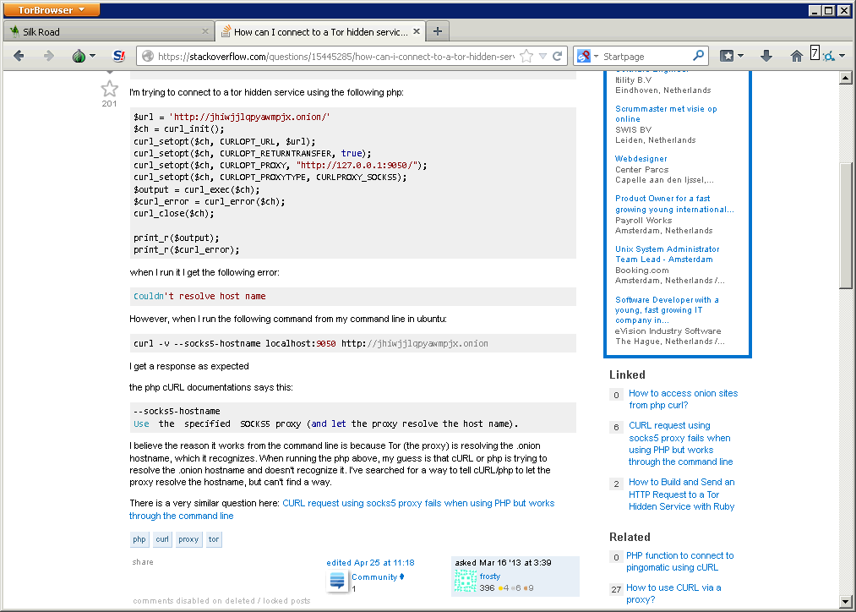
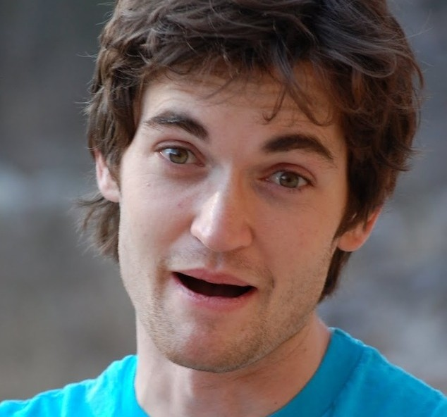
Case 3: The Silk Road
"Ross Ulbricht.” account also posted on StackOverflow asking for help with PHP code to connect to a Tor hidden service. The username was quickly changed to “frosty” (03/16/12).
http://stackoverflow.com/questions/15445285/how-can-i-connect-to-a-tor-hidden-service-using-curl-in-php
Guess who is now a suspect for being “Dread Pirate Roberts”? Ross William Ulbricht.

Slide 30
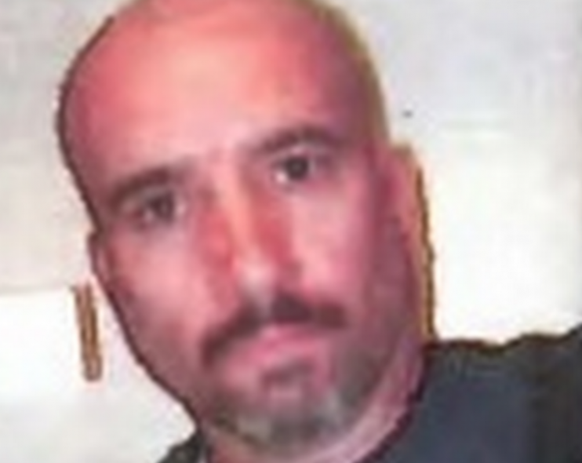
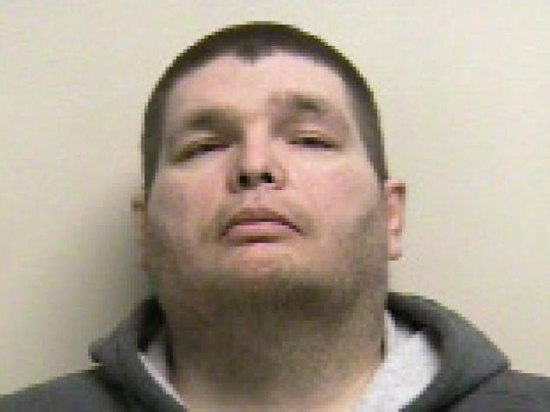
Case 3: The Silk Road
Post offices started to receive packages with drugs
Homeland Security created Operation Marco Polo taskforce
Carl Force (Nob, alias Eladio Guzman), DEA, went undercover
pretending to be a drug dealer on the Silk Road
Curtis Green helped with customer service on the Silk Road (“Flush”/“Chronicpain”)
DPR demanded a scan of Green’s driver’s license
DPR asked Green to help facilitate a transaction, but it was with an undercover agent
Green received a package the let off a cloud of white powered when opened, just before SWAT and DEA agents landed on him
DPR notice the absence, a Google search showed the arrest, and about $350,000 in BitCoins came up missing in Flush’s name

Slide 31
Case 3: The Silk Road
Carl Force (Nob, alias Eladio Guzman), DEA, had been pretending to be a drug dealer. DPR contacted him about a hit on Green.
Fake torture images of Green created
Admin Cirrus also turned
Secret Service Special Agent Shaun Bridges & Carl Force of the DEA caught later stealing BitCoins using an admin account (“Chronicpain/Flush”) used during the investigation to change user passwords
Tarbell: “it’s as if you found out at the end of Breaking Bad that Hank was dirty the whole time.”

Slide 32
Case 3: The Silk Road
Someone was connecting to a server that hosts the Silk Road from an Internet café near where Ross lived in San Francisco. Private messages on Silk Road make it seem Dread Pirate Roberts lived in the Pacific time zone.
IP of a Silk Road server was attached to via a VPN server that was connected to by an IP belonging to an Internet cafe on Laguna Street in San Francisco from which Ulbricht had also connected to his Gmail account with (both on June 3, 2013).
PM to Dread Pirate Roberts from a user said the site was leaking "some sort of external IP address" belonging to the VPN. Apparently there was a Reddit thread too. (https://www.reddit.com/r/SilkRoad/comments/1dmznd/should_we_be_worried_showing_on_login_page/ ?)
FBI agent Christopher Tarbell tried to cause and error by tossing things a Silk Road
193.107.86.49 (Thor Data Center, Reykjavik Iceland) had same Captcha as Silk Road

Slide 33
Case 3: The Silk Road
FBI starts taking down SilkRoad servers, though I’m not 100% sure how they were found. Could have been money trail to aliases, or as Nicholas Weaver conjectured, they hacked SilkRoad and made it contact an outsides server without using Tor so it revealed it’s real IP. Once located, FBI was able to get a copy of one of the servers.
Ross keep a diary/log of sorts.
Side notes:
  Protection racked was getting around $50, week not to DoS the site.
  May 2013, attackers key site down for a week
User FriendlyChemist apparently hacked user Lucydrop system, got a list of users and emails, and tried to black mail Ross
Ross tried to hire user redandwhite to kill FriendlyChemist. Later FriendlyChemist’s associate Tony76 and housemates. Also other scammers.
As far as we can tell, Ulbricht got scammed and no murders happened

Slide 34
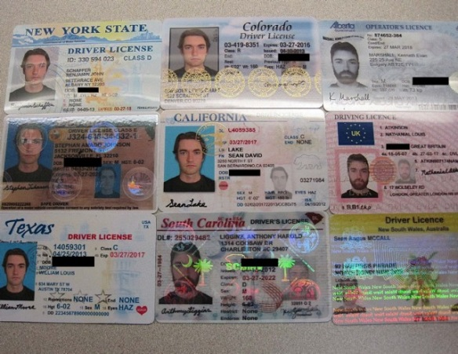
Case 3: The Silk Road
On 07/10/13 US Customs intercepted 9 IDs with different names, but all having a picture of Ulbricht. Homeland Security interviewed Ulbricht, but he denied having ordered them.
Smart: “ULBRICHT generally refused to answer any questions pertaining to the purchase of this or other counterfeit identity documents.”
Stupid: “However, ULBRICHT volunteered that "hypothetically" anyone could go onto a website named "Silk Road" on "Tor" and purchase any drugs or fake identity documents the person wanted. “
Roommates knew him as “Josh”. PMs show DPR was interested in getting fake IDs.

Slide 35
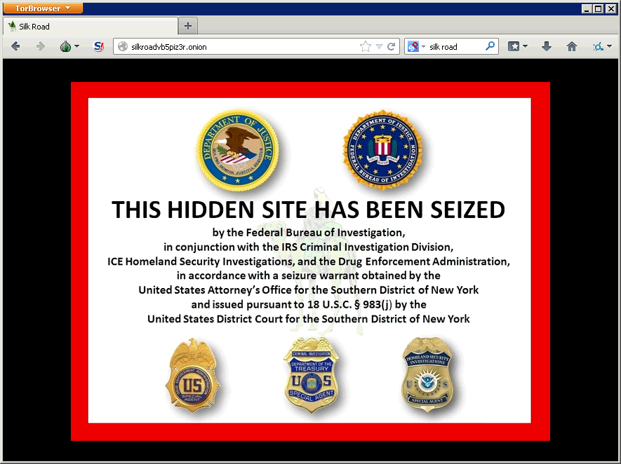
Case 3: The Silk Road
Server used SSH and a public key that ended in frosty@frosty. Server also had some of the same code posted on StackOverflow.
Eventually, on 10/01/2013 the FBI Landed on him in a Library right after he entered the password for his laptop (staging a fight behind him). More evidence was found on his laptop.
He had been downloading the previous night Colbert Report interviewing, Vince Gilligan, creator of Breaking Bad, just after series finale

Slide 36
Case 3: The Silk Road
When caught, Ulbricht supposedly said to Tarbell “I don’t suppose $20 million can get me out of this?”
Claim was maid by Ulbricht’s attorney that Ulbricht started SR1.0, but sold it off quickly
Assistant US Attorney Serrin Turner: "There's no dispute when the defendant was arrested, he was logged in as Dread Pirate Roberts.”
Ulbricht received a life sentence
More info (Big thanks to Nate Anderson for the original article and Agent Christopher Tarbell for court docs):
http://arstechnica.com/tech-policy/2013/10/how-the-feds-took-down-the-dread-pirate-roberts/
https://www.cs.columbia.edu/~smb/UlbrichtCriminalComplaint.pdf
See these articles by Joshuah Bearman & Tomer Hanuka:
http://www.wired.com/2015/04/silk-road-1/
http://www.wired.com/2015/05/silk-road-2/

Slide 37

Case 3: The Silk Road
Lessons Learned:
Keep online identities separate
  Keep different usernames
  From different locations
Have a consistent story
Don’t talk about interests
Don’t volunteer information!
Don’t keep a diary/log of criminal activity

Slide 38


Case 4: Tim DeFoggi
Former acting cyber security director for the US Department of Health and Human Services
FBI Operation Torpedo
Tim appears to have be a user of “PedoBook”, ran by Aaron McGrath, and sometimes used the user name “PTasseater”
Aaron McGrath’s site had been seized by FBI in later 2012
Network Investigative Tool (NIT) was set up on PedoBook and installed to phone home to the FBI
Tim’s home connection was confirmed to be using Tor
Home IP was used to access an AOL account called “ptasseater”

Slide 39

Operation Torpedo: FBI NIT
Information returned “The computer’s actual IP address, and the date and time that the NIT determined what that IP address was; a unique identifier generated by the NIT a series of numbers, letters, and/or special characters”
Based on Rapid 7’s decloaker
Moore had stopped work on it by 2011, since most users were no using the Tor Browser Bundle
Apparently, used Java, Javascript, or Flash and did not necessarily have to install real malware
https://web.archive.org/web/20110407092247/http://decloak.net/

Slide 40
Other
The payload was “Magneto”, which phoned home to servers in Virginia using the host’s public IP.
http://ghowen.me/fbi-tor-malware-analysis
It also reported back the computer’s:
  MAC address
  Windows host name
  unique serial number to tie a user to a site
May be same as EgotisticalGiraffe.
See also:
  Magic Lantern
  FOXACID
  Computer and Internet Protocol Address Verifier (CIPAV)
Thanks to Joe Cicero for "Privacy In a Surveillance State, Evading Detection" (P.I.S.S.E.D.) talk.
I am the best Giraffe
EVAR!!! Bow to my
Giraffey goodness!

Slide 41

Make hidden server contact you over public Internet
Let’s see if the hidden server app is vulnerable to an exploit (buffer overflow/web app shell exec/etc).
Send a payload that contacts an IP I monitor.
Exploit &
Payload

Slide 42
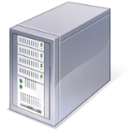
DNS Leaks
Monitored DNS Server
If I don’t use the proxy for DNS, I may send the query to a DNS server. It won’t see my traffic to/from the destination, but may now know I’m visiting someplace.com/.onion/.i2p
DNS
Query

Slide 43
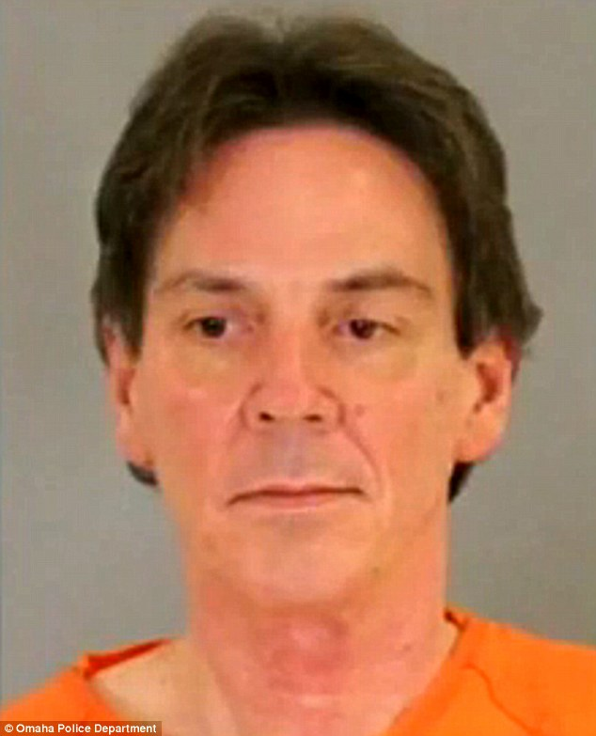
Case 4: Tim DeFoggi
Lessons Learned:
Don’t be a pedophile
Use the browser bundle
Don’t use Flash/Word Docs/
HTA/Etc.

Slide 44
Case 5: Blake Benthall & Operation Onymous
Around Oct 7 conversations had started about making a replacement for the SR1.0
One person invited to conversation was an undercover Homeland Security Investigator (HIS-UC) agent, eventually becoming a hired admin for SR2.0
Silk Road 2.0 began operation around Nov 6 2013, started by DPR2
In an Arstechnica interview (Feb 5, 2014) DPR2 said:
“There is only one person in the world that knows who [my second in command] “Defcon” is—me. So unless the feds have me they can never take down the Road, because as soon as I am missing he knows to just move servers and hit the killswitch on my access. Just think how much the FBI will be squirming in their seats and red-faced again if they could arrest the Dread Pirate Roberts and the Road continues to function in their face.”
Dec 20, 2013, the United States Attorney’s Office for the Southern District of New York announced the arrests of three alleged administrators of Silk Road 1.0 Andrew Michael Jones, Gary Davis, and Peter Phillip Nash
DPR2 comes up missing (one of the three guys above?)

Slide 45
Case 5: Blake Benthall & Operation Onymous
2nd in command “Defcon” posts the following exchanges:
Dec 20, 2013:
“Three of our dear friends were arrested in connection to their SR1.0 activities. They did not have access to anything which would compromise the marketplace. We are watching everything very closely regardless.”
Dec 22, 2013:
“The Captain is alive and well and is in touch with key staff members. I cannot reveal much, but here are the key facts: DPR places operational security above all else, including posting updates to this forum. Given his role he has every right to play it very safe.”
Later same day:
It has been over 24 hours since we last heard from our Captain. He is most certainly in grave danger. . . . As his second in command, I have very clear instructions as to what to do in this worst case scenario. . . I cannot elaborate on the specifics, but the marketplace is safe in my hands until the Captain returns or his successor appears.”

Slide 46
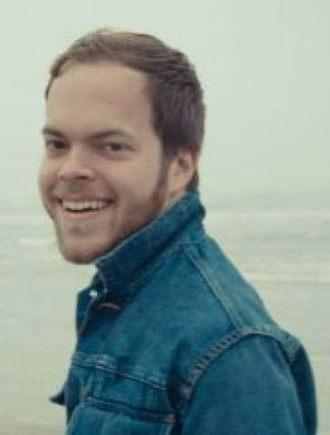
Case 5: Blake Benthall & Operation Onymous
Blake Benthall is the alleged operator of Silk Road 2.0 who took over
from DPR2 in late Dec 2013.
Conversations still taking place with DPR2 in Jan 2014.
January 28, 2014, DPR2 indicated desire withdrawal completely,
fearing arrest
Blake Benthall apparently used used his own email address
(blake@benthall.net) with the service provider when renting the
servers SR2.0 ran on (srv2.close.co)
IPs associated with administration of SR2.0 tied to use of the email address and also hotels Bent hall stayed at
Nov 6 2013 Twitter post: “All this talk about the #SilkRoad being back up makes me want to watch #ThePrincessBride.”
Late Jan 2014, made a $70 down payment on a Tesla Model S
HIS-UC could see version info and platform about Benthall’s browser when using the user support page, he was not using the Tor Browser Bundle but a beta version of Chrome
Also, he was not using Tor to access the user support interface

Slide 47
Case 5: Blake Benthall & Operation Onymous
Pen register data for Tor use, and Benthall’s comings and going
correlated with Defcon’s time on the SR2.0
Sep 10/11 2014 Defcon lets staff know that site was hacked and
Bitcoins balances stolen (about $1,412,000 at the time)
In late May, hosting server imaged. Downtime noticed by Defcon.
During Operation Onymous 414 .onion domains seized, including
Silk Road 2
Nov 5th, 2014 Benthall was arrested
Conjecture is that relay nodes along the path were DoSed, causing a pattern that could be seen.
  Possible abuse of the "introduce" message. Same as Canceled Carnegie Mellon University talk at BlackHat USA 2014?
  TOR Ticket #15463
Silk Road Reloaded now on I2P
More info:
https://www.documentcloud.org/documents/1354808-blake-benthall-complaint.html

Slide 48


Correlation of end point and exit point
Client
8MB
Client
Client
Client
5MB

Slide 49
Timing Correlation
I could just watch the timings.
DoS Attack
Client
Or even just change the load on the path.
DoS Attack
DoS outside host to affect traffic.
Client
Pulse the data flows myself.
Client

Slide 50
Case 5: Blake Benthall & Operation Onymous
Lessons Learned:
Don’t connect your name to anything
Trust no one
Use the browser bundle
Don’t buy flashy stuff
Be paranoid about downtime

Slide 51
Side Stuff

Slide 52
Reddit?
Feds subpoena Reddit in effort to learn about users behind Dark Web chatter
http://arstechnica.com/tech-policy/2015/03/feds-subpoena-reddit-in-effort-to-learn-about-users-behind-dark-web-chatter/

Slide 53
Demos
Maybe?

Slide 54
Many More Links
Part 1:
ShowMeCon https://www.youtube.com/watch?v=28dOllHyoM0
Defcon https:/www.youtube.com/watch?v=eQ2OZKitRwc
Talk on Darknets in general
http://www.irongeek.com/i.php?page=videos/aide-winter-2011#Cipherspace/Darknets:_anonymizing_private_networks
I2P FAQ
http://www.i2p2.de/faq.html
Tor FAQ
https://trac.torproject.org/projects/tor/wiki/doc/TorFAQ
Tor Manual
https://www.torproject.org/docs/tor-manual.html.en
I2P Index to Technical Documentation
http://www.i2p2.de/how

Slide 55
Sites of Mine
Intro to Darknets: Tor and I2P Workshop
http://www.irongeek.com/i.php?page=videos/intro-to-tor-i2p-darknets
My Tor/I2P Notes
http://www.irongeek.com/i.php?page=security/i2p-tor-workshop-notes
Cipherspaces/Darknets An Overview Of Attack Strategies
http://www.irongeek.com/i.php?page=videos/cipherspaces-darknets-an-overview-of-attack-strategies
Anonymous proxy to the normal web
http://www.irongeek.com/i.php?page=videos/tor-1
Hidden services
Normally websites, but can be just about any TCP connection
http://www.irongeek.com/i.php?page=videos/tor-hidden-services

Slide 56
ADHD Linux
Active Defense Harbinger Distribution (ADHD)
http://sourceforge.net/projects/adhd/
from Black Hills Information Security & SecureIdeas
Metasploit Decloaker, web bugs, etc.

Slide 57

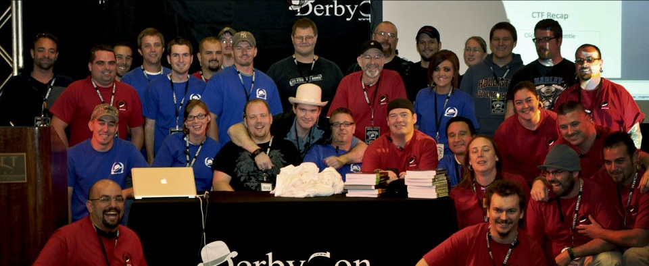
Events
Derbycon
Sept 20th-26th, 2016
http://www.derbycon.com
Others
Derbycon Art Credits to DigiP
Photo Credits to KC (devauto)
http://louisvilleinfosec.com
http://skydogcon.com
http://grrcon.com
https://circlecitycon.com
http://showmecon.com
Notes:
Beg for hardware donations. ☺

Slide 58
Questions?
42
Twitter: @Irongeek_ADC

